Slide 1
Linear algebra

Slide 2
Matrices

Slide 3
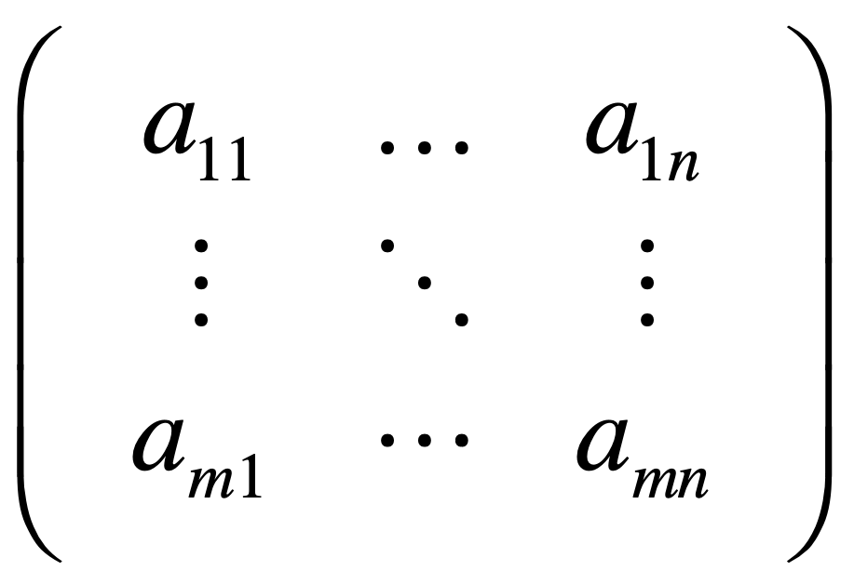

Slide 4
Vectors

Slide 5
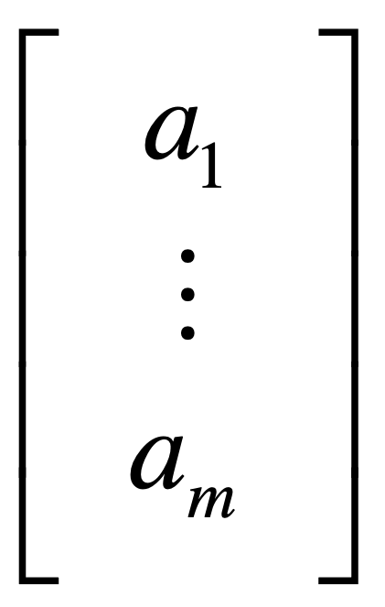

Slide 6
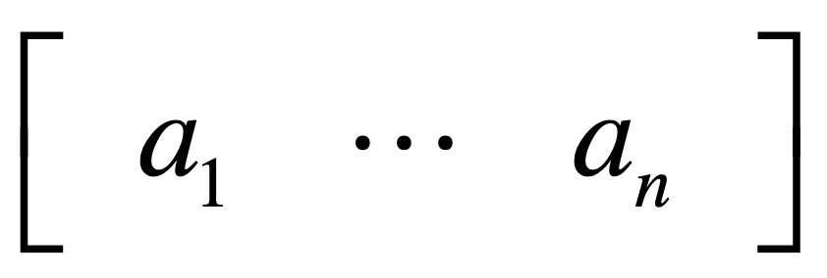

Slide 7
a sequence of numbers

Slide 8
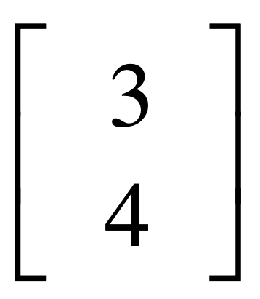
y
4
x
3

Slide 9
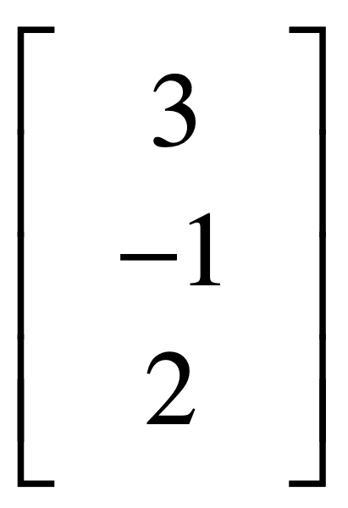
z
2
3
x
-1
y

Slide 10
vector multiplication

Slide 11
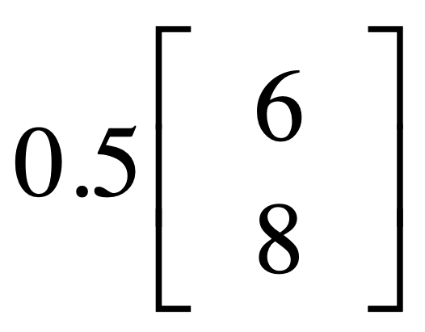
y
8
x
6

Slide 12
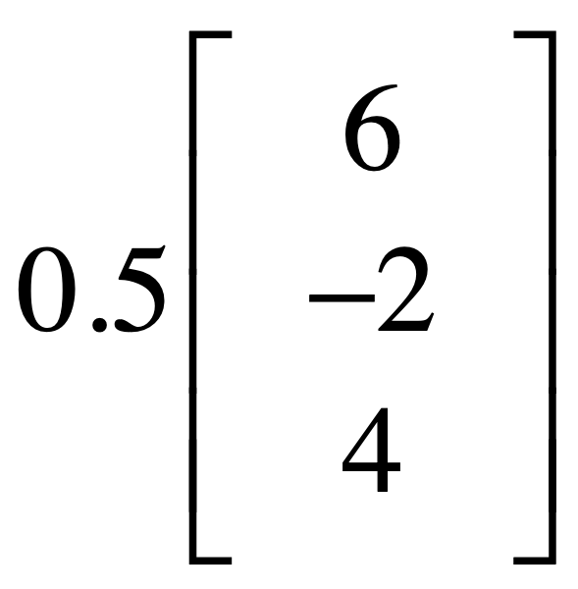
z
4
6
x
-2
y

Slide 13
vector addition

Slide 14
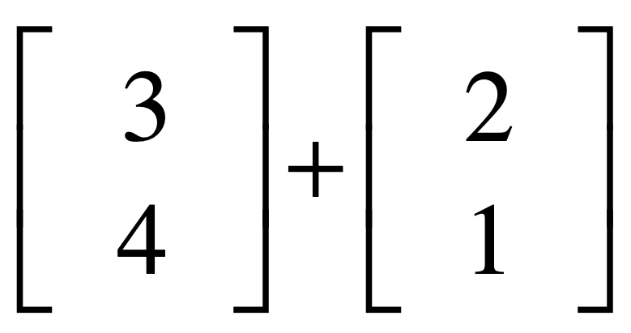
y
4
1
x
2
3

Slide 15
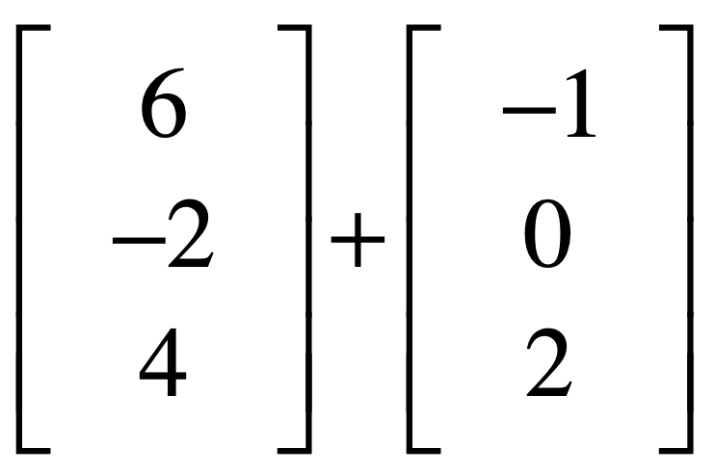
z
6
4
2
6
x
-1
-2
y

Slide 16
vector product

Slide 17
inner product
outer product
tensor product

Slide 18
inner product
y
a = [2, 3]
b = [3, 0]
a = (2,3)
algebraic: a·b = 2x3 + 3x0
θ
x
geometric: a·b = |a||b|cos(θ)
b = (3,0)
How to measure informational similarity between a and b?
cosine(θ)
a-b distance

Slide 19
inner product
y
y
a = (0,4)
90°
x
0°
a = (4,0)
x
b = (3,0)
b = (3,0)
a·b = 4x3xcos(π/2)
a·b = 4x3xcos(0)

Slide 20
correlation
-1≤r≤1
Science
English
Math
Math
Sleep
Math
Coffee
Height

Slide 21
correlation = cosine
Science
student 1
Math
science = [90, 48, 60, 89, 25, 48, 55, 72, 36, 51]
math = [92, 54, 55, 92, 30, 41, 56, 74, 39, 48]
a·b = |a||b|cos(θ)
→ cos(θ) = a·b / |a||b|

Slide 22

inner product
signal vectors
a = [0, 0.85, 1, 0.85, 0, -0.85, -1, -0.85, 0]
0°
b = [0, 0.85, 1, 0.85, 0, -0.85, -1, -0.85, 0]
a·b = ?

Slide 23
inner product
signal vectors
a = [0, 0.85, 1, 0.85, 0, -0.85, -1, -0.85, 0]
90°
b = [1, 0.85, 0, -0.85, -1, -0.85, 0, 0.85, 1]
a·b = ?

Slide 24
inner product
signal vectors

