Slide 1
Benchmarks: Pipelines

Slide 2
Benchmarks: Goals
Typical telco pipelines
Can be coded into most of our switches/data-planes (with documented restrictions)
Allow realistic dynamic workloads (add/del entries to/from flow table)
Performance illustrative in general
Currently BESS and OVS are to be supported (with prefab the pipeline config), Lagopus and ERFS should be added (Vpp would be very difficult)

Slide 3
Benchmarks: Pipelines
Macro-benchmarks:
  Mobile gateway (5G?) – more or less ready
  Broadband Network Gateway (BNG) – work-in-progress
Micro-benchmarks: what is a micro-benchmark after all?
Possible (not so) micro-benchmarks:
  port forward
  L2
  L3
  encap/decap
  ????

Slide 4
Mobile Gateway
Put users behind the base stations (bsts) to the Internet
Mobile Gateway, different UL/DL
  UL (from UE): GTP encapsulated packets
    L2, L3 and L4 check (GW, UDP, 2152)
    GTP decaps, save TEID
    rate limit per bearer (TEID)
    L3 routing towards Internet + L2 fwd
  DL (to UE): normal IP packets
    L2 and L3 check (DstIP is in UE range)
    DstIP -> rate limit + GTP encaps + set ext DstIP
    L3 routing towards BSTs + L2 fwd
Traces:
  Uplink: 10k GTP packets from 100 Base Stations (BSTs)
    external: DstIP = GW, DMAC = GW, SrcIP = BST(i)
    internal: DstIP = server (1k), SrcIP = UE (10k)
  Downlink: 10k IP packets, SrcIP = server, DstIP = UE
  packet sizes:
    64, 128, 256, 512, 1024, 1280
  filenames:
    TBD
Configuration
  before test
  use traces + next slide
  set S/DMAC
  set IP addresses + TEIDs
    use same TEIDs UL/DL
  do not do fragmentation (limit MTU)
  routes should match traffic
Tests:
  2 x uni + bi-directional
  1-2-4-8-… cores
  64-1280 byte packets
    to avoid fragmentation
    (if needed we can test it later)
In: physical 10/40/100G
Out: physical 10/40/100G

Slide 5

Mobile Gateway: Static config
Uplink: GTP decap→rate-limit→L3 lookup→group
Downlink: id user→GTP encap→L3 lookup→bst
ARP to GW IP
answer: Own MAC
Rate limiter #1
L3 fwd block
(see L3 fwd case)
Infra CP
Rate limiter #1
Rate limiter #i
key: TEID
GTP handler
(pop GTP, save TEID)
type = 0x0806 (ARP)
Ethertype
key: Ethertype
entries: 2
UL: GW IP, UDP, 2152
L2 fwd block
(see L2 fwd case)
IP + UDP select
key: IP.dst, UDP dport
entries: 2
own MAC + broadcast
UE selector
key: IP.dst
type: Hash
entries: 10k
actions: push GTP, set IP
DL: DstIP in UE range
out
port

Slide 6
BESS: Considerations
Egress/ingress traffic mapped to a single physical port; drop port configurable, either to default port (for rate measurements), or real drop port
No GTP in BESS: substituted with VxLAN
Rate limiters in BESS: no rate limiter per se, emulated with a Queue + Scheduler
Uplink/downlink go through a single per-user rate limiter: currently downlink rate limiting is for packets with VXLAN header, downlink for packets without VXLAN header

Slide 7
BESS: Considerations
Scheduling: the pipeline is scheduled from the input port and runs in run-to-completion mode, with users' queues separately
$ show tc
<worker 0>
+-- !default_rr_0 round_robin
+-- t_0_0 rate_limit 100000.000 Mbps
| +-- !leaf_rl_0_0:0 leaf
+-- t_0_1 rate_limit 100000.000 Mbps
| +-- !leaf_rl_0_1:0 leaf
+-- t_0_2 rate_limit 100000.000 Mbps
| +-- !leaf_rl_0_2:0 leaf
+-- !leaf_queue_inc0:0 leaf
3 users, users' queues (t_0_?) are rate limited
scheduled together with the input queue in round-robin

Slide 8
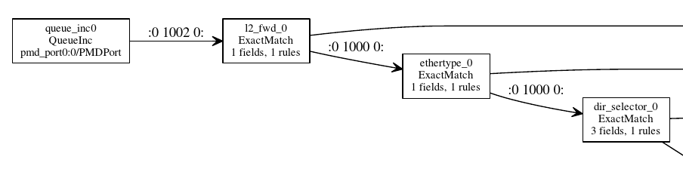
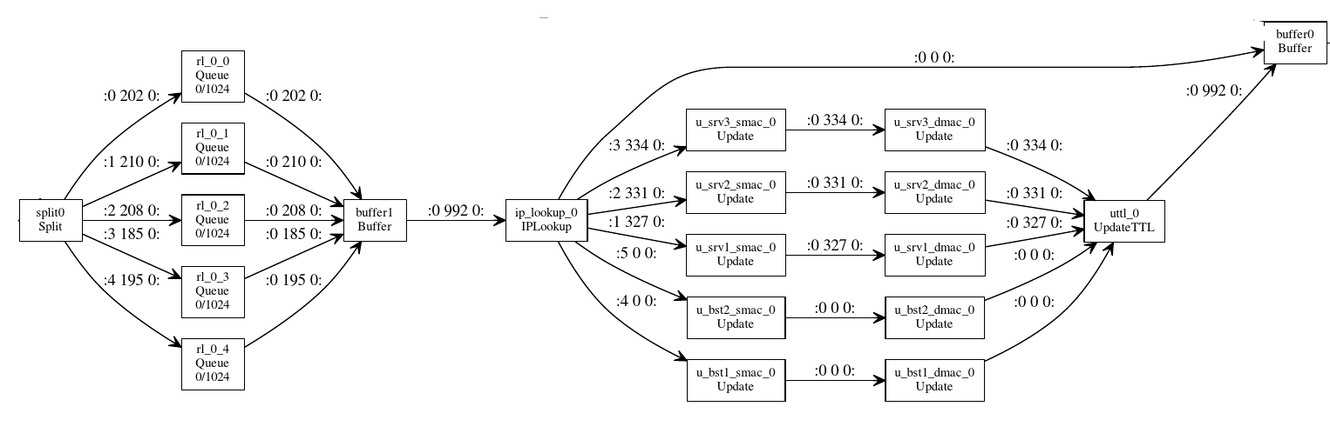
BESS pipeline
INGRESS:
EGRESS:
L3 lookup
group entries
uplink groups
downlink groups
Rate limiters (per user)
L3 fwd block

Slide 9

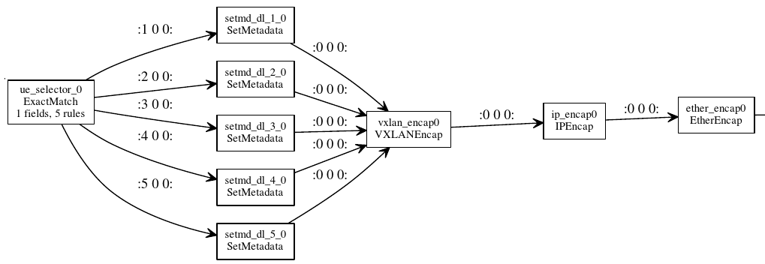
BESS pipeline
UPLINK:
INGRESS
EGRESS
DOWNLINK:
INGRESS
EGRESS

Slide 10
OVS: Considerations
Egress/ingress traffic mapped to a single physical port; drop port configurable, either to default port (for rate measurements), or real drop port
OpenFlow 1.3: should be supported by OVS, Lagopus, ESwitch/ERFS
GTP→VXLAN: to be on par with the BESS pipeline
VXLAN via standard OpenFlow “virtual port” abstraction (OXM_OF_TUNNEL_ID): no need to explicit encap/decap but we lose OpenFlow compatibility (Lagopus/ERFS??)
Rate limiters: per user OpenFlow “meters”

Slide 11
OVS pipeline
uplink: per-user rate limiters→L3
in_port=vport1, tunnel_id=user1(bst1), action: meter(user1(bst1)), goto:L3
in_port=vport1, tunnel_id=user2(bst1), action: meter(user2(bst1)), goto:L3
...
in_port=vport1, tunnel_id=useri(bst1), action: meter(useri(bst1)), goto:L3
in_port=vport2, tunnel_id=user1(bst2), action: meter(user1(bst2)), goto:L3
...
vport 1: bst1↔gw
Group1
Group1
vport 2: bst2↔gw
Group2
L3 lookup
(srvs)
vport k: bstk↔gw
Groupn
downlink: per-user rate limiters→vport for the proper bst
dst_ip=IP(user1), action: set_tunnelLteid(user1), meter(user1),output:vport(user1)
dst_ip=IP(user1), action: set_tunnelLteid(user1), meter(user1),output:vport(user1)
...
phys port

Slide 12
Dynamic workloads
Goal: measure impact of flow table changes to performance
Scenarios:
  handover (user changes base station)
  user add/delete: users disappear/appear
  server changes (L3 destination entries change)
Considerations:
  change rate: perform the entire change in one shot every second (in one batch)
  dynamism: add/delete the same entry (e.g., user comes, same user leaves)
BESS: from bess config script, OVS: from Ryu

Slide 13
How to use
Clone git tree: TODO
Generate config (10 users, 5 servers, 5 bsts, 4 handovers/sec, 5 usermods/sec)
Generate pcaps (200 thousand packets, each of 100 bytes, uplink+downlink, ASCII dump)
(Optionally) start flow table modification scripts
Start measurement (manually)
$ gen_scripts/mgw-gen-conf.py -u 10 -s 5 -b 5 --handovers 4 --fluctusers 5 -o mgw-updates.json
$ gen_scripts/mgw-gen-pcap.py -c mgw-updates.json --pkt-num=200000 --pkt-size 100 -a --dir b

Slide 14
BNG
TODO

