Slide 1

Embedded | Team 2

Slide 2

Team Leader:
Abdalla Hammos.
Team Members:
Mazin Nasr.
Ahmed Marwan.
Ali Osama.
Ahmed Khaled.

Slide 3
Power Control

Slide 4
Agenda:
Main Function of the project.
Gained Value.
Project in details.
Components & Used Technologies.
Hardware Design.
Software Design.
Further Updates.

Slide 5
Main Function of the project:
It allows the user to control loads and devices at his/her home using Smart Phone through WiFi.
Gained Value:
More easy way to control devices.
Save time.
Save power consumption.

Slide 6
Project in details:
Components & Technologies used:
C programming language.
Proteus.
Microcontroller (ATMega328P).
Relays.
ULN2003A.
LEDS.
Capacitors.
Diodes.
Zener Diodes.
Resistors.
Pin Headers & Terminal Blocks.

Slide 7
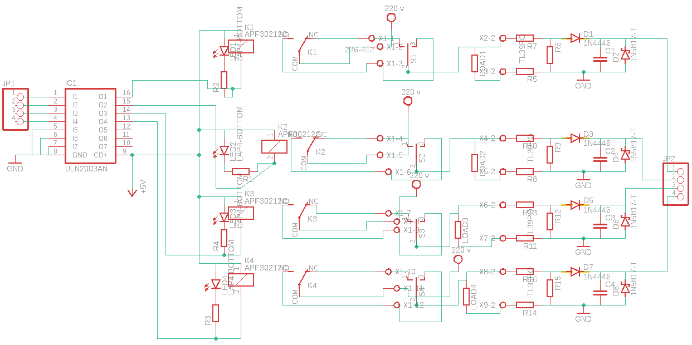
Hardware Design:
Switching Circuit for 4 Home Loads

Slide 8
- The Pin Header at the beginning of the circuit represents the output of
microcontroller which is high or low.
- The ULN2003A IC (Arrray of transistors) receives the signal from microcontroller then it determines if the relay is on when output is 1 or off when output is 0.

Slide 9
- The LEDs are to indicate if there is a signal from the microcontroller.
- The Switches are to allow manual control of the device when any problems like mobile or Wi Fi not working are present.
- Resistors in parallel with the load to sample some voltage from it.

Slide 10

- The Diode is for half wave rectification.
- Capacitors are for smoothing the sample rectified voltage.
- Finally Zener Diodes are to make the voltage constant to return it back to microcontroller through another pin header to know if device is on or off.

Slide 11
Software Design :
Block Diagram
Microcontroller
Relay
Relay
Switching
GPIO
Button
Button

Slide 12
Layered Diagram
Switching | App Layer
Relay | HWAL
GPIO | MCAL
Button

Slide 13
According to the Layered Architecture :
1-Microcontroller Abstraction Layer (MCAL):
-GPIO.h file is created to define the main GPIO functions (setting-resetting-reading).
2- Hardware Abstraction Layer (HWAL) :
-Relay.h file is to create all relays in the system.
-Button.h file is to create all inputs in the system (instead of WiFi signal because it isn’t available in current time ).

Slide 14
3-Application architecture layer :
Switching.h file is to initializing both relays and buttons then controlling relays through varies function.

Slide 15
Further Updates:
There are various updates could be included:
Adding measurement technique by including measurement circuit and writing a suitable code.
We can use some sensors in different applications (ex: temperature sensor in turning air condensing on or off automatically, …. etc).

Slide 16

Thank You

