Slide 1
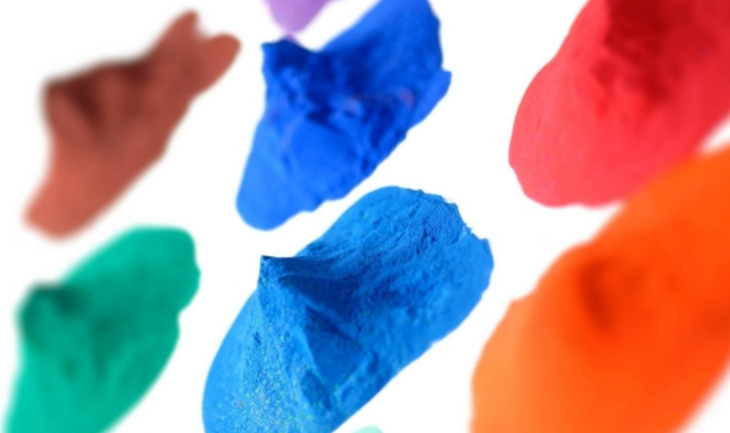
Career Summary
Powder Coating R&D & Technical Service

Slide 2
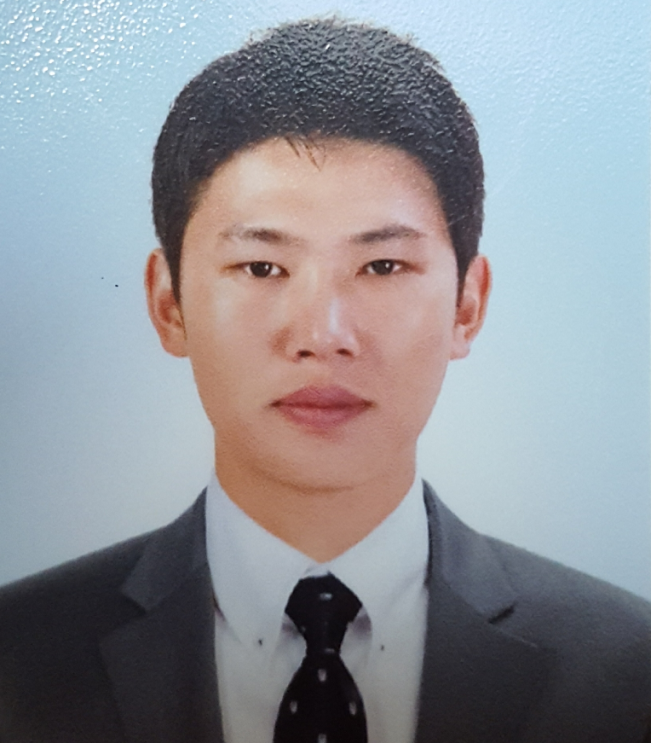
Overview
■ Career History
■ Personal Profile
- Hand Corporation(wheel manufacture) – 1year
Department : Coating Technology
Role : Coating Process Management
- AKZONOBEL Powder Coating – 7years (~2018)
Department : Product Development Team
Role : New Product Development per Customer Requirements
(1) New product development for home appliance makers
(Samsung Electronics, LG Electronics, etc.)
(2) Daewon Kangup, Sungwoo Automotive, Hyundai Motor
Development of automotive powder coatings and production line
stabilization
(3) INTERPON D certification audits and management
(4) New market entry into Japan: High-Tg product for Hino Truck
chassis frames
Product launch and joint patent filing; line stabilization for
Akebono, NHK, and others
- KCC Central Research Institute, Powder Coatings
Development - 8 years (~2026)
Department: Powder Coatings R&D Team
Role: New Projects and New Certified Product Development
(1) Qualicoat Class 2 certification for high-weatherability powder coatings
(2) GMW14664 Type A certification for automotive powder coatings
(3) Product approvals for agricultural and heavy equipment: HD
Hyundai Infracore, LS Mtron, TYM, and other manufacturers
(4) Heat-dissipating, heat-shielding, and easy-cleaning powder
coatings
Name : Sangok Hwang
Date of Birth : July 1, 1980 .
Phone: +82-10-2678-2889
E-mail : hsoksy1@naver.com
Education
Cheonan Bugil High School (Mar. 1999)
B.S, Soongsil University (Mar. 2008)
- Military Service : ROK Army, Infantry, Honorably
Discharged (JSA/UNC Security Battalion, Panmunjom)
Certifications
Engineer, Chemical Industry (HRD Korea, June. 2008)
Engineer, Gas (HRD Korea, Aug. 2008)
Engineer, Water Pollution/Environmental
(HRD Korea, Aug. 2009)

Slide 3
Core Competencies
1
Customer Support:
New color/design development for home appliance makers (Samsung Electronics, LG Electronics, etc.)
Chemistry conversion for AC outdoor units (Hybrid → Polyester)
Product development and launch for heavy equipment and agricultural machinery (LS Mtron, HD Hyundai Infracore, TYM, etc.)
Product development and quality approval for automotive exterior parts
New Product
Development
New Technology
Adoption
2
Technical Service:
Process / line stabilization for Hino Truck (Japan) chassis frames
Production line / process stabilization for Kangup, HD Hyundai Infracore, and others
Defect analysis and root-cause investigation for automotive parts → resolution of quality complaints
3
Quality Evaluation:
Holds NACE Class 2 certification
Extensive experience with INTERPON D certification audits and line inspections
GMW14664 Type A domestic product approval obtained (for automotive exterior parts)
Multiple weatherability evaluations and certifications per WOM and OEM standards
4
New Product Development:
Heat-dissipating and heat-shielding powder coatings; high-temperature resistant materials
Introduction of new resins for high-weatherability powder coatings and system stabilization
Formulation design capability across Epoxy, Hybrid, Polyester, Polyurethane, and Acrylic
Extensive experience with new resins including SMP, biobased, and silicone resins

Slide 4
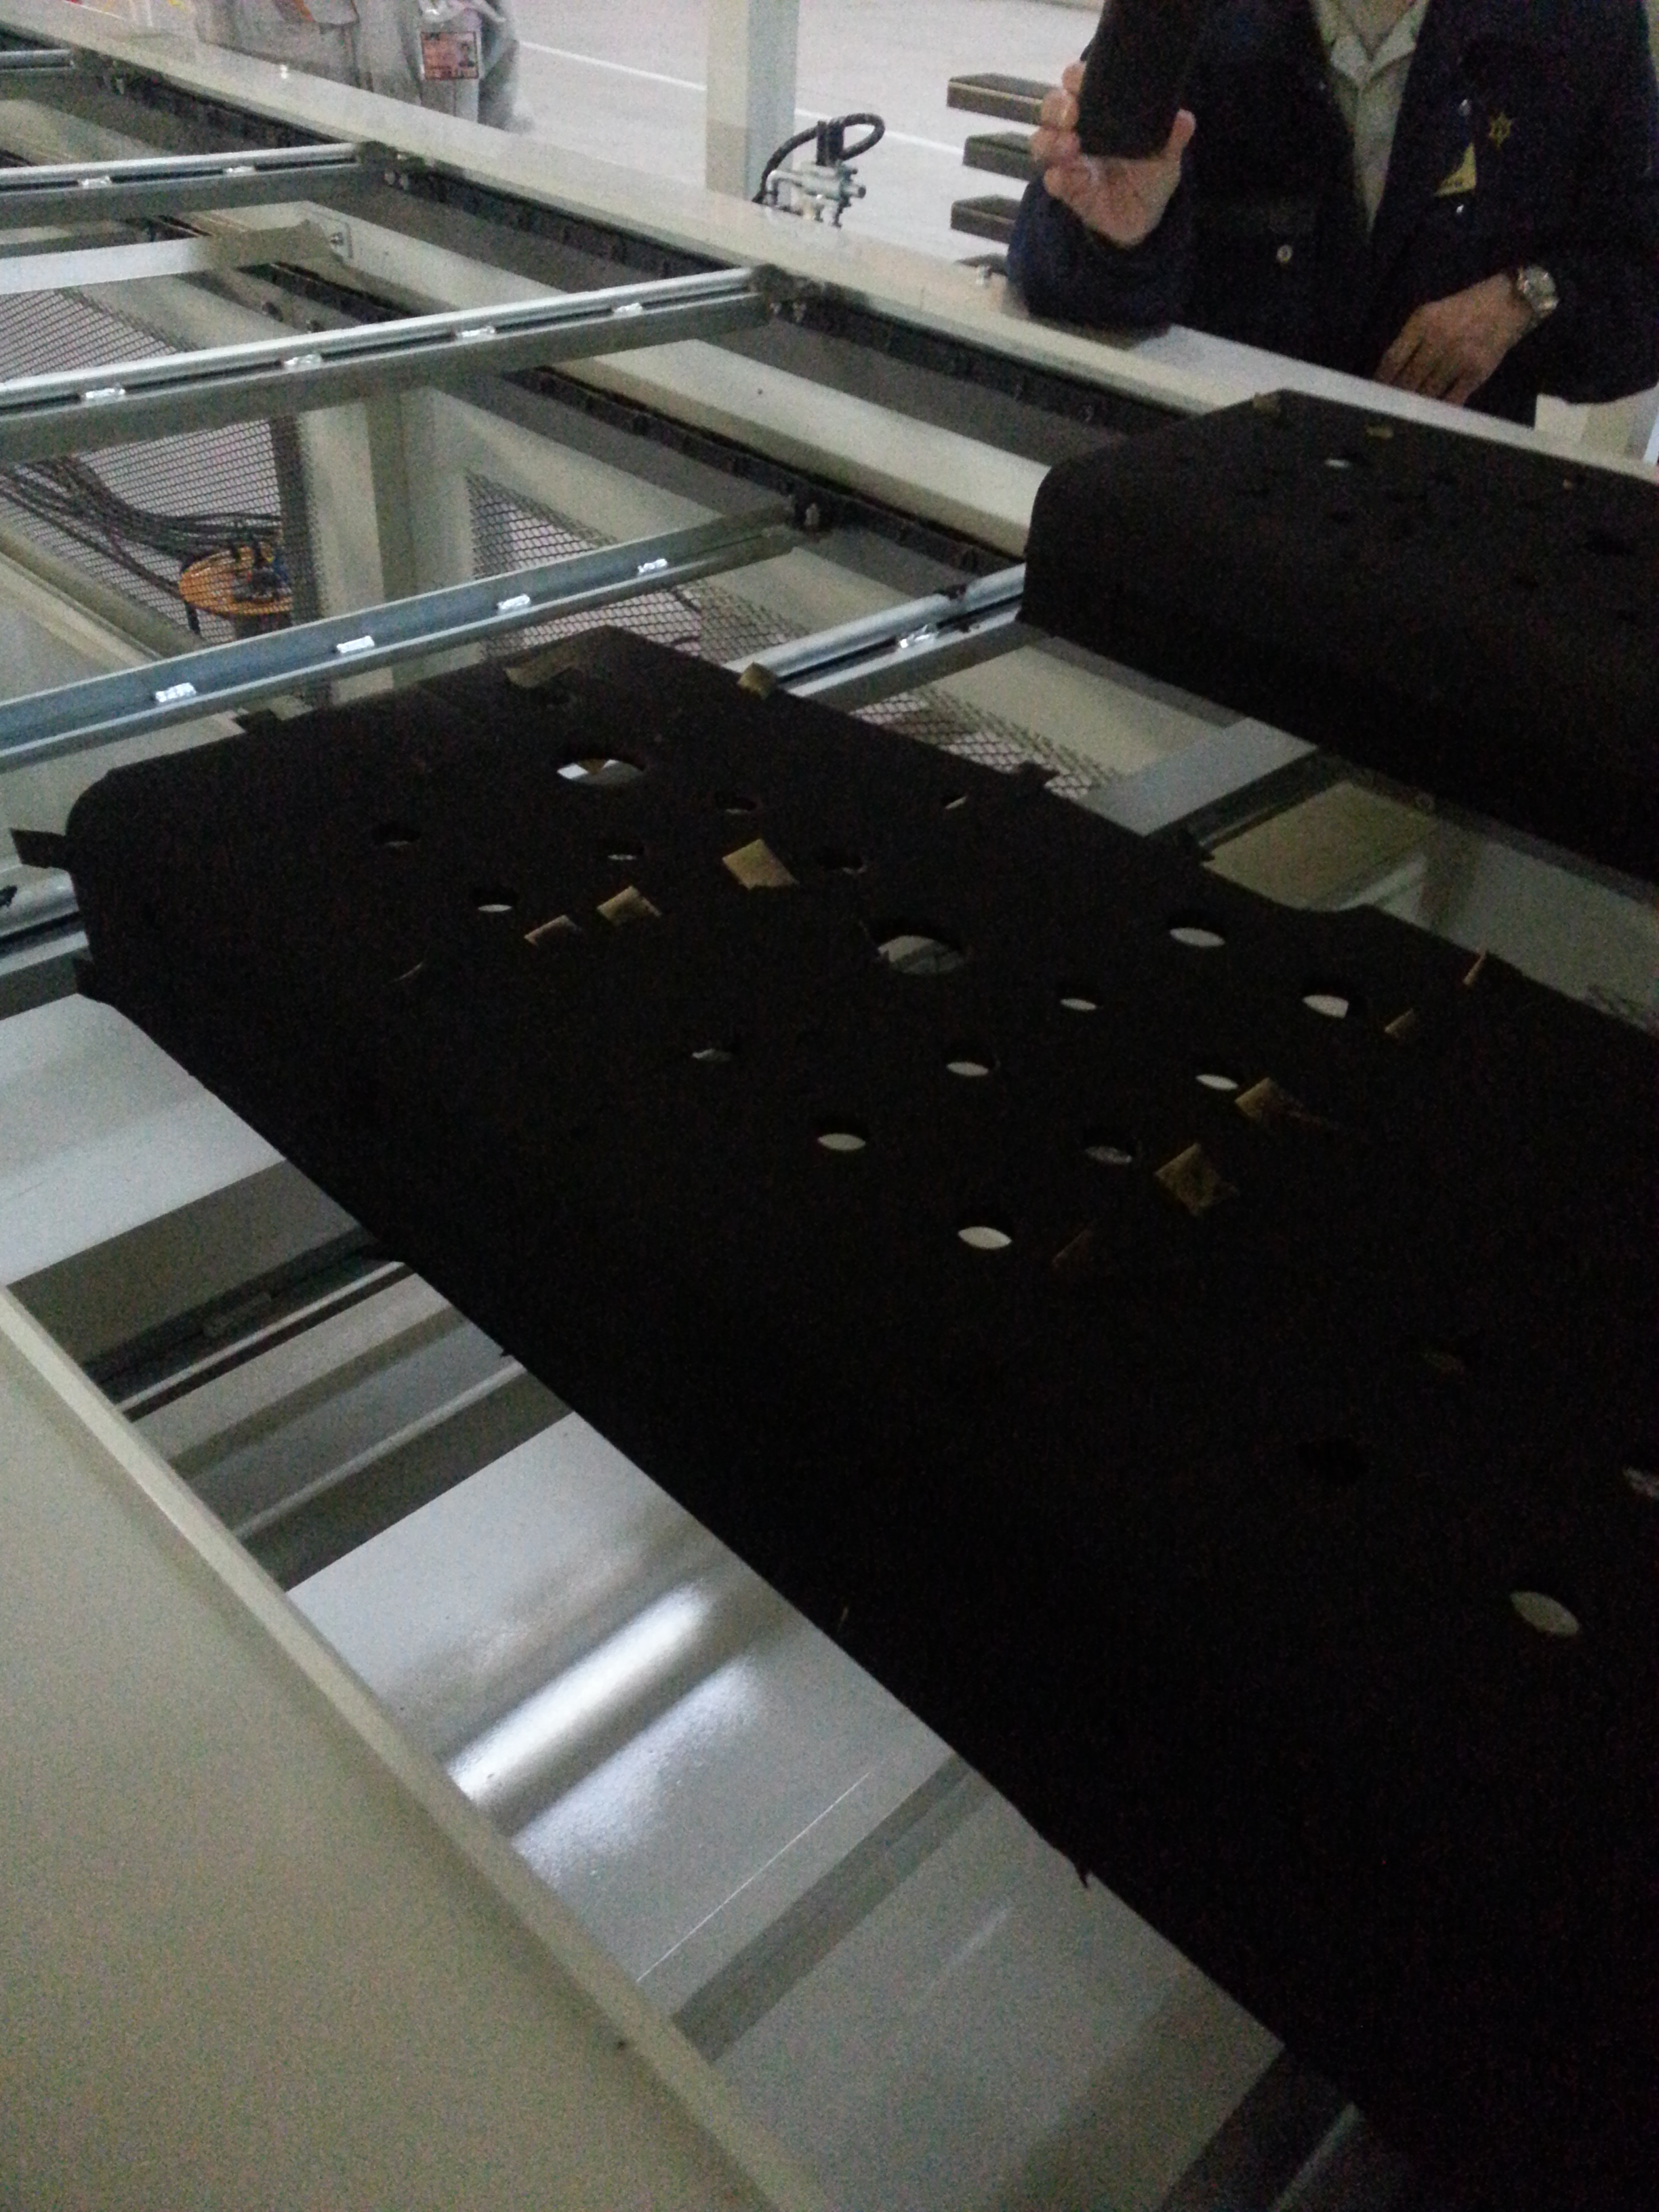
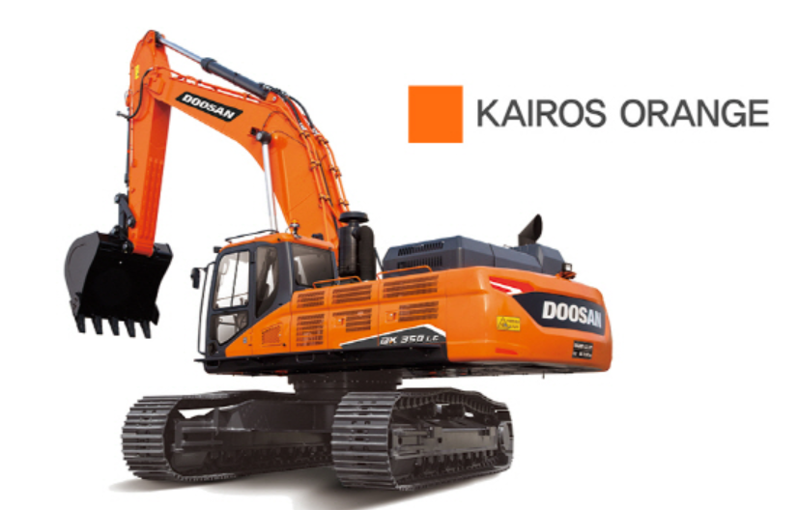
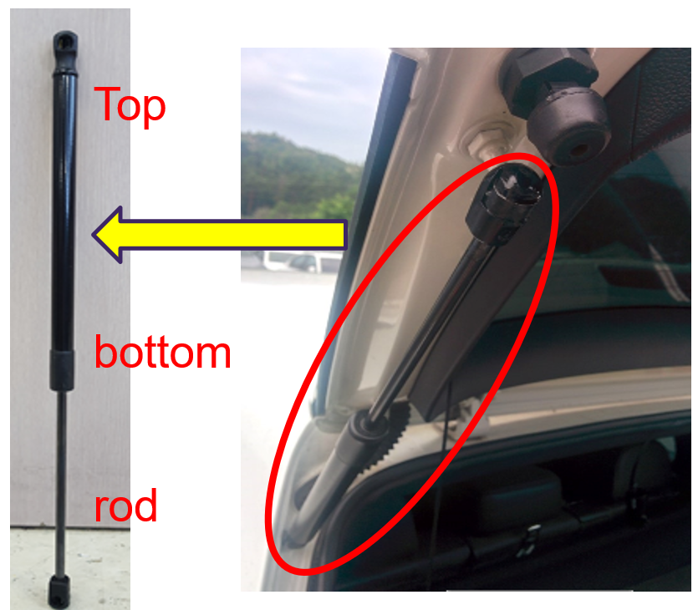
Case Study
item | Sector | Detail | Photo
1. Auto chassis frame (Hino Truck) | High Tg TGIC Free polyester | 1. High Tg ( over 80 ℃ ) : clamping force test 2. Edge coverage : Zero sagging 3. Corrosion resistance ( 50µm 1500 h) -Film thickness of corner part is about 50µm
2. Heavy Machine (HD Infracore) | High weatherability TGIC Free IPA polyester | 1. High weatherability : WOM 2000h (△E <4.0) 2. Good Leveling : DOI over 40 3. Orange color matching : Liquid STD (△E <2.0)
3. Trunk lid’s cylinder of car. | Phenolic Epoxy | NIR Oven application Cure Temp : 205 ℃ X 45 sec (the top) 135 ℃ X 45 sec (the bottom) 2. Smoke and smell 3. Good appearance

