Slide 1
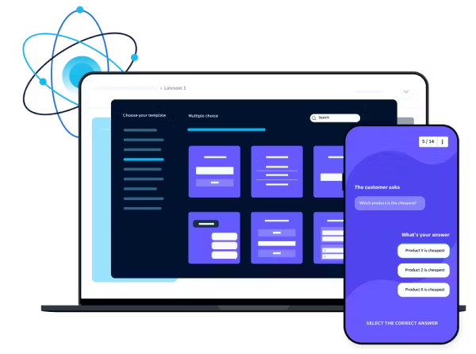
Online Quiz Platform
We created : TYPEit Quiz Platform
Presented by: GROUP 16
Harini Padmaja Solleti & Geethika Vulli

Slide 2

About the Project
TYPEit is a gamified, interactive quiz platform designed for high school students, aiming to make learning both effective and enjoyable.
"TYPE it" is an online quiz platform that blends conventional
testing methodologies with contemporary web technology. It
caters to students, professionals, and companies by providing
individualized quizzes, gamified challenges, and performance
data. The website allows users to check their knowledge, improve their typing abilities, and engage in real-time tournaments.
OBJECTIVE
Build a platform that functions effortlessly across devices and can handle increasing user base while maintaining strong performance and availability.
To enhance learning experience by providing the versatile platform to users .

Slide 3

Problem Statement
Addressing The Challenges Of Traditional Learning In High Schools
Student Engagement
Traditional paper-based quizzes and lectures often fail to capture students' interest and motivation, leading to lower participation and retention. Many students find these methods tedious and irrelevant to their daily lives, resulting in passive learning and poor performance. TYPEit aims to counter this by incorporating gamified elements and interactive feedback.
Educator Support and Assessment
Teachers frequently lack efficient tools to effectively monitor and guide student progress in real-time. Grading large volumes of paper quizzes is time-consuming, and providing individualized feedback is challenging. TYPEit addresses this by providing automated grading, performance dashboards for teachers to track individual and class progress, and targeted feedback mechanisms to personalize the learning experience for each student.

Slide 4
Proposed Solution : TYPEit platform
Addressing the Gaps: TYPEit's Unique Approach
Real-Time Feedback Robust Admin Dashboard
Students receive immediate visual feedback on their answers. Correct answers illuminate the progress bar in green, providing a clear indication of success and boosting motivation. Incorrect answers turn the progress bar red, prompting students to review the material and identify their mistakes, addressing issues of passive learning and poor performance found in traditional methods.
Students receive immediate visual feedback on their answers. Correct answers illuminate the progress bar in green, providing a clear indication of success and boosting motivation. Incorrect answers turn the progress bar red, prompting students to review the material and identify their mistakes, addressing issues of passive learning and poor performance found in traditional methods.

Slide 5
KEY Features
TYPEit's Innovative Features
Real-Time Feedback
Robust Admin Dashboard
Timer and Skip Functionality
Students receive immediate visual feedback on their answers. Correct answers illuminate the progress bar in green, providing a clear indication of success and boosting motivation. Incorrect answers turn the progress bar red, prompting students to review the material and identify their mistakes, addressing the issues of passive learning and poor performance found in traditional methods.
Educators can efficiently manage all aspects of TYPEit through a user- friendly dashboard. This includes creating and editing quiz topics, managing student accounts, tracking individual and class-wide progress, and accessing comprehensive quiz data, thereby overcoming the challenge of inefficient educator support and real-time progress monitoring.
TYPEit incorporates a built-in timer to add a layer of engaging competition, while the skip functionality prevents students from getting bogged down on overly difficult questions. This addresses the student engagement issues identified in traditional methods, increasing student participation and improving the overall learning experience.

Slide 6
Methodology: An Iterative and Collaborative Approach
1
Requirement Analysis
2
Technology Stack Selection
3
Development Phases
Based on the requirements and our experience, we selected a technology stack that prioritizes scalability, security, and ease of use. This involved choosing Flask for the backend to ensure efficient data management and communication with the database. We selected SQLite as a robust and reliable database solution, capable of handling large amounts of quiz data and user accounts. Finally, Bootstrap was chosen for the frontend development
The development process was iterative and agile,
We began by identifying the key challenges faced by high school students and educators in traditional learning environments, focusing on issues such as passive learning, poor performance, and inefficient educator support. This included surveys and interviews with teachers and students to understand their needs and priorities for a new quiz platform. Key findings revealed a need for features such as real-time feedback, customized quizzes, and a robust admin dashboard.
consisting of several phases of planning, implementation, and testing. Each phase involve close collaboration between our team members, ensuring the smooth integration of the backend a frontend components. After each phase, testing cycles were conducted to validate the functionali and design of each module. We focused on iterative development based on user feedback an
to guarantee a user-friendly and responsive interface test results. This helped us address any challenge
accessible on different devices, addressing the need for easy navigation and accessibility.
and ensure the final product met the specific requirements and feedback from students and educators, including features like the timer and skip functionality for improved student engagement.

Slide 7
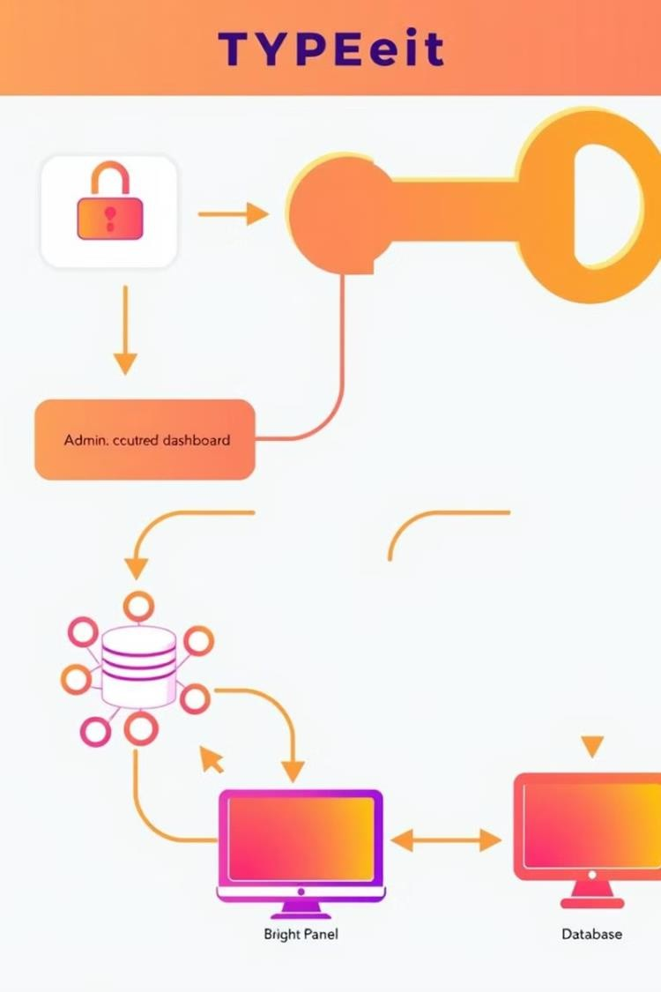



Implementation Details: A Seamless
Blend of Backend and Frontend
Secure User Authentication
Utilizing Flask for the backend, we implemented a secure login system with password hashing to protect user credentials. This system allows educators to easily enable or disable student accounts as needed.
SQLite Database Management
A robust SQLite database efficiently stores user profiles, comprehensive quiz data, and results, ensuring scalability and reliable data management as described in the methodology section. This database was chosen to support the real-time feedback features.
Admin Dashboard Interface
Built with Bootstrap for responsiveness and accessibility, the admin dashboard allows educators to manage quiz topics, user accounts, and view real-time class scores. This addresses the requirement for efficient educator support and progress monitoring.

Slide 8
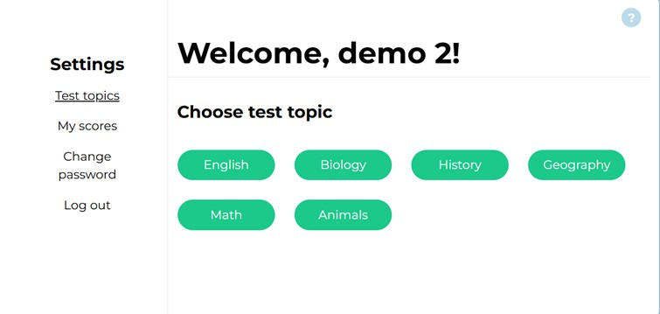
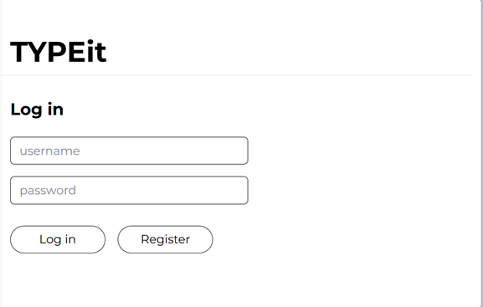
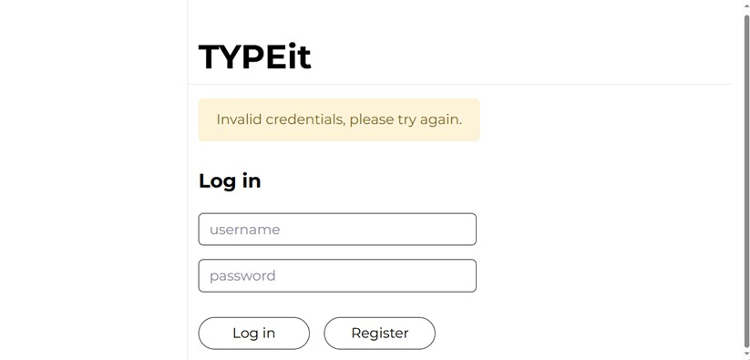
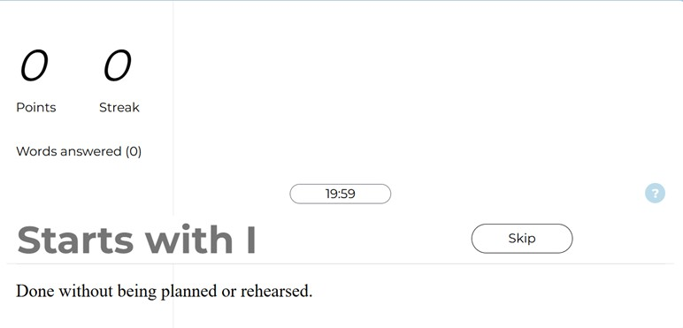
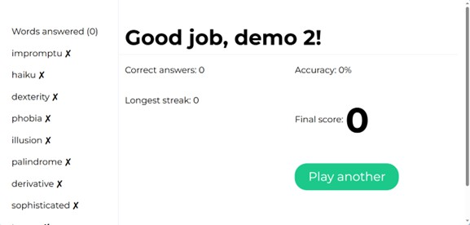
Outputs of our Platform

Slide 9
Engaging Experience
Real-time feedback, timer, and skip option enhance user engagement
Admin Efficiency
Results and Discussion: A Promising Solution for Education
Manage topics, users, and track student performance easily
System Stability
Rigorous testing ensures robust and reliable performance.

Slide 10
Secure Login System
Implementing a secure login system using Flask-Login for session management and bcrypt for password hashing presented an initial challenge. Ensuring that educator accounts could easily enable or disable student access required careful integration with the user roles and permissions system.
Responsive Interface
Creating a responsive interface proved crucial for ensuring accessibility across various devices (desktops, tablets, and smartphones). Integrating Bootstrap's responsive grid system while maintaining consistency in the user experience required careful consideration of different screen sizes and orientations.
Database Integrity
Maintaining database integrity was paramount, especially considering the real-time feedback and quiz data. The implementation of foreign key constraints in the SQLite database, coupled with rigorous unit and integration tests, proved effective in preventing data anomalies and ensuring reliable data management under heavy load.
Challenges and Solutions: Overcoming Development Hurdles

Slide 11
Conclusion and Future Work: A Step Towards Digital Learning
PHASE 1
Enhanced Question Types
PHASE 2
PHASE 3
Robust User Authentication
Granular Performance Analytics
Develop a comprehensive analytics dashboard, providing educators with detailed performance metrics, individual student progress reports, and class-wide trends, facilitating data-driven instruction and improved teaching strategies.
Expand quiz functionality by incorporating multimedia elements such as images, videos, and interactive simulations, improving student engagement and learning outcomes.
Implement a secure password recovery system, allowing users to reset forgotten passwords easily and securely, improving accessibility and user experience.
.

Slide 12
Team Contribution
Harini Padmaja Solleti – 811288992
I have developed the required code to develop our online quiz platform which is TYPEit and executed the code
using Visual Studio Code.
The documentation/project report was done by me which included all the required information or mentioned points in the instructions.
I also made a document of screenshots of code execution with explanation.
The challenges that I have faced while doing this project are as we are not professionals,
I encountered many errors where I had to look up everything and change it several number of times inorder to get
our desired output.
Geethika Vulli – 811290653
I have contributed by doing a demo video on how to implement the code and use the online quiz platform where it can be easily understood who ever sees it.
I have prepared the power point presentation and included all the required information.
The only challenge was to complete this entire project successfully and as I am the one who is preparing the power point presentation, I have to take extra care as that is the one which we showcase our project in front of everyone and as the slides should not contain so much matter and yet should convey all the necessary information, I had to be conscious.
We both, as a team had a great experience working together in this project. We shared works and kept updated about the progress from start to finish.

Slide 13
Thank you!
Feel free to approach us if you have any questions.

