Slide 1

Fraud Detection
Full Pipeline Overview

Slide 2
Agenda
Conceptual Model
Overview
Exploratory Data Analysis (EDA)
Data Preprocessing
Model Training and Evaluation
Key Findings and Conclusions
Deployment

Slide 3
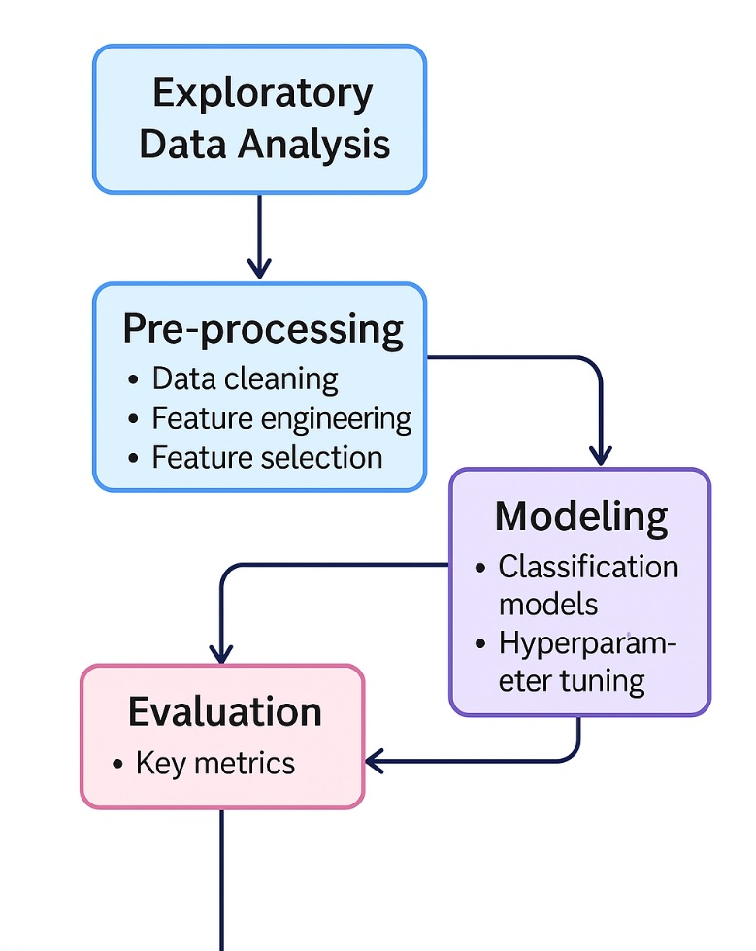
Conceptual Model

Slide 4
Overview - I
Fraud detection is a critical aspect of the financial ecosystem to minimize financial losses.
This project presents a machine learning pipeline to detect fraudulent transactions with high precision and recall, tailored for highly imbalanced datasets.
The dataset contains 99,615 transactions with the following attributes:
- Originator: Sender bank code
- Beneficiary: Receiver bank code
- Date and Time: When the transaction occurred
- Type: Transaction type (e.g., MT103, MT202)
- Currency: Currency type (all values normalized to USD)
- Value: Transaction amount
- Aggregate Value: Sum of transactions
- Aggregate Volume: Number of transactions
- Flag: Fraud label (0: Normal, 1: Fraudulent)
The dataset is highly imbalanced, with less than 2% fraud transactions

Slide 5
Overview - II
Fraud vs Non-Fraud Distribution

Slide 6
Exploratory Data Analysis (EDA)
Dataset: 99,615 transactions
~1.67% fraud transactions
Transaction Value highly skewed
Temporal fraud patterns (late hours)
Country-specific fraud trends
MT103 dominant message type

Slide 7
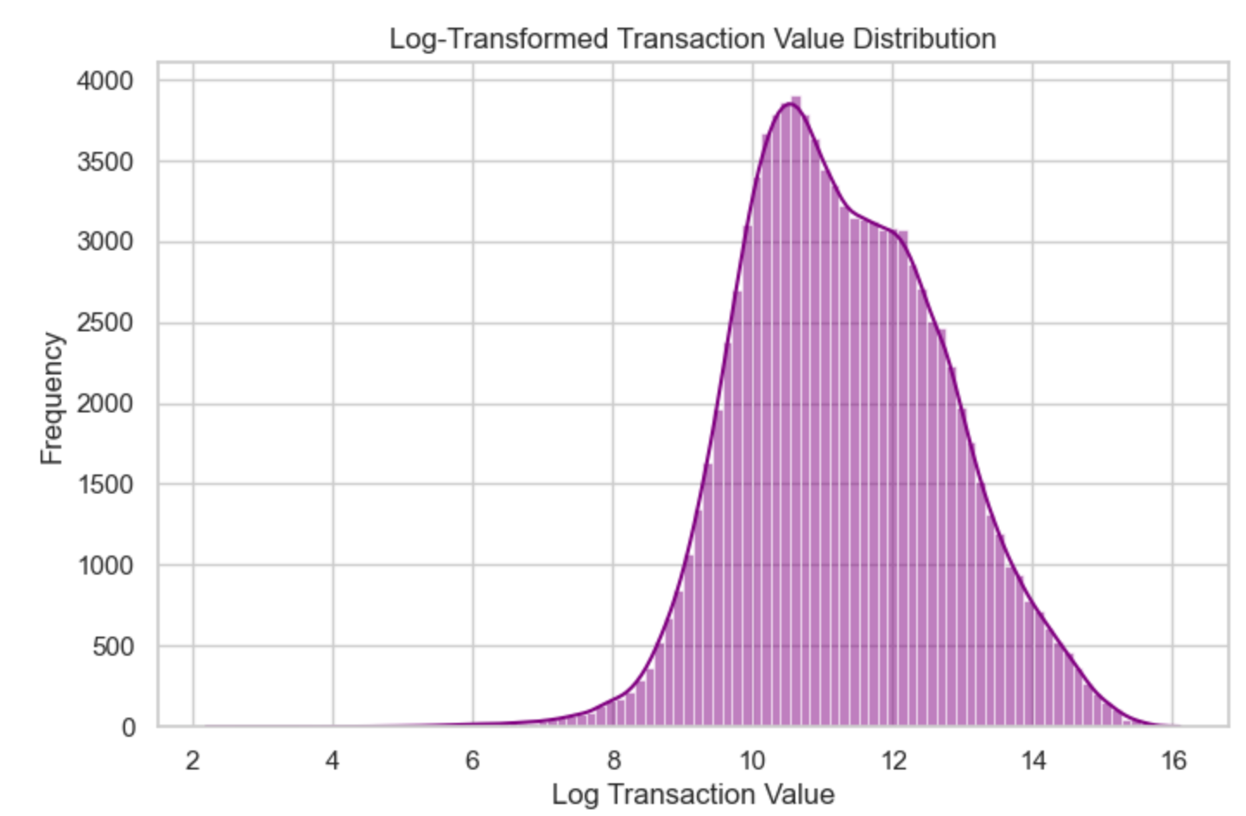
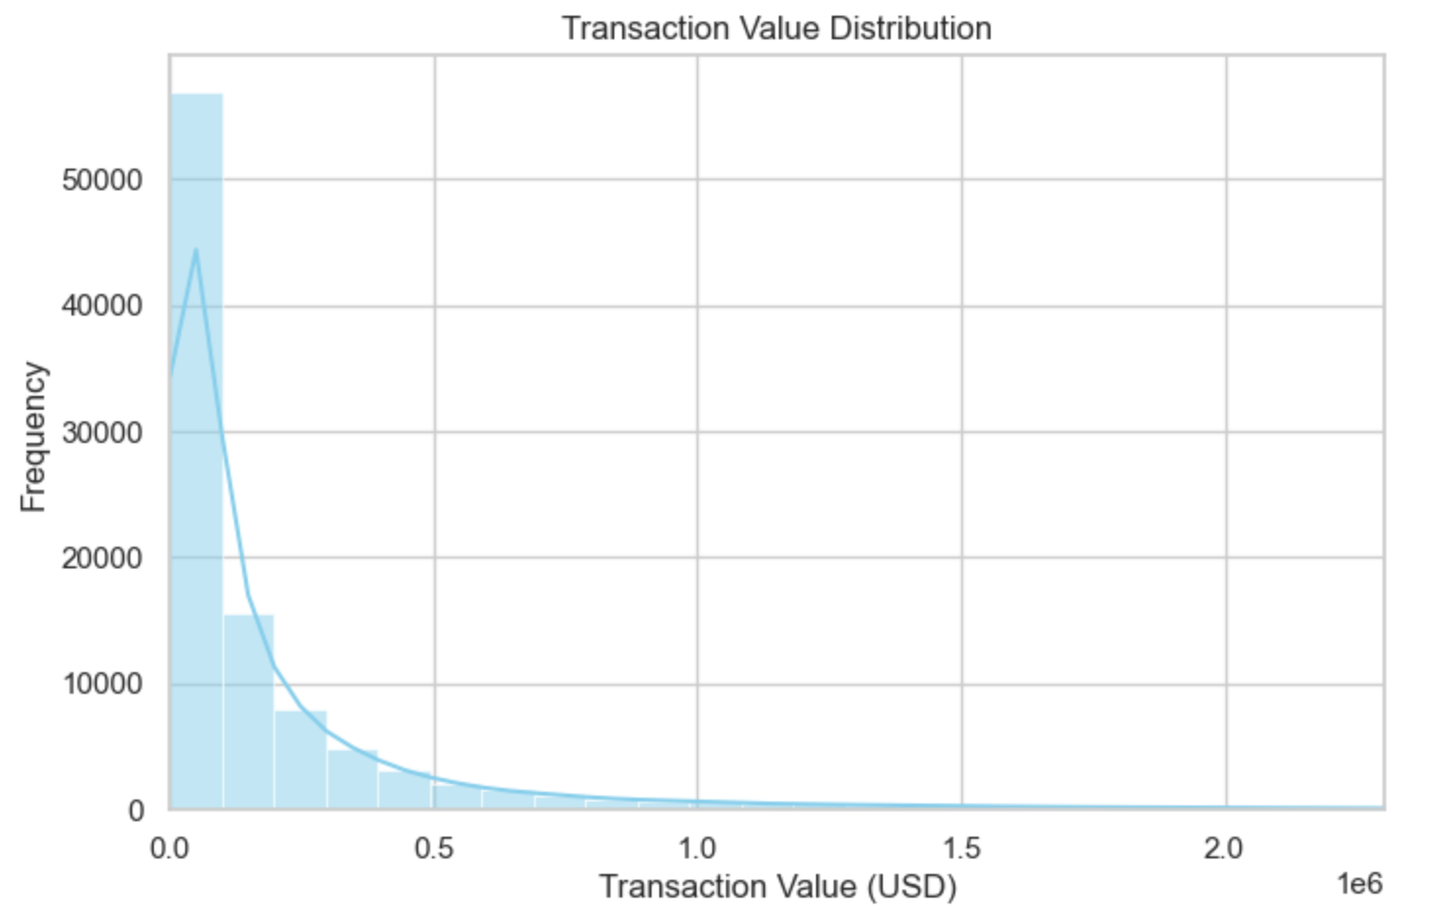
EDA - II
Transaction Value Distribution

Slide 8
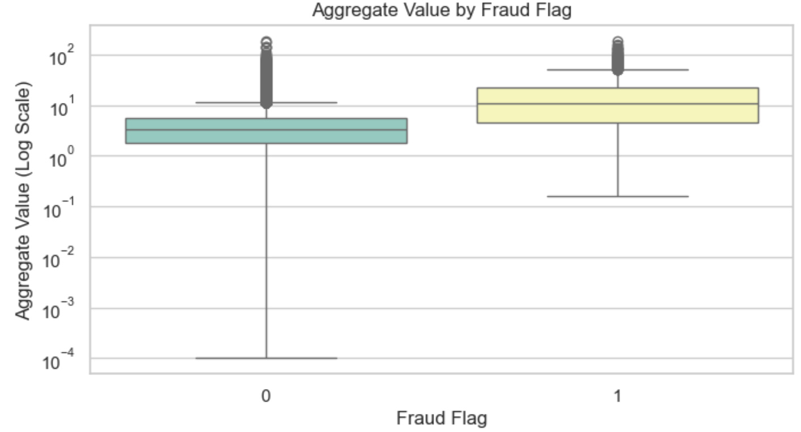
EDA - III
Aggregate Value Analysis by Fraud Flag
Fraud Flag | Interpretation
0 (Non-Fraud) | - Median aggregate_value is around 10^1 (~10) - Most values are between 10^0 (~1) and 10^1 (~10), with some large outliers up to 10^2 (100) - Also some very small values down near 10^-4 (0.0001)
1 (Fraud) | - Median aggregate_value is higher, around 10^1.5 (~31.6). - Distribution moved upwards: the bulk of fraud transactions have higher aggregate values - Outliers also reach above 10^2 (>100) - Fraud transactions tend to involve larger amounts
Summary | 1- Fraud transactions have a higher median aggregate value 2- More high-value outliers exist among frauds

Slide 9
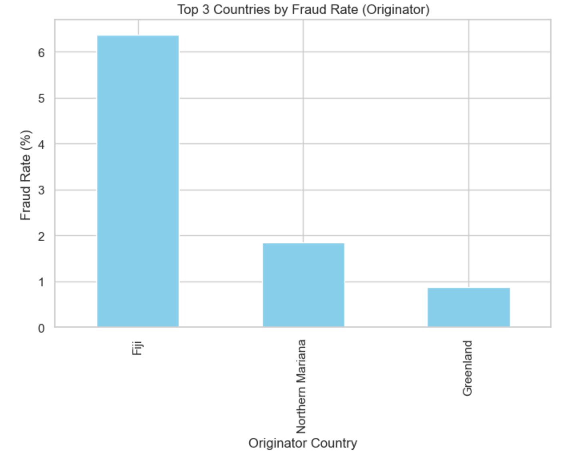
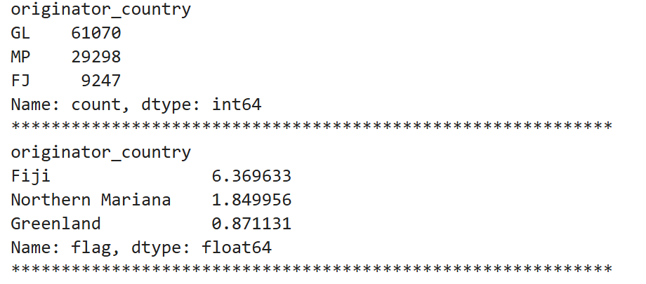
EDA - IIII
Country-Wise Transaction and Fraud Analysis

Slide 10
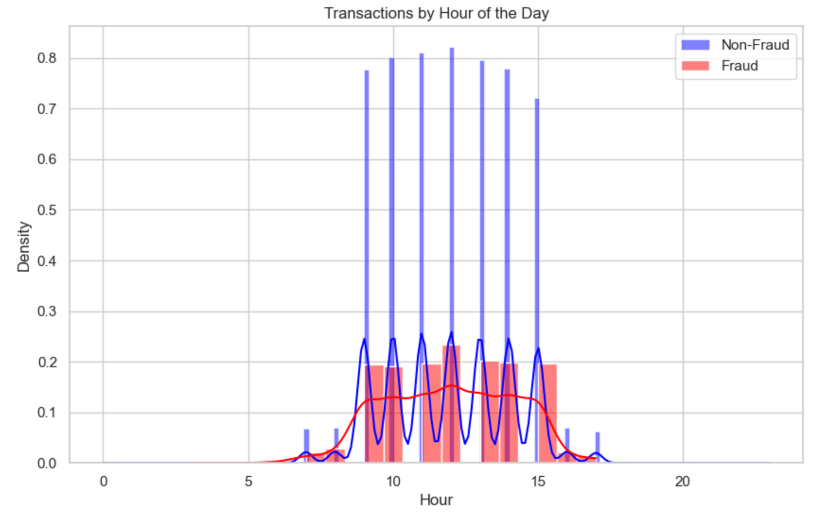
EDA - IIIII
Time-based Transaction Analysis
Temporal Patterns
Hours: Fraud occurs more frequently during standard business hours (9AM-5PM)
Time Pattern: 85% of fraudulent transactions occur during business hours on weekdays

Slide 11
Data Preprocessing - I
1- Data Cleaning
Extracted Country Codes: From Originator and Beneficiary bank codes
Extracted Transaction Hour: From time field
Dropped Redundant Fields: Originator, Beneficiary, raw Date and Time fields
Handled Missing Values: Confirmed no missing values post-cleaning
2- Feature Engineering
Log Transformation: Applied to skewed fields (value, aggregate_value, aggregate_volume)
Label Encoding: Applied to categorical features (originator_country, beneficiary_country, currency, type)

Slide 12
Data Preprocessing - II
3- Outlier Treatment
IQR Method: Capped extreme values in log-transformed fields
4- Data Scaling
StandardScaler: Used for numerical features to normalize feature distributions
5- Feature Selection
ANOVA F-test: Selected features assesses the statistical significance of each feature by measuring the ratio of between-group variance to within-group variance, indicating how well a feature differentiates between classes
6- Handling Class Imbalance
SMOTE (Synthetic Minority Over-sampling Technique) applied
Creates synthetic examples of the minority class

Slide 13
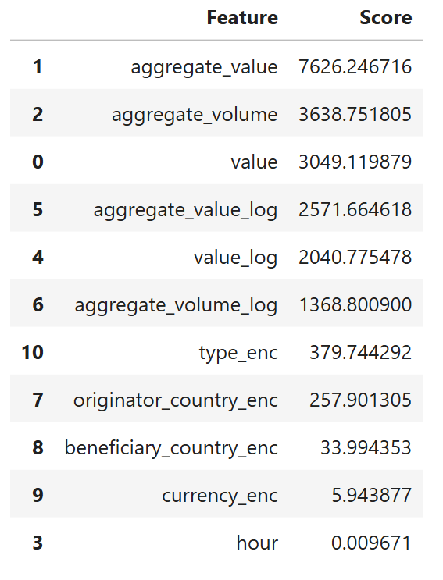
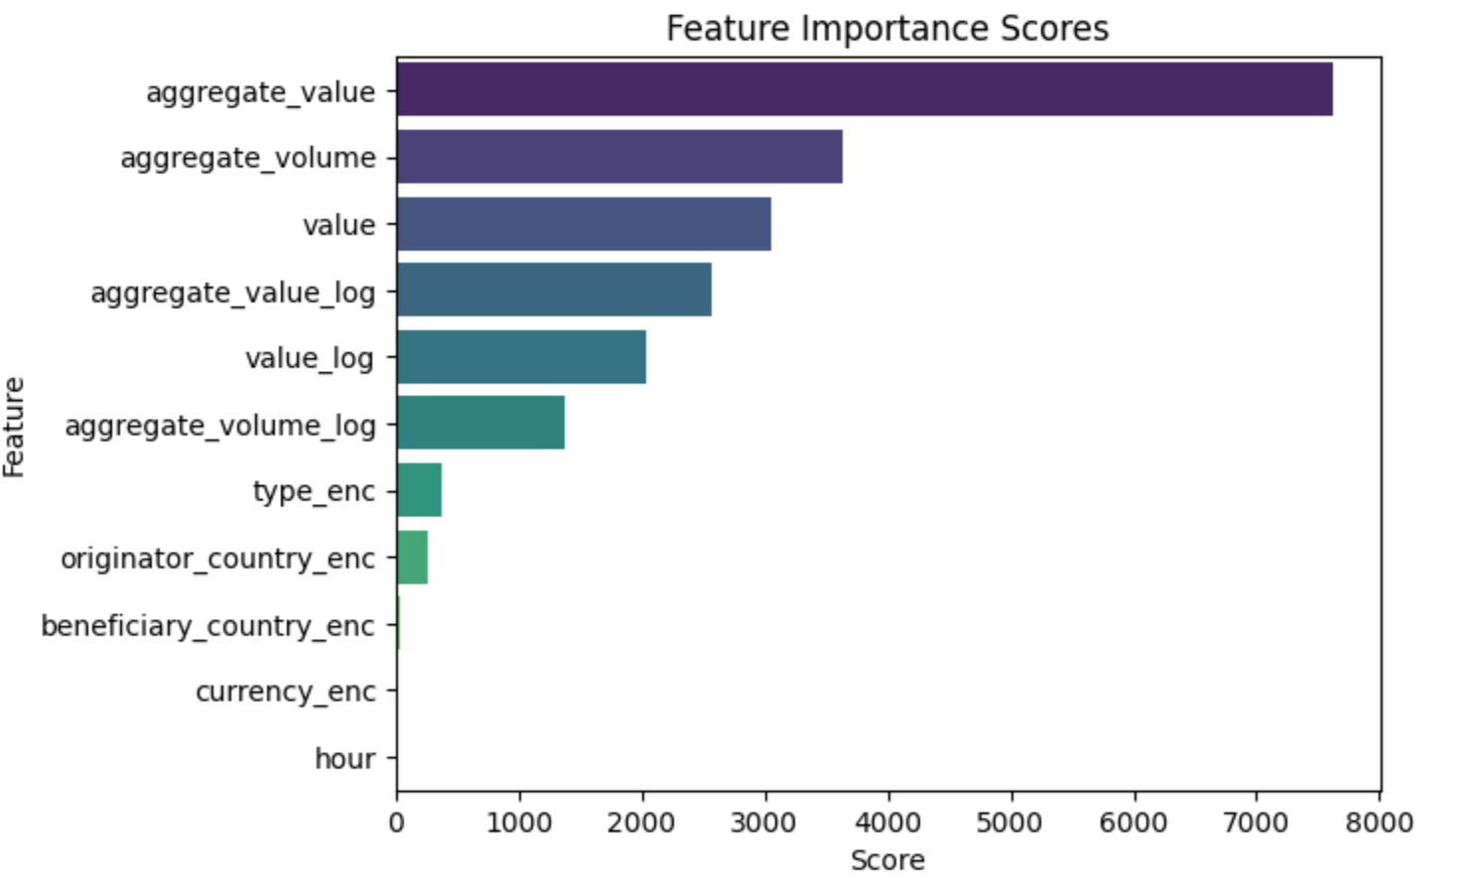
Data Preprocessing - III
Feature Selection

Slide 14
Model Training and Evaluation - I
Models Trained
- Logistic Regression: Baseline linear model
- Random Forest: Ensemble of decision trees with bagging
- XGBoost: Gradient Boosting with regularization
- LightGBM: Fast and scalable gradient boosting
Hyperparameter Tuning
- GridSearchCV: Performed for each model using 3-fold cross-validation
- Scoring Metric: ROC AUC Score

Slide 15
Model Training and Evaluation - II
Evaluation Metrics
- Accuracy: General correctness
- Precision: Focused on reducing false positives
- Recall (Sensitivity): Critical in detecting as many frauds as possible
- F1-Score: Balance between Precision and Recall
- ROC AUC Score: Overall model performance; higher the better
- Confusion Matrix: True Positives (TP), False Positives (FP), True Negatives (TN), False Negatives (FN)
- Precision-Recall Curve: Emphasizes performance on imbalanced data

Slide 16
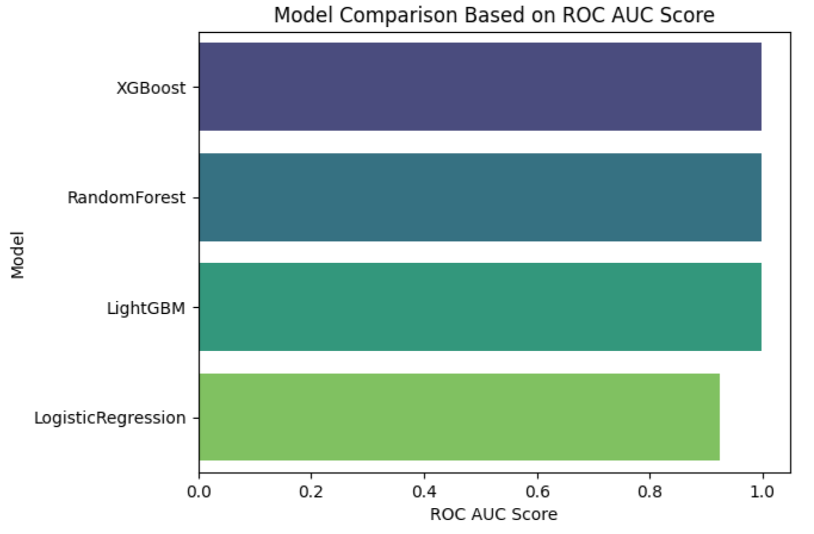
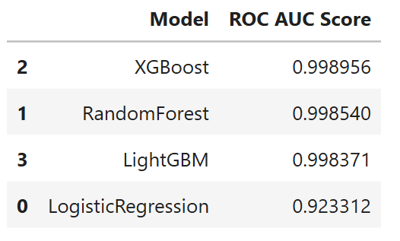
Model Training and Evaluation - III
Model Comparison

Slide 17
Key Findings
✓ Gradient boosting models outperform other algorithms
✓ SMOTE effectively addresses class imbalance challenges
✓ Top three features: aggregate_value, aggregate_volume, value
✓ Transaction value is a strong indicator of fraud risk
✓ Fraud more frequent in certain countries and times
Model | ROC AUC Score | Precision | Recall | F1-Score
Logistic Regression | 0.923 | 0.87 | 0.82 | 0.85
Random Forest | 0.998 | 0.98 | 0.99 | 0.98
XGBoost | 0.999 | 1.00 | 0.99 | 0.99
LightGBM | 0.998 | 0.99 | 0.98 | 0.98

Slide 18
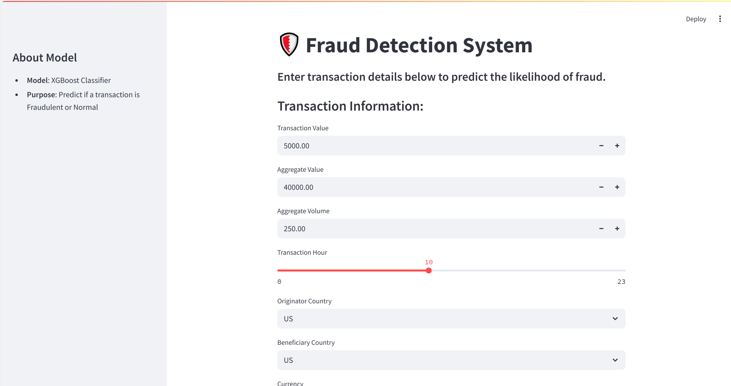
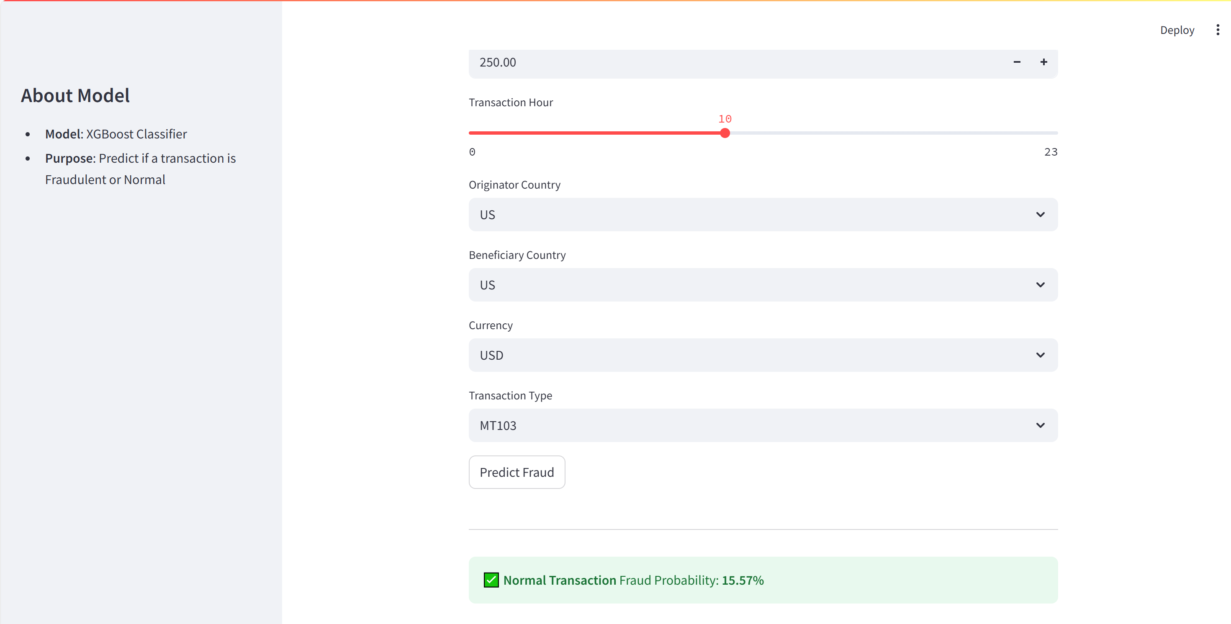
Deployment
Streamlit App
- Framework: Streamlit for frontend interaction
- Backend: Model is loaded inside Streamlit
- User Input: Form fields for transaction features
- Output: Fraud prediction and fraud probability

Slide 19
Thank you!

