Slide 1
STUDENT NAME: Harrison.J.S
REGISTER NO AND NMID: 24bcs010 & asunm123222401701
DEPARTMENT: B.Sc. Computer Science
COLLEGE: Mohamed Sathak College of Arts and Science

Slide 2
PROJECT TITLE
DIGITAL PORTFOLIO

Slide 3


AGENDA
Problem Statement
Project Overview
End Users
Tools and Technologies
Portfolio design and Layout
Features and Functionality
Results and Screenshots
Conclusion
Github Link
3/21/2024 Annual Review

Slide 4

PROBLEM STATEMENT
In today’s competitive digital world, individuals lack a centralized, professional, and visually appealing platform to showcase their academic achievements, skills, and projects. A digital portfolio is necessary to present personal and professional information effectively.

Slide 5

PROJECT OVERVIEW
The Digital Portfolio Website is a personal platform designed to highlight academic, technical, and creative skills. It contains sections such as About Me, Education, Projects, Skills, Certifications, and Contact information. The website is responsive, user-friendly, and customizable.

Slide 6

WHO ARE THE END USERS?
Students – Showcase academic achievements and skills Job Seekers – Highlight projects and certifications Professionals – Build an online personal brand Recruiters/Employers – View candidate portfolios easily

Slide 7

TOOLS AND TECHNIQUES
Frontend: HTML, CSS, JavaScript, Bootstrap Backend: Python (Flask/Django) or PHP (if required) Database: MySQL / SQLite (optional) Hosting: GitHub Pages / Netlify Version Control: Git & GitHub

Slide 8
POTFOLIO DESIGN AND LAYOUT
The design follows a clean, minimal, and professional layout with proper navigation. Sections include: Home, About, Skills, Projects, Education, Certifications, and Contact. The portfolio is responsive for both desktop and mobile devices.
8

Slide 9
FEATURES AND FUNCTIONALITY
User-friendly interface with smooth navigation Responsive design for mobile and desktop Sections for About, Projects, Skills, and Contact Integration with LinkedIn/GitHub Downloadable Resume option

Slide 10

RESULTS AND SCREENSHOTS
3/21/2024 Annual Review
10

Slide 11
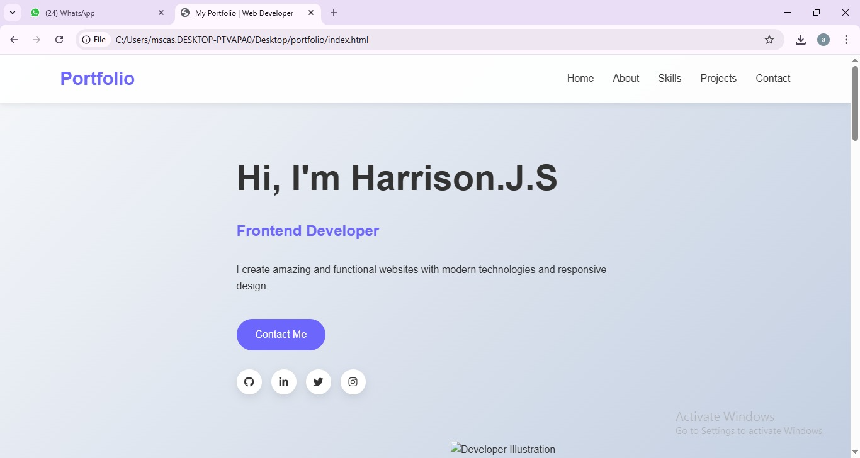

Slide 12
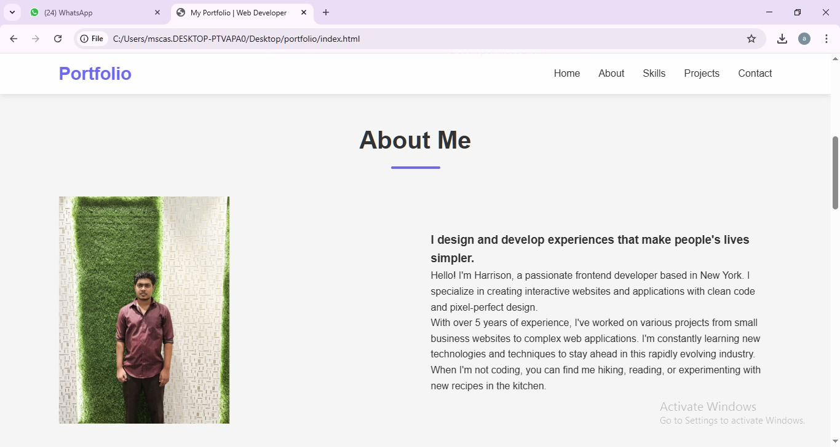

Slide 13
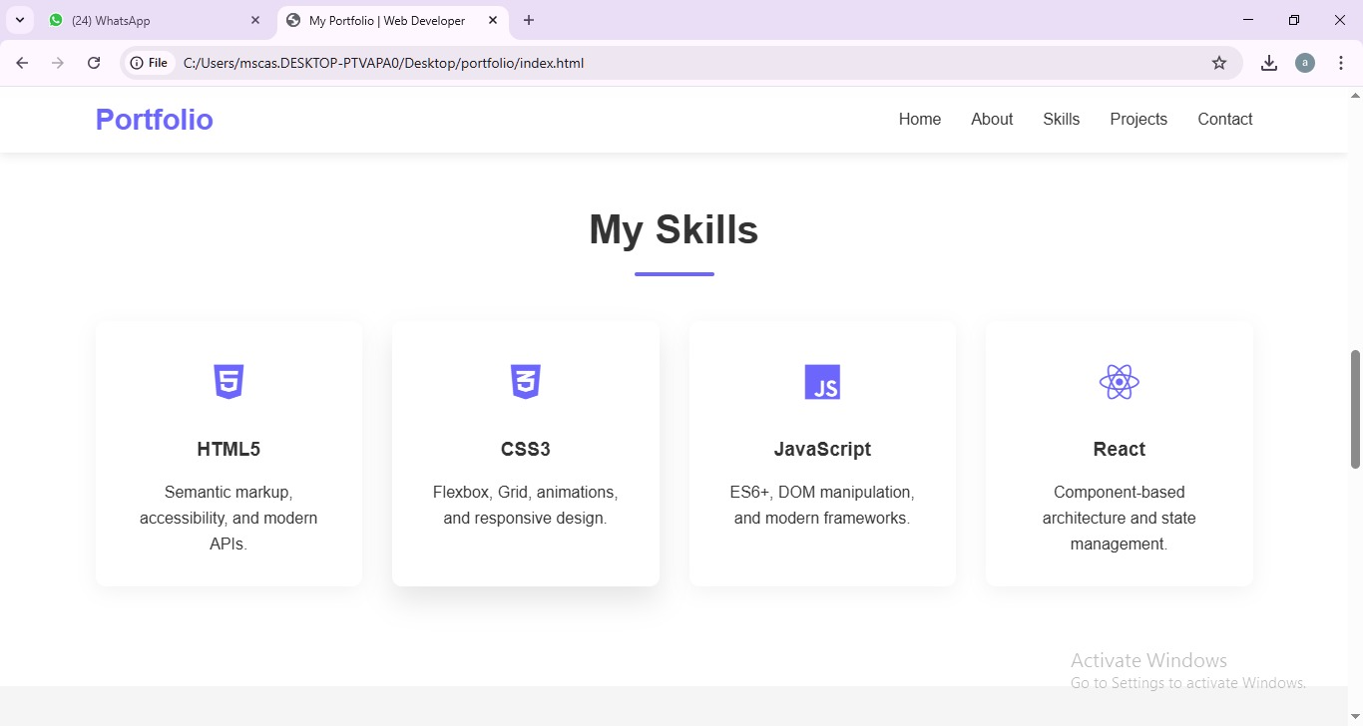

Slide 14
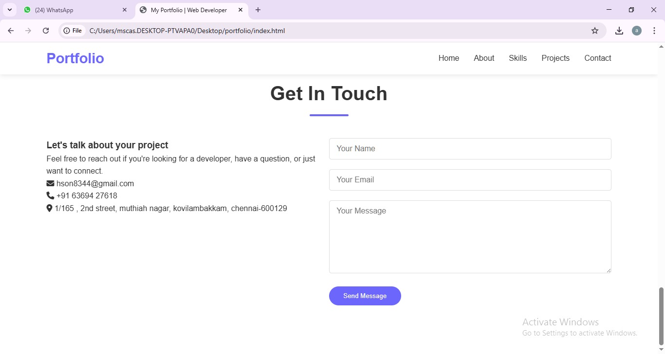

Slide 15
CONCLUSION
The Digital Portfolio Website provides an organized and professional way to present personal achievements, skills, and projects. It enhances career opportunities and creates a strong digital presence
15

