Slide 1

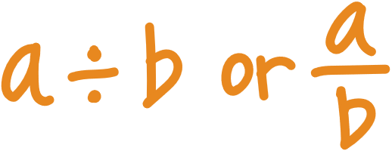

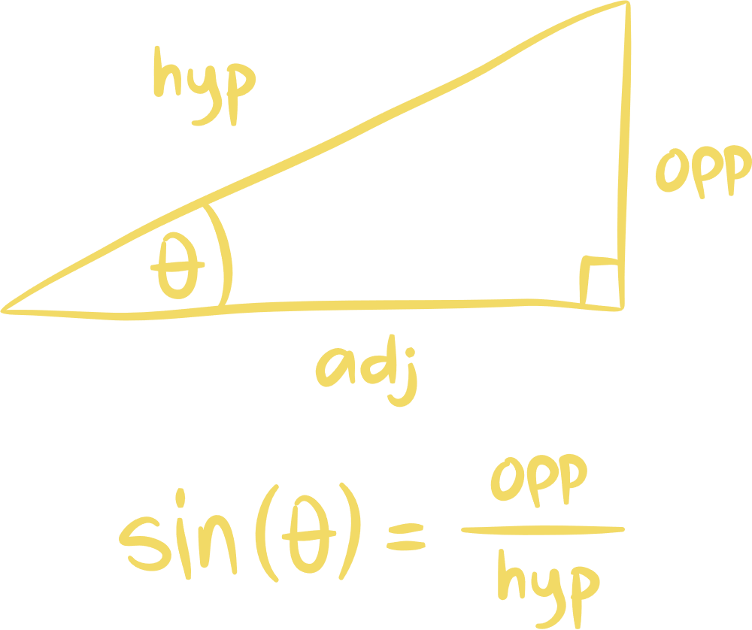
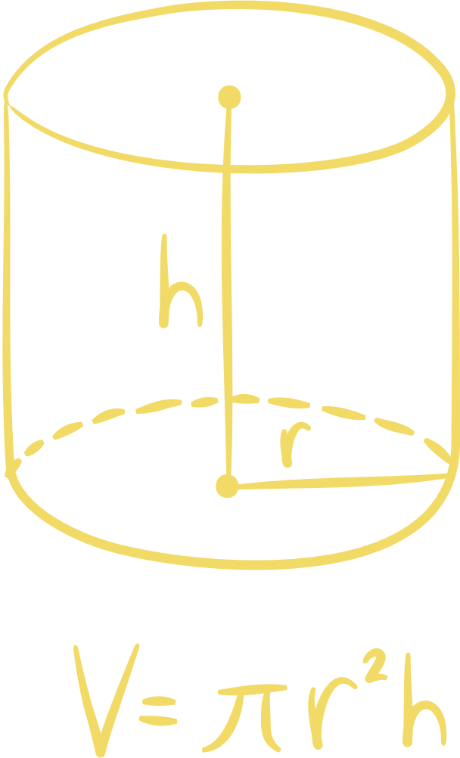


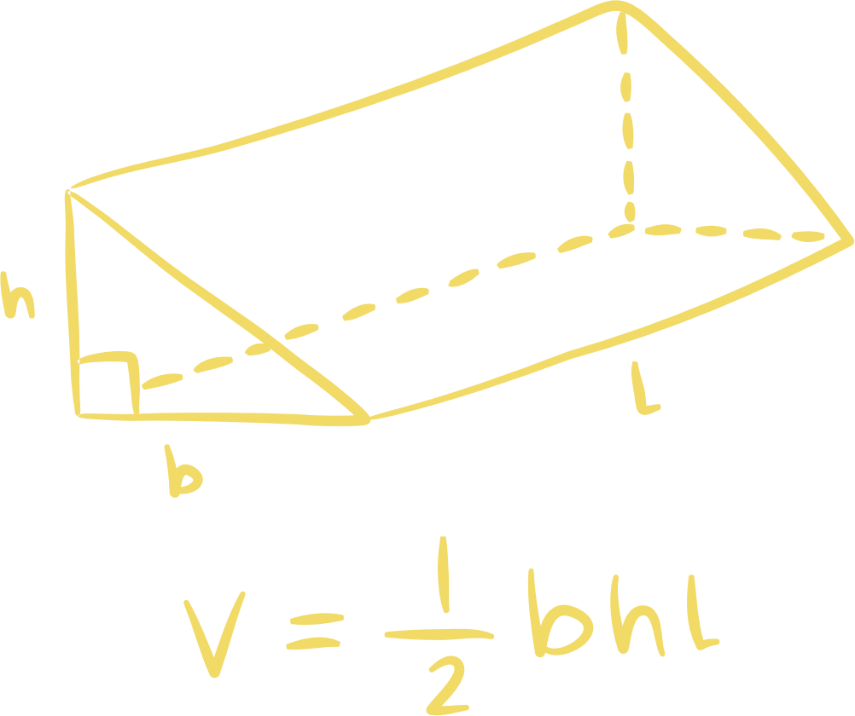
Our Team
1-Hussein Adel Jawad
2-Hussein Jaffer
3- hamza ahmed

Slide 2
Objective:
To build, train, and deploy a machine learning model that can identify numbers (0-9) from images.
Dataset: MNIST
the industry standard for computer vision, containing 70,000 grayscale images of handwritten digits.
Key Technology:
TensorFlow/Keras for the model, and Matplotlib for visualization.

Slide 3
Preparing the Data for the Brain
Normalization:
Pixel values are scaled from 0-255 to 0-1. This helps the neural network learn faster by keeping input values small.
Reshaping:
Images are converted into a 4D shape $(Samples, 28, 28, 1)$ to fit the requirements of a Convolutional layer.
Data Augmentation:
The code uses ImageDataGenerator to artificially create more training data by:
-Rotating images by 10°.
-Zooming in/out slightly.
-Shifting images horizontally and vertically.
-Benefit: This makes the model more robust to messy handwriting

Slide 4
Inside the Neural Network
The model is a Sequential CNN consisting of three main stages:
1-Feature Extraction:
-Conv2D Layers: Scan the image for edges, curves, and patterns.
-BatchNormalization: Stabilizes the learning process and speeds up training.
-MaxPooling: Shrinks the image size to focus on the most important features.
2-The Classifier:
- Flatten: Turns the 2D feature maps into a 1D vector.
-Dense (256 units): A fully connected layer that interprets the features.
-Dropout (0.5): Randomly "turns off" 50% of neurons to prevent overfitting (memorization).
3-The Output:
-Softmax Layer: 10 neurons (one for each digit 0-9) providing a probability score.

Slide 5
Optimization and Training
Optimizer:
Adam (Adaptive Moment Estimation), a popular algorithm that adjusts learning rates automatically.
Loss Function:
sparse_categorical_crossentropy – used because we are classifying images into 10 distinct categories.
ModelCheckpoint:
Automatically saves the "Best Version" of the model so we don't lose progress.
EarlyStopping:
Stops training if the model stops improving, saving time and computing power.

Slide 6
Putting the Model to Work
Inference Loop:
The code includes an interactive loop where users can provide a path to a custom image.
Super Preprocessing:
Custom images (like a PNG you draw) are:
1- Converted to Grayscale.
2- Resized to 28*28.
3- Inverted (because MNIST expects white digits on a black background).
Visualization: The code displays the processed image alongside a Bar Chart showing the model's confidence for each digit.

Slide 7
Results & Summary
Accuracy:
The model aims for high accuracy (typically > 99% on MNIST).
Robustness:
Thanks to Data Augmentation and Dropout, the model generalizes well to new, unseen handwriting.
Deployment Ready:
The best_model.keras file can be loaded into other applications for real-time digit recognition.

Slide 8
Thank You

