Slide 1
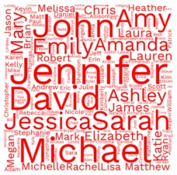

Most Common Runner Names
Nashville 2016-2019

Slide 2

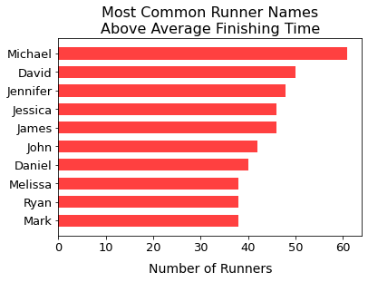
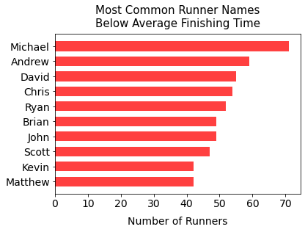
Most Common Full Marathon Finisher Names
Total Finishers: 9,705 Average Time: 4:48:27.21

Slide 3
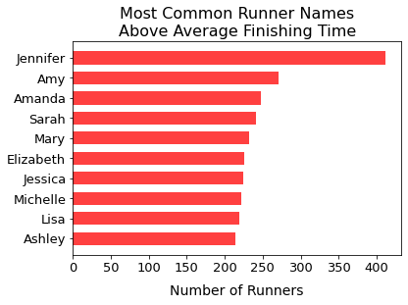
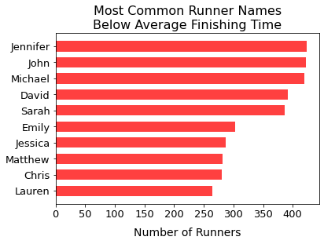
Most Common Half Marathon Finisher Names
Total Finishers: 64,278 Average Time: 2:35:17.81

