Slide 1
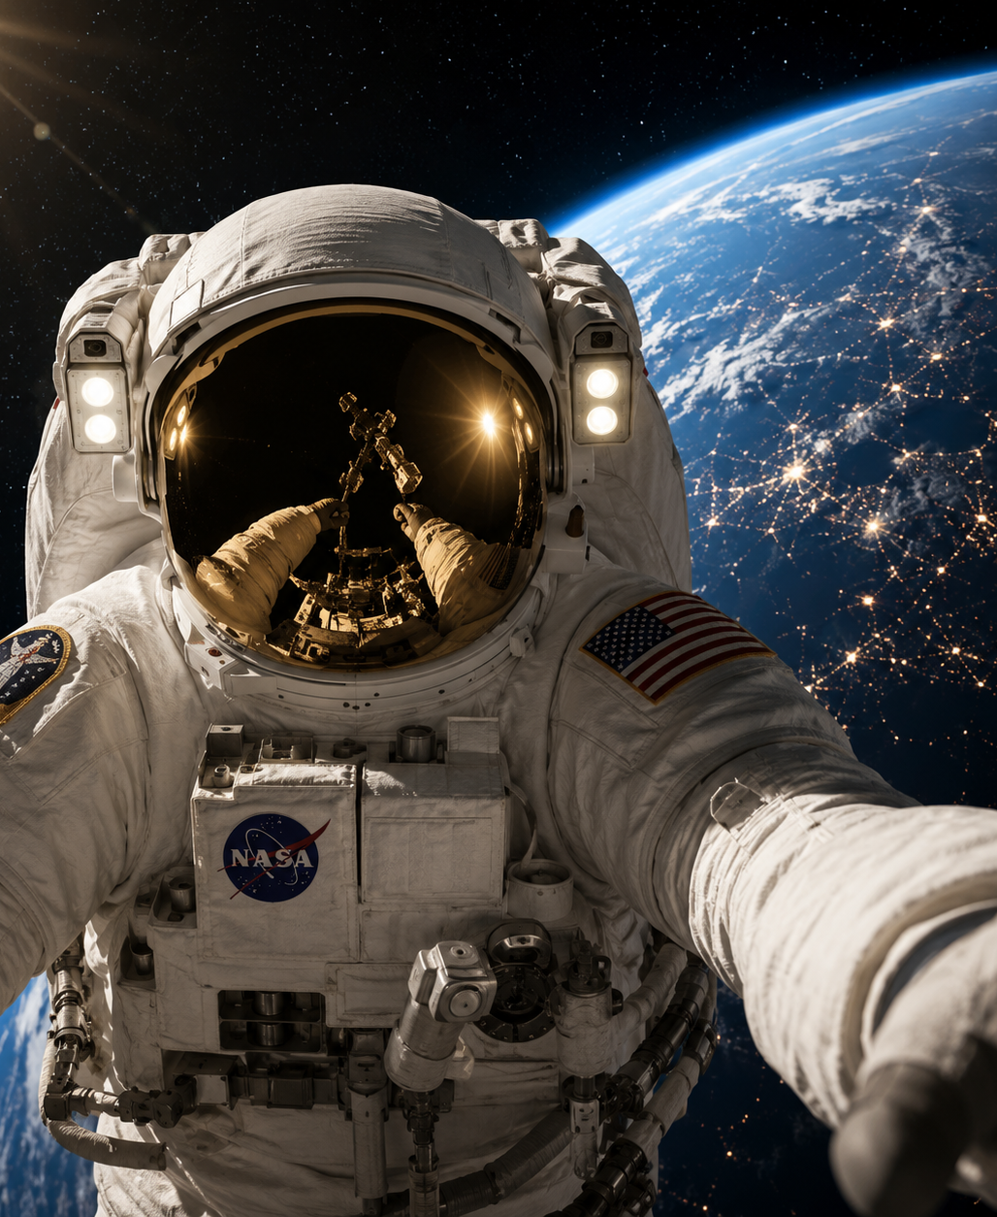
TUM HUMAN SPACEFLIGHT TECHNOLOGY
SPHERE
Thermal Insulation Laboratory
A classroom experiment linking transient heat transfer, physical testing and model validation
FINAL PROJECT PRESENTATION
Piyath Vithanage · Elio Krollpfeiffer
Dilan Fernando · Nuhansee Migelhewage
9 September 2026
Notes:
Suggested timing: 0:30
Open with the project purpose: SPHERE turns a spacesuit thermal-control challenge into a measurable classroom experiment. Introduce the four-person team and preview the link between theory, the physical test, and Mission Control.
Handoff cue: Pause for the next speaker or section when the final point lands.
Sources:
- README.md
- output/pdf/SPHERE_Thermal_Insulation_Project_Report_Updated.pdf

Slide 2
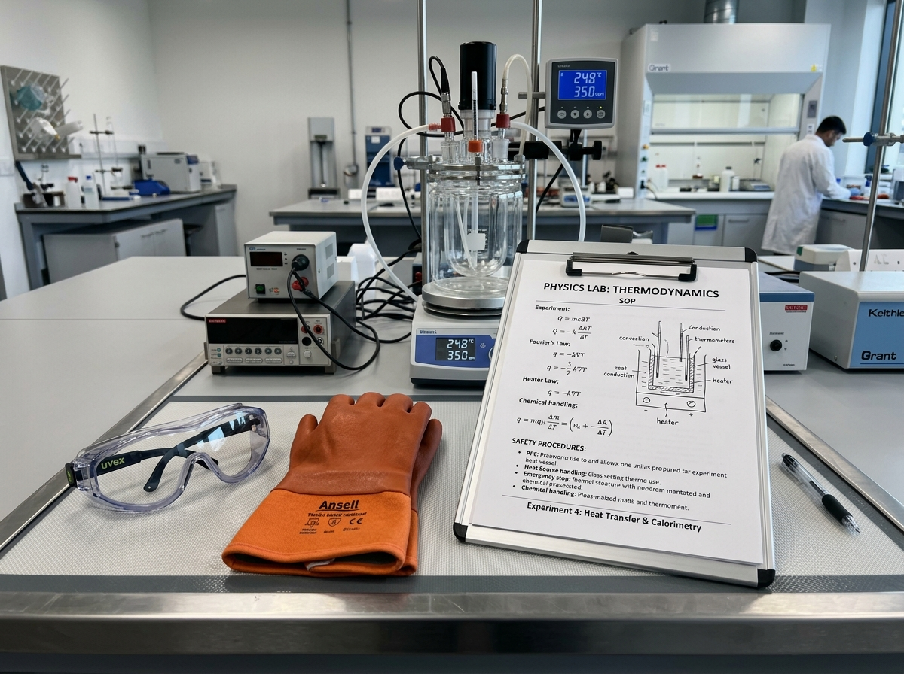
FINAL PRESENTATION
From spacesuit thermal control to a classroom experiment
THE ENGINEERING QUESTION
How do layered materials change the transient cooling of a protected thermal mass?
Warm water represents the protected thermal mass.
An ice-water bath supplies a repeatable cold boundary.
Four insulation builds create a controlled comparison.
Prediction and observation meet in the same workflow.
Analogy to spacecraft thermal control, not a vacuum simulation
SPHERE THERMAL INSULATION LABORATORY
02
Notes:
Suggested timing: 0:45
Frame the laboratory as an engineering analogy. The ice bath emphasizes conduction and convection, while a real spacesuit in vacuum relies heavily on radiation control and active thermal management. Avoid claiming that the setup reproduces space.
Handoff cue: Pause for the next speaker or section when the final point lands.
Sources:
- Engineering Project Report, Sections 1 and 2
- SPHERE Mission Control overview

Slide 3
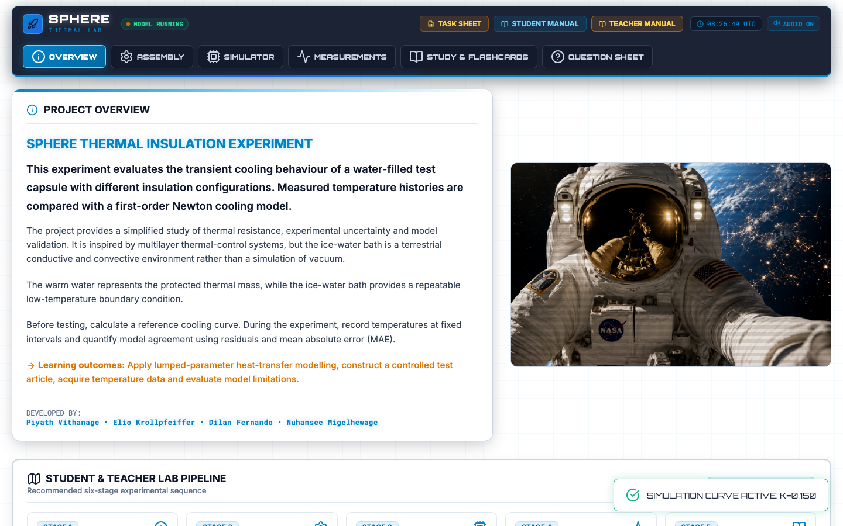
FINAL PRESENTATION
One project connects experiment, software and assessment
DELIVERABLE SUITE
Mission Control browser application
Student and teacher manuals
Illustrated experimental SOP
Two-page task sheet
Revision flashcards
Unified ten-question assessment
The same settings and terminology now appear across every learning resource.
SPHERE THERMAL INSULATION LABORATORY
03
Notes:
Suggested timing: 0:45
Explain that the strongest project outcome is integration. Students move from theory to assembly, prediction, measurement, analysis and assessment without changing tools or terminology.
Handoff cue: Pause for the next speaker or section when the final point lands.
Sources:
- README.md
- index.html
- student_manual.html
- teacher_manual.html

Slide 4
FINAL PRESENTATION
Learning objectives and classroom constraints
01
Heat-transfer mechanisms
Distinguish conduction, convection and radiation in the test system.
02
Newton cooling model
Interpret the effective cooling constant and calculate a reference curve.
03
Experimental evidence
Collect a controlled 16-point temperature history and plot it.
04
Model evaluation
Use residuals and MAE to explain agreement and uncertainty.
Class format
Four groups in parallel · 55–70 minutes · 15-minute measurement interval · Reusable hardware
SPHERE THERMAL INSULATION LABORATORY
04
Notes:
Suggested timing: 0:40
Connect each learning objective to an observable student action. The complete classroom run takes about 55 to 70 minutes, although the final presentation summarizes it in under 15 minutes.
Handoff cue: Pause for the next speaker or section when the final point lands.
Sources:
- README.md
- Engineering Project Report, Section 1

Slide 5
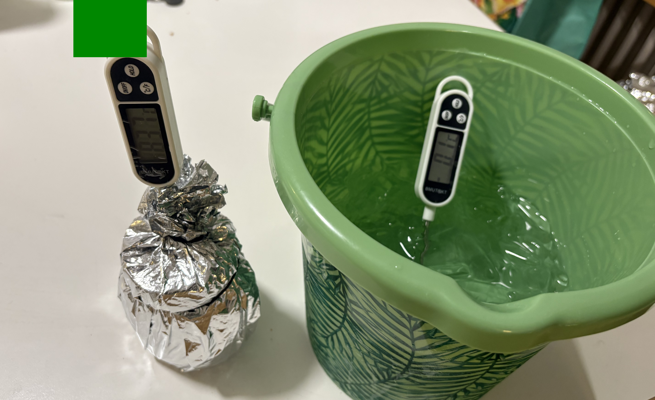
FINAL PRESENTATION
Experimental hardware and boundary conditions
VERIFIED SETTINGS
100 mL
wide-mouth glass thermal core
≈80 °C
initial water temperature; record actual T₀
Measured
ice-water bath temperature Tenv
1 minute
sampling from t = 0 through 15
Four matched cores allow parallel classroom testing
SPHERE THERMAL INSULATION LABORATORY
05
Notes:
Suggested timing: 0:45
Point out the separate bath probe, the centered core probe and the need for consistent immersion depth. The apparatus is deliberately simple, reusable and browser-independent at the sensing stage.
Handoff cue: Pause for the next speaker or section when the final point lands.
Sources:
- Engineering Project Report, Sections 3 and 10
- Thermal_Insulation_SOP.docx

Slide 6
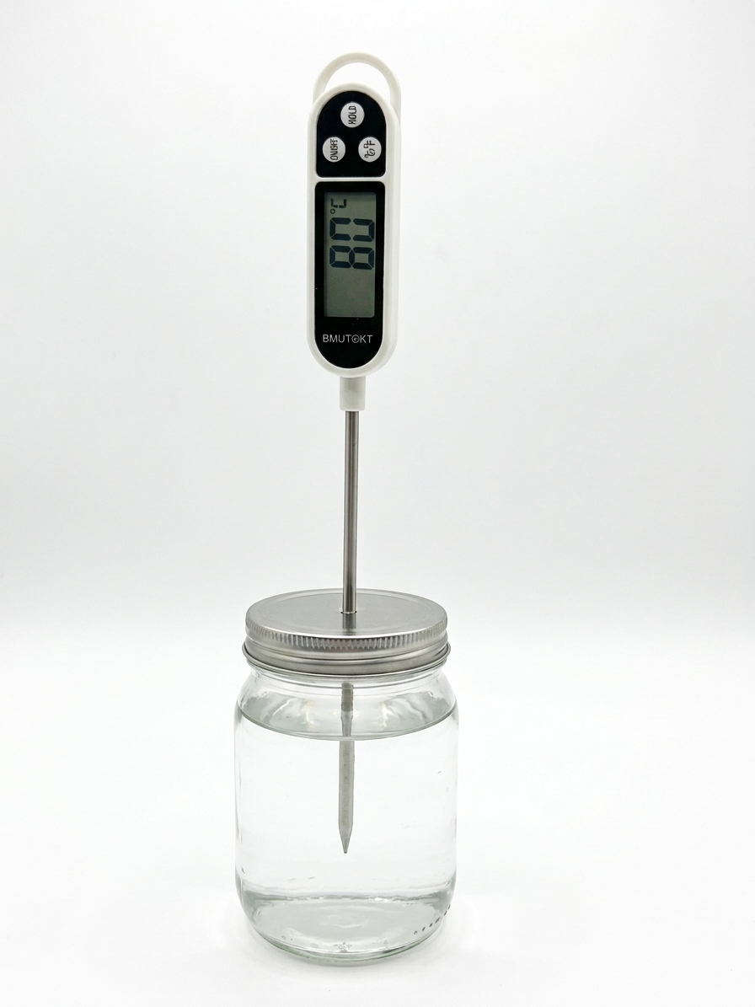
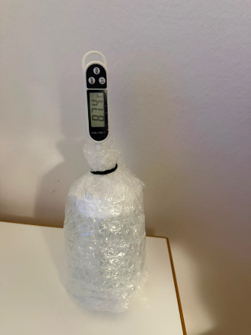
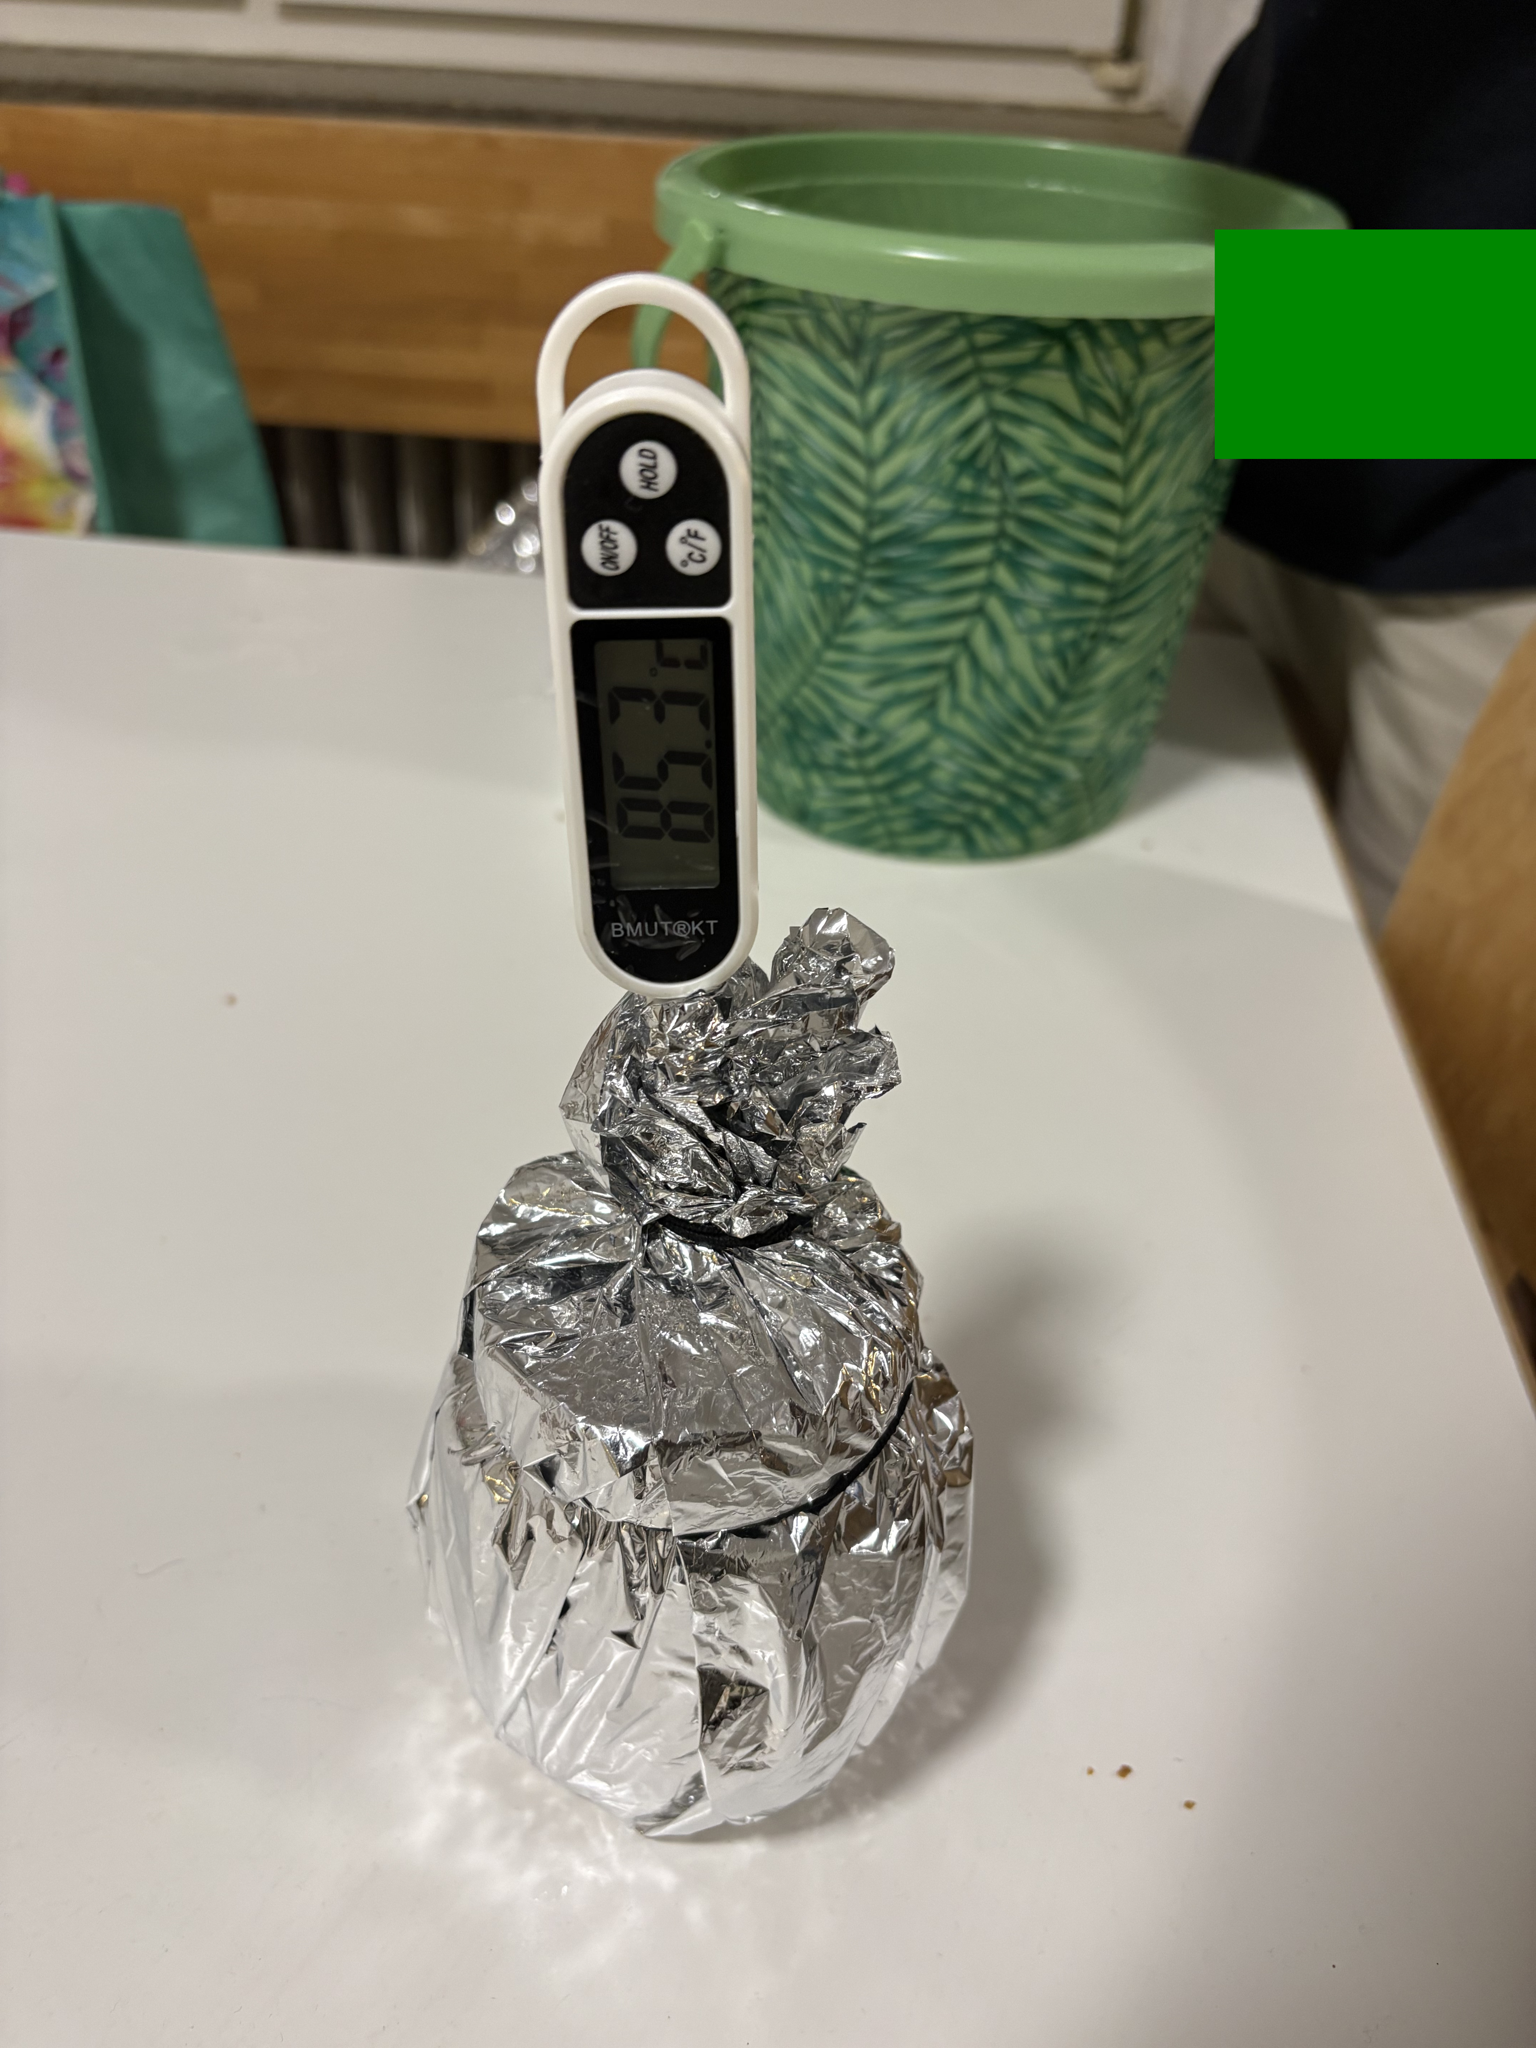
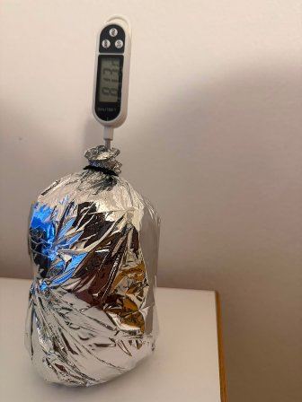
FINAL PRESENTATION
Four controlled insulation configurations
Bare control
Bubble wrap
Mylar only
Full MLI
k = 0.150 min⁻¹
k = 0.040 min⁻¹
k = 0.121 min⁻¹
k = 0.015 min⁻¹
Reference heat loss
Trapped air cells
Reflective layer
Cotton + bubble + Mylar
Reference coefficients are educational system settings, not material conductivities.
SPHERE THERMAL INSULATION LABORATORY
06
Notes:
Suggested timing: 0:50
Describe the physical construction and keep the distinction between effective system coefficient k and material thermal conductivity λ. The current verified Mylar setting is 0.121 min⁻¹.
Handoff cue: Pause for the next speaker or section when the final point lands.
Sources:
- app.js, modelConstants
- Student Manual, test configurations
- Engineering Project Report, Section 3

Slide 7
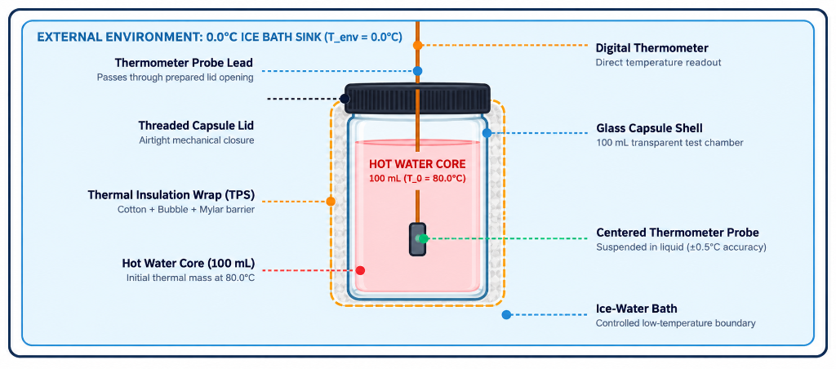
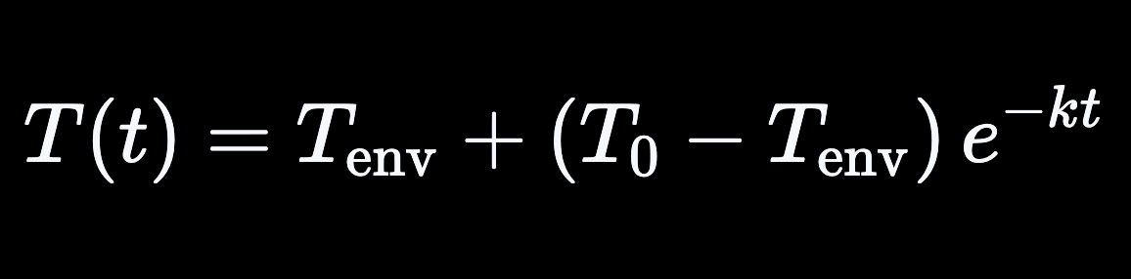
FINAL PRESENTATION
Thermodynamic framework
Newton cooling model
Smaller k means slower approach to the bath temperature
CONDUCTION
Direct contact through glass, water and solid layers
Cotton and interfaces add resistance
CONVECTION
Fluid movement in the bath and gaps
Sealed bubble cells restrict circulation
RADIATION
Infrared exchange between surfaces
Mylar reduces radiative exchange
SPHERE THERMAL INSULATION LABORATORY
07
Notes:
Suggested timing: 1:00
Explain the model as a lumped-parameter approximation. The effective k captures geometry, thermal mass, the boundary and every heat-loss path. It must not be presented as the thermal conductivity of cotton, bubble wrap or Mylar.
Handoff cue: Pause for the next speaker or section when the final point lands.
Sources:
- Engineering Project Report, Section 2
- README.md, Engineering model

Slide 8
FINAL PRESENTATION
Controlled method and safety-critical checks
01
PREPARE
02
CONDITION
03
MEASURE
04
ANALYSE
Measure Tenv, label conditions, leak-test the cores
Fill 100 mL near 80 °C and record the actual T₀
Immerse consistently and log one reading each minute
Compare curves, residuals, k and MAE
FAIR-TEST CONTROLS
Same jar geometry, water volume, probe depth and immersion location
MANDATORY SAFETY
Adult handling of water near 80 °C; never use boiling water
Same sampling interval and documented starting-temperature tolerance
Eye protection and heat-resistant gloves or tongs
Rank unequal starts by temperature drop, normalized retention or fitted k
Stable bath below waist height; electronics stay dry
Stop for leakage, probe movement or wet insulation
SPHERE THERMAL INSULATION LABORATORY
08
Notes:
Suggested timing: 1:00
Present safety as a design requirement. An adult handles hot water, every capsule is leak-tested, and only the metal probe enters water. Mention that the appendix contains the complete 12-step procedure.
Handoff cue: Pause for the next speaker or section when the final point lands.
Sources:
- Engineering Project Report, Sections 4 and 10
- Thermal Insulation SOP, Safety and Control Requirements

Slide 9
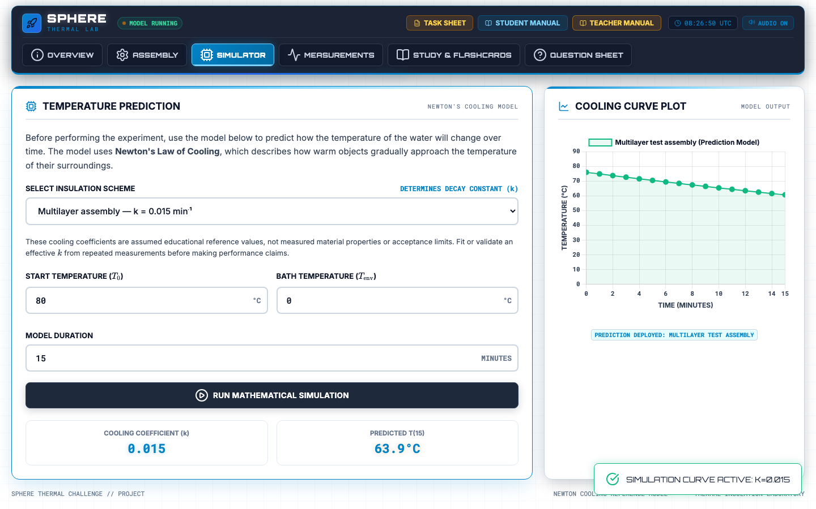
FINAL PRESENTATION
Mission Control links prediction with measurement
1
Select a configuration
Load its reference k value.
2
Set the boundary
Enter measured T₀ and Tenv.
3
Generate the prediction
Create a 0–15 minute cooling curve.
4
Enter observations
Overlay telemetry and calculate MAE.
Manual entry keeps the student involved in the act of measurement.
SPHERE THERMAL INSULATION LABORATORY
09
Notes:
Suggested timing: 0:50
Explain the closed loop. The website calculates the model but does not automate the thermometer. Students still observe and enter every value, then receive immediate visual and numerical feedback.
Handoff cue: Pause for the next speaker or section when the final point lands.
Sources:
- index.html
- app.js
- Engineering Project Report, Section 6

Slide 10
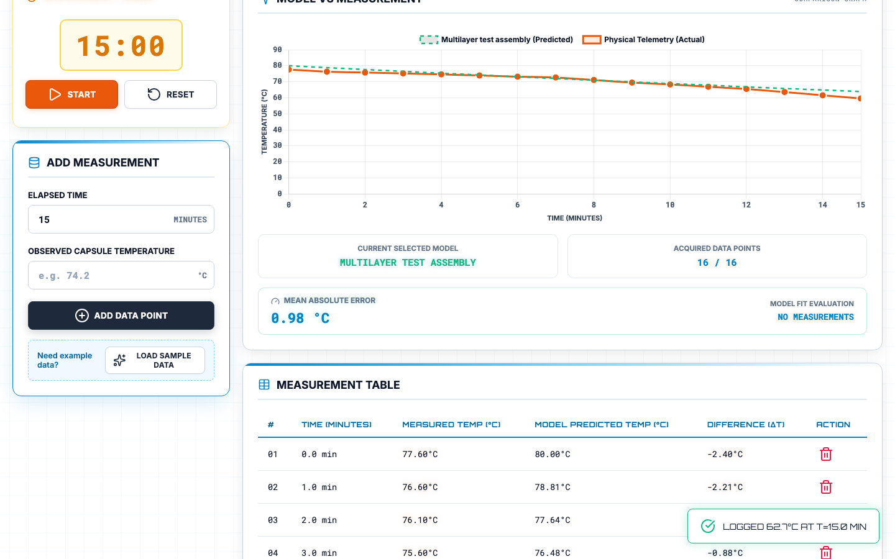
FINAL PRESENTATION
Live demonstration: prediction to evaluation
1
Choose Full MLI and confirm k = 0.015 min⁻¹
2
Run the 80 °C / 0 °C / 15 min prediction
3
Open Measurements and show the worked telemetry overlay
4
Read the 0.98 °C MAE and discuss one residual
If the browser or CDN assets fail, present these two verified screenshots and continue.
SPHERE THERMAL INSULATION LABORATORY
10
Notes:
Suggested timing: 2:00–3:00
DEMO SCRIPT
1. Open Simulator. Select Multilayer assembly. Confirm T₀ = 80 °C, Tenv = 0 °C and 15 minutes.
2. Run the model and point to T(15) = 63.9 °C.
3. Open Measurements. Load or show the supplied full-MLI series. Point to 16/16 points and MAE = 0.98 °C.
4. Explain that residuals change sign because the measured curve does not follow one perfect exponential.
Fallback: remain on this slide if Chart.js, KaTeX or web fonts do not load. The screenshots preserve the exact demonstration state.
Handoff cue: Pause for the next speaker or section when the final point lands.
Sources:
- SPHERE Mission Control local website
- Worked telemetry from Engineering Project Report, Section 8

Slide 11
FINAL PRESENTATION
Reference model separates the four expected cooling rates
MODEL T₁₅
Bare
8.4 °C
Bubble
43.9 °C
Mylar
13.0 °C
Full MLI
63.9 °C
Assumptions: T₀ = 80 °C and Tenv = 0 °C
SPHERE THERMAL INSULATION LABORATORY
11
Notes:
Suggested timing: 0:55
Use the chart to establish the expected ranking under one common starting point and boundary. State clearly that the coefficients are teaching references that require calibration for a new geometry or build.
Handoff cue: Pause for the next speaker or section when the final point lands.
Sources:
- app.js, modelConstants
- Engineering Project Report, Section 7

Slide 12
FINAL PRESENTATION
The worked example shows the full MLI retaining the most heat
Full MLI
14.9 °C drop
74.1% retained
Bubble
30.0 °C drop
52.1% retained
Bare
44.9 °C drop
25.3% retained
Mylar
47.2 °C drop
22.0% retained
Worked example only. Repeated measurements are required for validation.
SPHERE THERMAL INSULATION LABORATORY
12
Notes:
Suggested timing: 1:10
Compare temperature drop rather than final temperature alone because the four trials started at different values. The full MLI produced the smallest drop. Bubble wrap ranked second. The example is illustrative and does not replace repeated trials.
Handoff cue: Pause for the next speaker or section when the final point lands.
Sources:
- Engineering Project Report, Section 8
- Thermal Insulation SOP, complete observed series

Slide 13
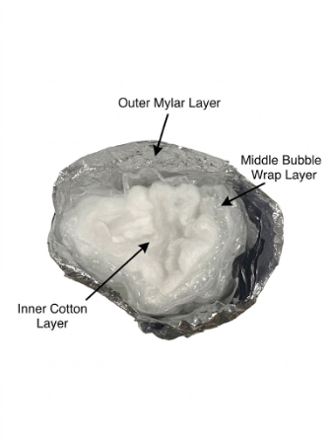
FINAL PRESENTATION
Boundary conditions explain the weak Mylar-only result
WHAT THE DATA SUPPORT
The layered package produced the smallest measured temperature drop.
Bubble wrap provided useful resistance through intact air cells.
The observed Mylar curve strongly disagreed with its reference model.
WHY MYLAR CAN FAIL HERE
Reflective foil targets infrared exchange, which matters strongly in vacuum.
Direct liquid contact and leakage can dominate the classroom water bath.
One weak run does not prove reflective insulation is ineffective in space.
Main uncertainties: probe position, neck seal, thermal stratification, bath warming, immersion depth and layer compression
SPHERE THERMAL INSULATION LABORATORY
13
Notes:
Suggested timing: 1:00
Use the Mylar result to demonstrate engineering interpretation. The correct conclusion concerns the boundary and construction, not a universal property of reflective insulation. Name two or three uncertainty sources and explain their direction of influence.
Handoff cue: Pause for the next speaker or section when the final point lands.
Sources:
- Engineering Project Report, Section 9

Slide 14
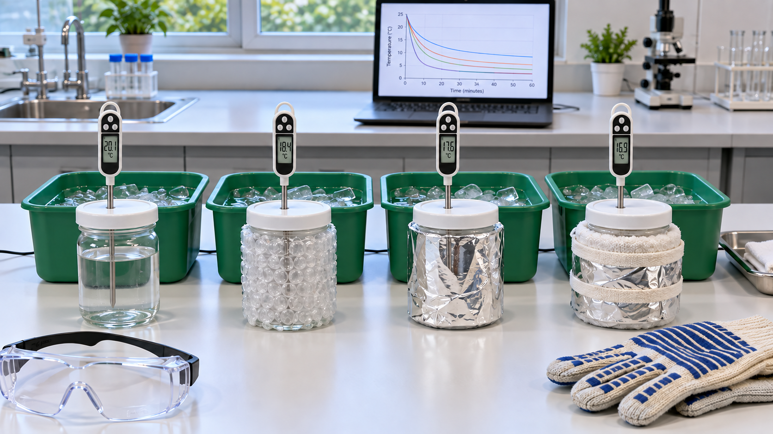
FINAL PRESENTATION
SPHERE delivers a complete theory-to-evidence learning loop
PROJECT OUTCOME
Students predict, build, measure and critique the same thermal system.
Aligned website, manuals, SOP, worksheet and assessment
Reusable apparatus with no native software installation
Clear separation between teaching models and measured evidence
CONTRIBUTIONS
Piyath Vithanage
Dilan Fernando
Website, integration, model and telemetry graphs, data visualisation
Thermodynamics, experiment, analysis, documentation and project integration
Elio Krollpfeiffer and Nuhansee Migelhewage remain listed as project team members in the current repository and learning materials.
SPHERE THERMAL INSULATION LABORATORY
14
Notes:
Suggested timing: 0:50
Close on the integration outcome. State the current contribution attribution exactly as documented. Invite questions on the experiment, model, website or classroom implementation.
Handoff cue: Pause for the next speaker or section when the final point lands.
Sources:
- Engineering Project Report, Sections 11 and 12
- README.md

Slide 15
APPENDIX
Appendix: complete apparatus list
Quantity | Item | Function
4 | 100 mL glass thermal cores | Comparable test vessels
4 + 1 | Digital probe thermometers | Core and bath measurements
1 | Bucket or deep container | Cold bath and secondary containment
1 set | Cotton, bubble wrap and Mylar | Four insulation configurations
As needed | Tape or elastic bands | Repeatable assembly without compression
1 set | Gloves or tongs, towels and timer | Safe handling, cleanup and timing
1 | Adult-controlled hot-water source | Prepare water near 80 °C
Per student | Task sheet or laboratory report | Hypothesis, raw data and evaluation
Exact cost depends on local sourcing. The older €35.20 estimate remains an unverified draft procurement figure.
SPHERE THERMAL INSULATION LABORATORY
15
Notes:
Suggested timing: Backup
Use this slide only if the audience asks about kit contents, reuse or feasibility.
Handoff cue: Pause for the next speaker or section when the final point lands.
Sources:
- Engineering Project Report, Section 10
- Thermal Insulation SOP, Hardware Checklist

Slide 16
APPENDIX
Appendix: 12-step operating procedure
01
Prepare a stable, dry work area.
07
Transfer with gloves or tongs; keep probe depth fixed.
02
Measure and record the bath temperature.
08
Start timing immediately and record T₀.
03
Label the four test conditions.
09
Record one temperature every minute through t = 15.
04
Build each package without compressing its layers.
10
Repeat with the same geometry, mass and method.
05
Prepare water near 80 °C under adult supervision.
11
Calculate drop, residuals, MAE and fitted k as required.
06
Condition the thermal core to 80 ± 2 °C.
12
Cool, dry and store all equipment safely.
SPHERE THERMAL INSULATION LABORATORY
16
Notes:
Suggested timing: Backup
This is the condensed presenter version of the complete SOP. Emphasize steps 5–7 when discussing hot-water handling.
Handoff cue: Pause for the next speaker or section when the final point lands.
Sources:
- Thermal_Insulation_SOP.docx
- Experimental_Toolkit_Thermal_Insulation_SOP_Illustrated.docx

Slide 17
APPENDIX
Appendix: complete observed temperature series
Time (min) | Full MLI (°C) | Bubble (°C) | Mylar (°C) | Bare (°C)
0 | 77.6 | 82.6 | 80.5 | 80.1
1 | 76.6 | 79.0 | 68.6 | 73.9
2 | 76.1 | 75.2 | 61.8 | 66.0
3 | 75.6 | 72.5 | 55.8 | 59.9
4 | 75.1 | 70.0 | 51.3 | 54.5
5 | 74.5 | 67.9 | 47.8 | 50.1
6 | 73.9 | 65.6 | 44.9 | 47.1
7 | 73.5 | 64.0 | 42.5 | 44.6
8 | 72.1 | 62.3 | 40.6 | 42.5
9 | 70.6 | 60.6 | 38.9 | 40.9
10 | 69.7 | 58.9 | 38.1 | 39.5
11 | 68.5 | 57.5 | 36.3 | 38.2
12 | 67.4 | 56.1 | 35.5 | 37.3
13 | 65.8 | 54.8 | 34.6 | 36.5
14 | 64.1 | 53.7 | 33.9 | 35.8
15 | 62.7 | 52.6 | 33.3 | 35.2
Notes:
Suggested timing: Backup
Use this slide to answer questions about individual readings or to verify the plotted series.
Handoff cue: Pause for the next speaker or section when the final point lands.
Sources:
- Engineering Project Report, Section 8
- Thermal Insulation SOP, Table 7

Slide 18


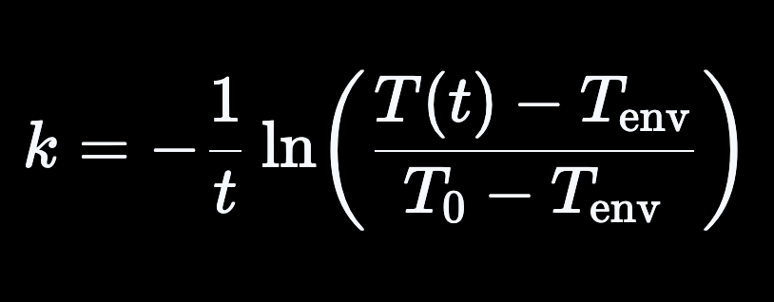
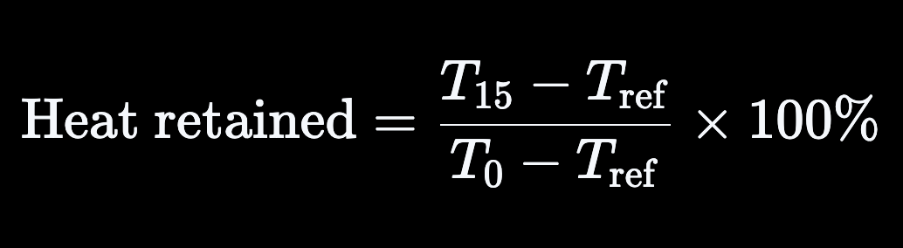
APPENDIX
Appendix: model agreement and fitted cooling constant
Residual at point i
Shows the signed difference at one timestamp
Mean absolute error
Summarizes the typical absolute temperature error
Fitted cooling constant
Valid only when the ratio is positive and the boundary is stable
Normalized heat retained
Supports comparison when starting temperatures differ
The Mission Control full-MLI screenshot uses the supplied 16-point series and reports MAE = 0.98 °C against the 80/0 °C reference curve.
SPHERE THERMAL INSULATION LABORATORY
18
Notes:
Suggested timing: Backup
Explain why MAE is easier to interpret than signed average error: positive and negative residuals cannot cancel. A fitted k is a system-level estimate for the tested boundary and geometry.
Handoff cue: Pause for the next speaker or section when the final point lands.
Sources:
- README.md
- Engineering Project Report, Section 9
- app.js, telemetry calculation

Slide 19
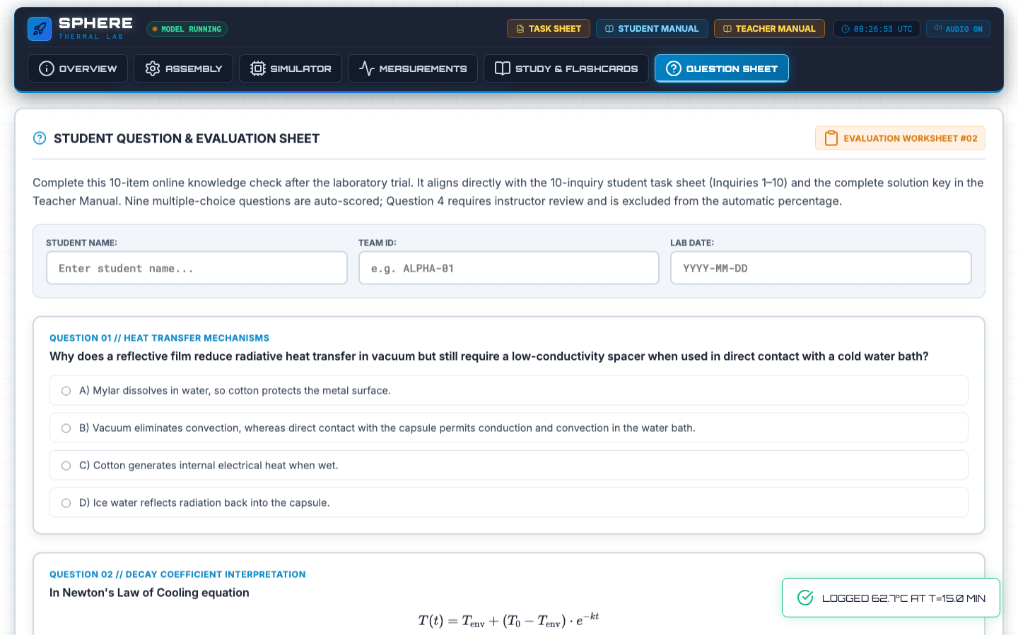
APPENDIX
Appendix: unified assessment and classroom guidance
TEN ALIGNED QUESTIONS
Student Task Sheet: Inquiries 1–10
Mission Control: Questions 1–10
Teacher Manual: complete solution key
Nine multiple-choice items auto-score online
Question 4 requires instructor review
Assessment focuses on mechanism, modelling, fair testing, uncertainty and spacesuit engineering trade-offs.
Safety disclosure: the activity does not certify materials for aerospace, pressure-vessel, fire-protection or personal-protective use.
SPHERE THERMAL INSULATION LABORATORY
19
Notes:
Suggested timing: Backup
Use this slide for questions about marking and learning verification. Question 4 remains open response because students must identify plausible physical causes of model deviation.
Handoff cue: Pause for the next speaker or section when the final point lands.
Sources:
- Teacher Manual, Assessment Guide
- index.html, Question Sheet
- README.md

