Slide 1
Listing Homes on the Blockchain
By Hunter Spence, Andre Montgomery, Nicholas Pamboukis

Slide 2
Introduction
Project
Design an application that can be used to buy and sell homes
Using python & blockchain technology
Able to view and create listings
Will execute transactions on the blockchain
Mission
Our goal is to provide a proof of concept demonstration on a payment solution for buying and selling houses using the blockchain. With our UI, users can view details of a house, then use their crypto wallet to transfer funds to the sellers address. In this solution, we use ETH.

Slide 3
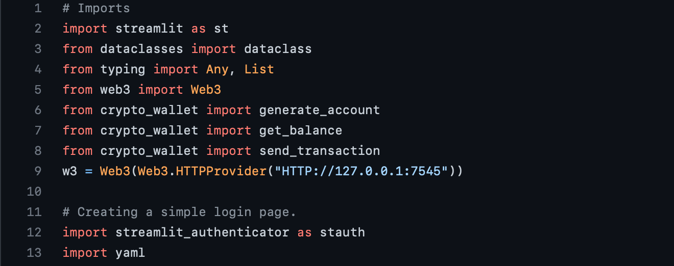
Project Files
Three Main Files
housing_streamlit.py
crypto_wallet.py
config.yaml
housing_streamlit.py
Footnotes:
Build a dApp
Created First during Development Phase
Useful for Ganache and back-testing preceding files

Slide 4
Goals for housing_streamlit.py
housing_streamlit.py
Successfully create a decentralized application (dApp) using Streamlit …
Purchase & Sell Homes
Images of listed homes
Displays the contract address and amount for each home
Efficient & Secure Payments w/ a validated transaction hash
Authenticate users’ login credentials
Important Files:
config.yaml: Storage for usernames and passwords for all accounts on dApps platform
crypto_wallet.py: Generate new accounts, authenticate purchases, and provide an easy-to-use user interface (UI)

Slide 5
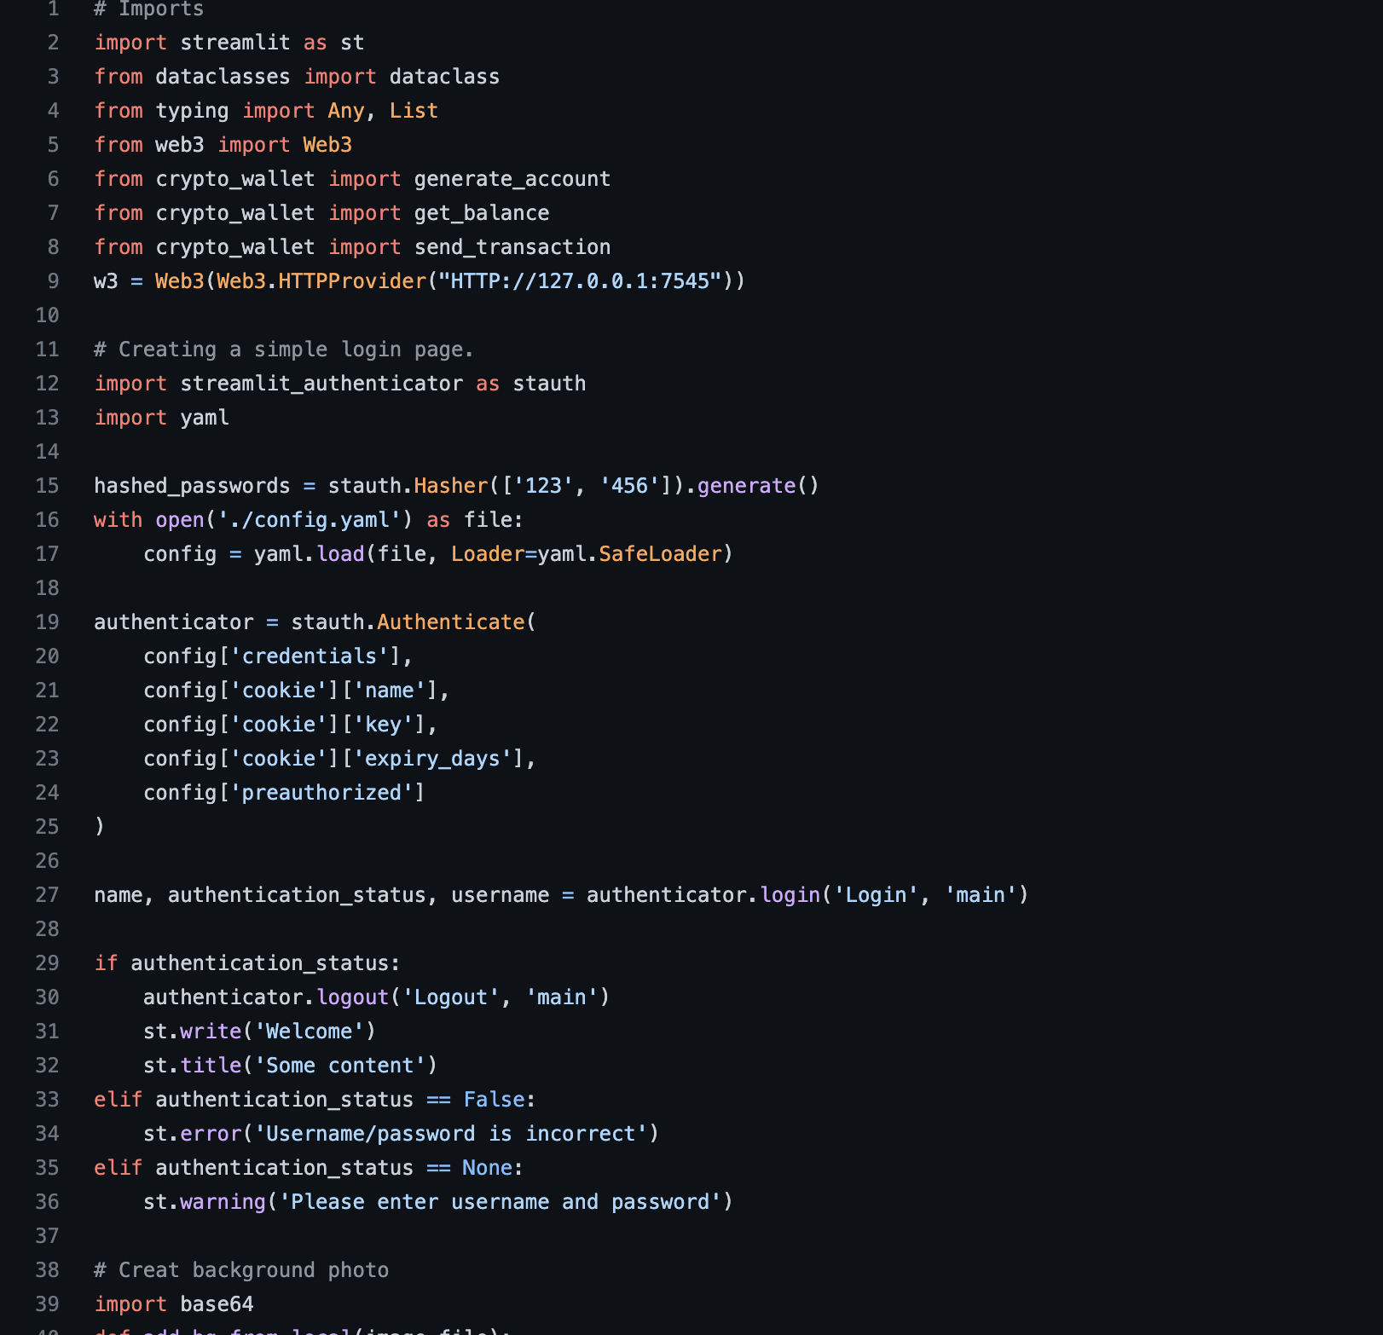
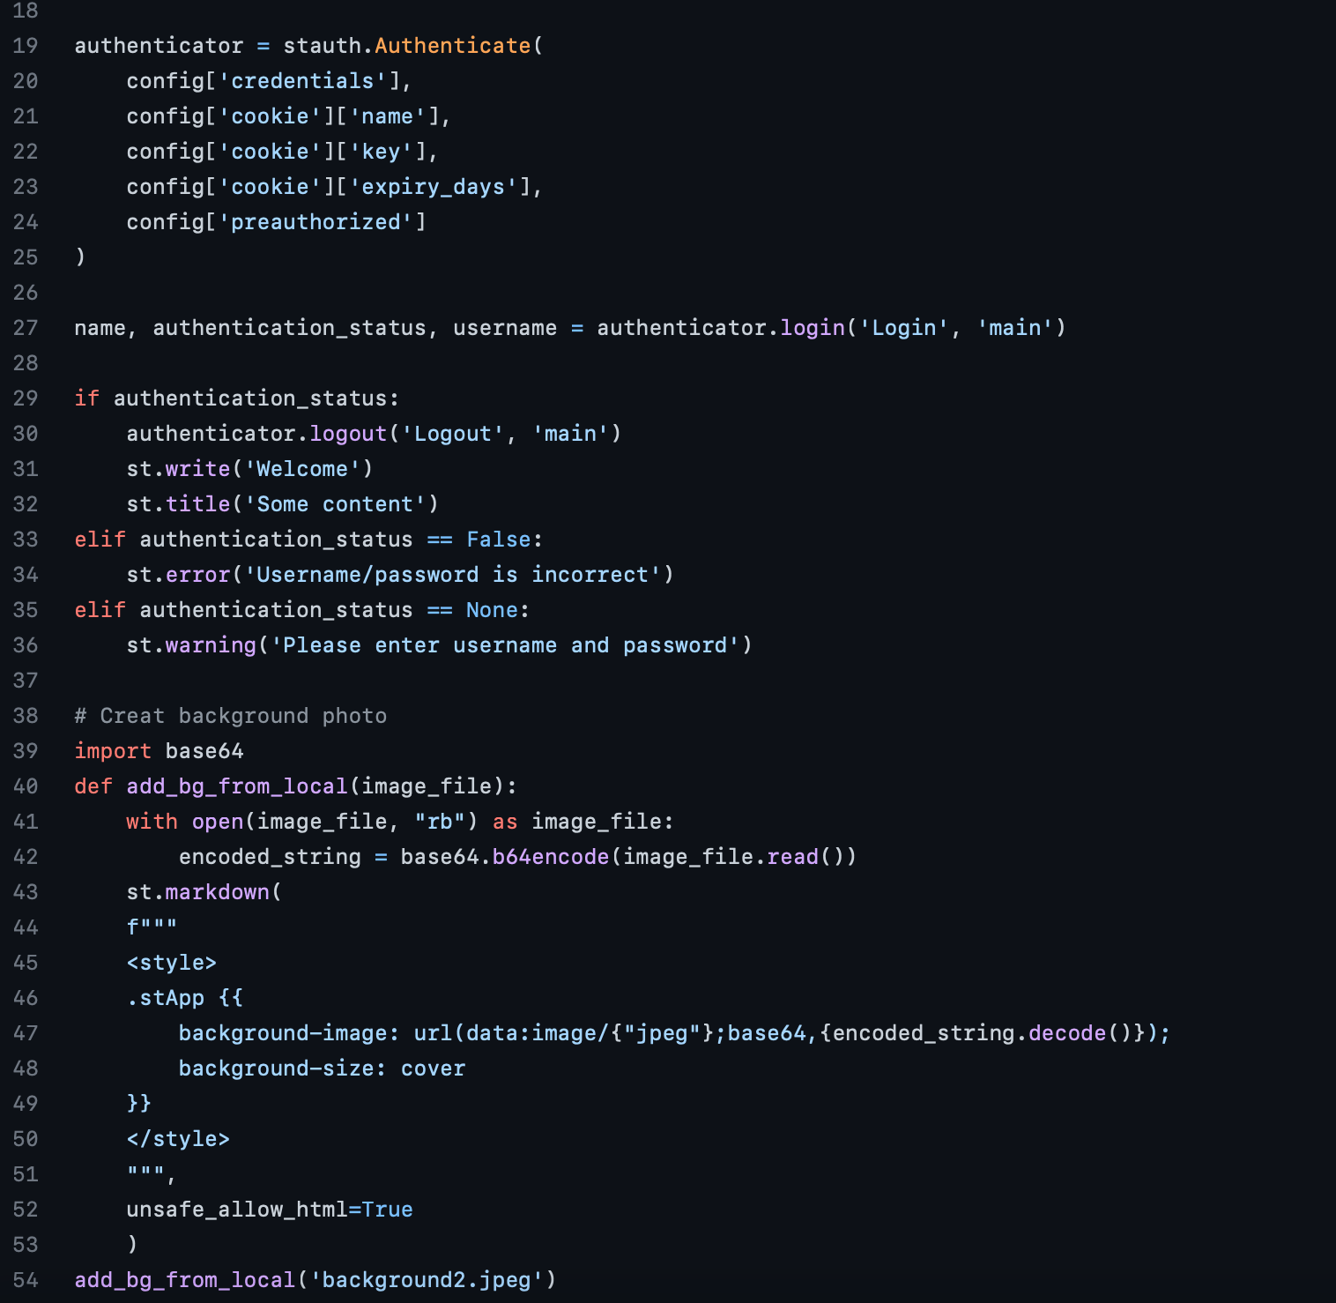
Partial Code for housing_streamlit.py

Slide 6
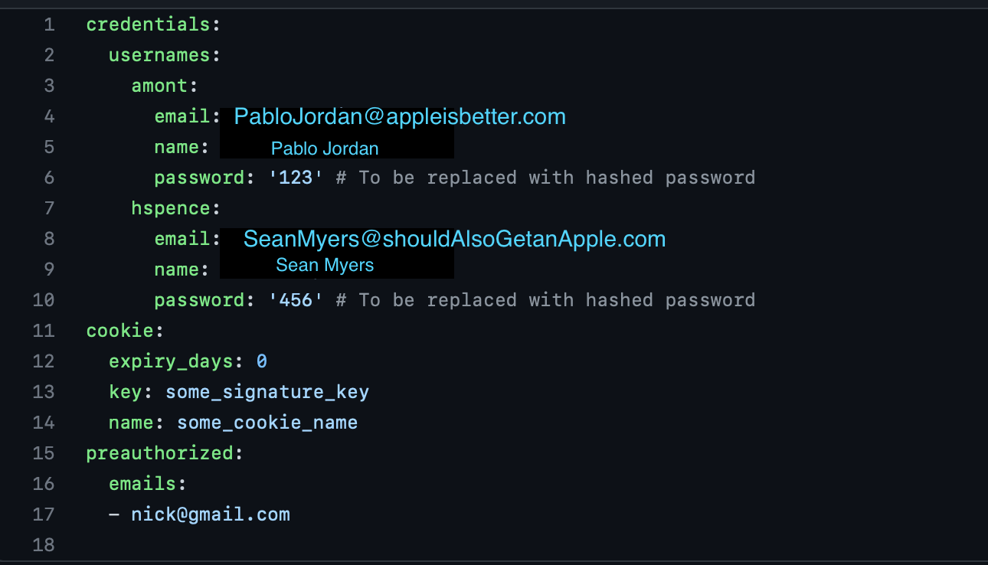
config.yaml
yaml.config
Simple enough… storage for a user’s super secret password to access the dApp !!

Slide 7

Goals for crypto_wallet.py
crypto_wallet.py
Generate Account:
Loads user’s dotenv() file for mnemonic phrase
Mnemonic phrase is unique to the user’s crypto wallet authentication keys
Gives functionality to User Interface:
get_balance: Converts user’s balance from wei to ether (eth)
send_transaction:
Automatically estimate and set gas price strategies for all executed transactions
Converts eth into wei: required for gas fees
Sends a signed transaction for user confirmation

Slide 8
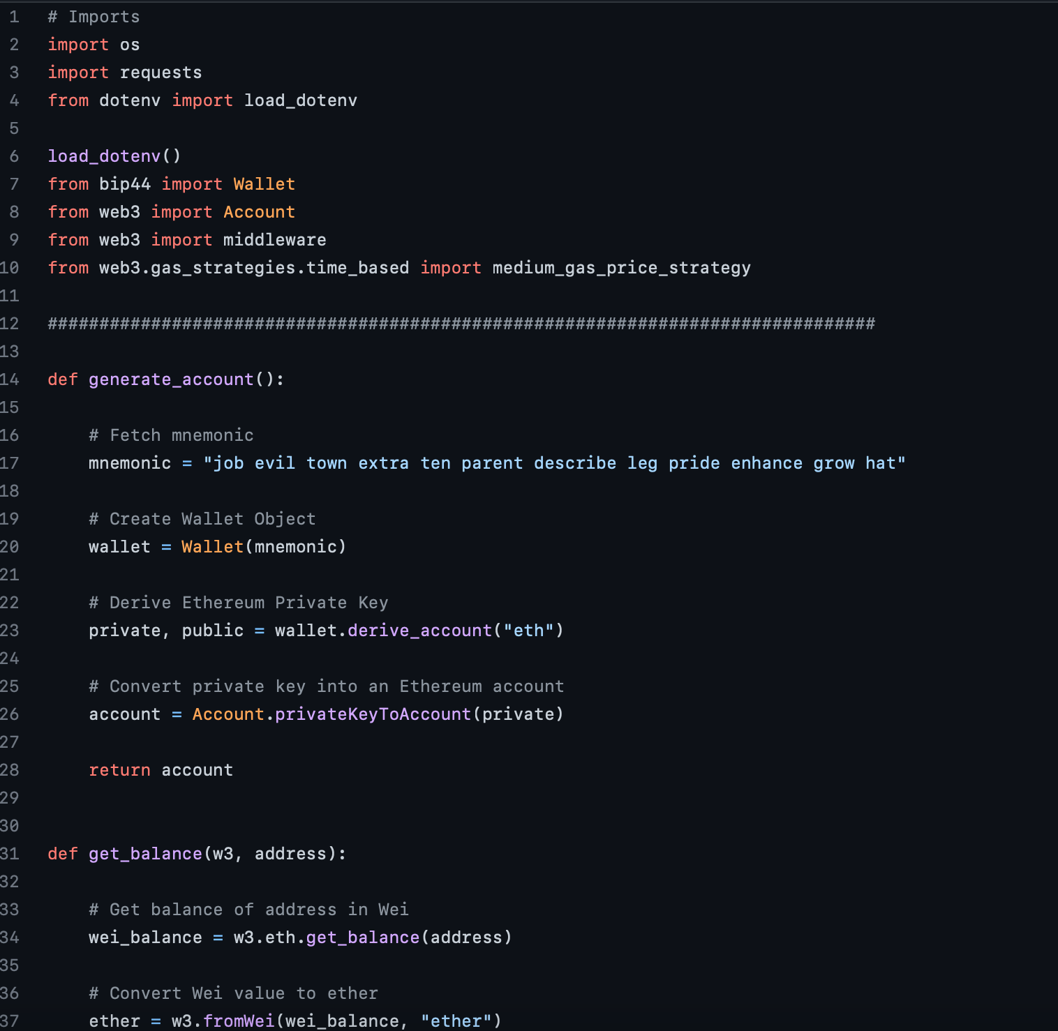
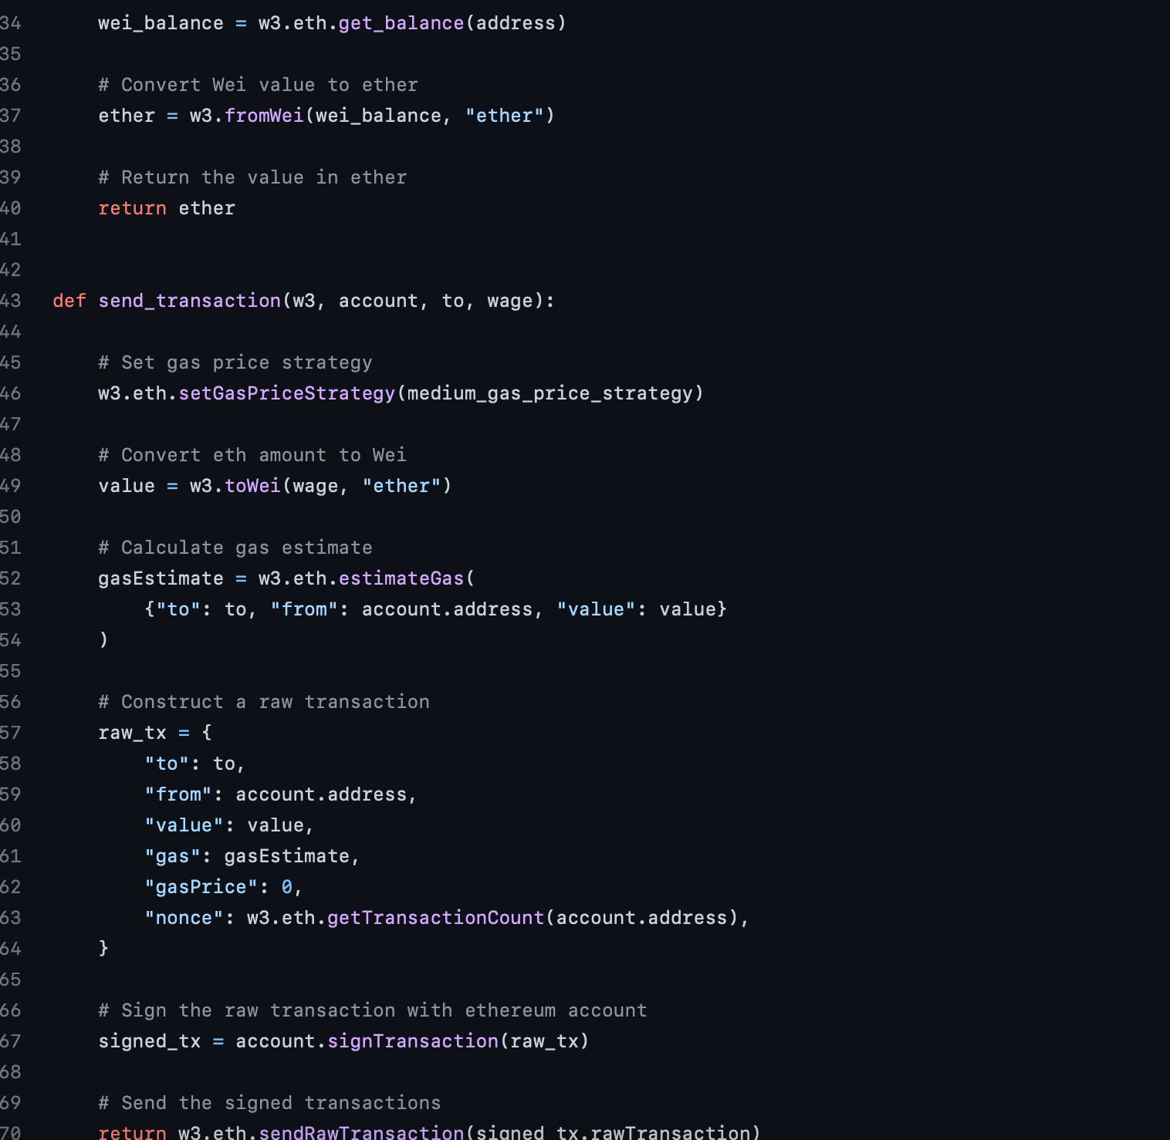
Code for crypto_wallet.py

Slide 9
Testing Transactions
Backtesting & Validating Results
Import functions into housing_stremlit.py (dApp)
Feed bogus passwords and wallet addresses to accurately receive error messages
After, correctly enter a user’s information for a successful send_transaction
Validate - User can visibly identify:
Account has been successfully created
Account balance is accurate with user’s current crypto wallet amount (eth)
Receive a signed transaction after a contract has been fulfilled

Slide 10
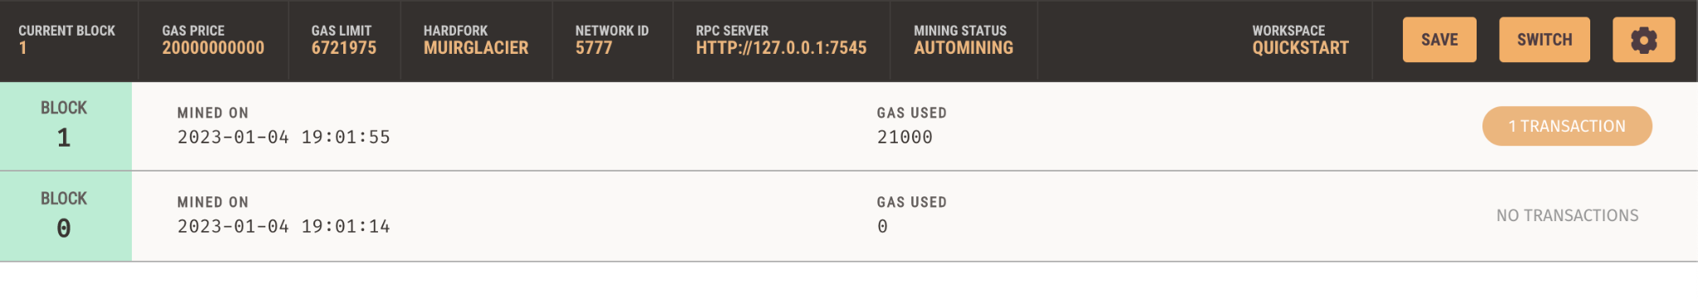
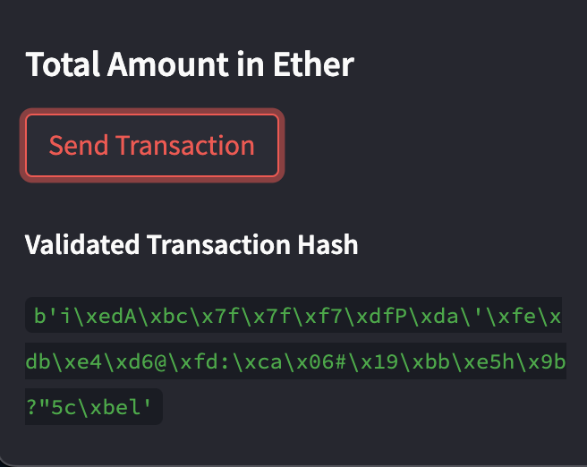
Validated Transaction ✓

Slide 11
Potential for the Future
Next Steps
Explore ways to create unique NFT art for individual listings
Possibility of Minting
Add an option for the homeowner to list and receive private mortgage loans
Professions such as Lien Specialist/ Officer and Private Mortgage Lenders then could also utilize the dApp
Change price to USD on streamlit, convert to ETH for transaction
Host the website on a cloud server
Add specific wallet configuration to streamlit
Add separate page, allowing users to create a listing

Slide 12
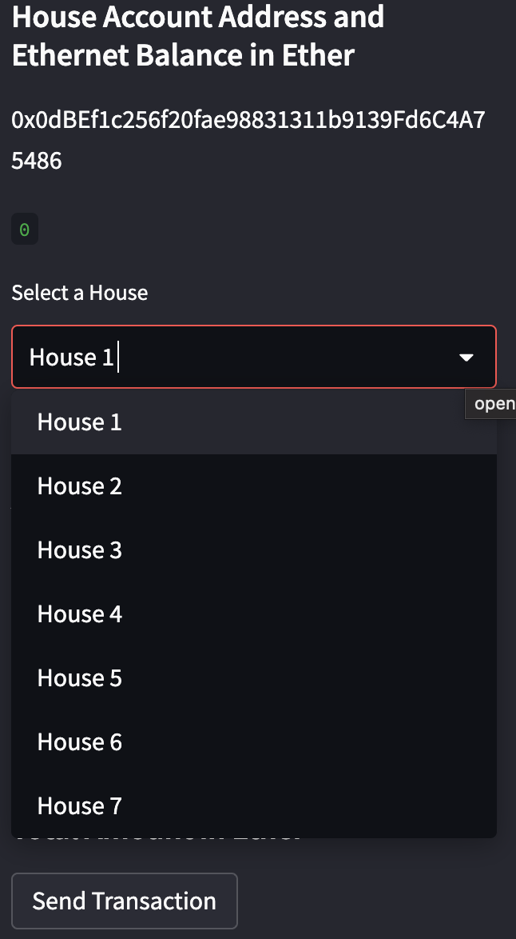
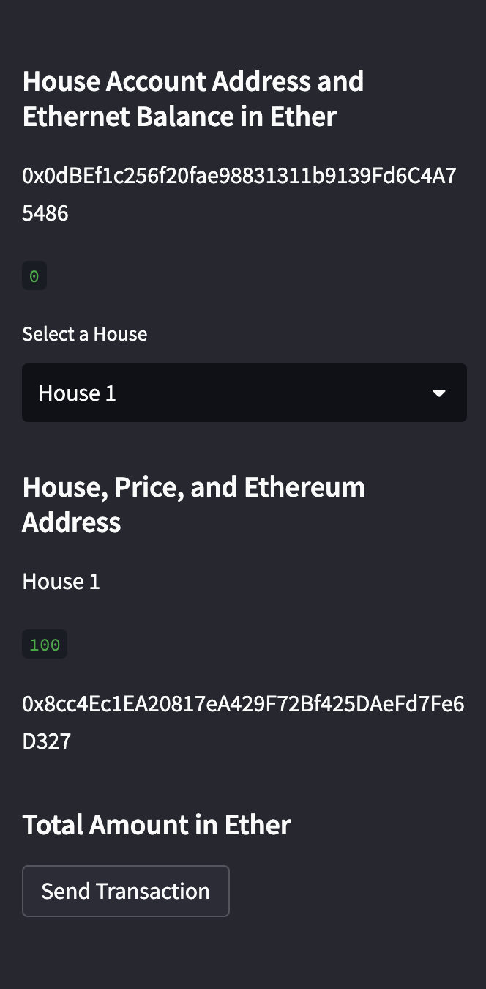
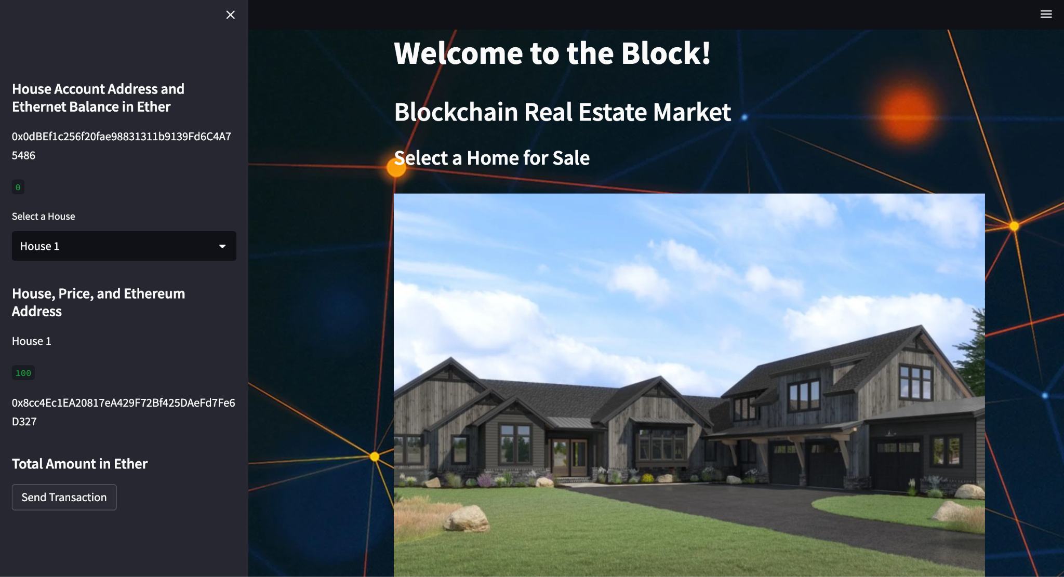
Pictures of dApp

Slide 13
Questions?

