Slide 1
NNFL Assignment 2
Group 13:
DHRUV PATIDAR 2018B4A80012G NEIL SHARMA 2018B2A80677G
Hrishikesh Pradhan 2018B4A80667G
Aishwarya Pratap singh 2018A1PS0085G

Slide 2
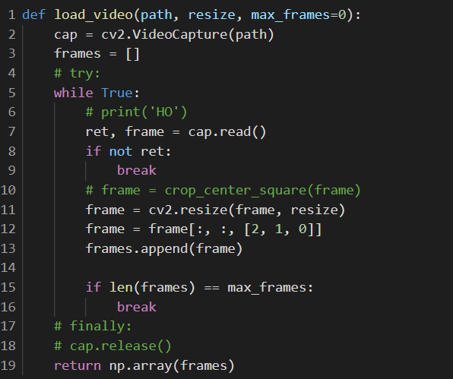
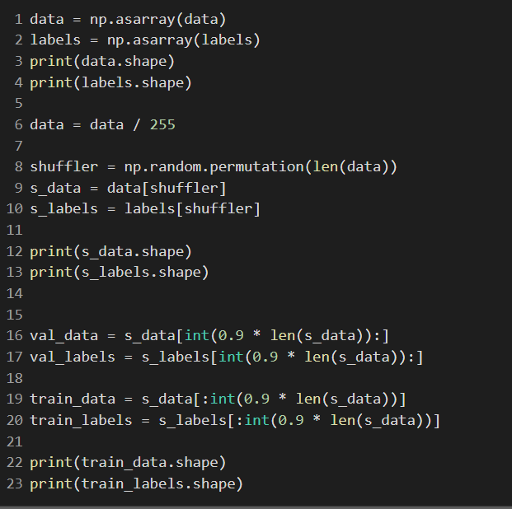
Data preprocessing
Sampling the first n frames of the video
n=20 frames was used
Cv2 was used to load the videos as frames of images, resized to (100, 100)
Finally, the pixel values was divided by 255 to make the range of pixel values between [0, 1]
Randomly shuffle the data and perform train-val-test split
Load and divide the values by 255
Train-val-test split

Slide 3
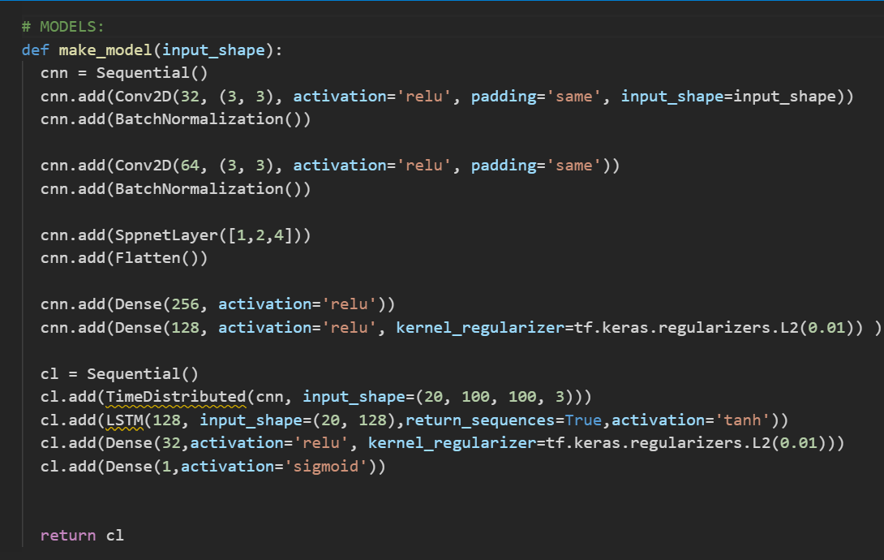
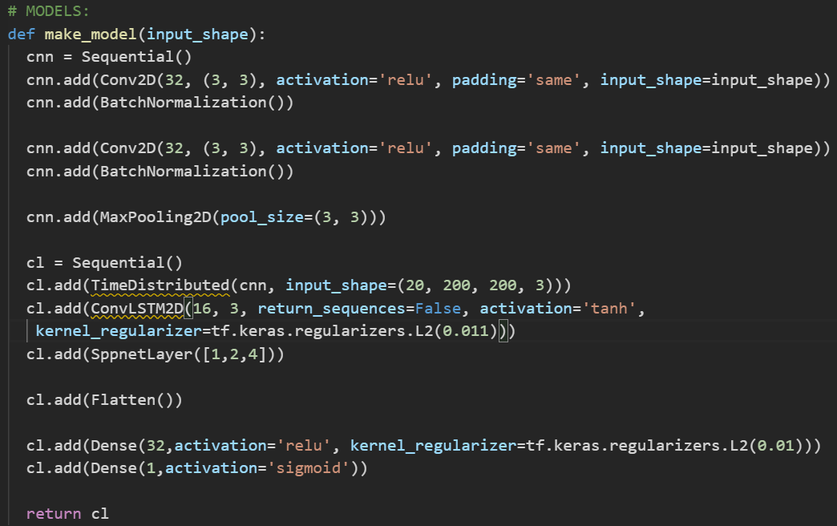
Architecture.
Model 1(left): 532,737 parameters
Model 2(right): 48,929 parameters.

Slide 4

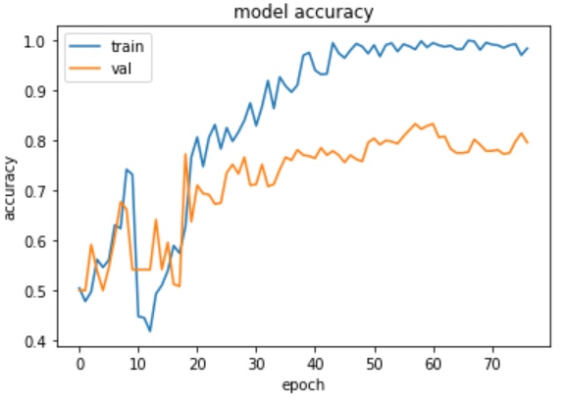
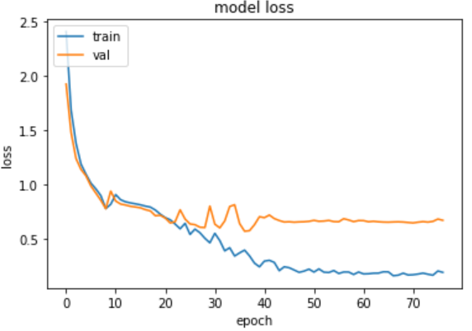
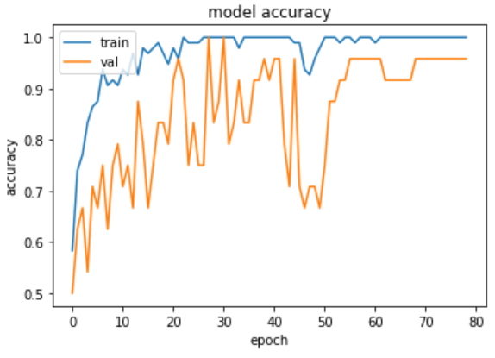
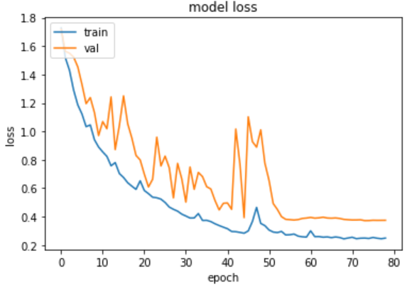
Training.
Optimizer: Adam (Model 1 and 2)
Learning rate: 1e-3 (Model 1 and 2)
Batch size: 2 for model 1, 8 for model 2 (bigger sizes were not permitted on Colab as they resulted in an out of memory error.)
Callbacks used: EarlyStopping, ReduceLROnPlateau (ModelCheckpoint gave errors.)
Epochs given: 100, however the EarlyStopping stopped around 75 for both.
Notebooks available on request.
Accuracy and loss graphs: Model 1 (left) and model 2(right)

Slide 5
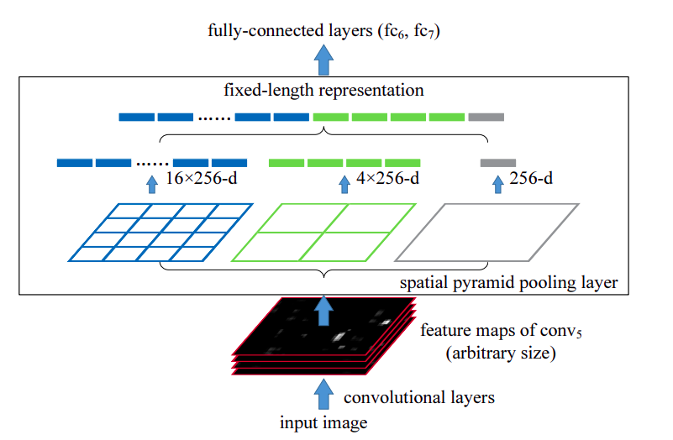
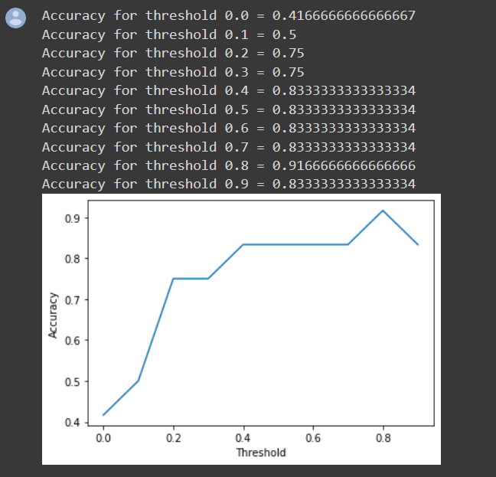
Extra highlights/conclusion
Model 1 had 10x the number of parameters to that of model 2, and also higher Val loss and lower test accuracy.
Model 1 had Convolutions + Dense followed by LSTM + Dense. It was made with the intuition that CNN + Dense gives features and LSTM uses those as context to further give better results.
Model 2 had Convolutions + ConvLSTM + Dense. It was made with the intuition that ConvLSTM gives out features using the context.
To tackle the problem of variable size of fire, both models have used SPP(Spatial Pyramid Pooling) layer. The intuition is given at the right. Paper’s Link: https://arxiv.org/abs/1406.4729
Optimal threshold for making a decision from the probabilities was done by grid search of thresholds on the holdout val set

