Slide 1

Hierarchical Attention Transfer Network for Cross-domain Sentiment Classification
Zheng Li, Ying Wei, Yu Zhang, Qiang Yang
Hong Kong University of Science and Technology
Notes:
Good morning, everyone. My name is Zheng Li, a PhD student from Hong Kong University of Science and Technology. Today, I will present my paper named Hierarchical Attention Transfer Network for Cross-domain Sentiment Classification.

Slide 2


Cross-Domain Sentiment classification
Testing data
Training data
Books
Books
84%
Sentiment Classifier
Restaurant
Challenges of Domain Adaptation:
-Domain discrepancy
76%
Notes:
As we all know, Deep learning methods that require a large amount of labeled data have been successfully to build sentiment classifiers for a specific domain. For example, if we train a convolution neural network on Books domain data and test on the same domain data, we can achieve a relatively high accuracy of 84%.
But If the training and testing data belongs to different domains like Books and restaurant respectively, the accuracy would drop to 76%.
This is because that the expression of users’emotions usually varies across domains. Due to the domain discrepancy, a sentiment classifier trained in a source domain may not work well when directly applied to a target domain.

Slide 3


Motivation
sent | Books (source domain) | Restaurant (target domain) | sent
 | Great books. His characters are engaging. | The food is great, and the drinks are tasty and delicious.
 | It is a very nice and sobering novel. | The food is very nice and tasty, and we’ll go back again.
 | A awful book and it is a little boring. | Shame on this place for the rude staff and awful food.
Pivots(domain-shared sentiment words):
great, wonderful, awful
Useful for target domain
It is important to identify these pivots.
Notes:
Let’s see a more detailed example. There are three reviews in each domains. The thumb up and down mean positive and negative sentiment respectively.
We can see that the pink words appear in both domains. We usually call these domain-shared sentiment words like great, nice awful as pivots.
It is important to recognize them because they contribute more to the domain-invariant representations.

Slide 4
Motivation
sent | Books (source domain) | Restaurant (target domain) | sent
 | Great books. His characters are engaging. | The food is great, and the drinks are tasty and delicious.
 | It is a very nice and sobering novel. | The food is very nice and tasty, and we’ll go back again.
 | A awful book and it is a little boring. | Shame on this place for the rude staff and awful food.
Non-Pivots(domain-specific sentiment words):
source domain: engaging, sobering…
target domain: delicious, tasty…
It is necessary to align non-pivots when there exists large discrepancy between
domains (few overlapping pivot features).
Notes:
Besides, there are also domain-specific sentiment words called non-pivots, which usually occur in their corresponding domain. Like engaging ,boring in the books domain, tasty, delicious, rude in the restaurant domain.
if we train a model on the book domain, it would be hard to recognize these restaurant-specific sentiment words as important sentiment features.
So it is necessary to align non-pivots.

Slide 5
Motivation
+ positive
- negative
Whether can we transfer attentions for emotions across domain?
domain-shared emotions (automatically identify the pivots)
domain-specific emotions (automatically align the non-pivots)
Source A
Target B
Attention Transfer
+ pivots
great nice
+ pivots
great nice
- pivots
awful
awful
- pivots
+ non-pivots
engaging sobering
tasty delicious
+ non-pivots
- non-pivots
boring
shame rude
- non-pivots
Notes:
Based on this observation, we would like our model can transfer attention for emotions across domain, that is to say when doing cross-domain sentiment classification from domain A to domain B, the model can automatically identify the pivots and at the same time align the non-pivots across domains,

Slide 6




Motivation
+ positive
- negative
How to transfer attention for domain-specific emotions without any target labeled data?
Source A
Attention Transfer
Target B
Correlation $θ$
Correlation$θ$
+ non-pivots
+ pivots
engaging sobering
great nice
tasty delicious
+ non-pivots
- non-pivots
Correlation $θ$
boring
awful
Correlation $θ$
shame rude
- non-pivots
- pivots
Notes:
But without any target labeled data, how to recognize and align the target non-pivots? Actually, we can see positive non-pivots tend to co-occur with positive pivots and negative non-pivots tend to co-occur with negative pivots.
Therefore we can find the correlation mapping $θ$between non-pivots and pivots using their co-occurrence information. In a word, we can realize transferring attention for source non-pivots to target non-pivots by using pivots as a bridge.

Slide 7
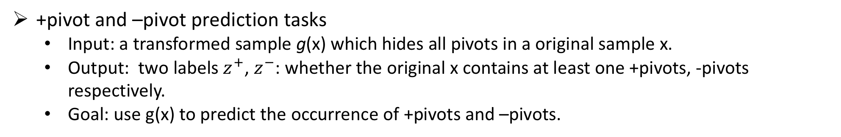
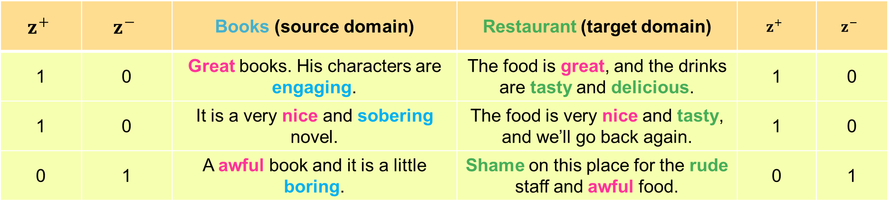
Motivation
+ positive
- negative
+pivot and –pivot prediction tasks
Input: a transformed sample g(x) which hides all pivots in a original sample x.
Output: two labels $z^{+}$, $z^{−}$: whether the original x contains at least one +pivots, -pivots respectively.
Goal: use g(x) to predict the occurrence of +pivots and –pivots.
$$z^{+}$$ | $$z^{−}$$ | Books (source domain) | Restaurant (target domain) | $$z^{+}$$ | $$z^{−}$$
1 | 0 | Great books. His characters are engaging. | The food is great, and the drinks are tasty and delicious. | 1 | 0
1 | 0 | It is a very nice and sobering novel. | The food is very nice and tasty, and we’ll go back again. | 1 | 0
0 | 1 | A awful book and it is a little boring. | Shame on this place for the rude staff and awful food. | 0 | 1
Notes:
We can model the correlations between pivots and non-pivots by two tasks, name positive pivot prediction task and negative prediction task.
For example, the original sample x is “Great books. His characters are engaging” x contains one positive pivot ‘great’, which is more likely to be overall positive. Meanwhile, the rest of x excluding the “great”is the transformed sample and may contain non-pivots, say “engaging” here, which also convey positive sentiment and highly correlate with the pivot “great”.
Thus, we can discover the non-pivots by hiding pivots in the original sample and using other words to predict whether the original sample contains at least one positive (negative) pivot.

Slide 8







Hierarchical Attention Transfer Network (HATN)
HATN consists of two hierarchical attention networks:
P-net: automatically identify the pivots.
NP-net: automatically align the non-pivots.
P-net
Sentence representation
Document representation
The book is great
It is very readable
Task2: Domain Classification
∑
Word Attention Layer
∑
Sentence Attention Layer
Gradient Reversal Layer
Softmax
a review $x$
Context vector $q_{w}$
Context vector $q_{s}$
Task1: Sentiment classification
Input Layer
Word Embedding Layer
Word
Positional Encoding
Sentence
Positional Encoding
Softmax
+pivot list
-pivot list
NP-net
great
good
….
awful
bad
….
Sentence representation
Document representation
Word Attention Layer
Sentence Attention Layer
Softmax
Task3: +pivot prediction
The book is ***
It is very readable
∑
∑
Softmax
Task4: -pivot prediction
a review hiding pivots $g\left(x\right)$
Context vector $q_{w}^{′}$
Context vector $q_{s}^{′}$
Notes:
Based on this motivation, we propose a hierarchical attention transfer network for cross-domain sentiment classification.
The model consists of two hierarchical attention. As illustrated in Figure, the first network is named Pnet, which aims to identify the pivots such as great in a sample x. The second network is named NP-net which is used to capture the non-pivots across domains such as readable in a transformed sample g(x). We realize the ‘hide all the pivots’ by replacing thenm with padding words and masking.

Slide 9
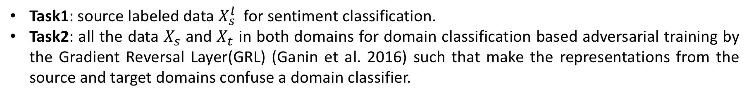



P-net
P-net aims to identify the pivots, which have two attributes:
They are important sentiment words for sentiment classification.
They are shared by both domains.
In order to achieve this goal,
Task1: source labeled data $X_{s}^{l}$ for sentiment classification.
Task2: all the data $X_{s}$ and $X_{t}$ in both domains for domain classification based adversarial training by the Gradient Reversal Layer(GRL) (Ganin et al. 2016) such that make the representations from the source and target domains confuse a domain classifier.
HAN
$X_{s}^{l}$
Task1: Sentiment classification
$$X_{s}$$
$$X_{t}$$
Task2: Adversarial Domain Classification
The sketch of the P-net
Notes:
The goal of the P-net is to identify the pivots, which have two attributes, 1. They are important sentiment words for sentiment classification. 2.They are shared by both domains. In order to achieve this goal, the P-net is jointly guided by task1 and task2. The tasks1 is using source labeled data for sentiment classification. The tasks2 is using all data
in this way it guarantees representations from the P-net are both domain-shared and useful for sentiment classification, and can identity the pivots with the attention mechanism.

Slide 10



NP-net
NP-net aims to align the non-pivots with two characteristics:
They are the useful sentiment words for sentiment classification.
They are domain-specific words.
To reach the goal
Task1: the source transformed labeled data ${g(X}_{s}^{l})$ for sentiment classification.
Task3 & 4: all transformed data $g(X_{s})$ and $g(X_{t})$in both domains for +/- pivot predictions.
HAN
$g(X_{s}^{l})$
Task1: Sentiment classification
$$g(X_{s})$$
$$g(X_{t})$$
Task3: +pivot prediction
Task4: -pivot prediction
The sketch of the NP-net
Notes:
The goal of the NP-net aims to align the non-pivots, which have two characteristics, 1. They are useful sentiment words for sentiment classification. 2.They are domain-specific words.
To reach the goal, NP-net is jointly learned by three tasks. For task1,
In this way, NP-net can discover domain-specific features with the pivots as a bridge and capture the non-pivots that are expected to correlate closely to the pivots with the attention mechanism.

Slide 11




Multi-task Learning for Attention Transfer
P-net
automatically identify the domain-invariant features (pivots) with attention instead of manual selection.
$$x_{S}$$
$$x_{T}$$
engaging sobering
great nice
tasty delicious
boring
bad awful
shame rude
NP-net
automatically capture the domain-specific features (non-pivots) with attention.
build the bridges between non-pivots and pivots using their co-occurrence information and project non-pivots into the domain-invariant feature space.
$$θ$$
$$θ$$
Notes:
Actually, our model make use of multi-task learning to achieve attention transfer cross-domains.
The P-net is responsible for ...
The NP-net

Slide 12
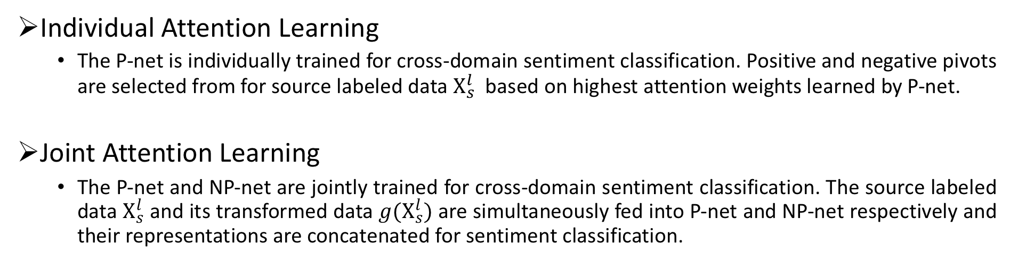
Training Process
Individual Attention Learning
The P-net is individually trained for cross-domain sentiment classification. Positive and negative pivots are selected from for source labeled data $X_{s}^{l}$ based on highest attention weights learned by P-net.
Joint Attention Learning
The P-net and NP-net are jointly trained for cross-domain sentiment classification. The source labeled data $X_{s}^{l}$ and its transformed data ${g(X}_{s}^{l})$ are simultaneously fed into P-net and NP-net respectively and their representations are concatenated for sentiment classification.
Notes:
Note that the NP-net needs the positive and negative pivots to build the bridge across domains. Different from traditional methods that need to manually select pivots, the P-net possesses the ability of automatically finding the pivots. Therefore, our training process consists of two stages.
Firstly, P-net is conduct individual Attention learning for cross-domain sentiment classification. We use the best parameters for P-net with early stopping on the validation set, Positive and negative pivots are selected from for source labeled data based on highest attention weights learned by P-net.
Secondly, we

Slide 13


Hierarchical Attention Network (HAN)
Hierarchical Attention Network:
Hierarchical content attention
Word attention
Sentence attention
Hierarchical position attention
HAN
Sentence representation
Document representation
The food is great
The drinks are delicious
∑
Word Attention Layer
∑
Sentence Attention Layer
a review $x$
Context vector $q_{w}$
Context vector $q_{s}$
Input Layer
Word
Positional Encoding
Sentence
Positional Encoding
Notes:
And then, let’s fistly introduce the base model we used, i.e., hierarchical attention networks. The hierarchical attention network mainly consist of hierarchical content attention and hierarchical position attention.

Slide 14


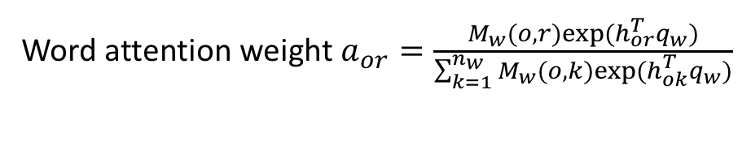











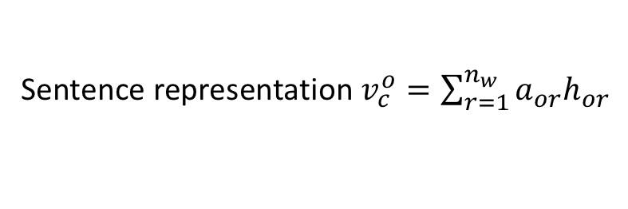
Hierarchical Content Attention
Word Attention
The contextual words contribute unequally to the semantic meaning of a sentence.
A document is made up of $n_{c}$ sentences $C={\{c_{o}\}}_{o=1}^{n_{c}}$.
The food is great
The drinks are delicious
$$v_{c}^{o}$$
Sentence representation $v_{c}^{o}=\sum_{r=1}^{n_{w}}{a_{or}h_{or}}$
…
Mask softmax
Word attention weight $a_{or}=\frac{M_{w}(o, r)exp⁡(h_{or}^{T}q_{w})}{\sum_{k=1}^{n_{w}}{M_{w}(o, k)exp⁡(h_{ok}^{T}q_{w})}}$
$$a_{o1}$$
$$a_{o2}$$
$$a_{or}$$
word-level query vector $q_{w}$
…
$$h_{o1}$$
$$h_{o2}$$
$$h_{or}$$
Hidden representation $h_{or}=tanh(W_{w}m_{or}+b_{w})$
MLP
$$m_{o1}$$
$$m_{o2}$$
…
$$m_{or}$$
$\text{E}\text{xternal} \text{memory}$: $m∈R^{n_{e}×n_{w}×n_{c}}$
The book is great
o-th sentence $c_{o}={\{w_{or}\}}_{r=1}^{n_{w}}$
Notes:
As all know, The contextual words contribute unequally to the semantic meaning of a sentence.
Assume that a document is made up of n_c sentences.
we first map each word into its embedding vector through embedding layer. For each sentence memory, we feed each word memory into a one-layer MLP to get the its hidden representation, and then The importance weight of this word is therefore measured as the similarity between its hidden representation and the word-level query vector, which is further normalized through a mask softmax function. The sentence vector is finally output as a weighted sum of all hidden representations.
Note that the word-level query vector q_w is expected to be a high level representation of the query “what is the important word over the sentence for the task”that like used in the Memory network.qwis randomly initialized and jointly learned during the training process.

Slide 15

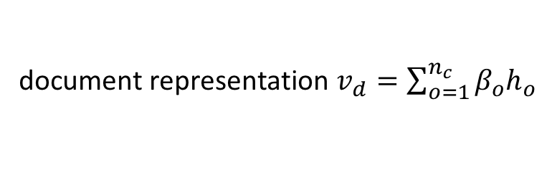



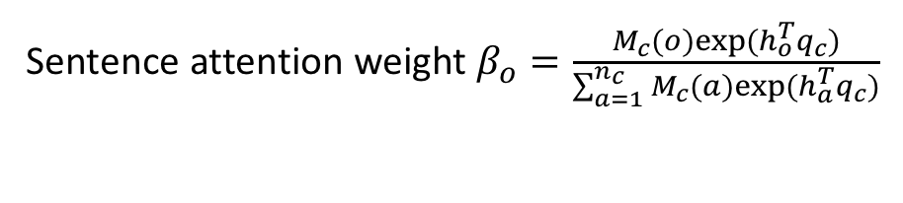









Hierarchical Content Attention
Sentence Attention
Contextual sentences do not contribute equally to the semantic meaning of a document.
$$v_{d}$$
document representation $v_{d}=\sum_{o=1}^{n_{c}}{β_{o}h_{o}}$
…
Mask softmax
Sentence attention weight $β_{o}=\frac{M_{c}(o)exp⁡(h_{o}^{T}q_{c})}{\sum_{a=1}^{n_{c}}{M_{c}(a)exp⁡(h_{a}^{T}q_{c})}}$
$$β_{1}$$
$$β_{2}$$
$$β_{o}$$
sentence-level query vector $q_{c}$
…
$$h_{1}$$
$$h_{2}$$
$$h_{o}$$
hidden representation $h_{o}=tanh(W_{c}v_{c}^{o}+b_{c})$
MLP
$$v_{c}^{1}$$
$$v_{c}^{2}$$
…
$$v_{c}^{o}$$
$$\text{Sentence} \text{representation}{ v}_{c}^{o}$$
Notes:
Similarly, contextual sentences do not contribute equally to the semantic meaning of a document.
We calculate the document vector in the same manner upon the sentence vectors we have obtained from word-attention layer.
The sentence-level query vector is expected to be a high-level representation of the query “what is the important sentence over the document over the task.”, which is randomly initialized and jointly learned during the training process.

Slide 16



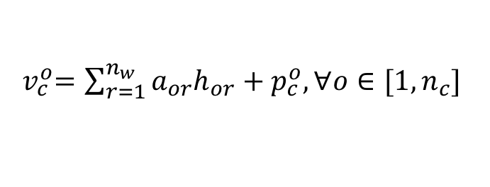
Hierarchical Position Attention
Hierarchical Positional Encoding
Fully take advantage of the order in each sequence.
Stay consistent with the hierarchical content mechanism and consider the order information of both words and sentences.
Word positional encoding
$m_{or}=e_{or}+p_{w}^{r}, ∀r∈[1,n_{w}]$
$p_{w}^{r}$: learnable word location vectors
Sentence positional encoding
${ v}_{c}^{o}=\sum_{r=1}^{n_{w}}{a_{or}h_{or}}+p_{c}^{o}, ∀o∈[1,n_{c}]$
$p_{c}^{o}$: learnable sentence location vectors
Notes:
To fully take advantage of the order in each sequence, we propose a hierarchical positional encoding scheme consisting of a word positional encoding and a sentence positional encoding
In terms of the word positional encoding, we update each piece of word memory by adding a word location vector p_w. As for the sentence positional encoding, we add a sentence location vector to each sentence’s embedding vector.
The word and sentence location vectors are randomly initialized and jointly learned during training process.

Slide 17
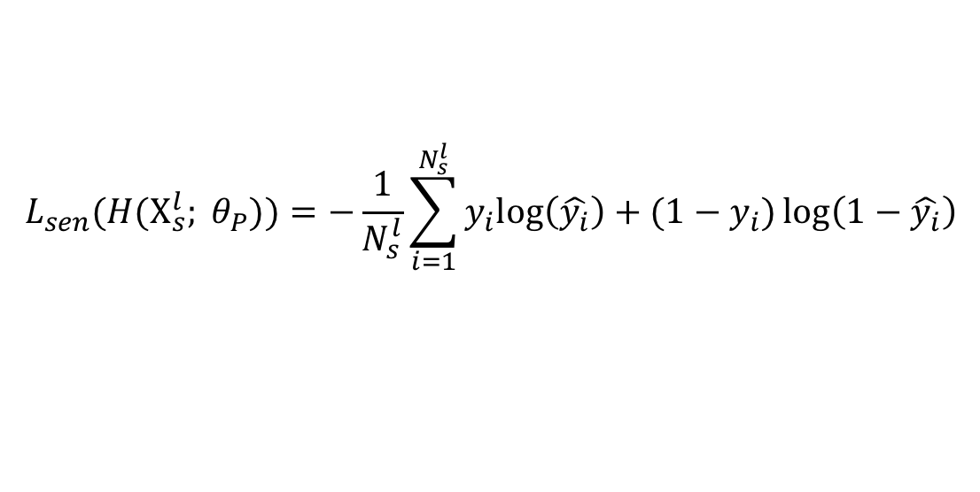
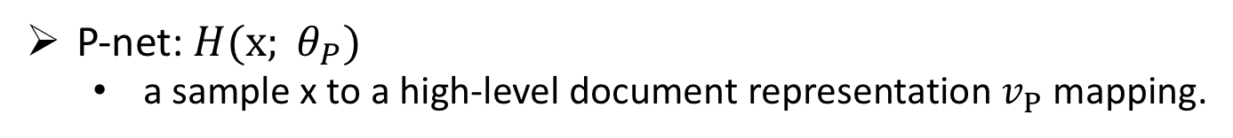
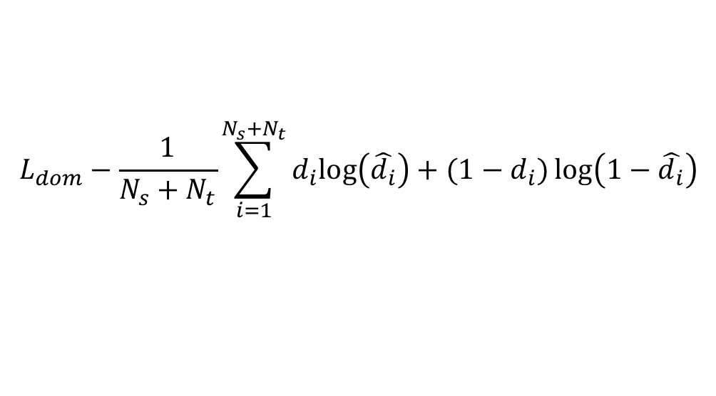
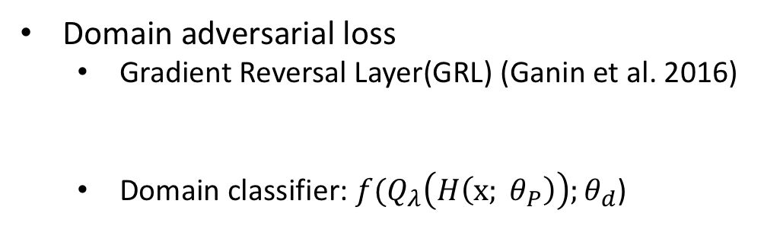
Individual Attention Learning
P-net: $H(x; θ_{P})$
a sample x to a high-level document representation $v_{P}$ mapping.
The loss of P-net consists of two parts:
Sentiment loss
$$L_{sen}(H(X_{s}^{l}; θ_{P}))=−\frac{1}{N_{s}^{l}}\sum_{i=1}^{N_{s}^{l}}{y_{i}log\left(\hat{y_{i}}\right)+(1−y_{i})\log\left(1−\hat{y_{i}}\right)}$$
Domain adversarial loss
Gradient Reversal Layer(GRL) (Ganin et al. 2016)
Domain classifier: $f(Q_{λ}\left(H\left(x; θ_{P}\right)\right);θ_{d}$)
Forward stage: $Q_{λ}\left(x\right)=x$ Backward stage: $\frac{{∂Q}_{λ}\left(x\right)}{∂x}=−$ $λI$
$$L_{dom}−\frac{1}{N_{s}+N_{t}}\sum_{i=1}^{N_{s}+N_{t}}{d_{i}log\left(\hat{d_{i}}\right)+(1−d_{i})\log\left(1−\hat{d_{i}}\right)}$$
Notes:
Then, we introduce loss functions for training the P-net and NP-net, respectively.
The loss of P-net consists of two parts:
.
The sentiment loss is to minimize the cross-entropy for the source labeled data
The domain adversarial loss enforce the P-net to produce such domain-shared representations that can confuse a domain classifier. During forward stage, the GRL behaves as identity function ,but reverse the gradient by multiply minus lamada during the backware.
If The P-net and domain classifier are parameterized by ${θ_{p} θ}_{d}$ respectively.
Learning with a GRL is adversarial: on one hand, the reversal gradient enforces domain loss to be maximized with respect to $θ_{P}$ for all the data from both domains; on the other hand, $θ_{P}$ is optimized to minimize the loss of the domain classifier

Slide 18
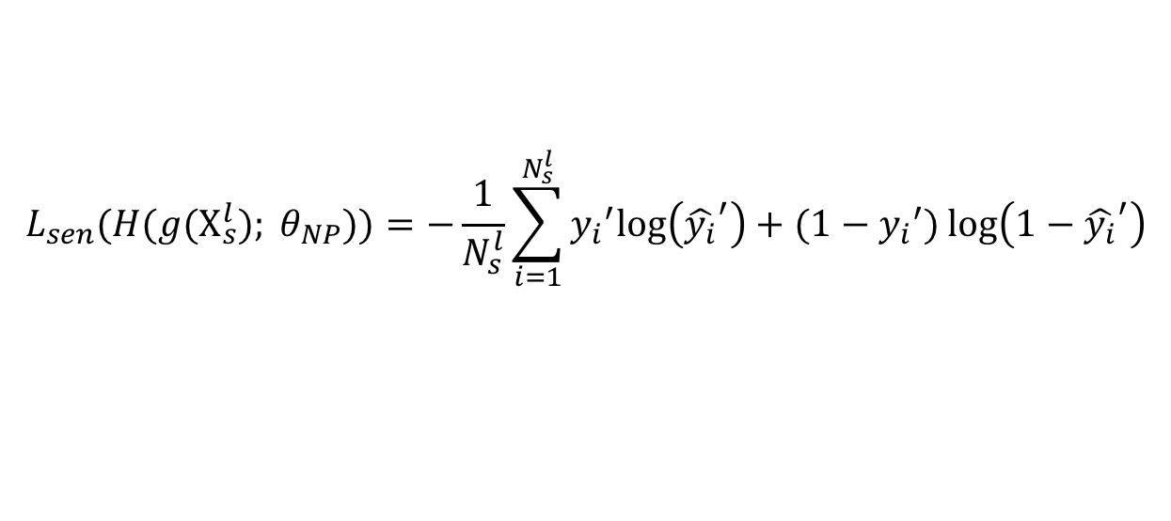
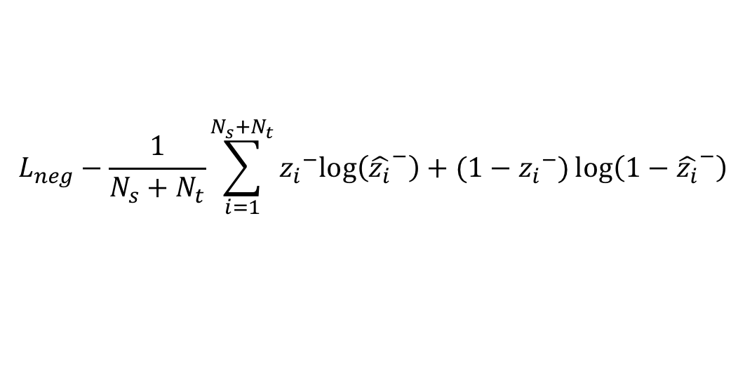
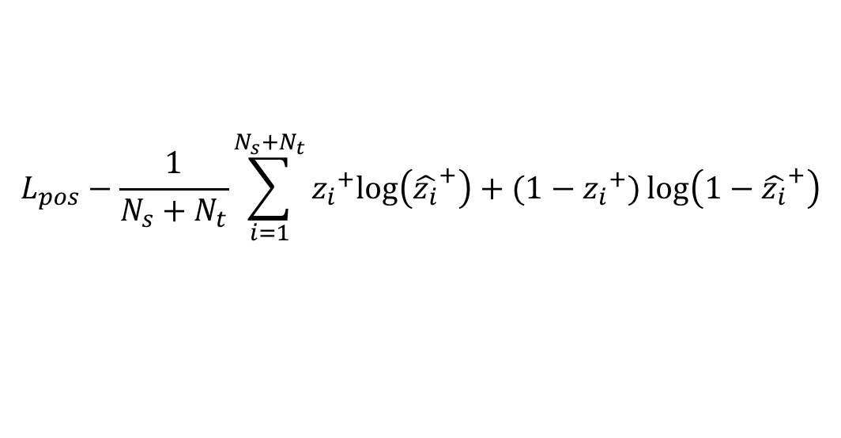
Individual Attention Learning
NP-net: $H(g(x); θ_{NP})$
a transformed sample $g(x)$ to a high-level document representation $v_{NP}$ mapping.
The loss of NP-net consists of two parts:
Sentiment loss
$$L_{sen}(H({g(X}_{s}^{l}); θ_{NP}))=−\frac{1}{N_{s}^{l}}\sum_{i=1}^{N_{s}^{l}}{{y_{i}}^{′}log\left({\hat{y_{i}}}^{′}\right)+(1−{y_{i}}^{′})\log\left(1−{\hat{y_{i}}}^{′}\right)}$$
positive and negative pivot predictions loss
$$L_{pos}−\frac{1}{N_{s}+N_{t}}\sum_{i=1}^{N_{s}+N_{t}}{{z_{i}}^{+}log\left({\hat{z_{i}}}^{+}\right)+(1−{z_{i}}^{+})\log\left(1−{\hat{z_{i}}}^{+}\right)}$$
$$L_{neg}−\frac{1}{N_{s}+N_{t}}\sum_{i=1}^{N_{s}+N_{t}}{{z_{i}}^{−}log\left({\hat{z_{i}}}^{−}\right)+(1−{z_{i}}^{−})\log\left(1−{\hat{z_{i}}}^{−}\right)}$$
Notes:
The sentiment loss is formulated to minimize the cross-entropy loss for all the source transformed labeled data. Moreover,
L_pos and L_neg denote the loss functions to minimize the cross-entropy of positive and negative pivot predictions, respectively:

Slide 19
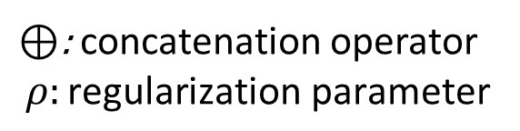
Joint Attention Learning
We combine the losses for both the P-net and NP-net together with a regularizer to constitute the overall objective function:
$L=L_{sen}(H(X_{s}^{l}; θ_{P})⊕H({g(X}_{s}^{l}); θ_{NP}))$+$L_{dom}$+$L_{pos}$+$L_{neg}$+${ρL}_{reg}$
$⊕$: concatenation operator
$$ρ:\text{regularization} \text{parameter}$$
Notes:
Since the representations of P-net and NP-net are complementary, we conduct joint attention learning for them. For the source labeled data and its transformed data, the representation produced by the P-net and the representation produced by the NP-net are concatenated together for sentiment classification. We combine the losses for both the P-net and NP-net together with a regularizer to constitute the overall objective function:

Slide 20
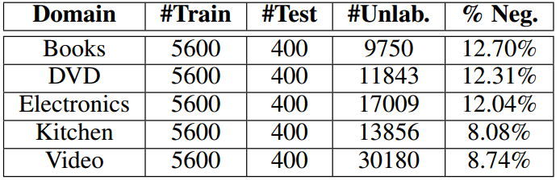
Experiment
Dataset
Amazon multi-domain review dataset
Table1: Statistics of the Amazon reviews dataset.
Setting
5 different domains, totally 20 transfer pairs.
For each transfer pair A-> B:
Source domain A: 5600 for training, 400 for validation.
Target domain B: All labeled data 6000 for testing.
All unlabeled data from A & B used for training.
Notes:
For experiment, We have evaluated our methods on the Amazon multi-domain review dataset, which is a benchmark dataset for cross-domain sentiment classification. The table shows the statistic the dataset. We have used 5 different domains data like books, DVD, and construct 20 transfer pairs.

Slide 21
Compared Methods
Baseline methods
Non-adaptive
Source-only: only use source data based on neural network.
Manually pivot selection
SFA [Pan et al., 2010] : Spectral Feature Alignment
CNN-aux [Yu and Jiang 2016]: CNN + two auxiliary tasks
Domain adversarial training based method
DANN [Ganin et al., 2016]: Domain-Adversarial Training of Neural Networks
DAmSDA [Ganin et al., 2016]: DANN + mSDA [Chen et al.,2012]
AMN [Li et al.,2017] : DANN + Memory Network
Notes:
We have compared with several recent state-of-the-art baseline methods.
The source-only is a non-adaptive baseline method based on neural networks and only use source data.
SFA aims to CNN-aux, all these two methods need to munally select pivots
For DANN,DAmSDA, and AMN, these three methods are all based on domain adversarial training .But they may not well exploit the domain-specific features.

Slide 22
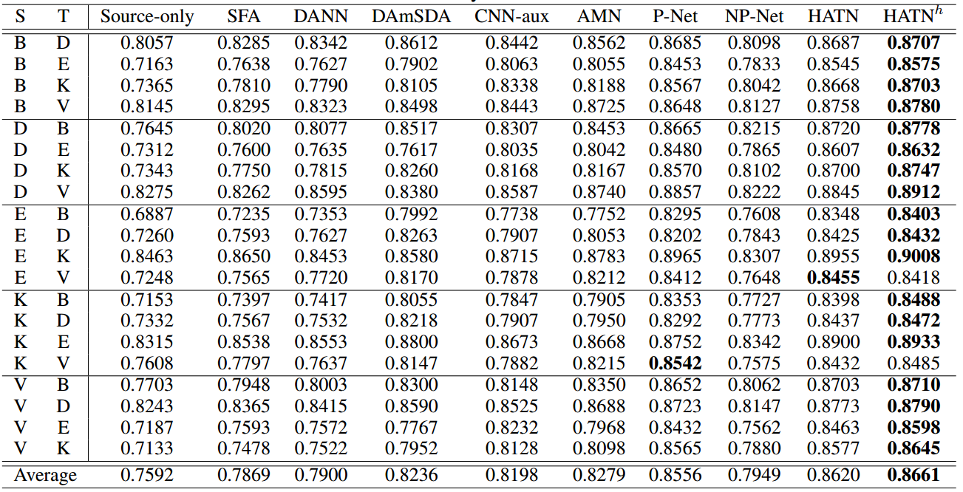
Experiment results
Comparison with baseline methods
Notes:
The Table reports the classification accuracies of different methods on the Amazon reviews dataset. The proposed methods consistently achieves the best performance on almost all the tasks.
Possible reasons are that HATN can automatically exploit better domain-shared representations with hierarchical attentions and make use of both pivot and non-pivot features which contribute more to the domain-shared representations than those only using the pivot features.

Slide 23
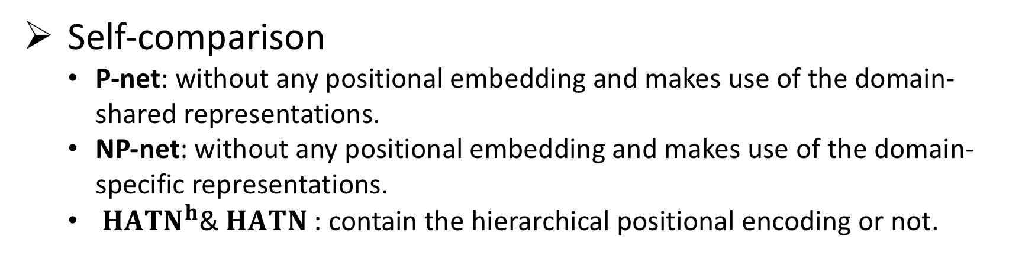
Compared Methods
Self-comparison
P-net: without any positional embedding and makes use of the domain-shared representations.
NP-net: without any positional embedding and makes use of the domain-specific representations.
${HATN}^{h}$&$HATN$ : contain the hierarchical positional encoding or not.
Notes:
In order to validate the effectiveness of each component, we compare with variants of the proposed method.

Slide 24
Experiment results
Self-Comparison
Notes:
First, we can see that P-net even outperforms the AMN that considerso nly word attention on average. which proves that hierarchical attention is more suitable for learning domain-shared representations.
Second, it is reasonable that NP-net only achieves low performance on average since the input for NP-net removes all pivots that contribute more to domain-shared features and it is insufficient to do sentiment classification.
Third, HATN can hebave better than both P-net and NP-net, which proves that the representations of P-net and NP-net are complementary.
Moreover, HATNh can further improve the performance of HATN by 0.41% on average, which also validates that P-net and NP-net can behave better with hierarchical positional encoding.
.

Slide 25
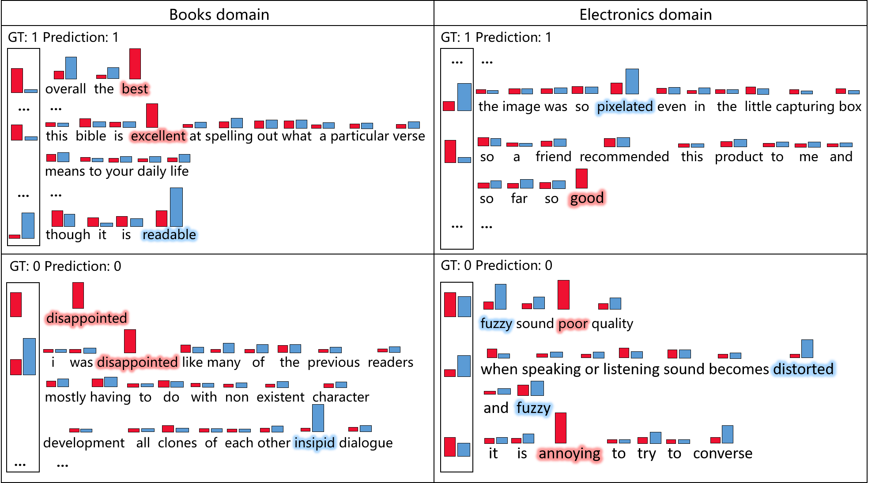
Visualization of Attention
P-net attention
NP-net attention
Notes:
In order to validate that our model is able to identity pivots and non-pivots simultaneously with hierarchical attentions, we visualize the word and sentence attention layers of the P-net and NP-net for Books domain to Electronics domain transfer task. The red and blue stand for P-net attention and NP-net attention respectively.
The Figure shows that P-net tends to pay higher word attentions to the pivots between domains, such as positive pivots best, excellent, good and negative pivots disappointed, poor, annoying. The sentences that contain these pivots also get higher sentence attentions in the P-net. Different from P-net, NP-net aims to pay higher word attentions to the non-pivots in the two domains, such as source non-pivots readable, insipid in the Books domain and target non-pivots pixelated, fuzzy, distorted in the Electronics domain. The sentences that contain these non-pivots also get higher sentence attentions in the NP-net. Overall, the visualization of attentions illustrates that our model can achieve transferring attentions between domains.

Slide 26
Visualization of Attention
Books domain
Electronics domain
+
-
great good excellent best highly wonderful
enjoyable love funny fantastic classic favorite interesting loved beautiful amazing fabulous fascinating important nice inspiring well essential useful fun incredible hilarious enjoyed solid inspirational true perfect compelling pretty greatest valuable real humorous finest outstanding refreshing awesome brilliant easy entertaining sweet
bad disappointing boring disappointed poorly worst horrible terrible awful annoying misleading confusing useless outdated waste poor flawed simplistic tedious repetitive pathetic hard silly wrong slow weak wasted frustrating inaccurate dull mediocre sloppy uninteresting lacking ridiculous missing difficult uninspired shallow superficial
Pivots
readable heroic believable appealing adorable thoughtful endearing factual inherently rhetoric engaging relatable religious deliberate platonic cohesive genuinely memorable astoundingly introspective conscious grittier insipid
entrancing inventive conversational hearted lighthearted eloquent comedic understandable emotional
stereo noticeably noticeable hooked
softened rubbery rigid shielded labeled responsive flashy pixelated
personalizing craving buffering glossy
matched conspicuous coaxed useable
boomy programibilty prerecorded ample fabulously audible intact slick crispier polished markedly illuminated intuitive brighter fixable repairable
+
Non-pivots
depressing insulting trite unappealing pointless distracting cliched pretentious ignorant cutesy disorganized obnoxious devoid gullible excessively plotless disturbing trivial repetitious formulaic immature sophomoric aimless preachy
hackneyed forgettable extraneous implausible monotonous convoluted
plugged bulky spotty oily scratched laggy laborious negligible kludgy clogged riled intrusive inconspicuous loosened untoward cumbersome blurry
restrictive noisy ghosting corrupted flimsy inferior sticky garbled chintzy distorted patched smearing unfixable
Ineffective shaky distractingly frayed
-
Notes:
As showed in Figure, we list some examples of pivots and non-pivots captured based on the attention weights of P-net and NP-net respectively in the B!E task. Actually, These pivots and non-pivots are crucial for cross-domain sentiment classification.

Slide 27
Conclusion
We propose a hierarchical attention transfer mechanism, which can transfer attentions for emotions across domains by automatically capturing the pivots and non-pivots simultaneously.
Besides, it can tell what to transfer in the hierarchical attention, which makes the representations shared by domains more interpretable.
Experiments on the Amazon review dataset demonstrate the effectiveness of HATN.

Slide 28
Thank you!

