Slide 1
Block-pushing robot · Progress report 02
One camera. One planner.
One pushing robot.
Overhead vision guides a differential-drive robot with a shallow U-shaped pusher.
Observe
Decide
Move
→
→
Overhead camera + OpenCV
Offboard computer
VSCode + ESP32 + AT8236 driver
Locate the robot and blocks
Select targets and pushing paths
520 encoder motors
STRATEGY
CURRENT STAGE
Opening push → adaptive midgame → quick final pushes
Module testing → system integration
Planned architecture; the complete autonomous loop is still to be integrated.
Notes:
我们的总体方案保持不变：顶置摄像头采集场地信息，电脑用 OpenCV 识别机器人和方块，并完成目标选择，再通过无线连接向 ESP32 发送运动指令。车端采用 AT8236 驱动模块和 520 编码器电机，前端使用浅 U 形推板。策略分为开局、中盘、终盘三个阶段。这次汇报的重点是从模块验证走向系统联调。图中是目标架构，完整的实车闭环还没有接通。

Slide 2
Current progress
The robot now moves
under PC serial control.
Module | Evidence so far | Status
Motion control | PC serial control: forward, reverse, left and right. | Basic movement achieved
Wireless | Phone-based Wi-Fi control code prepared. | Hardware test pending
Vision | Photo-processing prototype; real empty-field perspective correction. | Static prototype
Strategy | Three-stage planner shared with a continuous 2D simulation. | Software prototype
Next step: make these modules work together on the robot.
Updated with confirmed movement progress: 19 October 2026.
Notes:
相比第一次汇报，现在硬件已经确定，ESP32 已完成烧录，小车已经能连接电脑串口，通过电脑指令实现前进、后退、左转和右转。这是已经实现的实物进展；重复动作的稳定性仍需继续验证。手机 Wi-Fi 遥控程序已经写好，尚未确认烧录和实测。视觉已具备静态照片处理功能，实际验证过的是空场地的透视展开，还没有完成实拍方块识别验收。策略已做成前中后期共享原型，并有连续二维演示。这些成果说明各模块已有基础，但还没有自主推块实车成果。运动进度已按 10 月 19 日最新反馈更新。

Slide 3
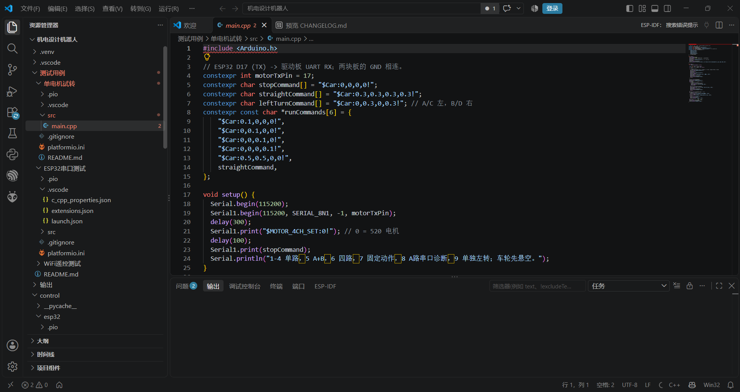
Notes:
空白页，可按需补充内容。

Slide 4
What still needs to work
Four gaps before autonomous pushing.
01
Chassis footprint
The current robot may exceed the area limit.
Redesign the chassis for a smaller footprint.
02
Reliable movement
Check command reliability over repeated runs.
Verify turning and stopping consistently.
03
Live localization
Connect the camera, AprilTag pose estimation
and stable block tracking.
04
Integrated execution
Fix the four known planner issues;
connect decisions to real motion and feedback.
Priority: measure the complete robot footprint and redesign the chassis layout.
Notes:
目前主要有四个缺口。首先也是比较重要的一项：当前小车面积可能超过比赛要求，需要实测整车占地并重新设计底盘，调整部件布局。第二，已有电脑串口控制的基本移动能力，接下来需要继续验证重复动作、转向和停车的可靠性。第三，接入实时摄像头、AprilTag 位姿和方块跟踪。第四，修复已有策略问题，并接入真实运动执行和反馈。策略审查已复现四项问题：推板边缘障碍漏检、远块拖累近块、首选路线失败后缺少次选回退，以及过期反馈影响阶段。

Slide 5
Next plan · in order of dependency
Resize the chassis. Then integrate.
01 / CHASSIS & CONTROL
02 / FEEDBACK
03 / AUTONOMY
Rework the chassis
Connect real feedback
Close the pushing loop
Measure and reduce the footprint.
Read encoder feedback.
Fix planner defects.
Compare replacement tires.
Calibrate wheel motion.
Connect vision to motion.
Test wireless control and pushing.
Validate live robot and block positions.
Tune in repeated mock matches.
EXIT CONDITION
EXIT CONDITION
EXIT CONDITION
Meet the area limit and push one block
Reach and stop at a target point.
Detect, approach and push one block
by remote control.
autonomously.
Compare tire size and grip; recalibrate wheel motion if the tires are replaced.
Notes:
后续按依赖关系分三步。先调整底盘与控制：实测整车占地，重新设计更紧凑的底盘，同时加入更换轮胎的备选方案，对比轮胎尺寸和抓地表现，是否更换由测试结果决定。保留已经实现的电脑串口移动能力，再测试无线指令和推板，先人工遥控推走一个方块。再做反馈：接真实编码器，标定轮径和轮距，并完成实时视觉定位，验收能否到达目标点并停车。最后接自主策略，实现识别、接近、推送的完整流程，再通过模拟比赛调参。若更换轮胎，需要重新标定轮径及运动参数；不在没有实测依据的情况下承诺具体完成日期。

Slide 6
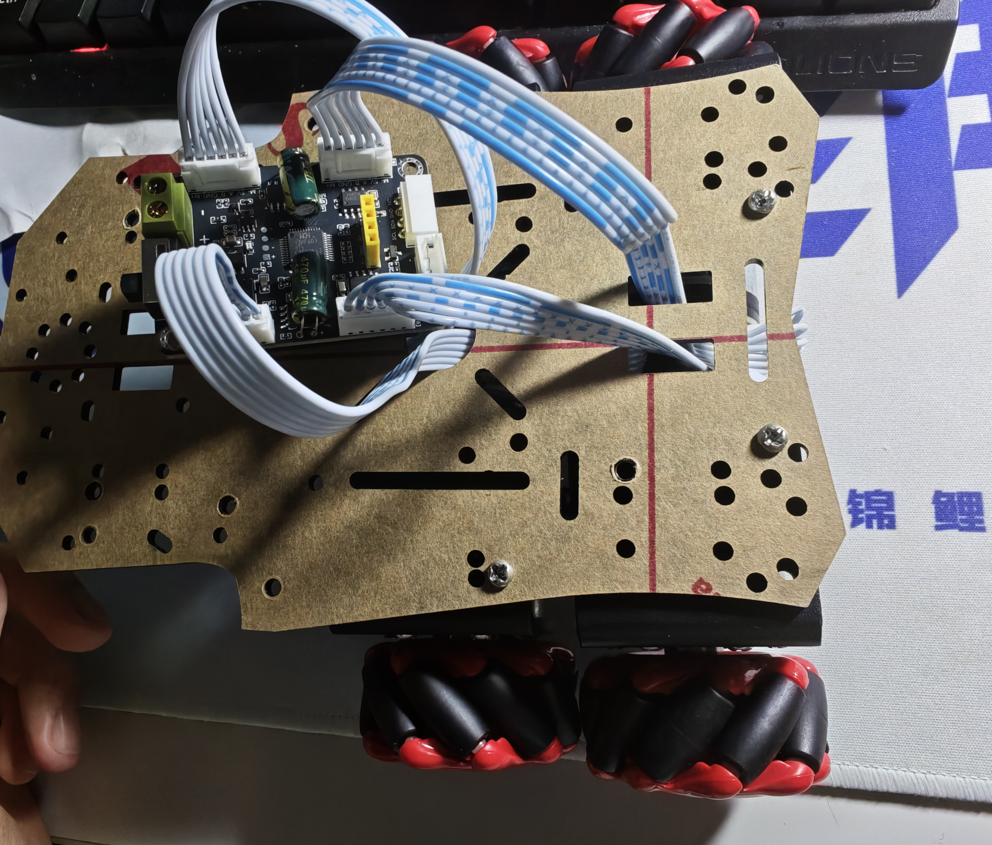
Notes:
空白页，可按需补充内容。

Slide 7
Immediate milestone
A small, measurable physical result.
Fit within the area limit.
Push one real block.
PROPOSED CHECK 01
PROPOSED CHECK 02
PROPOSED CHECK 03
Measure the redesigned robot
Repeat moves and turns;
Record a complete
against the area limit.
verify stopping reliably.
remote-controlled push.
Then extend the same task to autonomous operation.
Notes:
近期里程碑尽量小而明确：重新设计底盘，使整车面积满足要求，再稳定遥控并推走一个真实方块。建议验收包括测量改版后的整车占地，反复验证前后移动、转向、停车和失联停车，最后录制一次完整遥控推块。底盘缩小和轮胎更换均属于接下来要验证的工作，并非已经完成。目前独立 USB 工程中的模拟里程计和超时归零检查，不代表这些能力已经接入真实电机或 Wi-Fi 工程。完成这一里程碑后，再把同一任务扩展为自主完成。

Slide 8
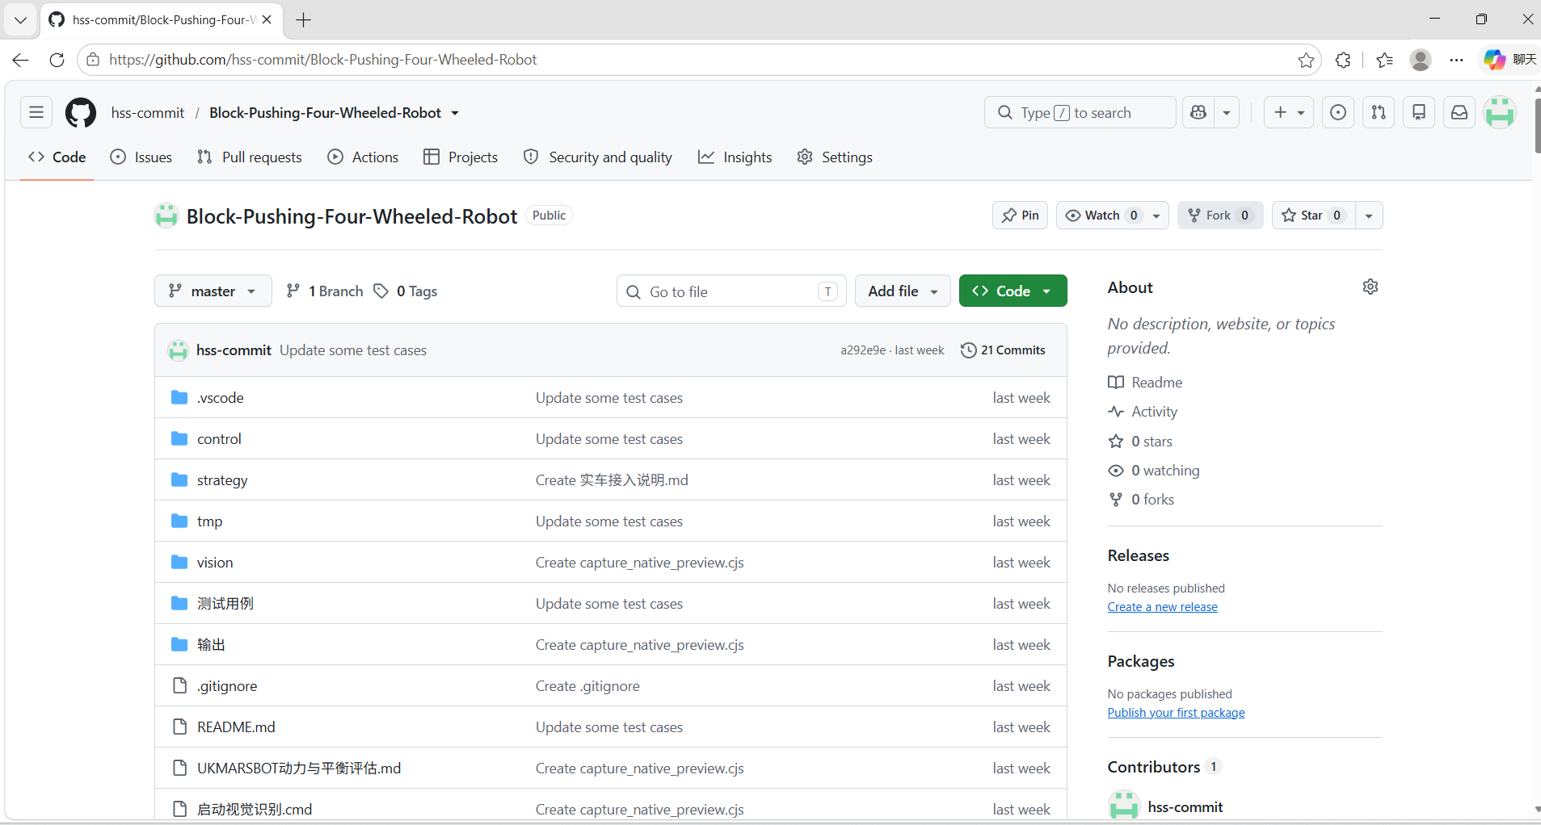
Our Repositories--https://github.com/hss-commit/Block-Pushing-Four-Wheeled-Robot
Notes:
空白页，可按需补充内容。

