Slide 1
PROJECT PROGRESS · 03
Block-Pushing
Robot
Completed work & next steps
阶段成果与后续计划
2 November 2026
Notes:
大家好，这次汇报主要介绍我们这一阶段已经完成的工作，以及接下来的测试和实施计划。

Slide 2
PROGRESS OVERVIEW
A working foundation
for system integration.
The robot can move forward, reverse and turn under PC serial control.
Live camera processing and a robot localization prototype are now available.
Wireless and single-target approach test software has been prepared for hardware validation.
Notes:
这一阶段，我们主要完成了三个方面的工作：小车已经能够通过电脑串口实现基本移动；视觉程序已经支持实时画面和小车定位原型；同时准备了无线联动和单目标接近的测试程序。整体正在从单独模块开发走向系统联调，但完整自主推块还没有完成。

Slide 3
COMPLETED WORK · VISION
Live field images
can now be processed.
A phone connected by USB provides live images to the computer.
The program supports field correction, block detection and blue/yellow region identification.
Annotated images and detection results can be saved for review and further tuning.
Notes:
视觉方面，我们已经通过USB连接手机，把实时画面送入电脑。程序能够进行场地四角校正、方块识别和蓝黄分区，也能保存原始画面、标注图和检测数据，方便复查。真实照片和视频中已经做过检测，但反光、相邻方块粘连和部分漏检仍需优化。

Slide 4
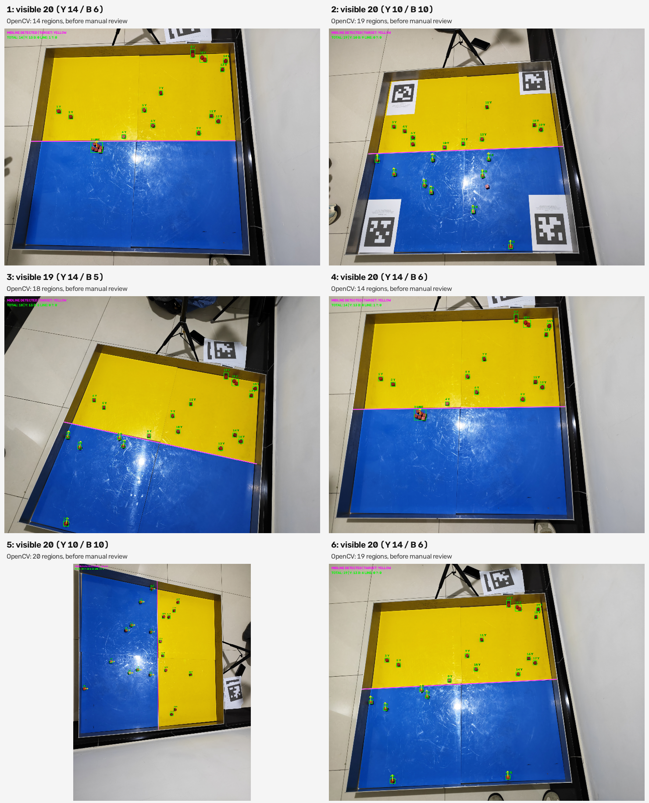
Notes:
空白页，可按需补充内容。

Slide 5
COMPLETED WORK · LOCALIZATION
Robot position and heading
can be estimated.
The prototype detects four red wheels and estimates the robot center.
The front and rear wheel spacing is used to determine its heading.
Position markers and a heading arrow are displayed in the camera view; field accuracy still needs testing.
Notes:
小车定位已经采用四个红色轮胎作为识别特征，根据前后轮间距的区别判断车头方向，并在画面上显示中心和朝向箭头。参考照片及其旋转后的图像已完成检查。当前仍是定位原型，四轮缺失或朝向不明确时不会输出有效朝向，全场精度和遮挡影响还需要现场测试。

Slide 6
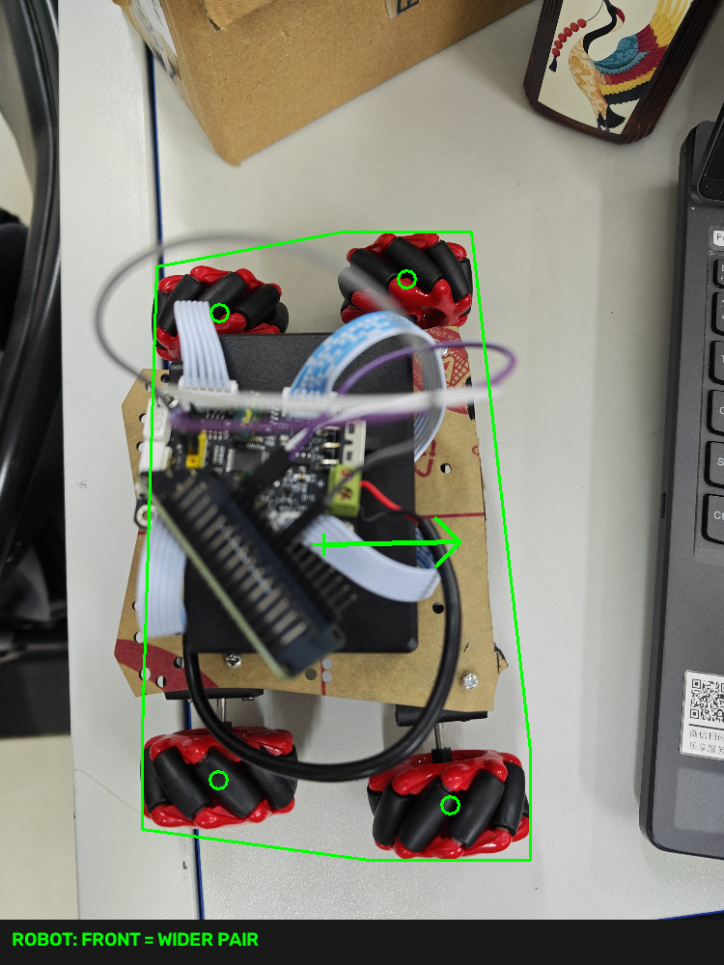
Notes:
空白页，可按需补充内容。

Slide 7
COMPLETED WORK · MOTION
Basic movement
has been achieved.
The ESP32, motor driver and motors form the current control setup.
PC serial commands can move the robot forward, reverse, left and right.
This provides a practical basis for the next round of wireless movement and stopping tests.
Notes:
硬件控制方面，目前采用ESP32、驱动模块和电机的控制组合。已经确认小车能够通过电脑串口实现前进、后退、左转和右转，说明基本控制通路已经建立。接下来会继续检查重复动作、转向和停车表现，再开展无线联动测试。

Slide 8
INTEGRATION PREPARATION
Test software is ready.
Hardware validation comes next.
The Wi-Fi test can request short movements and includes time-limited stopping logic.
The approach test uses visual observations to adjust direction and stop at an approach point.
Software checks and firmware compilation passed; the new tests still await firmware upload and real-world validation.
Notes:
联动方面，我们准备了两类测试程序。一类是视觉与Wi-Fi短动作测试，另一类是根据画面调整方向、接近目标点后停止的测试。相关软件检查和固件编译已经通过，但新增固件尚未烧录，实车动作也没有验证。这里的成果是测试程序和软件准备，不能表述为已经完成自主接近或自主推块。

Slide 9
NEXT PLAN · FIELD TESTING
Validate vision and motion
on the real field.
Fix the camera position and check detection at the center and edges of the field.
Upload the test firmware, then verify motor direction, short movements and stopping with the wheels raised.
Proceed to low-speed ground tests and record positioning error and stopping behavior.
Notes:
接下来先把摄像头固定好，检查场地中心、边缘和转向过程中，小车与方块能否持续识别。然后烧录测试固件，先架空核对电机方向、短动作和停止，再进行低速落地测试。测试过程中记录定位误差、动作表现和停车情况，用结果来调整参数。

Slide 10
NEXT PLAN · MILESTONE
Complete one task
before expanding the system.
First demonstrate reliable detection, approach and stopping for one target.
Then add the pushing action and record one complete physical trial.
In parallel, check the chassis footprint and evaluate tire size and grip.
Notes:
近期目标是先完成一个可验证的小任务：稳定识别一个目标，自动接近并在接近点停车。这个过程可靠后，再加入推送动作，录制一次完整实车试验。同时继续核对整车占地，评估轮胎尺寸和抓地表现。先把单目标流程做稳定，再逐步增加任务复杂度。

Slide 11
Notes:
空白页，可按需补充内容。

