Slide 1

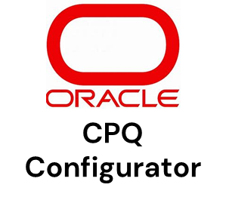




















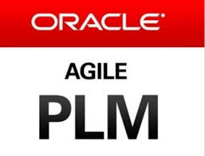





















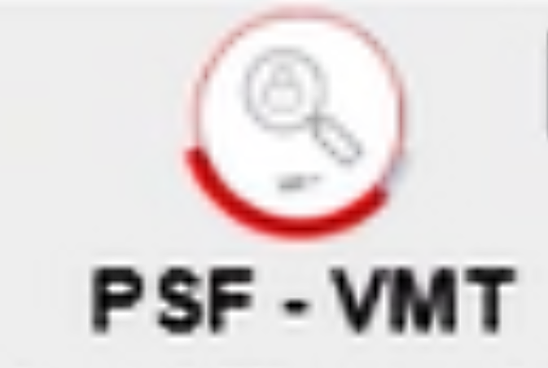

















As-Is Agile PLM Tool Landscape – Keysight NAS
Manual
Automatic
Product Requirement Specification (PRD)
Design Specifications
System Architecture diagrams(UML)
Part Number Generation by MDM for 9XX parts
Configuration data Migration
Engg. Requirement Specification (ERD)
Test cases
Sub-System Architecture diagrams (UML)
PCN
CPQ Tool
Jira Ticket
Requirements & Test Cases
System Design
BOM Structure
Agile BOM Import spreadsheet
Products, trade-in approvals, Assets, Entitlements
Data search repository
Used by MCAD
licensing system used for NS products and some VS products
Software Licenses BOM
Part Lifecycle + ITEM Status
During DEV Phase
NRND Notes
Product BOM
Mech. Components 2D/3D
Components, BOM information
DFM (Design for Manufacturability)
Assembly & Test Procedures
Part Numbers
Manufacturing Fixtures (JTAG, etc.)
Packaging Finalized
Network drive
Script based
MCAD
PLM
Change Management
Salesforce Attributes
- Packed Weight
- Packed Dimension
- ATI SPN
- Renewal Note
- Is Chassis/Base System
Oracle EBS
Production Phase is managed by Contract Manufacturers. No information on ME tools used till Pilot phase.
ECAD
IDX, IDF
Design Data Mgmt.
Items
Item Master IM1
Component Specifications
MCO - Manufacturing Change order
MO BOM (Inc SW BOM & STDHW)
ECAD BOM, Part Numbers,
Engineering Drawings
ECN – Engineering Change Notice
Manufacturing Eng. tools
PCB Layout Design
Manuals and Software
ECO – Engineering Change Order
BOM
GDO
Global Delivery
Propagation
F-Org
Primary Factory
Data versioning
BOM Management
Quality
Deviation – DEV
E Org
MO BOM
Mfg BOM
F-Org
Secondary
Schematic Design
IDX, IDF
ECAD BOM, Part Numbers, final schematics
Part Numbers
NCR
Model Option (MO) BOM
Demand Management and Sales and Operations Planning
(Used by Product Manager)
EDA Connect – Custom Integration
BOM Structures
STR
PIP Interface
A/M/P/S/W Org
X Org
Compliance
K Org
L Org
AML, BOM Info
Part qualification test before CO release
Costing
Item, Change & BOM attributes, Mfg. information, Part Lifecycle + ITEM Status
PTO & Spare Items
China Taxation
Supply chain risk analysis
Costing Information
ERP
Parts data, BOMS, Item Master
SFDC attributes, Pricing data
Cost data
Commodity Managers, Buyers
Procurement Team
Costing data import template for Oracle EBS
Software package information
Supply Chain
View
Corporate Quality
Plan
Code
Build
SSDF Compliance
Field Issues
Verify
Publish
Issues, OBEs, RCA, CAPA, Quality Audits
CI
Software package information
Quality Reports
Quality compliance guidelines, documentation
WRAP
Reporting Tools
KPI Dashboard
Software Package publish
Analog circuit simulation
Project Management
Customers
Software
Keysight.com
Detailed planning for Software team
No information available
Additional tools used by very limited users
*CloudBees compliance tool implementation can be done in future
Simulation

Slide 2
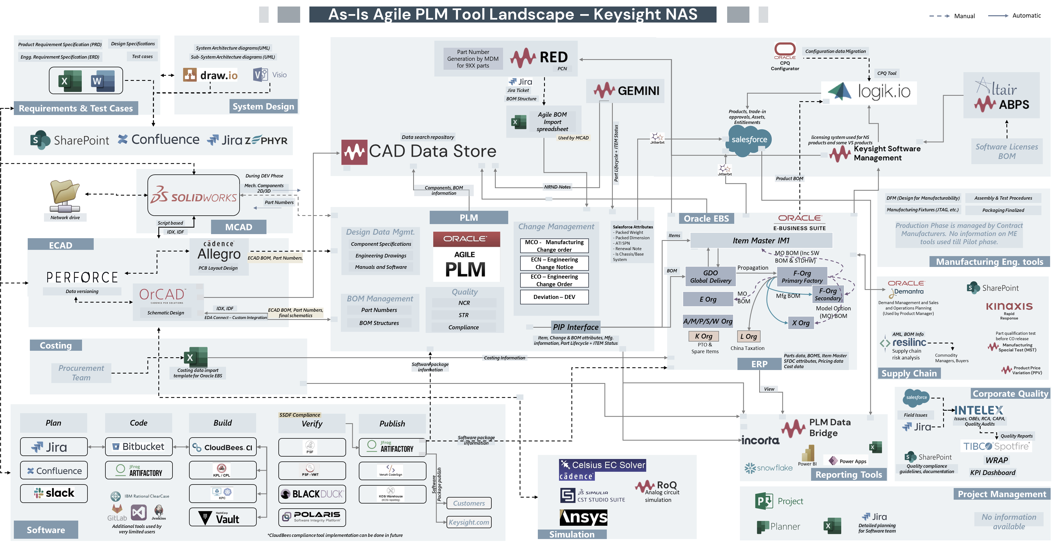
No MBSE tool is used to handle the System/Sub System architecture
The current digital landscape limits adoption of digital technologies like Digital Twin, IoT, AI, etc.
Custom CAD data Store tool is use for data information search. PLM is not single source of truth for all data information.
Part Numbering request process for MCAD is not fully automated.
There are significant lags in synchronizing data across boundary applications
Requirements are managed in Word, excel. No Dedicated ALM (Application Lifecycle Management) tool is used to maintain the traceability
Not all OOTB functionalities within Agile PLM has been utilized e.g., Project Management, Variants etc.
SolidWorks & Allegro are not directly integrated with PLM tool
Concept data, data revisions are not handled in PLM. Perforce is primary source for ECAD data revisions
150% BOM functionality is not used by users. BOM duplication happens to manage the variants
Tools used for supplier collaboration are not directly integrated with PLM tool
Parts variants & revisions handled through part number schema. Users are not using OOTB Agile functionalities to handle the variants
Multiple tools are used to create and maintain various reports & dashboards
No end-to-end traceability between Requirements, Test cases, Source code, defect, Part Number etc.
Corporate quality tools are not integrated with PLM tool to track quality documents & feedback
No centralized Project management tool is used to track project status and deliverables

