Slide 1
Diabetes Mellitus: Epidemiology, Pathophysiology, Management & Prevention
MBBS 3rd year
Dr Siddalingaiah H S
Professor, Community Medicine
SIMSRH, Tumkur

Slide 2
Learning Objectives
Define, diagnose, manage diabetes comprehensively
Apply evidence-based prevention strategies
Understand national programmes and future innovations

Slide 3
Comprehensive Diabetes Overview
• DEFINITION & CLASSIFICATION - ADA/WHO Criteria 2024
• GLOBAL EPIDEMIOLOGY - 537M cases, 11.3% prevalence
• PATHOGENESIS - β-cell dysfunction, insulin resistance
• CLINICAL FEATURES - Symptoms, complications spectrum
• DIAGNOSIS - FPG, OGTT, HbA1c thresholds
• MANAGEMENT - Lifestyle, pharmacological, technology
• CONTROL STRATEGIES - Glycemic targets, monitoring
• PREVENTION - DPP model, lifestyle intervention
• NATIONAL PROGRAMME - NPCDCS implementation
• FUTURE DIRECTIONS - Precision medicine, AI, stem cells

Slide 4
Diabetes Mellitus: Definition & Classification (ADA 2024)
WORLD HEALTH ORGANIZATION DEFINITION
• Chronic hyperglycemia due to defects in:
- Insulin secretion (β-cell dysfunction)
- Insulin action (insulin resistance)
- Both mechanisms
• Characterized by disturbances in:
- Carbohydrate, fat, and protein metabolism
ADA CLASSIFICATION SYSTEM
• Type 1 DM: Autoimmune β-cell destruction
• Type 2 DM: Insulin resistance + relative insulin deficiency
• Gestational DM: Glucose intolerance in pregnancy
• Other specific types: Monogenic, drug-induced, etc.
• Prediabetes: IFG, IGT, or both
HISTORICAL EVOLUTION:
Ancient descriptions → 1921 Insulin discovery → 1950s Oral agents →
1980s HbA1c → 2020s CGM/Precision medicine

Slide 5
Classification of Diabetes Mellitus
TYPE 1 DM
(5-10%)
• Age: Usually <30 years
• Onset: Acute/rapid
• Autoantibodies: GAD, IA2
• C-peptide: Low/absent
• HLA association: DR3/4
• Complications: Ketoacidosis common
TYPE 2 DM
(90-95%)
• Age: Usually >40 years
• Onset: Insidious/gradual
• Insulin resistance: Primary
• C-peptide: Initially normal
• Obesity: Common
• Family history: Strong
OTHER SPECIFIC TYPES
• MODY: Maturity onset
• LADA: Latent autoimmune
• Neonatal DM
• Drug-induced (steroids)
• Pancreatic diseases
• Genetic syndromes
GESTATIONAL & PREDIABETES
• GDM: Pregnancy onset
• Prediabetes: IFG/IGT
• Risk of T2DM: High
• Screening: Universal
• Management: Lifestyle ± metformin
• Postpartum monitoring

Slide 6
Global Diabetes Epidemiology (IDF 2021)
GLOBAL BURDEN STATISTICS
• 537 MILLION adults with diabetes (2021)
• 1 in 10 adults affected worldwide
• 541 million in prediabetes stage
• 75% live in low- and middle-income countries
• 6.7 million deaths annually
• $966 billion healthcare expenditure
• Projected: 783 million by 2045
REGIONAL PREVALENCE (%)
• Middle East & North Africa: 14.0%
• North America: 11.7%
• South & Central America: 9.9%
• South Asia: 8.8%
• East Asia & Pacific: 8.4%
• Western Europe: 5.4%
• Sub-Saharan Africa: 3.3%
TREND:
3-fold increase since 1980;
Slowing growth in high-income countries;
Rapid rise in LMICs

Slide 7
Diabetes Epidemiology in India
INDIA DIABETES BURDEN (2021)
• 101.2 MILLION people with diabetes
• 11.4% prevalence (20-79 years)
• Second highest globally after China
• 136 million with prediabetes
• Annual cost: INR 2.5-3 lakh crores
• Projected: 140 million by 2030
REGIONAL VARIATIONS IN INDIA
• Kerala, Punjab, Tamil Nadu: >15%
• Andhra Pradesh, Karnataka: 13-15%
• Maharashtra, Gujarat: 10-13%
• Rural areas: Lower prevalence
• Urban-rural ratio: 2:1
KEY CONTRIBUTING FACTORS:
Urbanization
Lifestyle changes
Genetic predisposition
Low birth weight
Dietary transition
Physical inactivity

Slide 8
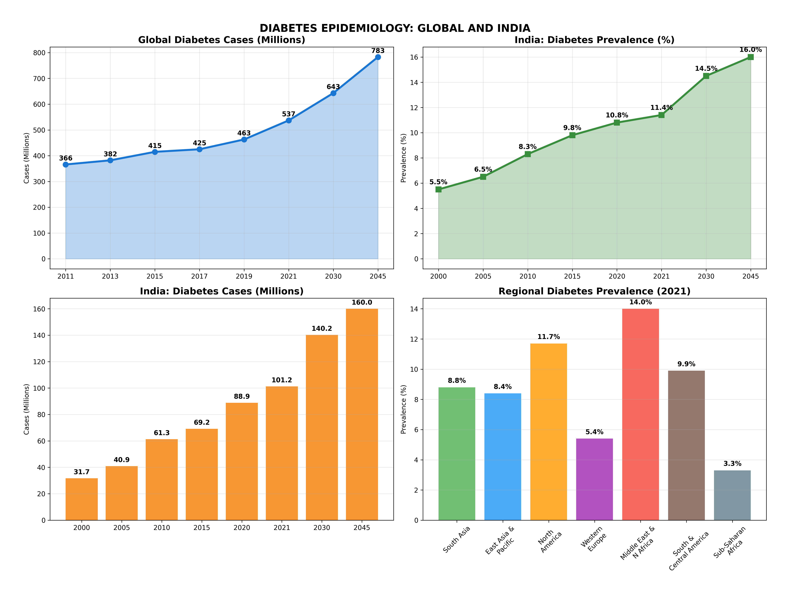
Diabetes Trends: Global vs India

Slide 9
Pathophysiology of Diabetes Mellitus
NORMAL GLUCOSE METABOLISM
• Insulin secretion (β-cells)
• Insulin action (target tissues)
• Glucose uptake (GLUT4 translocation)
• Glycogen synthesis
• Gluconeogenesis suppression
TYPE 1 DM PATHOGENESIS
• Autoimmune destruction of β-cells
• Genetic susceptibility (HLA-DR3/4)
• Environmental triggers (virus?)
• Insulitis → absolute insulin deficiency
• Ketoacidosis risk high
TYPE 2 DM PATHOGENESIS
• Insulin resistance (primary defect)
• β-cell dysfunction (secondary)
• Increased gluconeogenesis
• Decreased insulin secretion
• Chronic inflammation

Slide 10
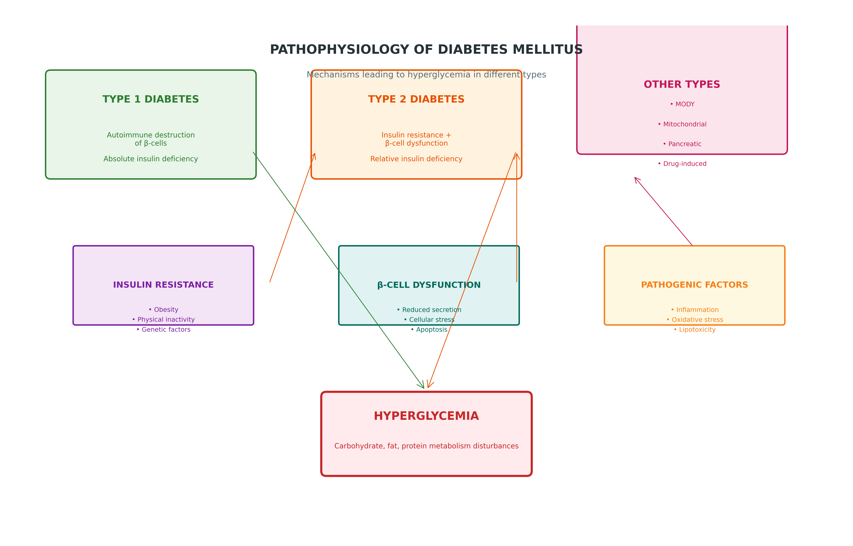
Molecular Mechanisms in Diabetes Pathogenesis

Slide 11
Risk Factors for Diabetes Mellitus
NON-MODIFIABLE RISK FACTORS
• Age >45 years
• Family history (first-degree)
• Genetics (T2DM: polygenic)
• Ethnicity (South Asians high risk)
• Previous GDM
• Low birth weight
MODIFIABLE LIFESTYLE FACTORS
• Obesity (BMI >25 kg/m²)
• Central obesity (waist ≥90cm M, ≥80cm F)
• Physical inactivity (<150 min/week)
• Unhealthy diet (high refined carbs)
• Smoking and alcohol excess
• Sleep deprivation (<7 hours)
MEDICAL CONDITIONS
• Polycystic ovary syndrome
• Metabolic syndrome
• Hypertension
• Dyslipidemia
• NAFLD
• Psychiatric disorders
INDIAN DIABETES RISK SCORE (IDRS): Age + BMI + Waist + FH + Activity.
Score ≥60 = High risk.
Validated for Asian Indians.

Slide 12
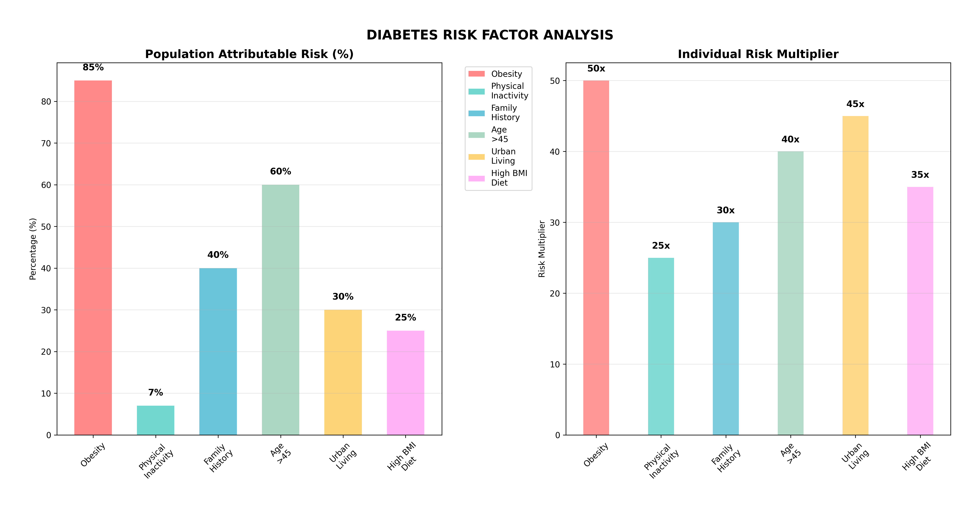
Risk Factor Interactions & Prevention Opportunities

Slide 13
Clinical Features of Diabetes Mellitus
CLASSIC SYMPTOMS (3P's)
• Polyuria (increased urination)
• Polydipsia (increased thirst)
• Polyphagia (increased hunger)
• Unexplained weight loss
• Fatigue and weakness
• Blurred vision
ASYMPTOMATIC PRESENTATION
• Routine screening detection
• Incidental hyperglycemia
• Complications presentation
• Associated conditions
• Type 2 DM common pattern
• Delayed diagnosis risks
PHYSICAL EXAMINATION
• BMI and waist circumference
• Blood pressure measurement
• Signs of dehydration
• Insulin resistance markers
• Foot examination
• Oral health assessment
DIFFERENTIAL PRESENTATION: T1DM often acute with DKA risk; T2DM usually insidious with complications; GDM detected during pregnancy screening; MODY may present with mild symptoms

Slide 14
Diagnosis of Diabetes Mellitus (ADA 2024)
DIAGNOSTIC THRESHOLDS
• HbA1c ≥ 6.5% (NGSP certified)
• FPG ≥ 126 mg/dL (8.0 mmol/L)
• 2h-PG ≥ 200 mg/dL (11.1 mmol/L)
• Random PG ≥ 200 mg/dL + symptoms
• OGTT: 75g glucose load
• Repeat testing for confirmation
PREDIABETES CRITERIA
• IFG: FPG 100-125 mg/dL
• IGT: 2h-PG 140-199 mg/dL
• HbA1c 5.7-6.4% (may be included)
• High risk for T2DM progression
• Requires lifestyle intervention
• Annual monitoring recommended
SPECIAL SITUATIONS: Pregnancy (IADPSG criteria), children (pediatric thresholds), symptomatic patients (random glucose)

Slide 15
Management of Diabetes Mellitus
NON-PHARMACOLOGICAL MANAGEMENT
• Diabetes Self-Management Education (DSME)
• Medical Nutrition Therapy (MNT)
• Physical Activity (150 min/week)
• Weight Management (5-10% weight loss)
• Smoking Cessation
• Problem Solving Support
PHARMACOLOGICAL MANAGEMENT
• Metformin: First-line for T2DM
• SGLT2i: CV and renal benefits (empagliflozin)
• GLP-1 RA: Weight loss and CV protection (semaglutide)
• DPP-4i: Low hypoglycemia risk (sitagliptin)
• Insulin: Essential for T1DM, progressive T2DM
• TZDs: Insulin sensitizers (pioglitazone)
INSULIN THERAPY: Basal (long-acting) + Bolus (rapid-acting).
Regimens: Basal-bolus, premixed, basal-plus.
Individualized based on needs, lifestyle, and response.

Slide 16
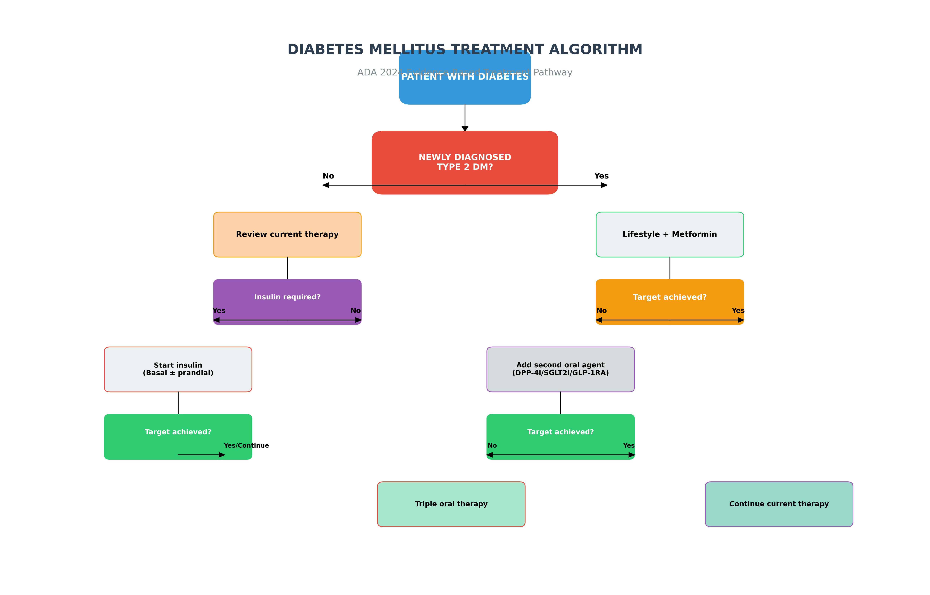
ADA Treatment Algorithm for Type 2 Diabetes

Slide 17
Glycemic Control Targets (ADA 2024)
GENERAL TARGETS
• HbA1c: <7.0% (most adults)
• Preprandial glucose: 80-130 mg/dL
• Peak postprandial: <180 mg/dL
• Bedtime glucose: 100-140 mg/dL
• TIR (Time in Range): >70%
INDIVIDUALIZED TARGETS
• Young patients (<40): HbA1c <6.5-7.0%
• Elderly (≥65): HbA1c 7.5-8.0%
• Longstanding DM (>10y): More liberal
• High CV risk: Stringent control
• Frequent hypoglycemia: Relaxed targets
LATEST EVIDENCE (2024): TIR >70% and HbA1c <7% balance benefits vs. hypoglycemia.
GRADE study: Intensive control (HbA1c <6.5%) prevents complications but increases hypoglycemia.
Personalized targets based on CGM, comorbidities, and patient preferences.

Slide 18
Diabetes Monitoring Strategies (2024)
SELF-MONITORING OF BLOOD GLUCOSE
• T2DM oral agents: 1-2x daily
• T2DM on insulin: 2-4x daily
• T1DM: 4-6x daily (basal-bolus)
• Pre/postprandial monitoring
• Pattern recognition
CONTINUOUS GLUCOSE MONITORING
• TIR (>70%): Primary outcome
• TBR (<4%): Minimize hypo
• TAR (<25%): Manage hyper
• AGP analysis
• Real-time vs. intermittent
COMPREHENSIVE MONITORING
• HbA1c: Every 3-6 months
• Lipid profile: Annual
• Kidney function: eGFR, ACR
• Eye examination: Annual
• Foot assessment: Annual
2024 ADVANCES: AI-powered CGM with predictive alerts, integrated digital platforms, remote monitoring capabilities, automated insulin delivery systems

Slide 19
Diabetes Prevention: Evidence-Based Strategies
PRIMARY PREVENTION
(Prevent Onset)
• Target: High-risk prediabetics
• DPP model: 58% reduction
• Intensive lifestyle intervention
• 5-7% weight loss
• 150 min/week activity
• Metformin optional (BMI ≥35)
SECONDARY PREVENTION
(Delay Progression)
• Prediabetes management
• IFG: 100-125 mg/dL
• IGT: 140-199 mg/dL (2h)
• Lifestyle first-line
• Metformin if BMI ≥35
• Annual monitoring
TERTIARY PREVENTION
(Prevent Complications)
• Established diabetes
• Optimal glycemic control
• Complication screening
• CV risk management
• Multidisciplinary care
• Lifestyle reinforcement
EVIDENCE:
DPP trial (2002) showed 58% diabetes prevention with lifestyle alone.
Da Qing study (1986): 46% reduction in China.
Indian DPP study (2006): 28.5% reduction with lifestyle intervention.

Slide 20
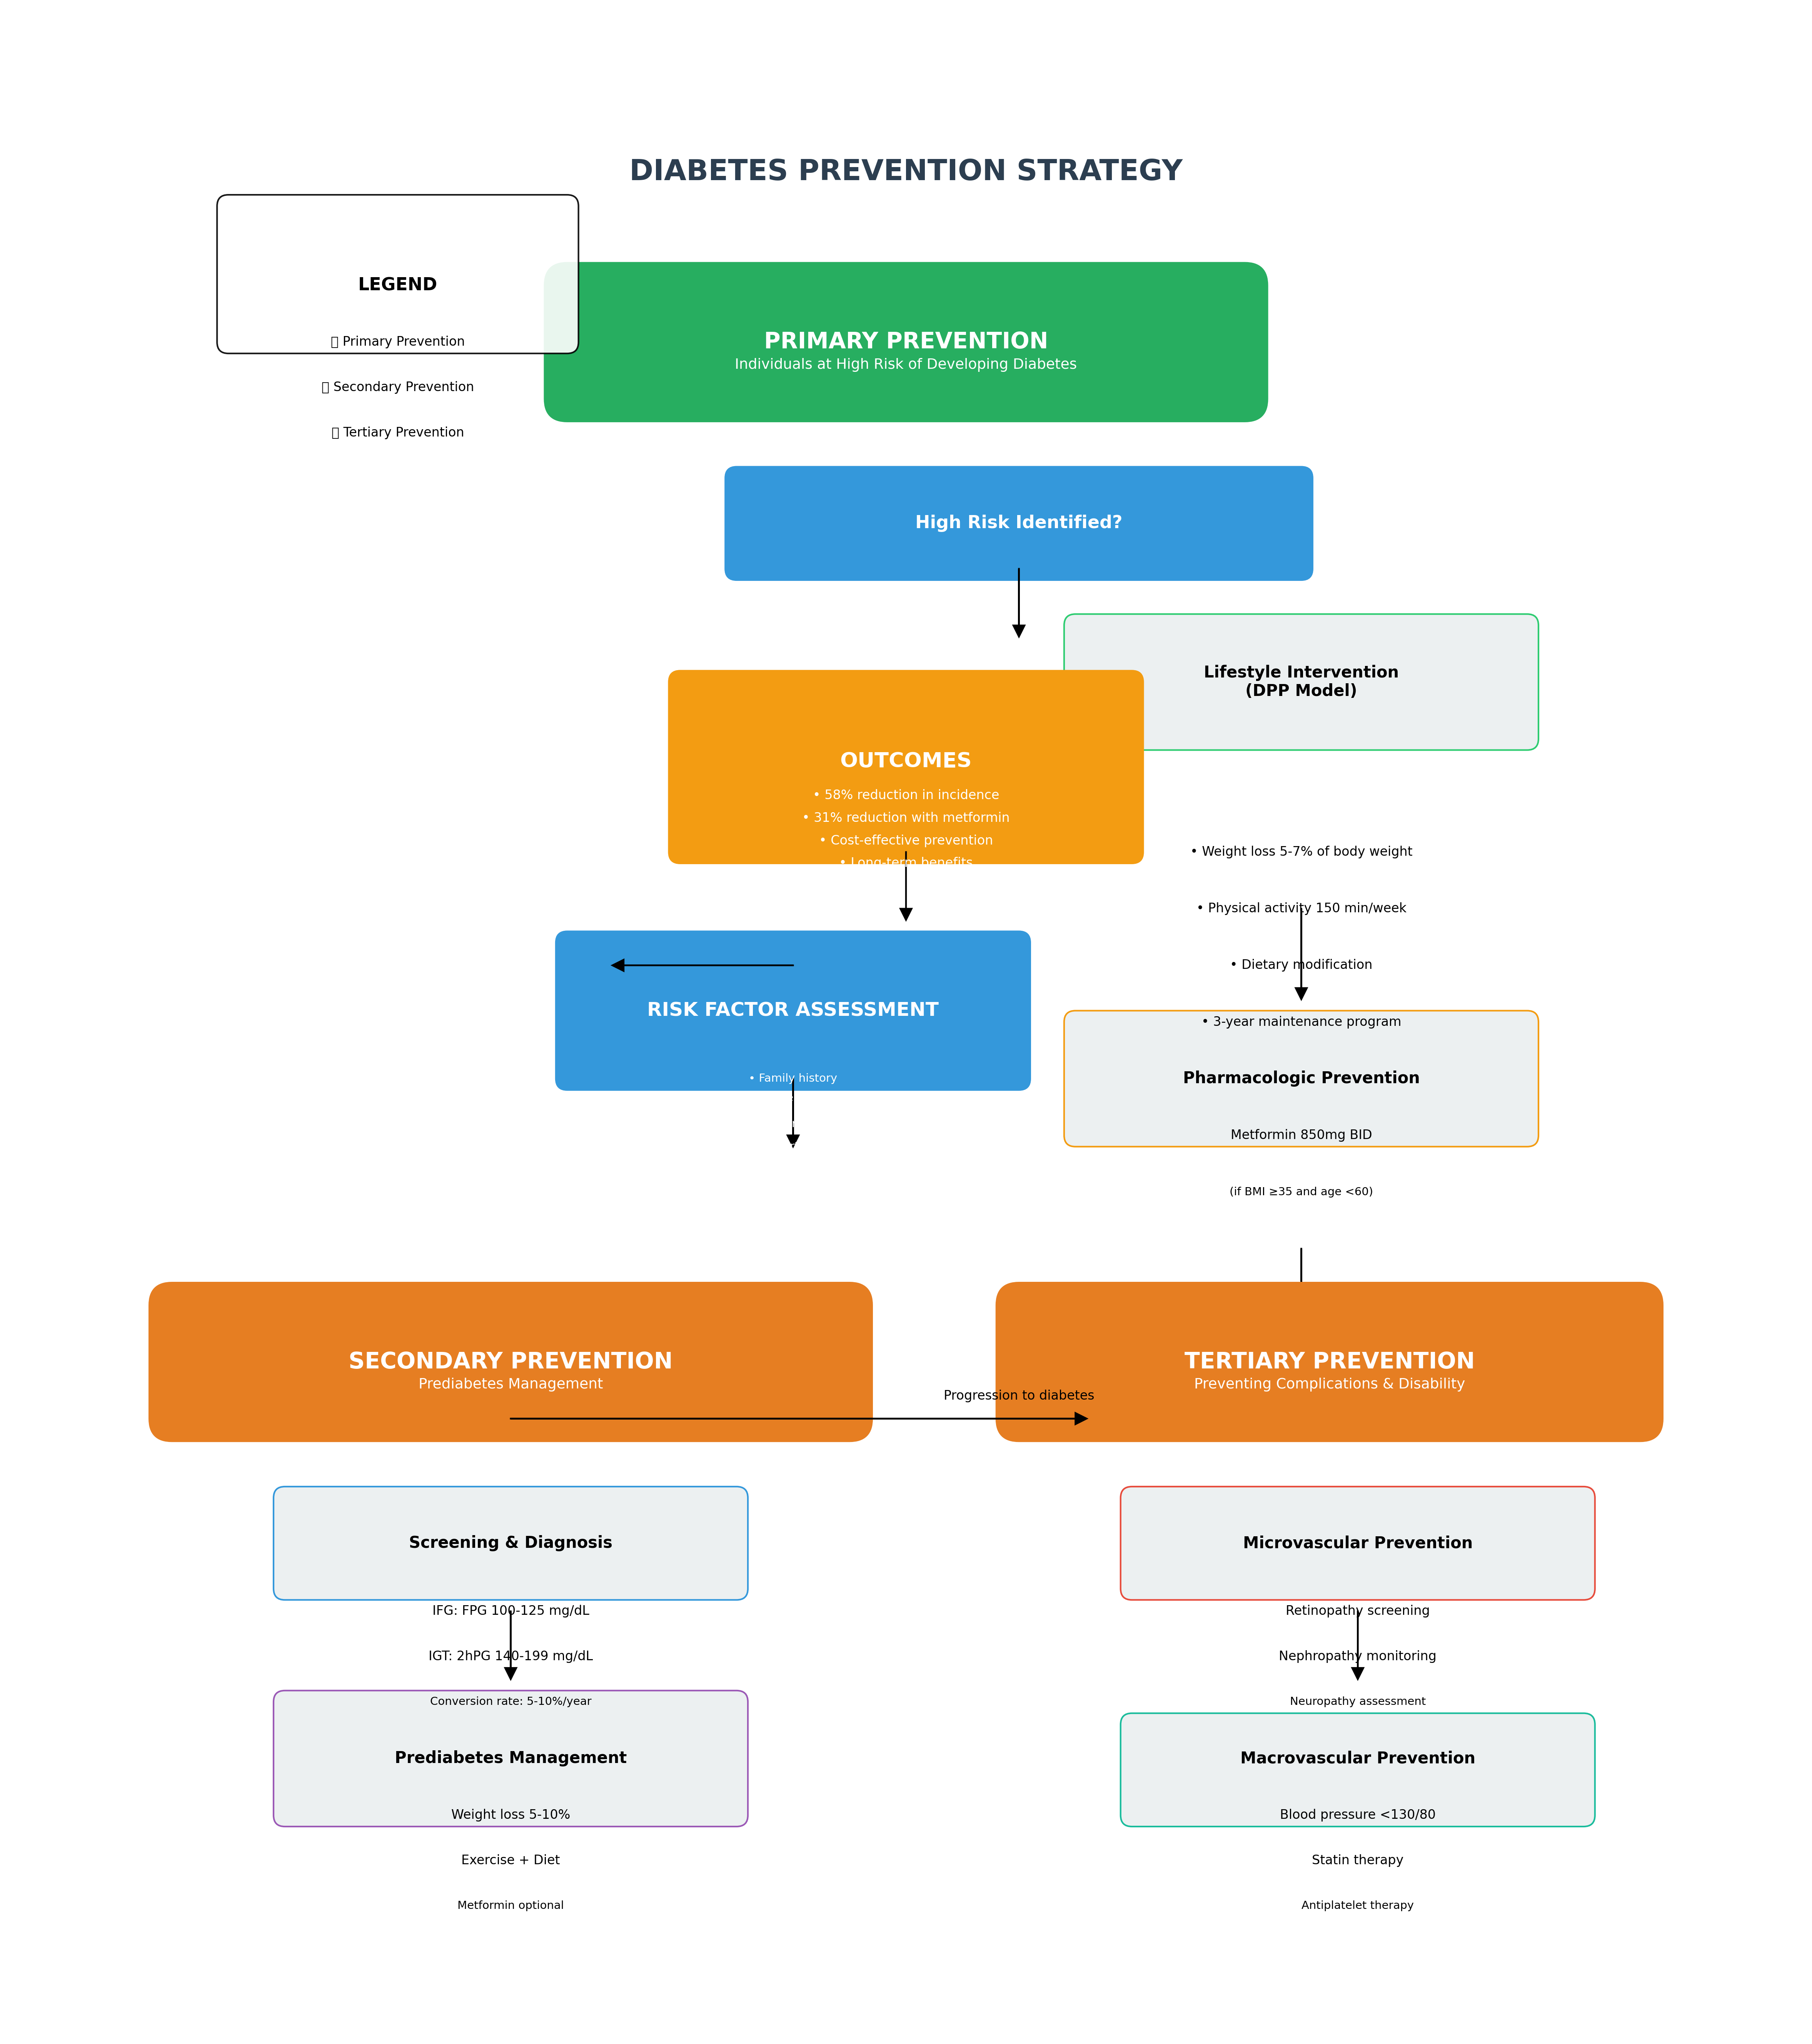
Diabetes Prevention Decision Flowchart

Slide 21
National Programme for Prevention & Control of Diabetes
NPCDCS - Ministry of Health & Family Welfare, India (2010-ongoing)
KEY OBJECTIVES
• 25% reduction in premature mortality
• Early diagnosis and treatment
• Health promotion and prevention
• Capacity building of healthcare workers
• Improved quality of life for patients
PROGRAM COMPONENTS
• NCD clinics at district level
• Population-based screening
• Free diagnostic services
• Drug procurement and distribution
• Health promotion activities
• Training and IEC activities
IMPLEMENTATION: Multi-tier approach (National-State-District-Community).
Key achievements: 355 operational NCD clinics, over 4 crore screenings, oral drug distribution to 50 lakh patients. Integration with Ayushman Bharat and health wellness centres.

Slide 22
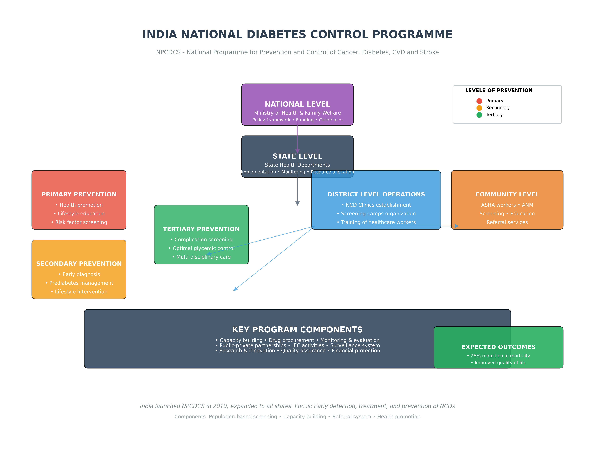
NPCDCS Implementation Framework

Slide 23
Future Directions in Diabetes Care (2024-2030)
HEALTH SYSTEM TRANSFORMATION
• Multidisciplinary teams
• Digital health integration
• Population health approach
• Health economics focus
• Community-based care
PRECISION MEDICINE
• Genetic profiling for therapy
• Biomarker development
• Targeted therapies
• Individualized targets
• Pharmacogenomics
ADVANCED TECHNOLOGIES
• Closed-loop systems
• Stem cell therapy
• Gene therapy (CRISPR)
• AI-driven predictions
• Digital therapeutics
CHALLENGES: Cost of new technologies, equitable access, workforce training, data privacy.
OPPORTUNITIES: Prevention focus shift, AI integration, global collaborations, personalized approaches.

Slide 24
Challenges in Diabetes Control & Prevention
KEY CHALLENGES
• Therapeutic inertia (delayed treatment intensification)
• Long-term lifestyle adherence issues
• Hypoglycemia risk with intensive control
• Resource constraints in LMICs
• Cultural and behavioral barriers
• Socioeconomic disparities in access to care
STRATEGIC SOLUTIONS
• Treatment algorithm audits and standardization
• Behavioral support and digital health tools
• CGM-guided therapy adjustments
• Task shifting to trained non-physicians
• Culturally adapted health education
• Community-based peer support programs
MEASURING SUCCESS: Process indicators (screening rates, timely intensification), outcome indicators (HbA1c targets, complication rates), patient-reported outcomes

Slide 25
Conclusion & Key Takeaways
EPIDEMIOLOGY & BURDEN
• 537M adults with diabetes globally, 101M in India
• Projected growth to 783M (2045) and 160M (India)
• South Asia faces highest proportional increase
• LMICs bear disproportionate burden
• Economic cost: $966B globally, INR 2.5-3 lakh cr in India
PATHOGENESIS & CLASSIFICATION
• T2DM: Insulin resistance + β-cell dysfunction
• T1DM: Autoimmune destruction of β-cells
• Prediabetes affects 541M globally
• Genetic-environment interaction crucial
• Early intervention prevents progression
MANAGEMENT & PREVENTION
• Individualized targets: HbA1c <7% generally
• Metformin first-line, early combination therapy
• CGM/TIR important for personalized control
• DPP lifestyle intervention: 58% prevention
• Multidisciplinary, technology-integrated approach
FUTURE DIRECTIONS
• Precision medicine and AI-driven care
• Stem cell and gene therapies
• Closed-loop automated systems
• Population health and prevention focus
• Global collaboration for equitable care
CALL TO ACTION: Early screening, intensive lifestyle intervention, comprehensive management, technology adoption, health system strengthening

