Slide 1
Diabetes Mellitus Control, Prevention & National Programme
Comprehensive Strategies for Diabetes Management in India
MBBS Teaching Learning Material

Slide 2
Presentation Overview
• Diabetes Control Strategies - Glycemic targets, monitoring, technology
• Prevention Framework - Primary, secondary, and tertiary prevention
• National Programme (NPCDCS) - India's diabetes control initiative
• Implementation Strategies - Multidisciplinary approach
• Evidence-based Interventions - Lifestyle, pharmacological, behavioral
• Outcome Measures - Process and outcome indicators

Slide 3
Glycemic Control Targets (ADA 2024)
GENERAL TARGETS
• HbA1c: <7.0% (most adults)
• Preprandial glucose: 80-130 mg/dL
• Peak postprandial: <180 mg/dL
• Bedtime glucose: 100-140 mg/dL
• TIR (Time in Range): >70%
INDIVIDUALIZED TARGETS
• Young patients (<40): HbA1c <6.5-7.0%
• Elderly (≥65): HbA1c 7.5-8.0%
• Longstanding DM (>10y): More liberal
• High CV risk: Stringent control
• Frequent hypoglycemia: Relaxed targets
Key Considerations: Age, comorbidities, life expectancy, hypoglycmia risk, and patient preferences should guide target setting. SMBG/CGM data crucial for pattern management.

Slide 4
Diabetes Monitoring Strategies
SELF-MONITORING OF BLOOD GLUCOSE
• Type 2 DM on oral agents: 1-2x daily
• Type 2 DM on insulin: 2-4x daily
• Type 1 DM: 4-6x daily (basal-bolus)
• Pre/postprandial monitoring essential
• Pattern recognition for dose adjustment
CONTINUOUS GLUCOSE MONITORING
• TIR (>70%): Primary outcome measure
• TBR (<4%): Minimize hypoglycemia
• TAR (<25%): Manage hyperglycemia
• Ambulatory Glucose Profile analysis
• Real-time vs. intermittently scanned
HbA1c: Every 3-6 months (clinically meaningful change: 0.5%)

Slide 5
Levels of Diabetes Prevention
PRIMARY PREVENTION
(Prevent Diabetes Onset)
• Target: High-risk individuals (prediabetes)
• DPP model: 58% incidence reduction
• Intensive lifestyle intervention
• 5-7% weight loss + 150 min/week activity
• Metformin in selected cases (BMI ≥35)
• Health promotion campaigns
SECONDARY PREVENTION
(Delay Progression)
• Target: Prediabetes management
• IFG: 100-125 mg/dL
• IGT: 140-199 mg/dL (2h PG)
• Lifestyle modification first-line
• Metformin optional (BMI ≥35)
• Annual monitoring for progression
TERTIARY PREVENTION
(Prevent Complications)
• Target: Established diabetes
• Optimal glycemic control
• Complication screening (annual)
• Cardiovascular risk management
• Multidisciplinary care approach
• Rehabilitation and support

Slide 6
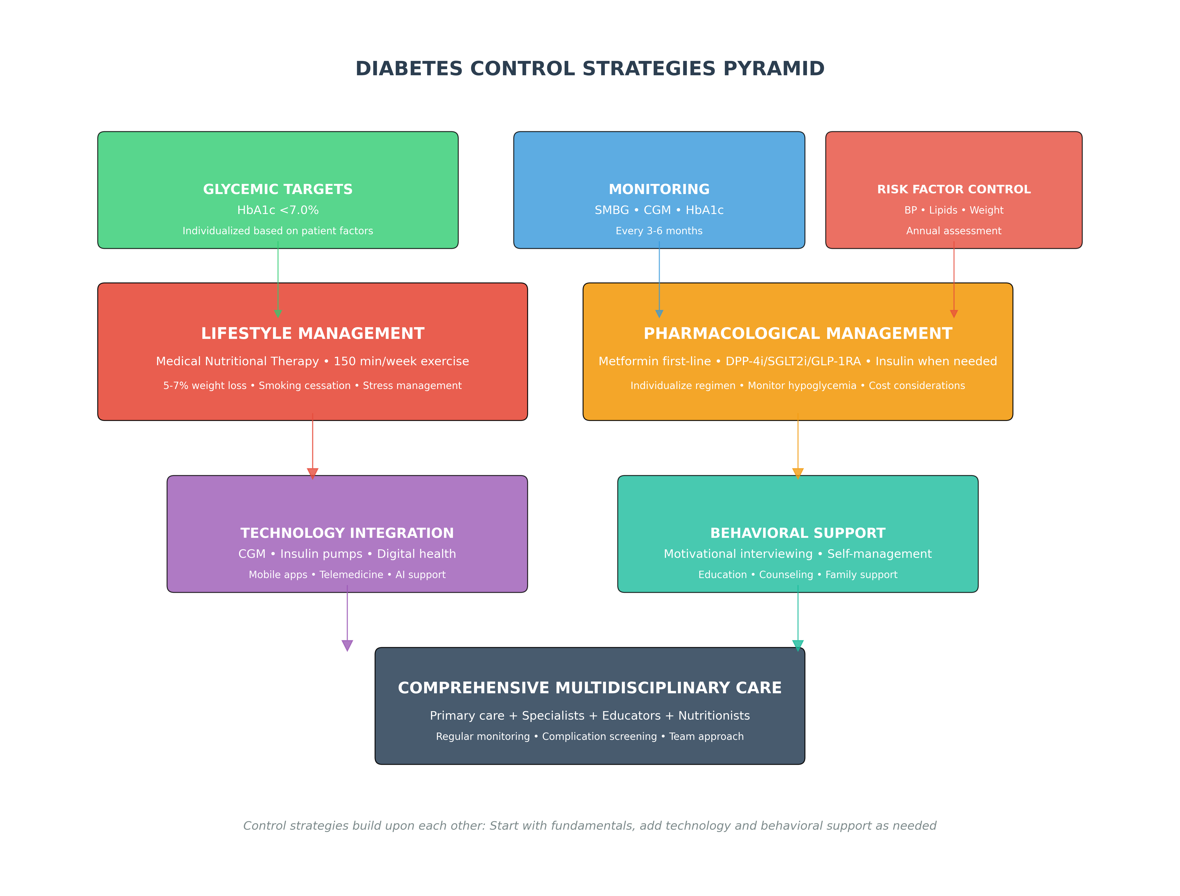
Diabetes Control Strategies Pyramid

Slide 7
National Programme for Prevention & Control of Diabetes
NPCDCS - Ministry of Health & Family Welfare, India (2010-ongoing)
KEY OBJECTIVES
• 25% reduction in premature mortality
• Early diagnosis and treatment
• Health promotion and prevention
• Capacity building of healthcare workers
• Improved quality of life for patients
PROGRAM COMPONENTS
• NCD clinics at district level
• Population-based screening
• Free diagnostic services
• Drug procurement & distribution
• Health promotion activities
IMPLEMENTATION: National → State → District → Community (ASHA/ANM workers)

Slide 8
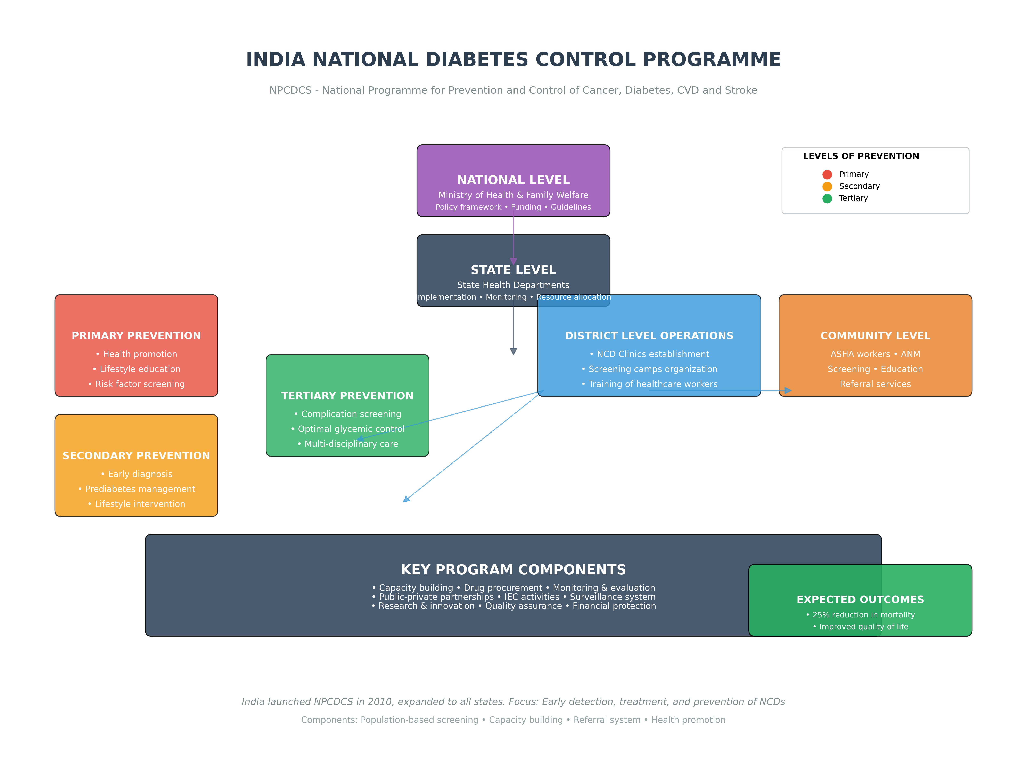
NPCDCS Implementation Framework

Slide 9
Diet & Physical Activity for Diabetes Control & Prevention
DIETARY RECOMMENDATIONS
• Mediterranean/DASH diets preferred
• Low glycemic index carbohydrates
• Increased fiber intake (25-30g/day)
• Plant-based proteins (pulses, legumes)
• Reduced saturated/trans fats (<7% energy)
• Portion control and mindful eating
PHYSICAL ACTIVITY PRESCRIPTION
• 150 minutes/week moderate intensity
• Combination of aerobic + resistance training
• Yoga and flexibility exercises
• Walking/bicycling for commuting
• Sedentary behavior reduction
• Individualized based on fitness level
Evidence: DPP trial showed 58% reduction in diabetes incidence with lifestyle intervention alone.

Slide 10
Challenges in Diabetes Control & Prevention
KEY CHALLENGES
• Therapeutic inertia (delay in treatment intensification)
• Adherence to lifestyle changes long-term
• Hypoglycemia risk with intensive control
• Resource constraints in low-income settings
• Cultural and behavioral barriers
• Socioeconomic disparities in access
STRATEGIC SOLUTIONS
• Regular treatment algorithm audits
• Behavioral support and counseling
• CGM-guided therapy adjustments
• Task shifting to trained non-physicians
• Culturally adapted health education
• Community-based peer support groups

Slide 11
Conclusion & Key Takeaways
CONTROL STRATEGIES
• Individualized glycemic targets based on patient characteristics (age, comorbidities, hypoglycemia risk)
• Comprehensive monitoring: SMBG/CGM + HbA1c every 3-6 months
• Lifestyle intervention as foundation + metformin first-line pharmacological therapy
• Multidisciplinary team approach with regular complication screening
• Technology utilization (CGM, pumps) and behavioral support for optimal outcomes
PREVENTION FRAMEWORK
• Primary prevention: DPP model (58% reduction) - lifestyle intervention for high-risk individuals
• Secondary prevention: Prediabetes management with lifestyle ± metformin
• Tertiary prevention: Optimal control and complication management in established diabetes
• Population-based approaches combined with high-risk individual strategies
NATIONAL PROGRAMME (NPCDCS)
• Comprehensive government initiative for diabetes and NCD control
• Multi-level implementation: National → State → District → Community
• Key components: Screening, treatment, health promotion, capacity building
• Focus on prevention, early diagnosis, and comprehensive management

