Slide 1
Diabetes Mellitus
Teaching Learning Material for MBBS Students
Comprehensive Guide with India Focus

Slide 2
Definition & Diagnostic Criteria
DEFINITION & CRITERIA
• Type 1: Autoimmune β-cell destruction
• Type 2: Insulin resistance + β-cell failure
• Maturity-onset diabetes of young (MODY)
• Gestational diabetes mellitus
• Other specific types (drug-induced, genetic)
DIAGNOSTIC CRITERIA
• Fasting Plasma Glucose (FPG): ≥126 mg/dL
• 2-hour Plasma Glucose (2hPG): ≥200 mg/dL
• Glycated Hemoglobin (HbA1c): ≥6.5%
• Random PG + symptoms: ≥200 mg/dL
• Asymptomatic: Confirmatory testing required
• ADA 2024 criteria with Indian adaptations

Slide 3
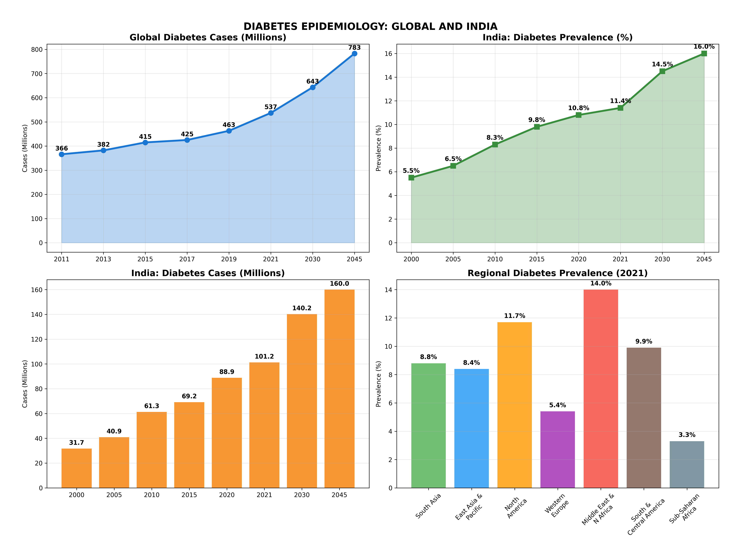
Epidemiology & Disease Burden
• Global: 537M cases (2021) → 643M (2030) • India: 101M cases • $966B healthcare cost • 6.7M annual deaths

Slide 4
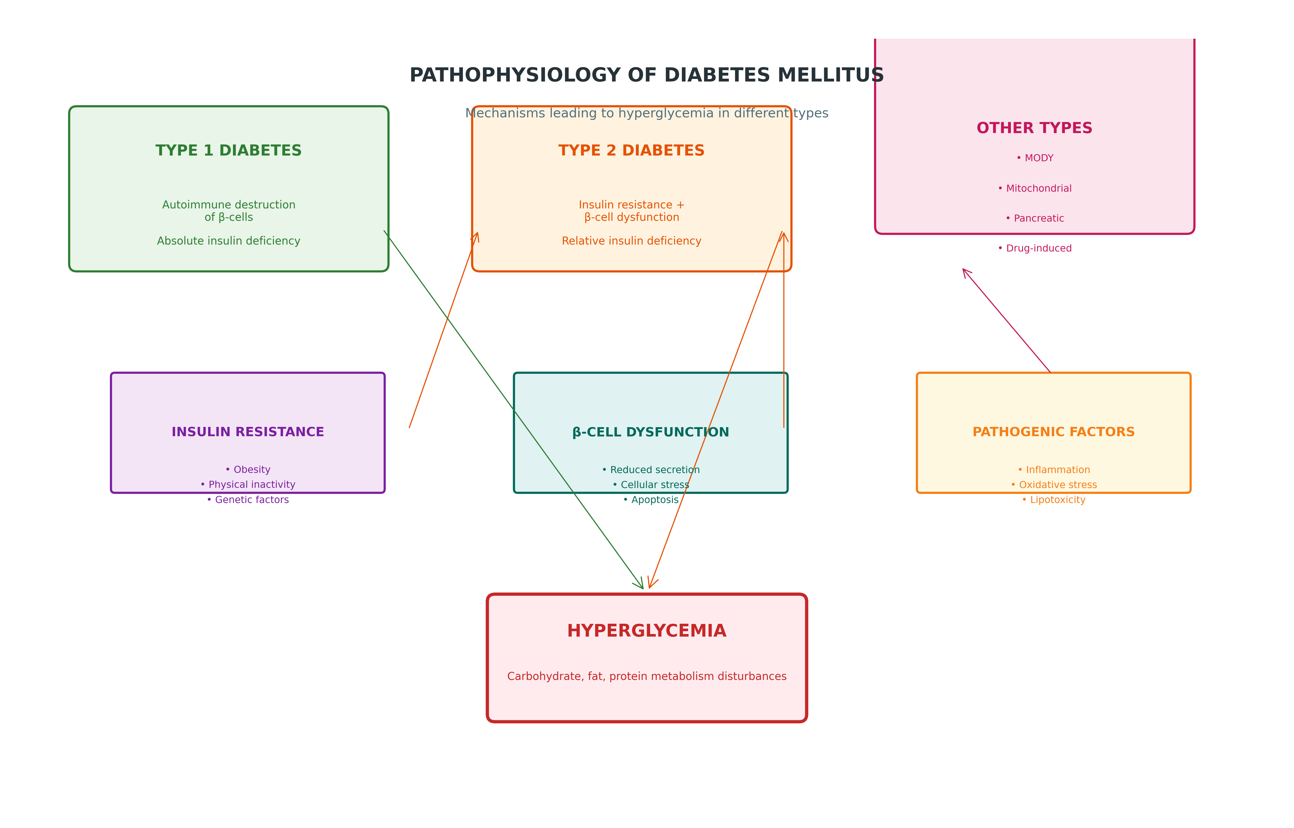
Pathophysiology of Diabetes Mellitus
• Type 1: Autoimmune β-cell destruction → Absolute insulin deficiency → Ketosis-prone • Type 2: Insulin resistance + β-cell failure → Relative insulin deficiency → Lifestyle modifiable

Slide 5
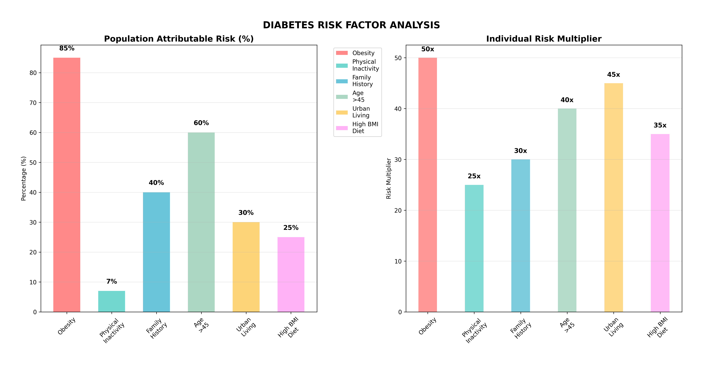
Risk Factors for Diabetes Mellitus

Slide 6
Diagnostic Criteria (ADA 2024)
Parameter | Diabetes | Prediabetes | Normal
FPG | ≥126 mg/dL | 100-125 mg/dL | <100 mg/dL
2hPG | ≥200 mg/dL | 140-199 mg/dL | <140 mg/dL
HbA1c | ≥6.5% | 5.7-6.4% | <5.7%
Random PG | ≥200 mg/dL + symptoms | - | -

Slide 7
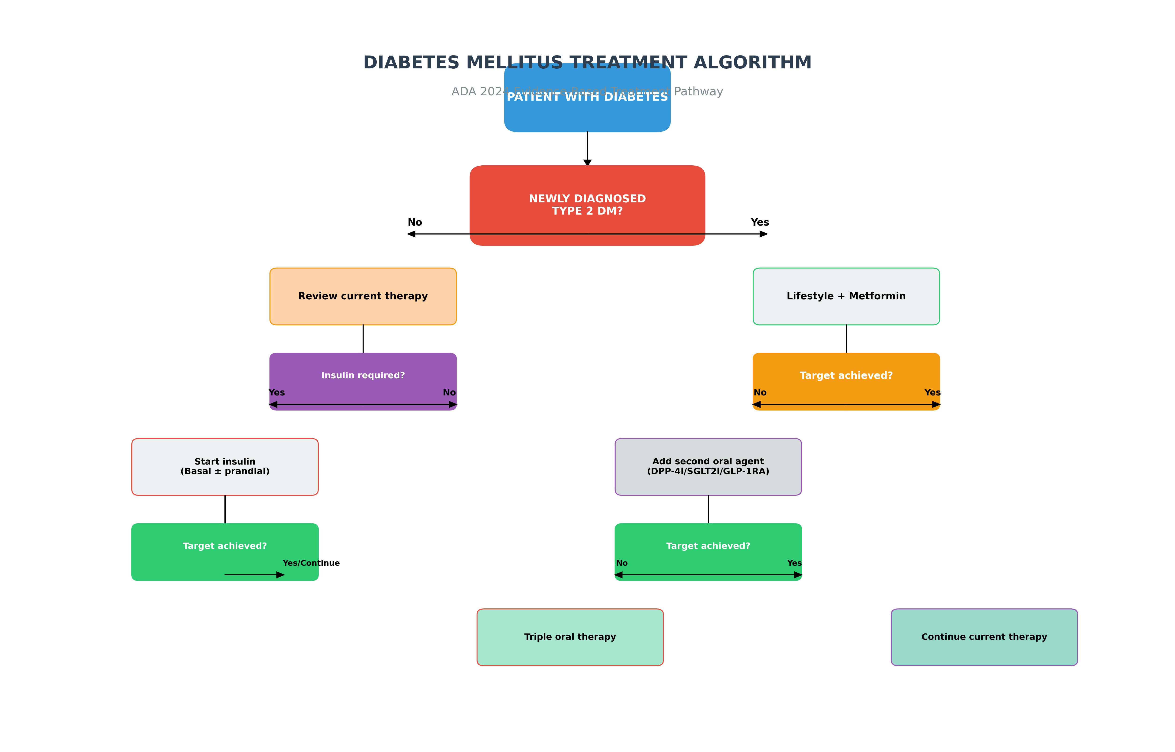
ADA Treatment Algorithm (2024)
• Lifestyle + Metformin first-line • Individualize based on patient factors • DPP-4i, SGLT2i, GLP-1 RA for dual therapy • Insulin initiation when needed

Slide 8
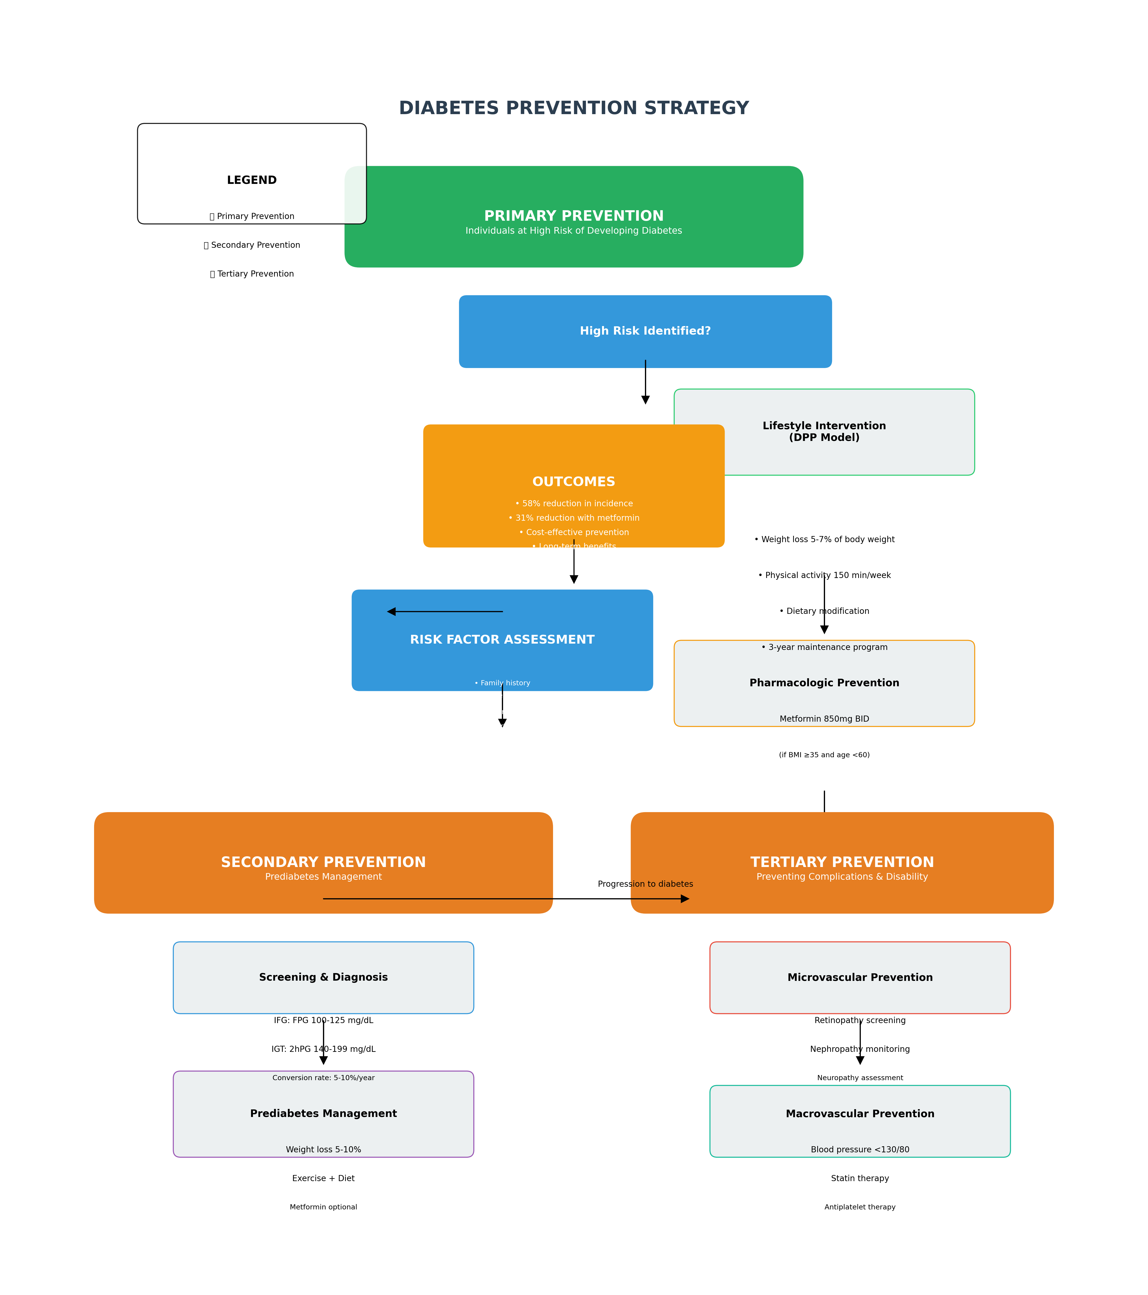
Prevention of Diabetes Mellitus
• Primary: Prevent progression from prediabetes • Secondary: Lifestyle + metformin for prediabetes • Tertiary: Optimal management of established diabetes

Slide 9
Learning Objectives & Key Takeaways
LEARNING OBJECTIVES
• Master diabetes pathophysiology (T1DM vs T2DM)
• Apply ADA 2024 diagnostic criteria confidently
• Develop evidence-based treatment algorithms
• Understand India-specific epidemiological patterns
• Design comprehensive prevention strategies
• Recognize and manage complications
• Implement lifestyle interventions effectively
CLINICAL PEARLS
• Three P's: Polyuria, Polydipsia, Polyphagia
• Diabetes diagnostic: FPG≥126, 2hPG≥200, HbA1c≥6.5
• Lifestyle + metformin first-line therapy
• Individualize targets based on patient factors
• Prevention better than cure - focus on lifestyle
• Foot examination essential at every visit

