Slide 1
Epidemiology and Control Measures of JE and Chikungunya in India
Comprehensive Teaching Material for MBBS Students
Aligned with CBME Curriculum - National Medical Commission

Slide 2
Learning Objectives
By the end of this session, students will be able to:
• Understand global and Indian epidemiology of JE and Chikungunya
• Describe transmission cycles and clinical features in Indian context
• Explain diagnostic methods and evidence-based treatment approaches
• Discuss prevention and control measures under NVBDCP and UIP
• Compare both diseases and appreciate their public health impact
• Apply knowledge in community medicine rotations and clinical practice

Slide 3
Introduction to Vector-Borne Diseases in India
• Arboviruses: RNA viruses transmitted by arthropod vectors
• Global burden: >1 billion people affected by vector-borne diseases
• Indian perspective: NVBDCP coordinates control of 6 major VBDs
• JE and Chikungunya: Major public health challenges in India
• Relevance to MBBS: Community medicine, epidemiology, preventive medicine
• CBME alignment: Practical application in Indian healthcare settings

Slide 4
Japanese Encephalitis: Global and Indian Epidemiology
Global:
• Endemic in 24 countries across WHO South-East Asia and Western Pacific
• Affects over 3 billion people at risk
• Annual clinical cases: ~100,000 (95% CI: 61,720–157,522)
• Case fatality: 20-30% among symptomatic cases
India:
• High burden states: UP, Bihar, Assam, West Bengal
• Annual cases: 1,000-3,000 reported (likely underreported)
• Age group: Children <15 years (majority of cases)
• Seasonal pattern: July-October (monsoon season)
• NVBDCP sentinel surveillance in endemic districts

Slide 5
JE: Indian Context and Risk Factors
• Vaccination impact: Cases declined significantly since UIP introduction
• Current status: Sporadic outbreaks in endemic areas
• Rural epidemiology: Rice cultivation, pig farming, irrigation systems
• Transmission cycle: Maintained by domestic pigs and ardeid birds
• Monsoon correlation: Peak transmission during July-October
• Surveillance: Integrated Disease Surveillance Programme (IDSP)
• Control: Universal Immunization Programme (UIP) campaigns

Slide 6
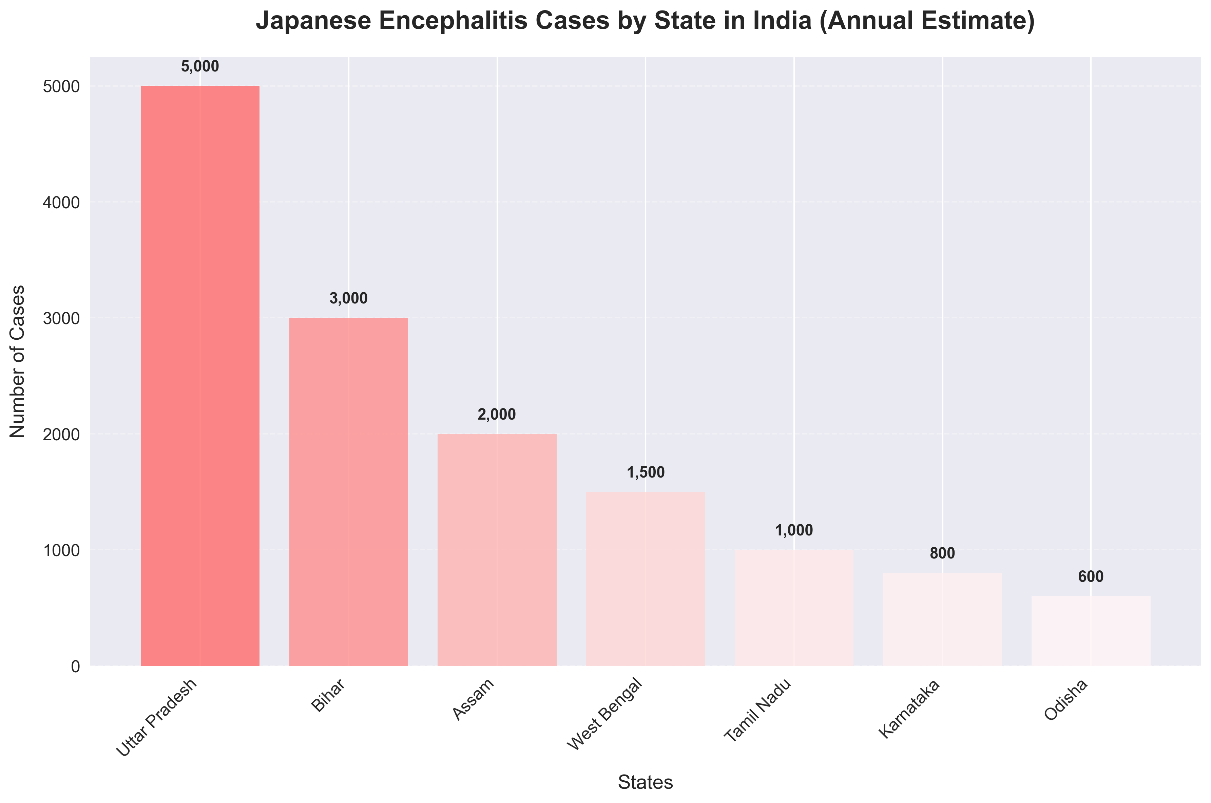
JE Burden in India: Statistics and Impact
Annual Burden:
• Cases: 1,000-3,000 reported
• Deaths: 200-500
• Sequelae: 30-50% of survivors
• Economic cost: ₹500-1000 crores
High Burden States:
• UP: 40% of total cases
• Bihar: 25% of total cases
• Assam: 15% of total cases

Slide 7
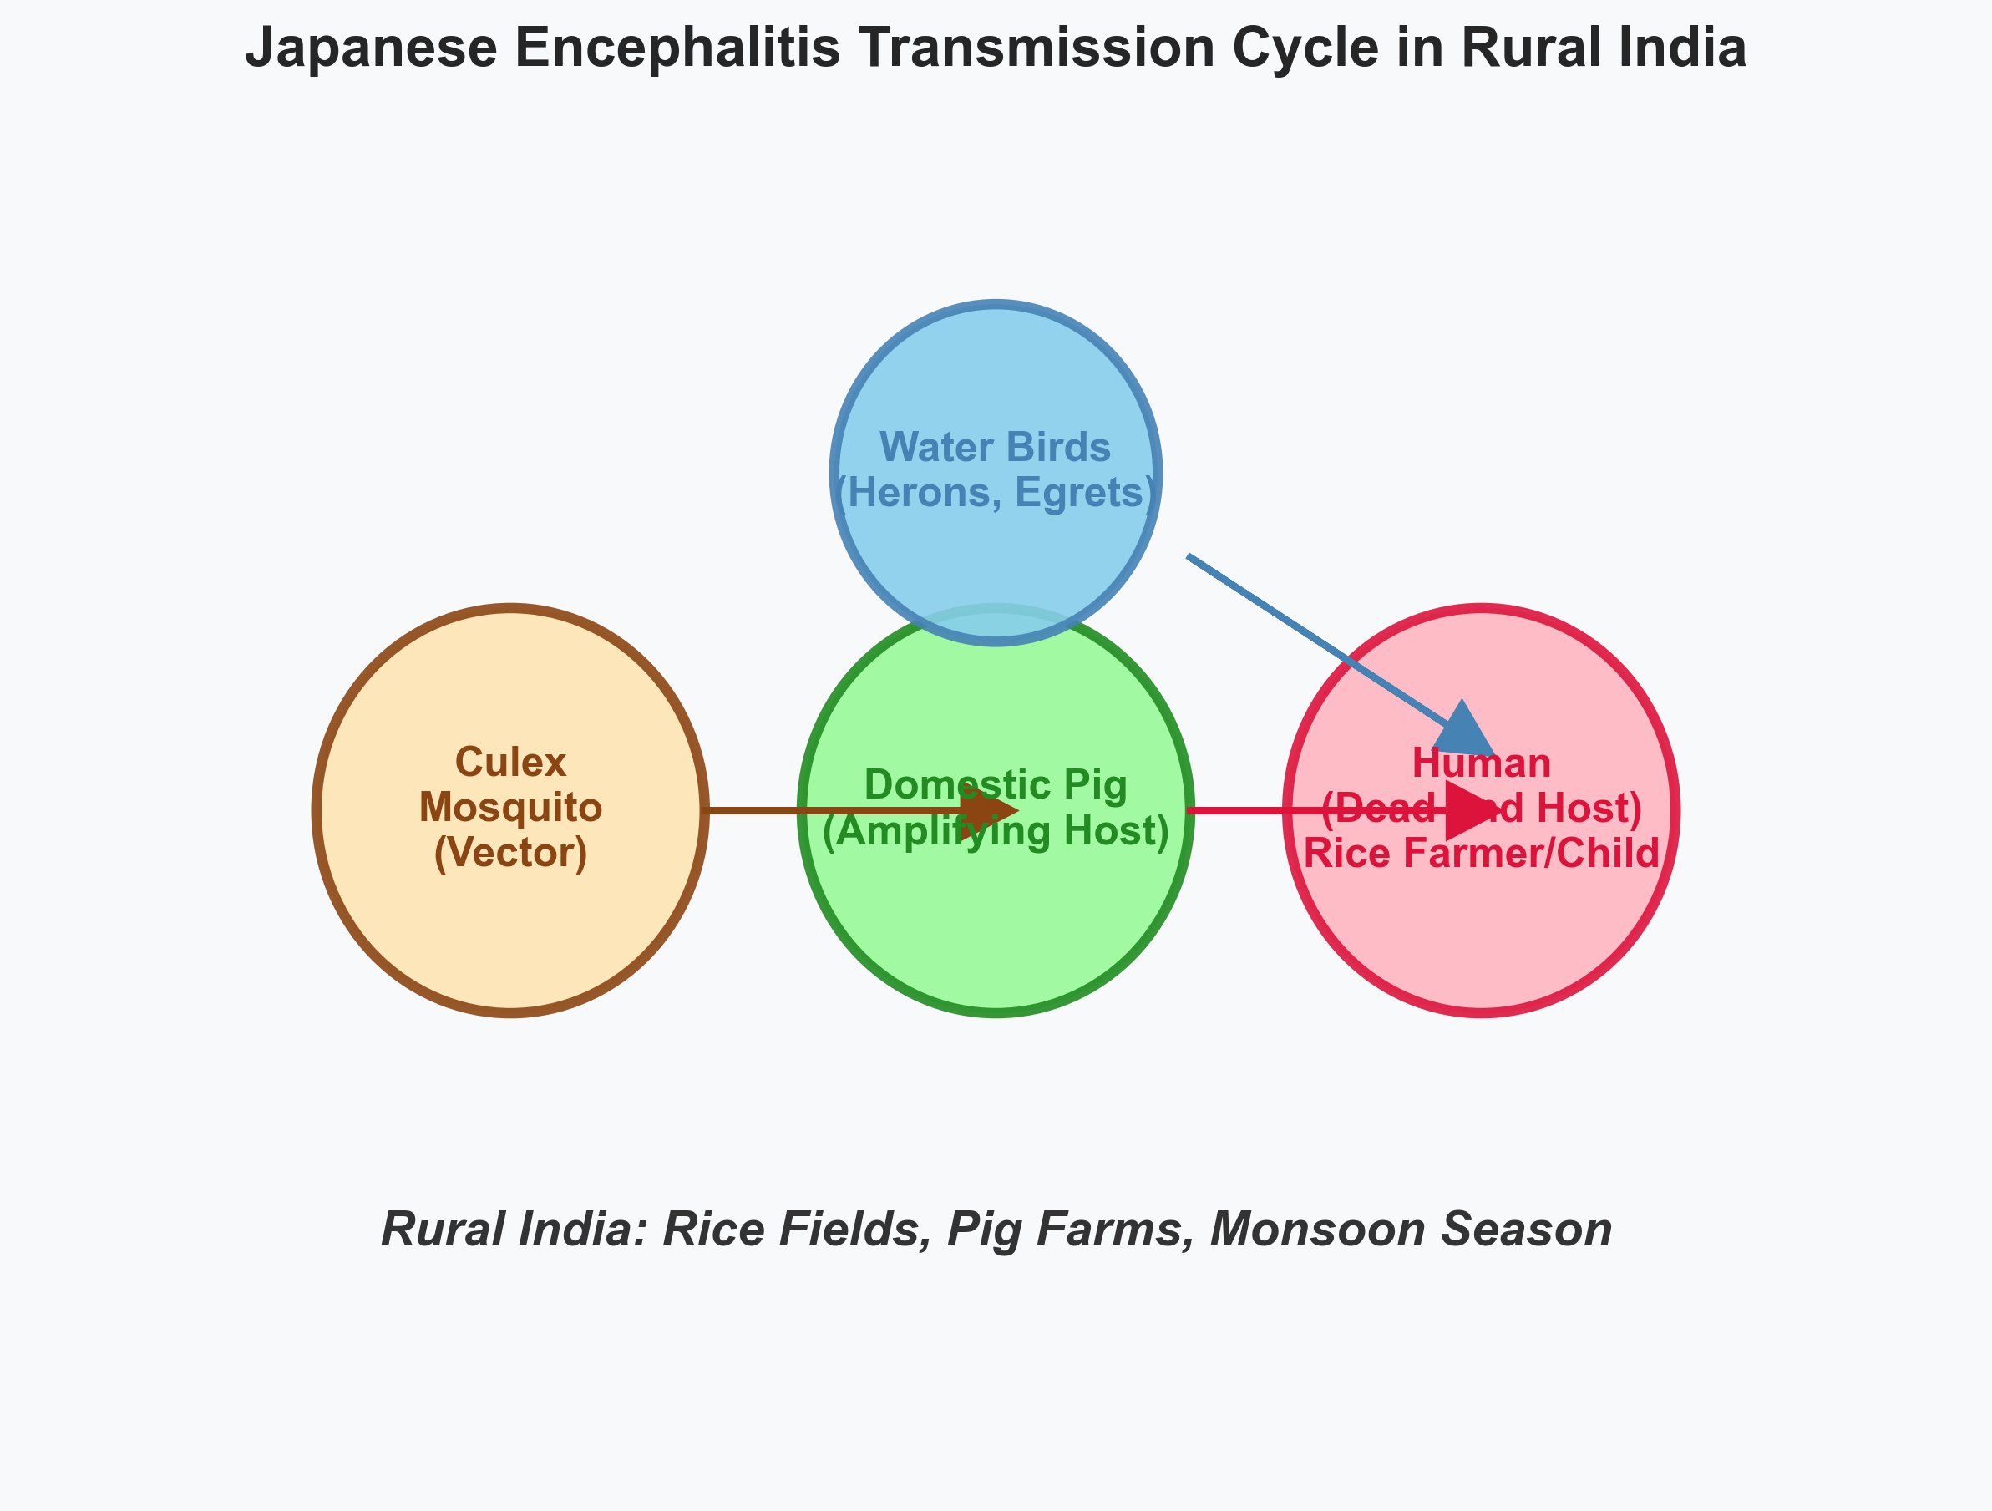
JE Transmission Cycle in Rural India
Enzootic Cycle:
• Mosquito-Pig/Bird-Mosquito
• Humans: Dead-end hosts
• Amplifying hosts: Domestic pigs, water birds
• Vector: Culex tritaeniorhynchus
• Indian context: Rice fields, pig farms

Slide 8
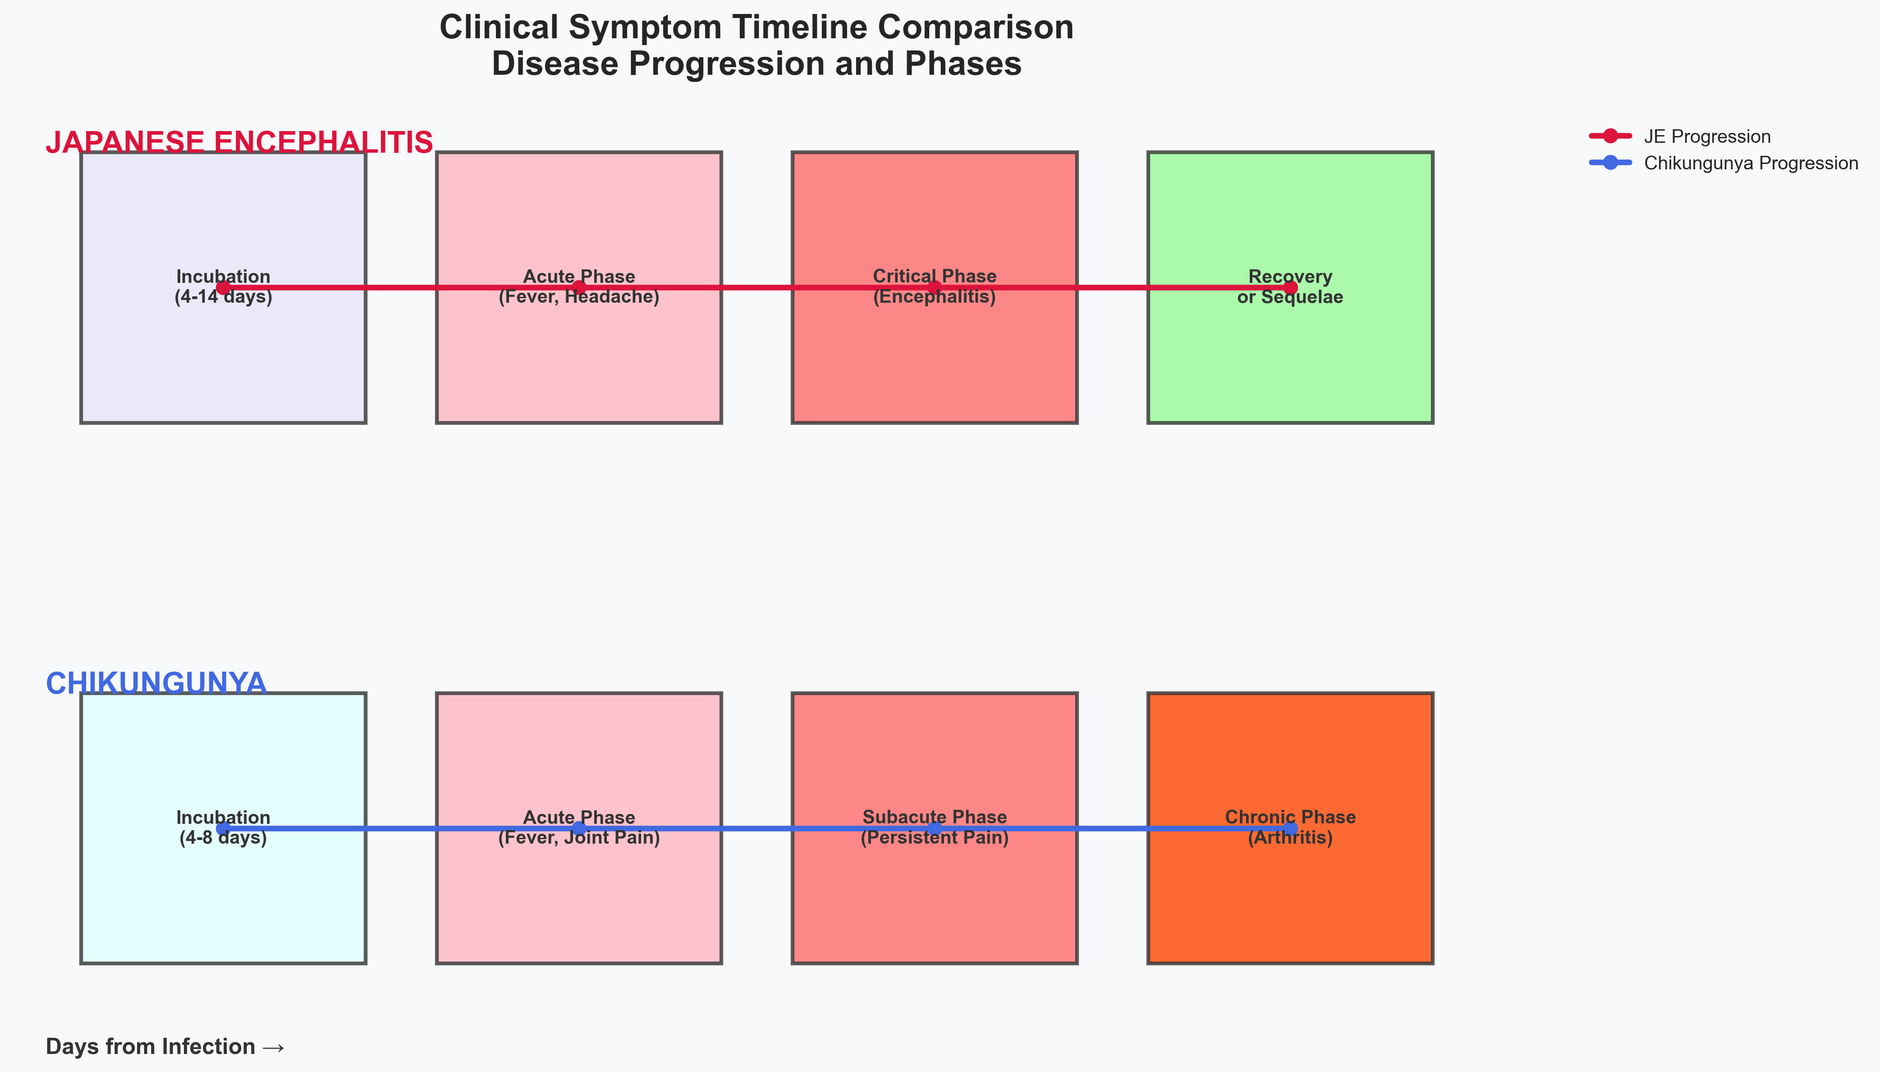
JE Clinical Features and Symptom Timeline
Clinical Presentation:
• Incubation: 4-14 days
• Mild (99%): Fever, headache
• Severe (1 in 250): Encephalitis, seizures, paralysis
• Indian context: Acute Encephalitis Syndrome (AES)
• Complications: Neurological deficits, death

Slide 9
JE: Diagnosis and Treatment in India
Diagnosis:
• Clinical suspicion in endemic areas
• IgM-capture ELISA on CSF (preferred) or serum
• RT-PCR in early stages
• IDSP guidelines for sample collection
• Differential diagnosis from other encephalitis
Treatment:
• No specific antiviral therapy
• Supportive care: Intensive care for severe cases
• Management: Airway, seizures, fluid balance
• Rehabilitation: Essential for neurological deficits
• Indian context: District hospital care, limited rural rehabilitation

Slide 10
JE Prevention and Control in India
Vaccination:
• Universal Immunization Programme (UIP)
• Vaccine: Live attenuated SA 14-14-2
• Target: Children aged 1-15 years
• Coverage: High in UP, Bihar, Assam, West Bengal
Vector Control:
• NVBDCP strategies: Fogging, larviciding
• Personal protection: Repellents, bed nets
• Community measures: Pig management, rice field irrigation
• Surveillance: IDSP, AES monitoring
• Outbreak response: Rapid vaccination campaigns

Slide 11
Chikungunya: Global and Indian Epidemiology
Global:
• 110+ countries affected since 1952
• Major outbreaks in Africa, Asia, Americas, Europe
• Annual burden: Millions affected during epidemics
• Case fatality: <0.1% (rarely fatal)
India:
• All states affected, major outbreaks every few years
• 2006 epidemic: 1.3 million cases
• Recent outbreaks: Delhi (2016-2017), Punjab, Haryana
• Urban and rural transmission
• Vectors: Aedes aegypti (urban), Aedes albopictus (rural)
• Seasonal pattern: Monsoon-linked transmission

Slide 12
Chikungunya: Indian Context and Risk Factors
• Vector adaptation: CHIKV adapted to Aedes albopictus
• Urban transmission: Water storage containers, poor waste management
• Rural transmission: Natural breeding sites, vegetation
• Climate change impact: Expanded vector habitats
• Population movement: Urban-rural migration patterns
• Surveillance: IDSP mandatory reporting
• Control: NVBDCP integrated vector management
• Economic impact: ₹200-500 crores per major outbreak

Slide 13
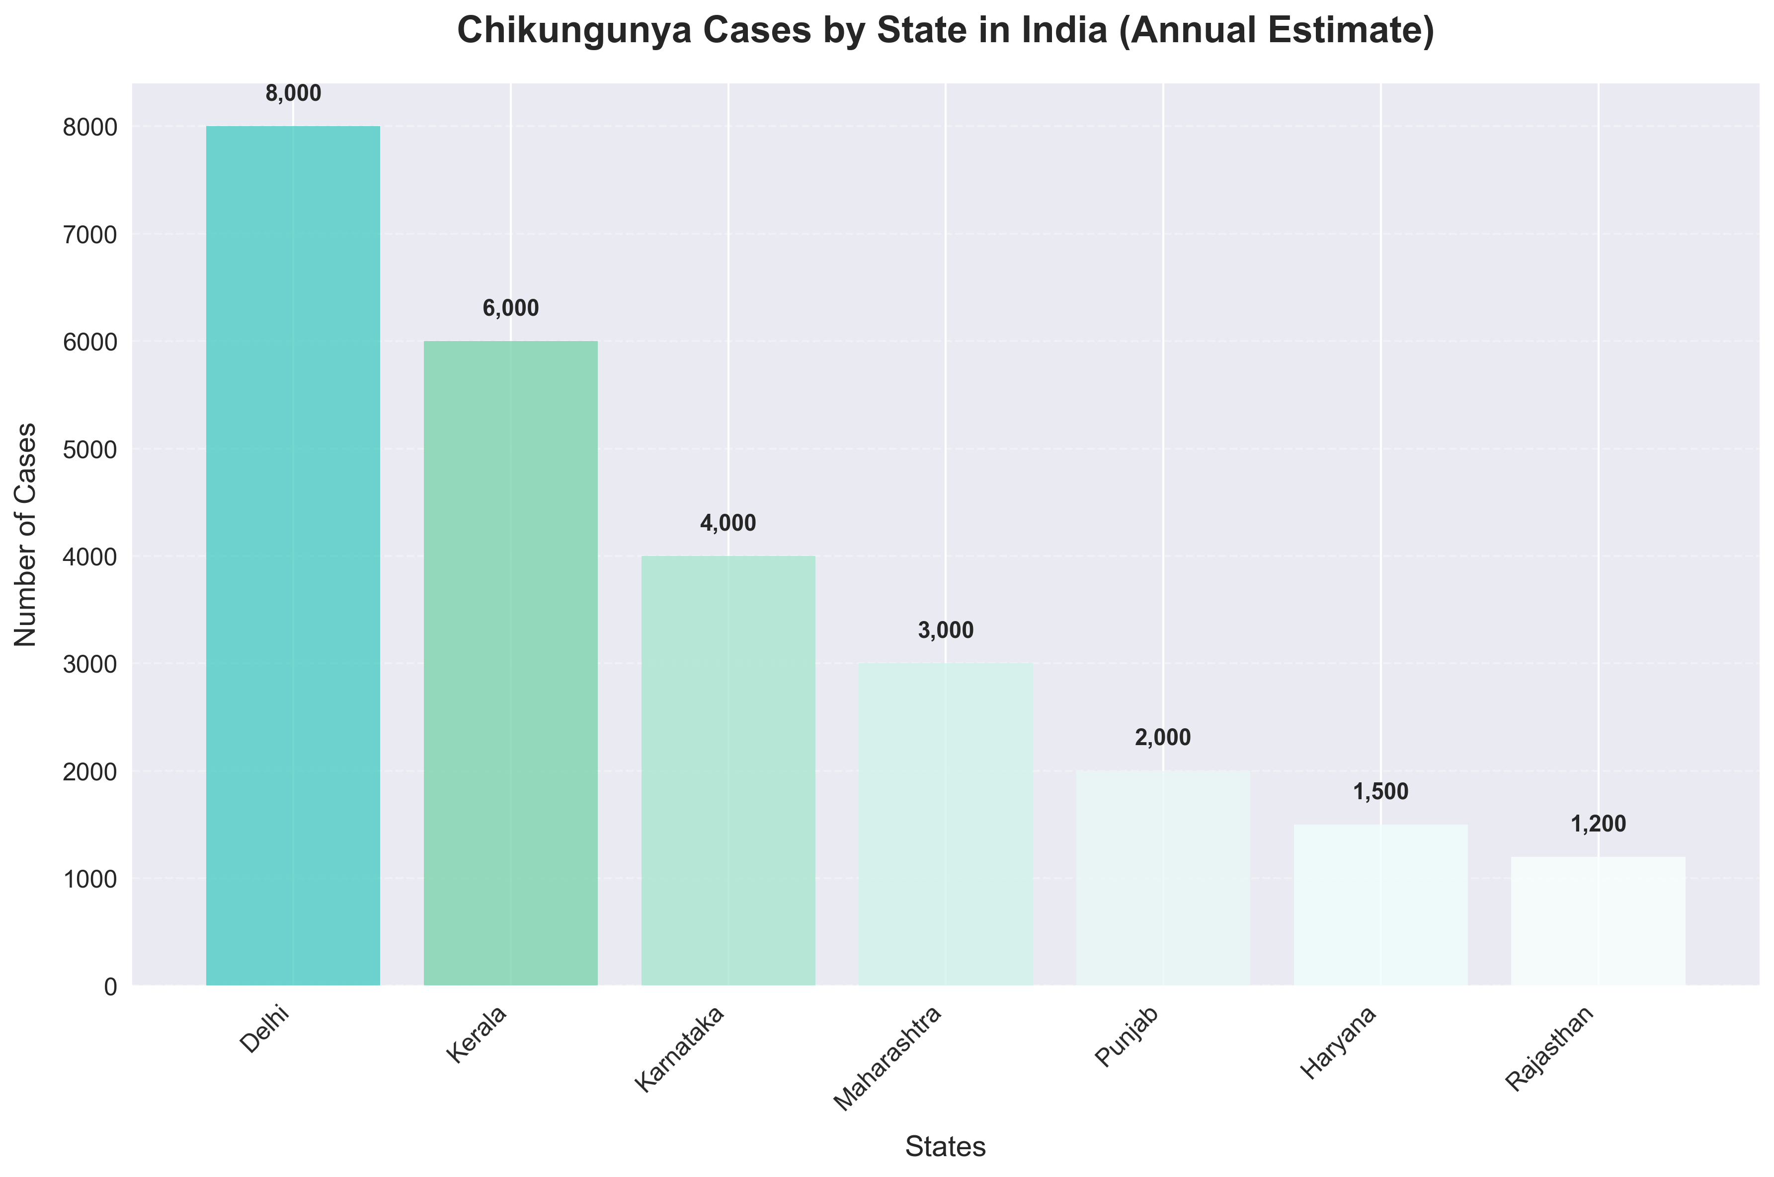
Chikungunya Burden in India: Statistics and Impact
Outbreak Impact:
• 2006: 1.3 million cases
• 2016-2017: 60,000+ cases in Delhi
• Chronic cases: 100,000-300,000 affected
• Economic cost: ₹200-500 crores per outbreak
• Productivity loss: Significant in urban areas

Slide 14
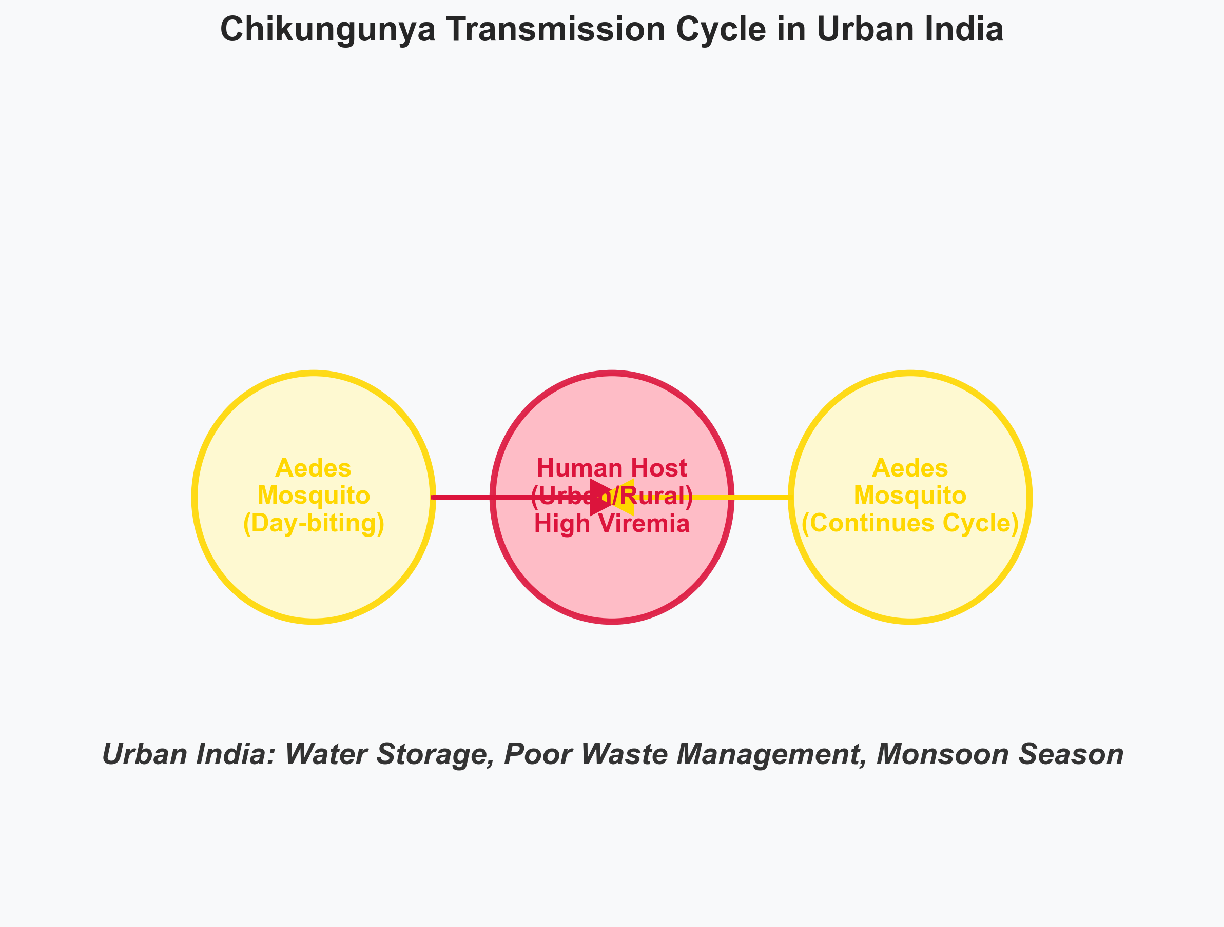
Chikungunya Transmission Cycle in Urban India
Human-Mosquito Cycle:
• No animal reservoirs
• High viremia in humans
• Day-biting mosquitoes
• Urban: Aedes aegypti
• Rural: Aedes albopictus
• Indian context: Water storage, poor sanitation

Slide 15
Chikungunya: Clinical Features in Indian Context
Clinical Presentation:
• Incubation: 4-8 days (range 2-12 days)
• Acute phase: High fever (≥39°C), severe joint pain
• Characteristic: "Chikungunya gait" due to joint pain
• Rash: Present in 40-50% of cases
• Other symptoms: Headache, myalgia, nausea, fatigue
Indian Context:
• Often mimics dengue fever (diagnostic challenge)
• Chronic phase: Persistent arthritis (10-30% of patients)
• Complications: Neurological (10-15%), cardiac, ocular
• Severe disease: Infants, elderly, comorbidities

Slide 16
Chikungunya: Diagnosis and Treatment in India
Diagnosis:
• RT-PCR: First week of illness (acute phase)
• Serology: IgM/IgG ELISA from day 5 onwards
• NVBDCP guidelines for sample collection
• Differential diagnosis: Dengue, Zika, other arboviruses
• Cross-reactivity: Can complicate serologic diagnosis
Treatment:
• No specific antiviral therapy
• Symptomatic: Paracetamol, adequate hydration, rest
• Avoid NSAIDs initially (dengue co-infection risk)
• Corticosteroids: For severe arthritis
• Indian context: Physiotherapy, traditional medicine (Ayurveda)

Slide 17
Chikungunya Prevention in India
Vector Control:
• Source reduction: Weekly emptying of water containers
• Community education: Waste management, sanitation
• NVBDCP: Larviciding, adulticiding during outbreaks
• Personal protection: DEET repellents, long clothing, bed nets
Vaccination:
• Ixchiq and Valneva vaccines approved in some countries
• Not yet widely available in India
• Ongoing research for improved vaccines
Surveillance:
• IDSP mandatory reporting of suspected cases
• Outbreak response: Indoor residual spraying
• Community participation: Essential for source reduction

Slide 18
Comparative Analysis: Similarities
Etiology:
• Both RNA viruses (JEV: Flavivirus, CHIKV: Alphavirus)
• Both mosquito-borne arboviruses
Geographic Distribution:
• Prevalent in tropical and subtropical regions
• Both major public health concerns in Asia
• Endemic/epidemic in India
Seasonality:
• Both show monsoon season correlation
• Peak transmission during July-October
• Vector breeding linked to rainfall
Prevention:
• Both preventable through vector control
• Personal protection measures effective
• Community education crucial
Public Health:
• Both require IDSP surveillance
• NVBDCP coordination for control
• Significant economic and social impact

Slide 19
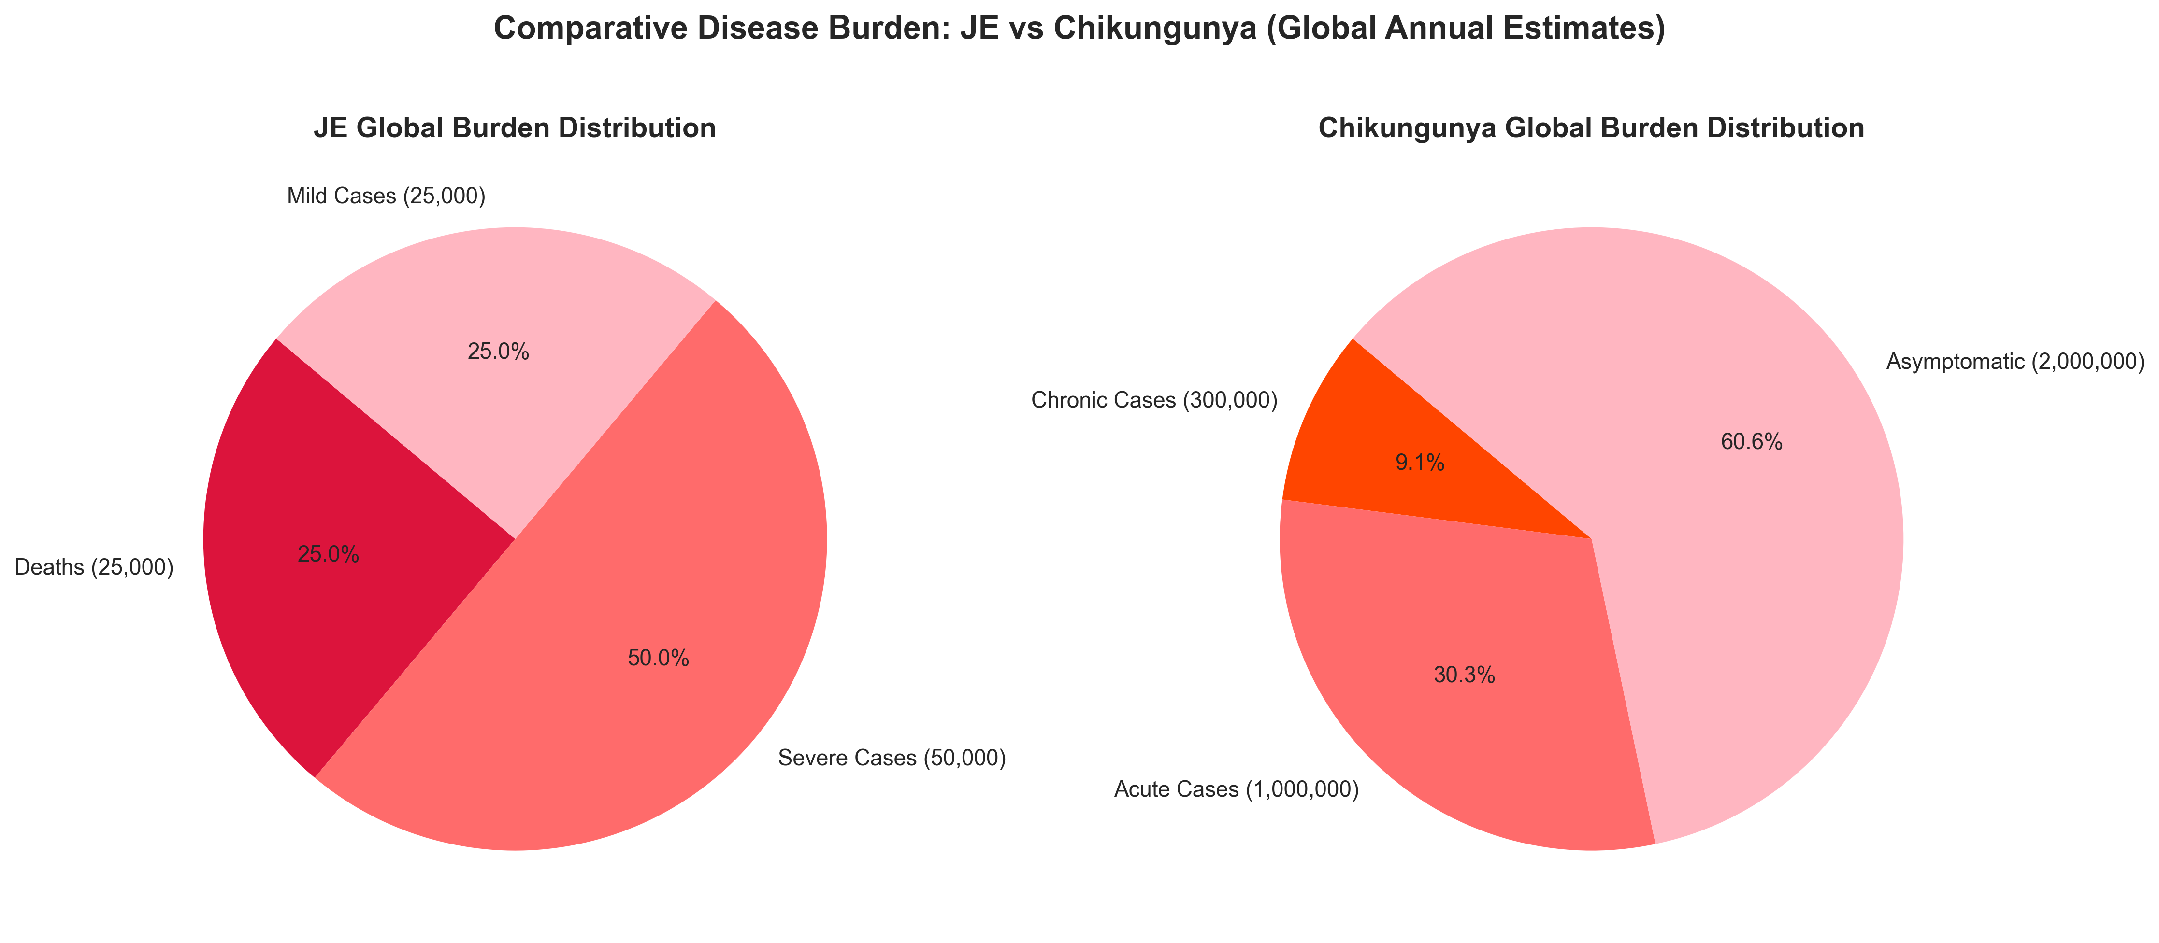
Comparative Analysis: Key Differences
Key Differences:
• JE: CNS involvement, high fatality (20-30%), rural focus
• Chikungunya: Joint pain, low fatality (<0.1%), urban/rural
• Transmission: JE requires animal reservoirs, Chikungunya does not
• Indian programs: JE in UIP, Chikungunya in NVBDCP source reduction

Slide 20
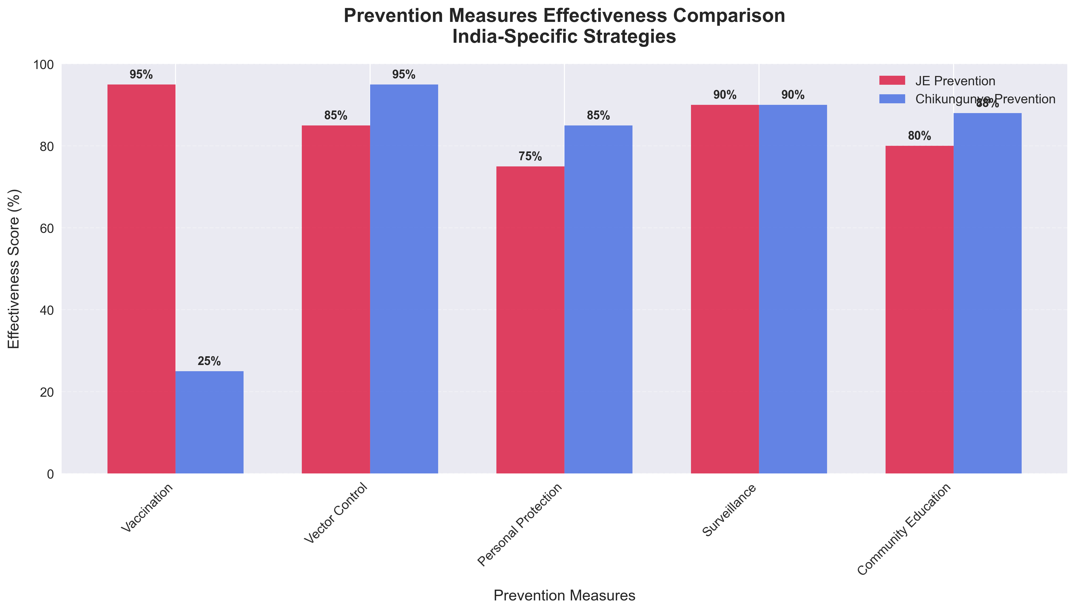
Prevention Measures Effectiveness Comparison
Effectiveness Scores:
• Vaccination: 95% for JE, 25% for Chikungunya
• Vector control: 85% JE, 95% Chikungunya
• Personal protection: 75% JE, 85% Chikungunya
• Surveillance: 90% for both diseases

Slide 21
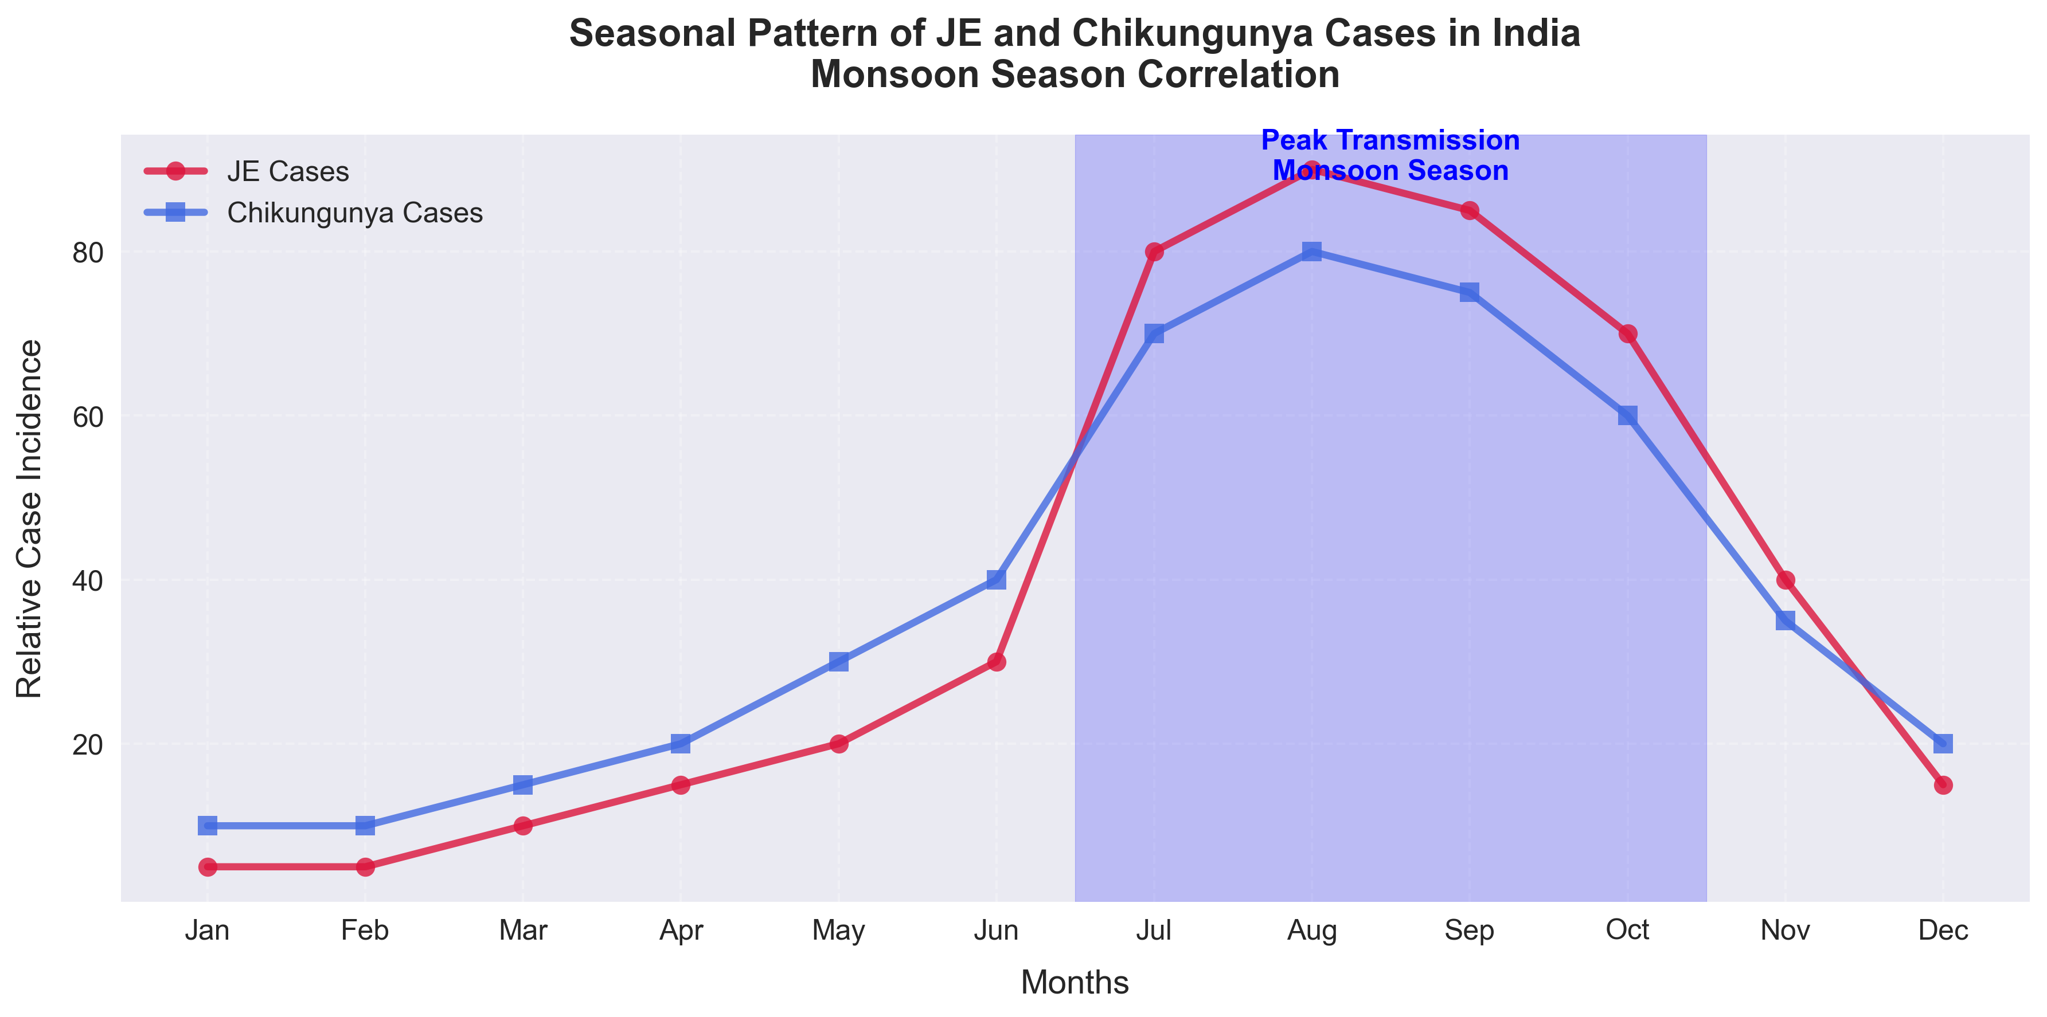
Seasonal Patterns and Monsoon Correlation
Monsoon Impact:
• Peak transmission: June-October
• Vector proliferation: Rice fields, water containers
• JE: Rural agricultural areas
• Chikungunya: Urban water storage
• Climate change: Extended transmission seasons

Slide 22
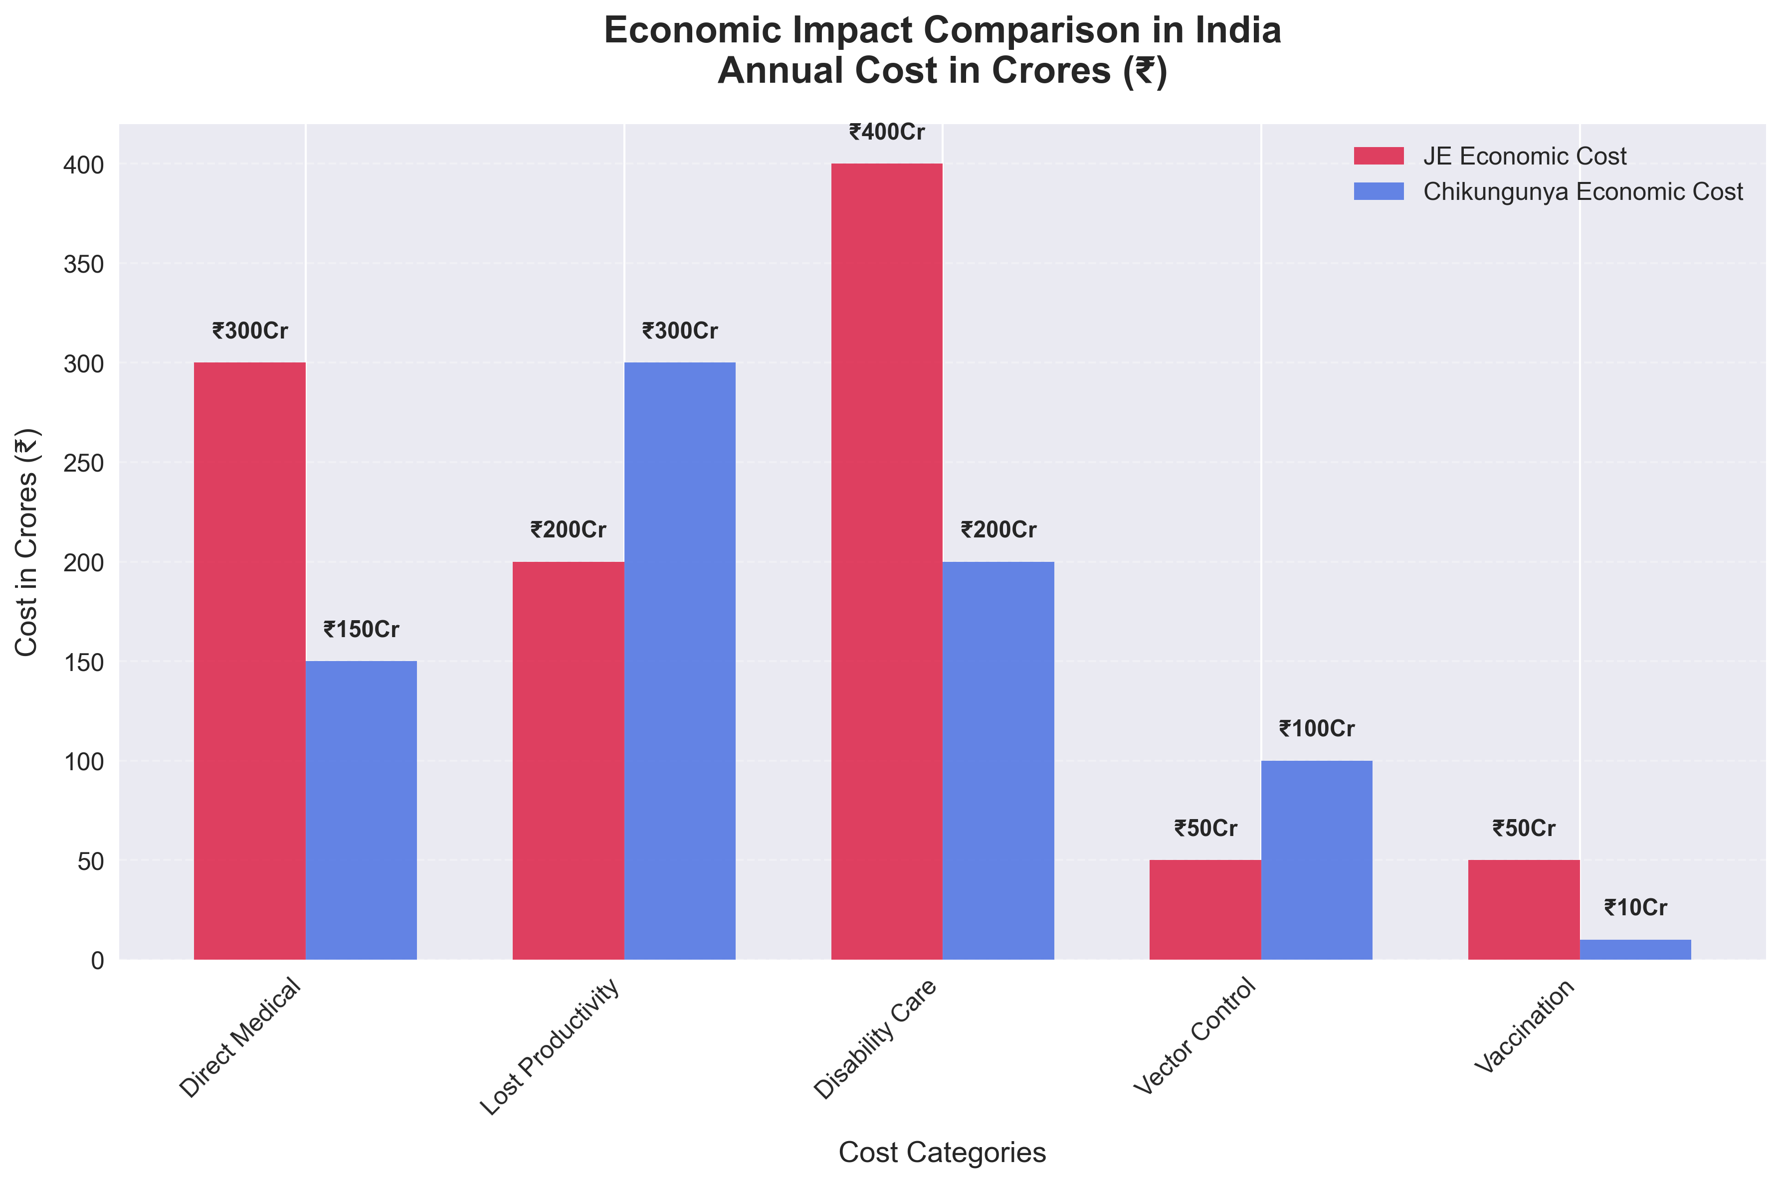
Economic Impact Comparison in India
Annual Economic Cost:
• JE: ₹1000 crores (disability care, lost productivity)
• Chikungunya: ₹500 crores (acute care, chronic management)
• Both: Significant burden on healthcare system
• Indirect costs: Lost workdays, rehabilitation

Slide 23
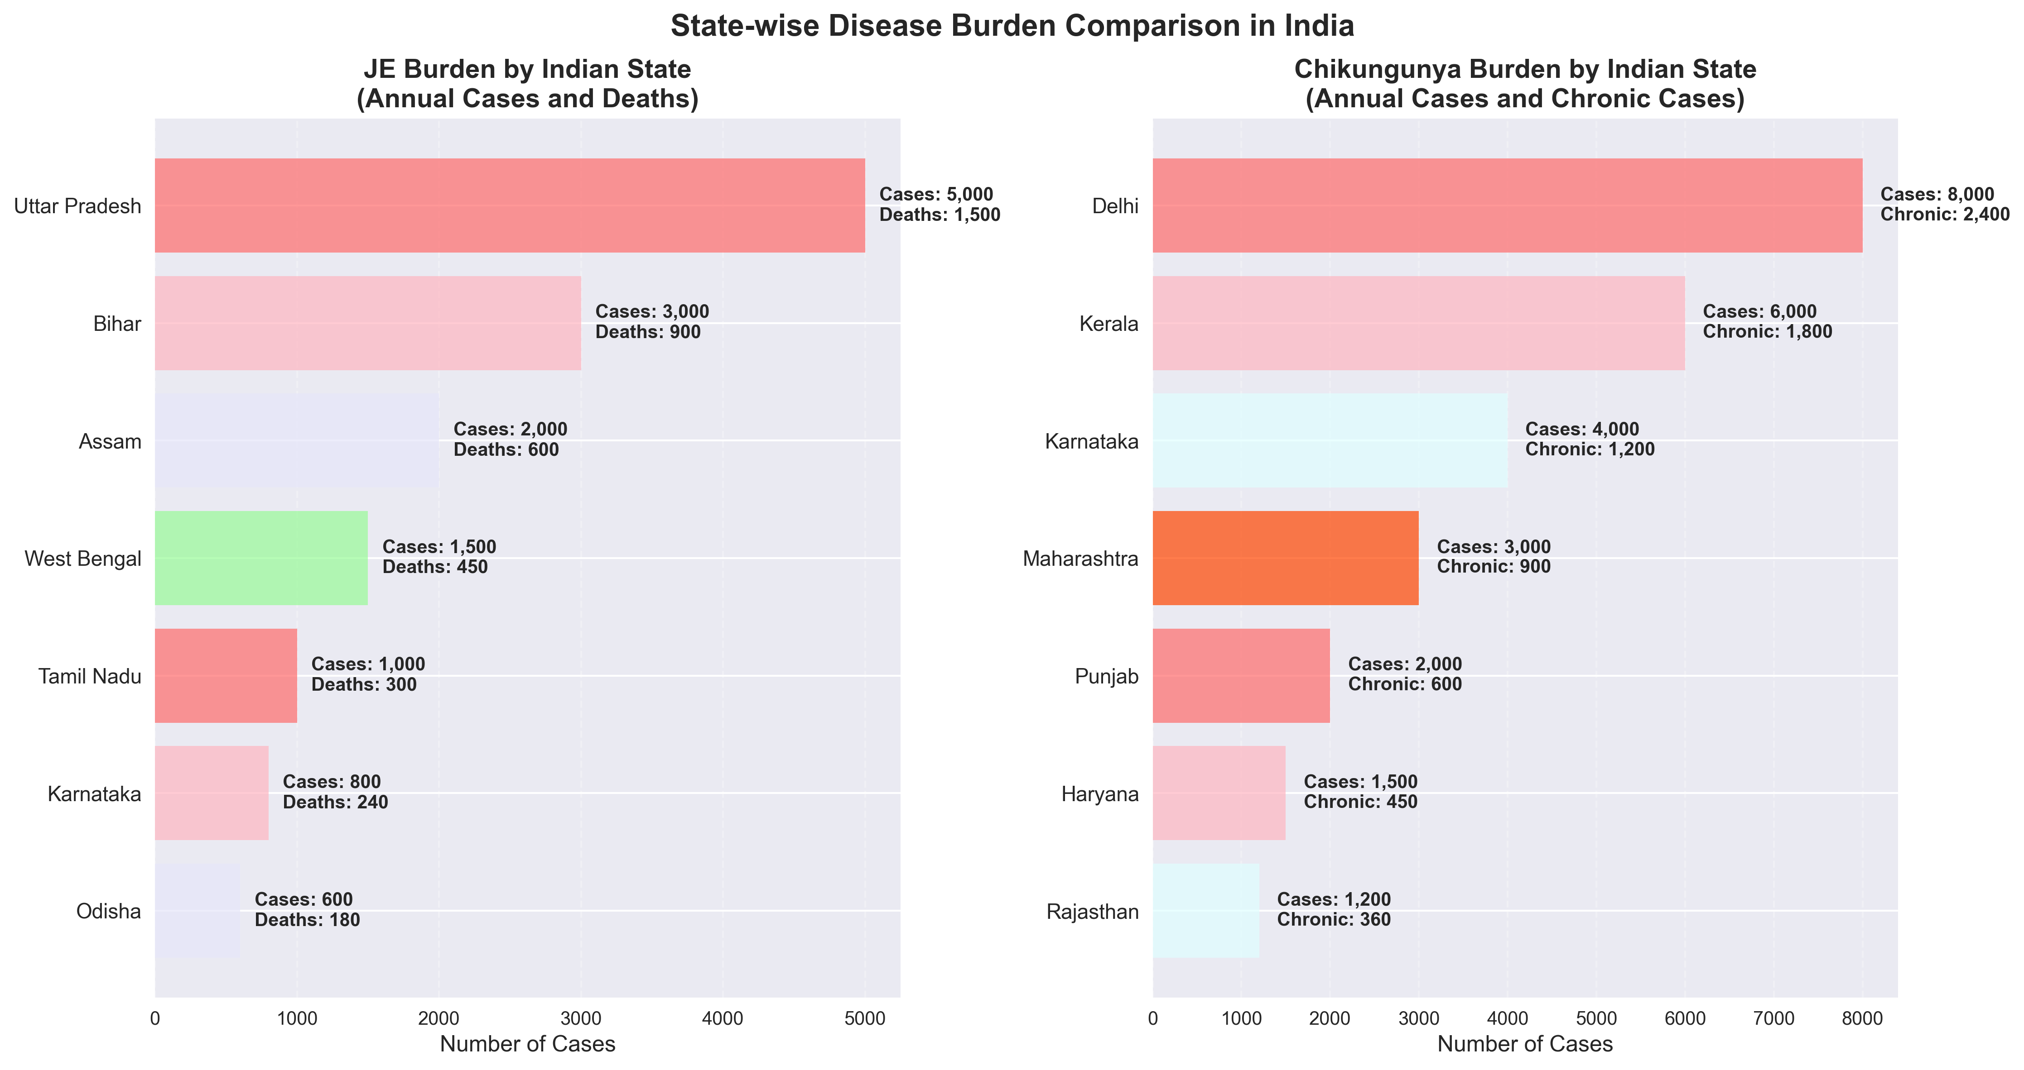
State-wise Disease Burden in India
Regional Distribution:
• JE: Eastern states (UP, Bihar, Assam)
• Chikungunya: Nationwide outbreaks
• High burden areas: Population density, vector habitats
• Surveillance: IDSP monitoring in all states

Slide 24
Role of MBBS Students and Future Doctors
Clinical Practice:
• Early diagnosis and appropriate management
• Differential diagnosis from other febrile illnesses
• Reporting to IDSP for surveillance
• Patient education on prevention measures
Community Medicine:
• Participation in NVBDCP activities
• Community education on vector control
• Outbreak investigation and response
• Research on local epidemiology
Public Health Advocacy:
• Promote vaccination programs (JE)
• Advocate for improved sanitation (Chikungunya)
• Address health disparities in rural areas
• Contribute to policy development

Slide 25
Assessment and Self-Evaluation
MCQ Quiz:
• 18 comprehensive questions (5 basic, 5 intermediate, 5 advanced, 3 case-based)
• Available in teaching material and Google Forms
• Passing score: 70% (12.6/18)
• Time limit: 30 minutes
Key Learning Points:
• Understand Indian context and NVBDCP role
• Differentiate clinical presentations
• Apply prevention strategies in practice
• Appreciate public health implications
Discussion Topics:
• Case studies from Indian outbreaks
• Community-based interventions
• Challenges in rural healthcare delivery
• Future directions in vector-borne disease control

Slide 26
Conclusion and Key Takeaways
Key Takeaways:
• JE and Chikungunya are major VBDs in India with distinct epidemiology
• JE: High fatality, neurological impact, rural focus, vaccine-preventable
• Chikungunya: Chronic morbidity, urban/rural, vector control essential
• Both: Monsoon-linked, NVBDCP-coordinated, IDSP-surveilled
• MBBS students: Crucial role in prevention, diagnosis, and community health
CBME Integration:
• Community medicine competencies
• Epidemiology and biostatistics skills
• Preventive medicine practice
• Public health advocacy
Future Directions:
• Climate change adaptation
• Vaccine development (Chikungunya)
• Integrated vector management
• Digital surveillance systems
• Research on local epidemiology

Slide 27
References and Further Reading
Primary Sources:
• WHO Japanese Encephalitis Fact Sheet (2024)
• WHO Chikungunya Fact Sheet (2025)
• CDC JE and Chikungunya Guidelines
Indian Government:
• NVBDCP Guidelines for VBD Control
• IDSP Weekly Outbreak Reports
• UIP Operational Guidelines
• ICMR Research Publications
Scientific Literature:
• Systematic reviews in PLoS NTD and Emerging Microbes & Infections
• Indian Journal of Medical Research articles
• Bulletin of WHO epidemiological studies
Note: Always verify latest information from official sources as disease epidemiology and control strategies may change over time.

