Slide 1
Social and Cultural Determinants of Health and Disease: A Comprehensive Analysis
Postgraduate Seminar Presentation
Department of Community Medicine
[Your Name]
[Date]

Slide 2
Session Learning Objectives
• Define and differentiate social and cultural determinants of health.
• Analyze the impact of these determinants on health outcomes using evidence-based data.
• Evaluate Indian-specific contexts and government interventions.
• Synthesize findings from high-impact research, including the Lancet Commission, to propose actionable recommendations.
• Engage in discussions on policy implications for community medicine.

Slide 3
Presentation Outline
1. Introduction to Determinants
2. Theoretical Framework
3. Lancet Commission on Social Determinants of Health (2008)
4. Social Determinants in Detail
5. Cultural Determinants in Detail
6. Indian Socio-Cultural Context
7. Evidence from Research
8. Data Visualizations
9. Case Studies
10. Conclusions and Implications
11. Recommendations and Action Plans
12. References and Further Reading

Slide 4
Introduction to Determinants
Social determinants of health (SDOH) encompass the conditions in which people are born, grow, live, work, and age (WHO, 2023).
Cultural determinants include shared beliefs, values, norms, and practices that influence health behaviors (CDC, 2024).
These factors interact to create health inequities, disproportionately affecting vulnerable populations.
In India, rapid economic growth coexists with persistent disparities, making this topic critical for public health.

Slide 5
Theoretical Framework
Based on the WHO Commission on Social Determinants of Health (2008), SDOH operate through pathways like material circumstances, psychosocial factors, and behavioral patterns.
Cultural determinants are framed by theories of cultural competence and health belief models (Kleinman, 1980).
Intersectionality theory highlights how social identities (e.g., caste, gender) compound health risks (Crenshaw, 1989).

Slide 6
Lancet Commission on Social Determinants of Health (2008)
Established in 2005, the Commission aimed to address health inequities through action on SDOH.
Key Findings:
• Social determinants are responsible for the majority of health inequities within and between countries.
• The social gradient in health: Lower socioeconomic position correlates with worse health outcomes.
• Recommendations: Improve daily living conditions, tackle inequitable distribution of power, money, and resources, and measure the problem.

Slide 7
Lancet Commission - Three Areas for Action
1. Improve daily living conditions: Circumstances of birth, growth, living, working, and aging.
2. Tackle the inequitable distribution of power, money, and resources: Structural drivers like policies and governance.
3. Measure and understand the problem: Expand knowledge base, train workforce, raise awareness.
The Commission emphasized universal but proportionate action to address inequities.

Slide 8
Updates and Follow-ups (2023)
In 2023, The Lancet published updates on SDOH, highlighting persistent inequities exacerbated by COVID-19.
Key Insights:
• Widening gaps in health outcomes due to social determinants.
• Need for renewed commitment to equity in post-pandemic recovery.
• Emphasis on intersectoral action and health equity monitoring.

Slide 9
Social Determinants: Economic Factors
Poverty limits access to nutritious food, safe housing, and healthcare, leading to higher disease burden (Marmot, 2005).
In India, 21.9% live below the poverty line, correlating with higher malnutrition and infectious diseases (NFHS-5, 2021).
Unemployment exacerbates mental health issues and chronic conditions.

Slide 10
Social Determinants: Education
Education enhances health literacy, enabling better decision-making and preventive behaviors (Nutbeam, 2000).
India's literacy rate is 77.7%, with rural-urban gaps affecting maternal and child health (Census 2011).
Low education is linked to higher NCD prevalence.

Slide 11
Social Determinants: Healthcare Access
Barriers include affordability, availability, and quality, particularly in rural India.
Ayushman Bharat aims to cover 50 crore people, but implementation challenges persist (PMJAY, 2018).

Slide 12
Social Determinants: Environment
Neighborhood factors like pollution and sanitation influence respiratory and infectious diseases.
Swachh Bharat Mission has built over 10 crore toilets, reducing open defecation (SBM, 2014).

Slide 13
Social Determinants: Social Context
Discrimination based on caste, gender, and class affects resource allocation and health outcomes.
In India, Scheduled Castes face higher morbidity due to social exclusion (NFHS-5).

Slide 14
Cultural Determinants: Beliefs and Practices
Cultural beliefs about illness (e.g., karma, supernatural causes) can delay modern treatment (Kleinman, 1980).
In India, stigma around mental health and HIV/AIDS hinders care-seeking.

Slide 15
Cultural Determinants: Gender Norms
Patriarchal norms limit women's access to education and healthcare, affecting maternal health.
Son preference contributes to sex-selective abortions and female malnutrition (Beti Bachao Beti Padhao, 2015).

Slide 16
Cultural Determinants: Caste System
Caste influences occupation and social status, leading to health disparities.
Lower castes have higher rates of anemia and undernutrition (NFHS-5).

Slide 17
Cultural Determinants: Language and Communication
India's multilingualism poses barriers to health education and services.
Localization of health messages is essential for effective communication.

Slide 18
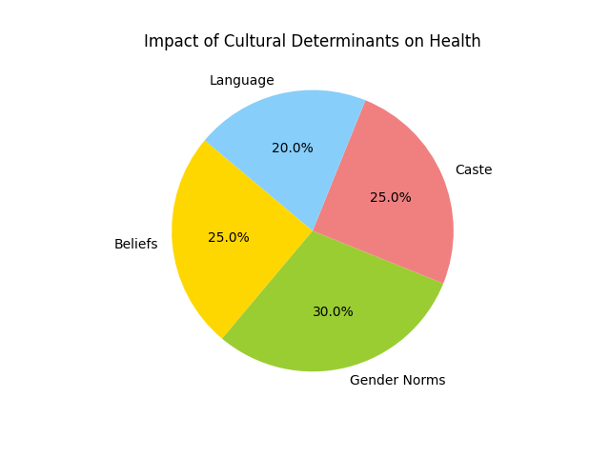

Slide 19
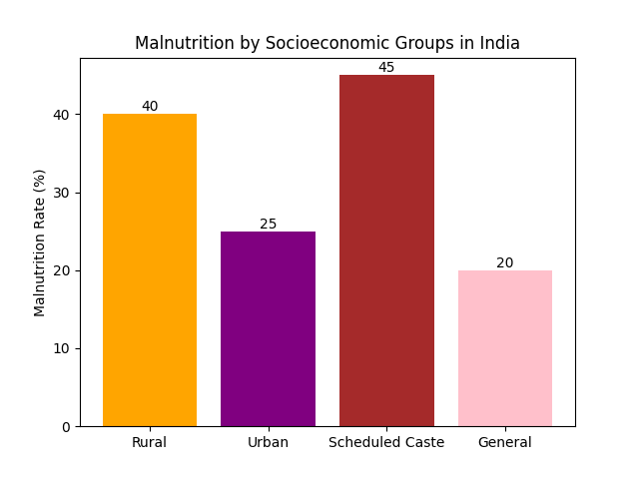

Slide 20
Indian Socio-Cultural Context
India's diversity in culture, religion, and geography amplifies determinant effects.
Urbanization and migration create new health challenges like stress-related disorders.
Government programs address these through integrated approaches.

Slide 21
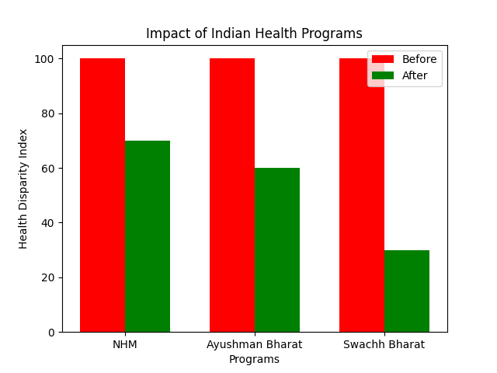

Slide 22
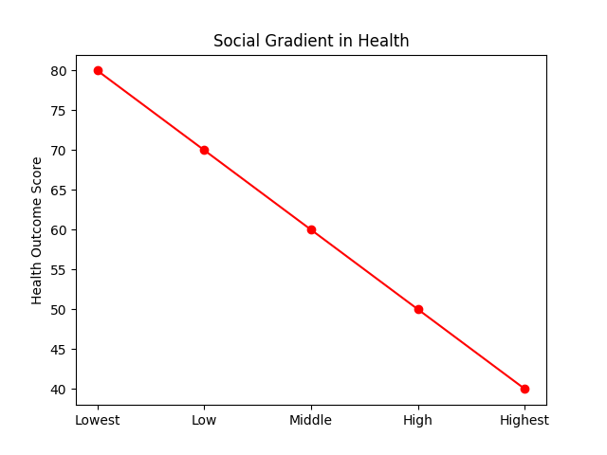

Slide 23
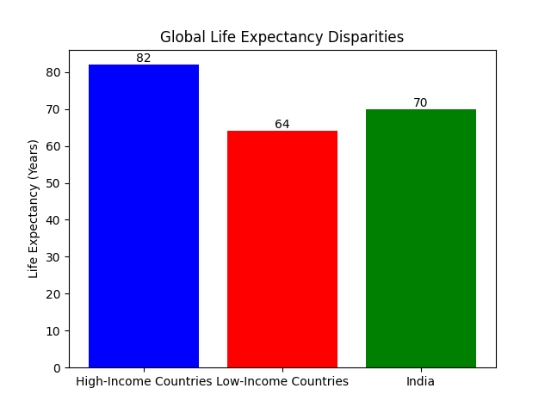

Slide 24
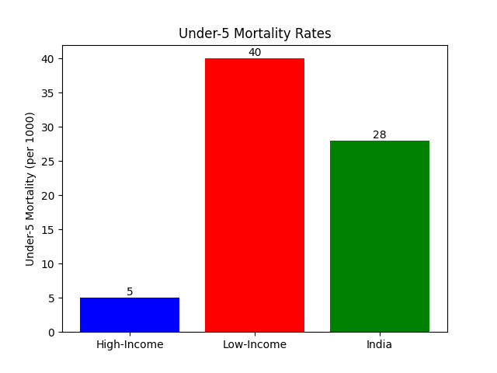

Slide 25
National Health Mission (NHM)
Launched in 2005, focuses on universal healthcare access.
Achievements: Reduced MMR from 254 to 97 per 100,000 live births (NHM Report, 2022).

Slide 26
Ayushman Bharat
Provides financial protection for secondary and tertiary care.
Covers 10.74 crore families, reducing out-of-pocket expenses (PMJAY, 2023).

Slide 27
Swachh Bharat Mission
Promotes sanitation and hygiene to prevent diseases.
Resulted in 100% open defecation-free status in many states (SBM, 2023).

Slide 28
Evidence from Research - Global
Marmot (2005, The Lancet): Social gradient in health; lower SES linked to higher mortality.
WHO (2023): SDOH account for 30-50% of health outcomes in high-income countries.

Slide 29
Evidence from Research - India
Cowling et al. (2014, Int J Equity Health): State-wise inequities in SDOH.
NFHS-5 (2021): 35% children under 5 stunted, higher in rural and low-SES groups.

Slide 30
Key Research Articles
1. Marmot (2005). The Lancet. DOI: 10.1016/S0140-6736(05)17728-8
2. Kleinman (1980). Patients and Healers in the Context of Culture.
3. Crenshaw (1989). Demarginalizing the Intersection of Race and Sex.
4. Victora et al. (2021). The Lancet. DOI: 10.1016/S0140-6736(21)00394-9
5. Chaturvedi et al. (2024). Hypertension. DOI: 10.1161/HYPERTENSIONAHA.123.21354
6. Commission on Social Determinants of Health (2008). The Lancet.

Slide 31
Visualizations: Global Health Disparities

Slide 32
Visualizations: Indian Socioeconomic Inequities

Slide 33
Case Studies - Rural India
Poor sanitation in rural areas leads to high diarrhea incidence; Swachh Bharat reduced it by 20% (SBM Report).
Low female literacy correlates with higher maternal mortality (NFHS-5).

Slide 34
Case Studies - Urban Slums
Overcrowding and pollution increase respiratory diseases; air quality index often exceeds 200 in Delhi.
Migration-related stress contributes to mental health issues.

Slide 35
Conclusions
Social and cultural determinants profoundly influence health and disease patterns in India.
The Lancet Commission (2008) and updates (2023) highlight the need for urgent action on inequities.
Government programs have made strides, but persistent inequities require sustained efforts.

Slide 36
Implications for Community Medicine
Community medicine must integrate SDOH in assessments and interventions.
Cultural sensitivity is key to effective health promotion.
Training in equity-focused practices is essential for future practitioners.

Slide 37
Recommendations - Policy Level
Adopt Health in All Policies to integrate SDOH across sectors.
Strengthen Ayushman Bharat and NHM for universal coverage.
Enhance data systems for monitoring inequities.

Slide 38
Recommendations - Community Level
Promote community-led interventions to address cultural barriers.
Educate on health literacy and stigma reduction.
Engage local leaders for sustainable change.

Slide 39
Recommendations - Research Level
Conduct longitudinal studies on cultural determinants in India.
Evaluate program impacts using mixed methods.
Foster interdisciplinary research for holistic insights.

Slide 40
Action Plans
Short-term: Scale up sanitation and nutrition programs.
Medium-term: Integrate SDOH in medical curricula.
Long-term: Achieve SDG 3 through equity-focused policies.

Slide 41
References
• WHO. (2023). Social determinants of health.
• CDC. (2024). Social Determinants of Health.
• Marmot, M. (2005). The Lancet. DOI: 10.1016/S0140-6736(05)17728-8
• Kleinman, A. (1980). Patients and Healers in the Context of Culture.
• Crenshaw, K. (1989). University of Chicago Legal Forum.
• NFHS-5. (2021). National Family Health Survey.
• NHM Report. (2022). National Health Mission.
• PMJAY. (2023). Ayushman Bharat.
• Commission on Social Determinants of Health. (2008). The Lancet.

