Slide 1
HIV/AIDS: Comprehensive Management in Indian Context
MBBS 3rd Year Class
Duration: 60 minutes
Author: Dr Siddalingaiah H S, Professor, Community Medicine, SIMSRH, Tumkur
Email: hssling@yahoo.com | Phone: 8941087719
Date: [Date]

Slide 2
What is HIV/AIDS?
Definition and Overview
Definition:
• HIV: Human Immunodeficiency Virus
• AIDS: Acquired Immune Deficiency Syndrome
• Retrovirus that attacks CD4+ T lymphocytes
• Leads to progressive immunosuppression
Key Facts:
• Discovered in 1983
• 39 million people living with HIV globally (2022)
• 23.1 lakh PLHIV in India (NACO 2023)
• Chronic manageable condition with ART

Slide 3
HIV Virology
Virus Structure and Replication
Structure:
• Envelope: GP120 and GP41 proteins
• Core: Capsid containing RNA genome
• Enzymes: Reverse transcriptase, integrase, protease
• Receptors: CD4, CCR5/CXCR4 co-receptors
Replication Cycle:
1. Attachment: GP120 binds to CD4 receptor
2. Entry: Fusion with host cell membrane
3. Reverse Transcription: RNA → DNA
4. Integration: Viral DNA into host genome
5. Transcription: Viral mRNA production
6. Assembly & Budding: New virions released

Slide 4
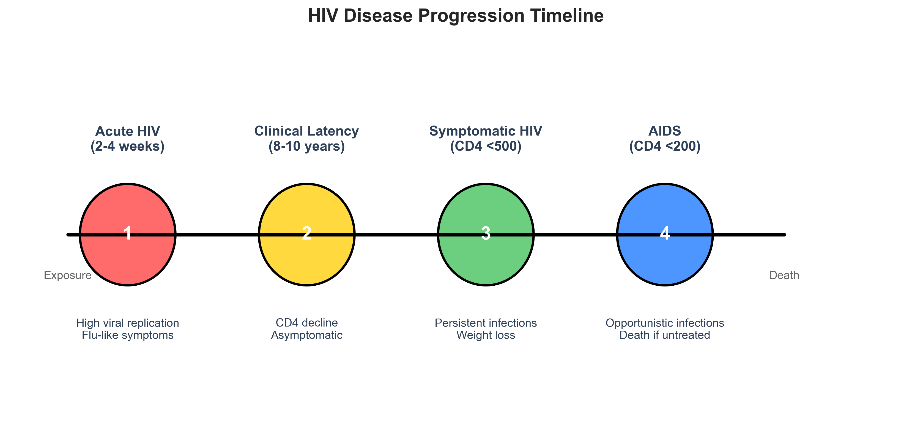
Pathogenesis and Natural History
Disease Progression

Slide 5
Epidemiology - Global Burden
Global HIV Statistics
UNAIDS 2023 Report:
• 39 million people living with HIV
• 1.3 million new infections annually
• 630,000 AIDS-related deaths
• 29.8 million on antiretroviral therapy
Regional Distribution:
• Sub-Saharan Africa: 25.7 million (66% of global total)
• Asia-Pacific: 5.9 million
• Western & Central Europe/North America: 2.2 million
• Eastern Europe & Central Asia: 1.5 million

Slide 6
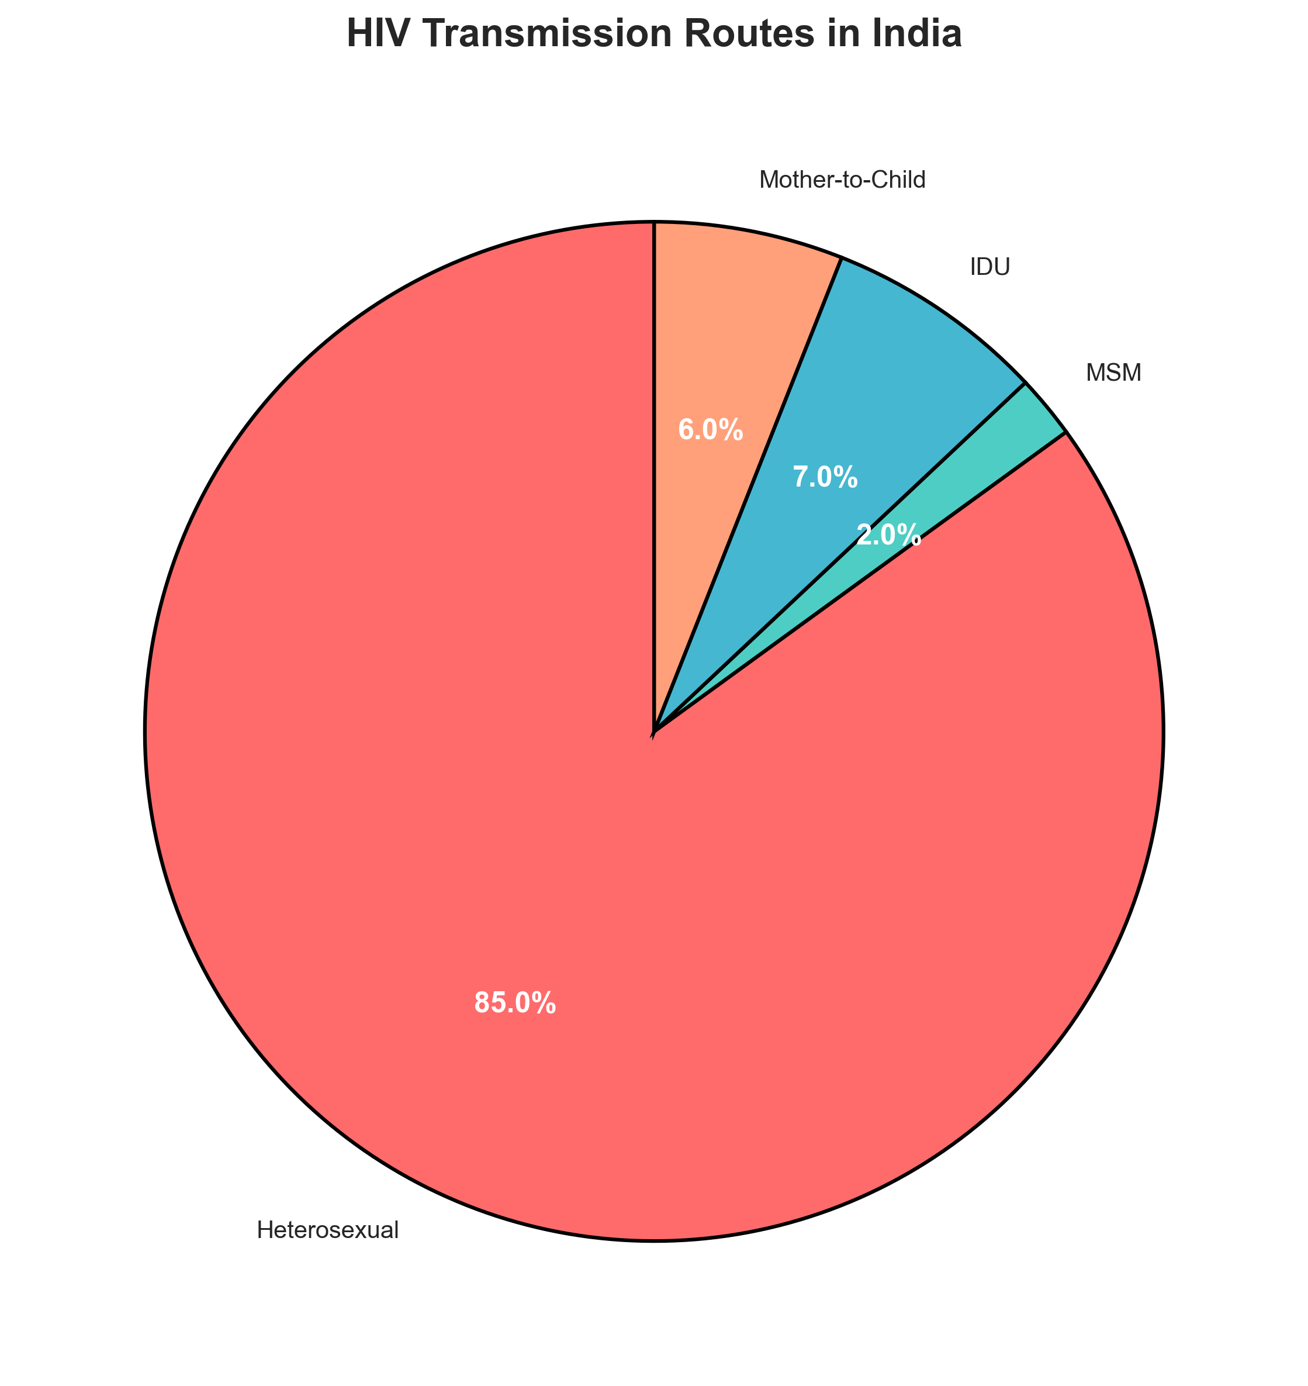
Epidemiology - Indian Context
HIV in India: Progress and Challenges
Current Status (NACO 2023):
• Adult prevalence: 0.22%
• People living with HIV: 23.1 lakh
• New infections: ~58,000 annually
• AIDS-related deaths: ~15,000 annually

Slide 7
Transmission Routes
How HIV Spreads
Sexual Transmission (Primary Route):
• Unprotected vaginal intercourse
• Unprotected anal intercourse
• Oral sex (less efficient)
• Multiple partners increase risk
Blood-Borne Transmission:
• Sharing contaminated needles/syringes
• Blood transfusions (rare in screened blood)
• Organ transplantation
• Mother-to-child transmission
Risk Factors for Transmission:
• High viral load (acute infection, untreated)
• Co-infections (STDs increase risk)
• Lack of circumcision (male)
• Traumatic sex, bleeding

Slide 8
Clinical Features - Stages
Clinical Presentation
Acute HIV Infection (Seroconversion):
• Fever, rash, fatigue (70-90%)
• Sore throat, lymphadenopathy
• Myalgia, arthralgia
• Headache, nausea
• Duration: 1-4 weeks
Asymptomatic Stage:
• No symptoms for 8-10 years
• Gradual CD4 decline
• Persistent lymphadenopathy possible
Symptomatic HIV:
• Unexplained weight loss (>10%)
• Chronic diarrhea
• Persistent fever
• Oral candidiasis
• Herpes zoster

Slide 9
Diagnosis - Testing Algorithm
HIV Diagnostic Strategy
NACO Testing Algorithm (2023):
Step 1: Screening Tests
• ELISA/ECLIA (Enzyme/Chemiluminescent Immunoassay)
• Rapid tests (fingerstick/oral fluid)
• Combination assays (Ab + p24 Ag)
Step 2: Confirmatory Tests
• Western blot (gold standard)
• Line immunoassay (cheaper alternative)
• HIV-1 RNA PCR (for infants <18 months)
Step 3: Tie-breaker (if discordant)
• Different assay or HIV-1 RNA test
Window Periods:
• Antibody tests: 4-12 weeks
• Combination tests: 2-4 weeks
• RNA PCR: 10-14 days

Slide 10
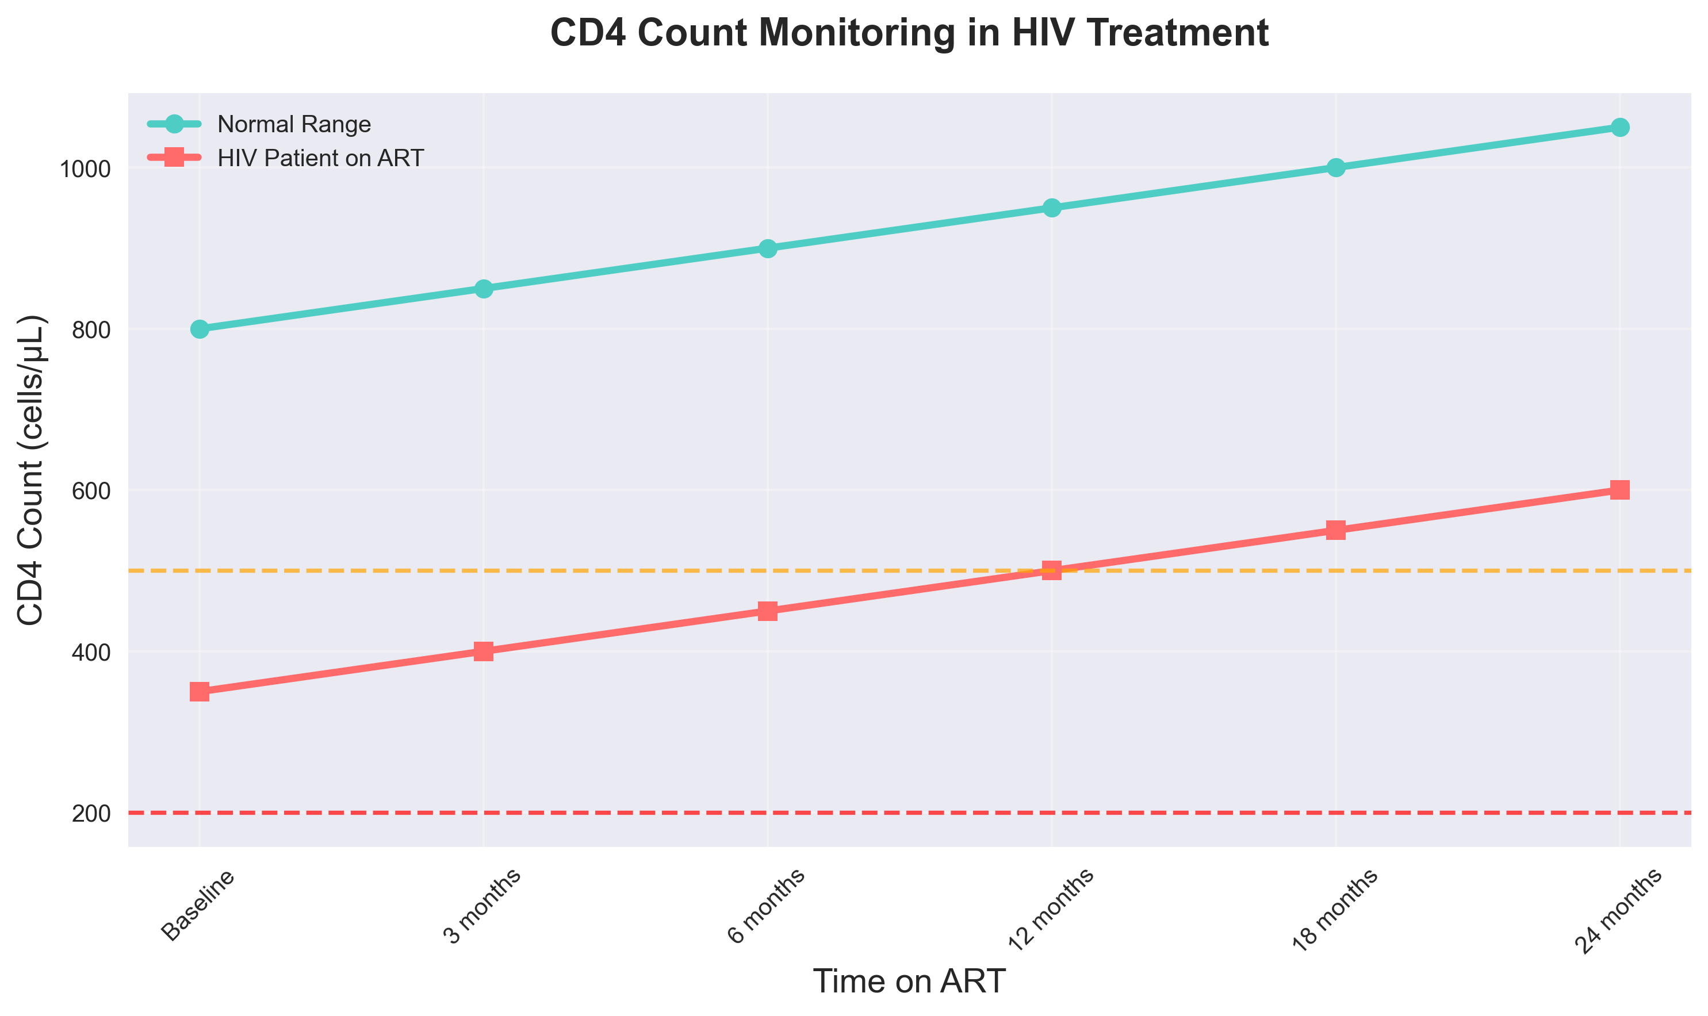
Laboratory Monitoring
Disease Monitoring Parameters

Slide 11
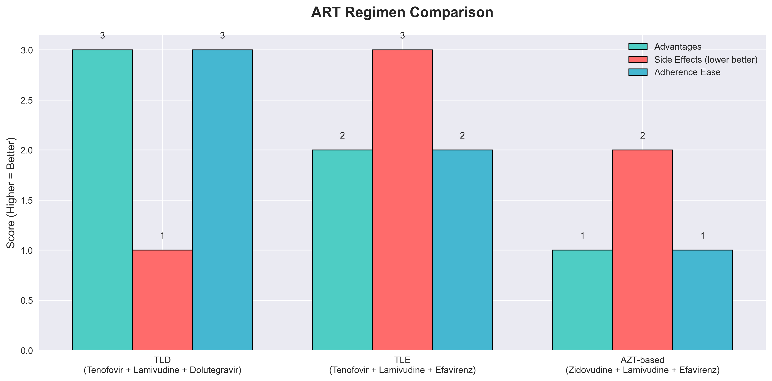
Antiretroviral Therapy (ART)
Treatment Principles
NACO ART Guidelines 2023:
• Test and Treat: ART for all PLHIV regardless of CD4
• Preferred First-Line: TLD (Tenofovir + Lamivudine + Dolutegravir)
• Alternative First-Line: TLE (Tenofovir + Lamivudine + Efavirenz)
• Second-Line: Protease inhibitor-based regimens

Slide 12
ART Management and Side Effects
Treatment Monitoring and Challenges
Adherence Strategies:
• Fixed-dose combinations
• Once-daily regimens
• Pill organizers, reminders
• Linkage to daily routines
Common Side Effects:
• Efavirenz: CNS effects (dizziness, nightmares)
• Tenofovir: Renal toxicity, Fanconi syndrome
• Zidovudine: Anemia, neutropenia
• Dolutegravir: Minimal side effects
Drug Interactions:
• Rifampicin reduces ART levels
• Hormonal contraceptives
• Traditional medicines
• Recreational drugs

Slide 13
Opportunistic Infections
OI Prevention and Management
Common OIs in India:
• Tuberculosis: Most common OI (10% of HIV patients)
• Pneumocystis pneumonia: CD4 <200
• Toxoplasma encephalitis: CD4 <100
• Cryptococcal meningitis: CD4 <100
• Candidiasis: Oral/esophageal
Prophylaxis Guidelines:
• Cotrimoxazole: CD4 <200 (prevents PCP, Toxoplasma, bacterial infections)
• INH: For latent TB (300mg daily × 6-9 months)
• Azithromycin: For MAC prevention (CD4 <50)
Key Points:
• Early ART prevents most OIs
• Prophylaxis reduces morbidity/mortality
• TB-HIV co-infection common in India

Slide 14
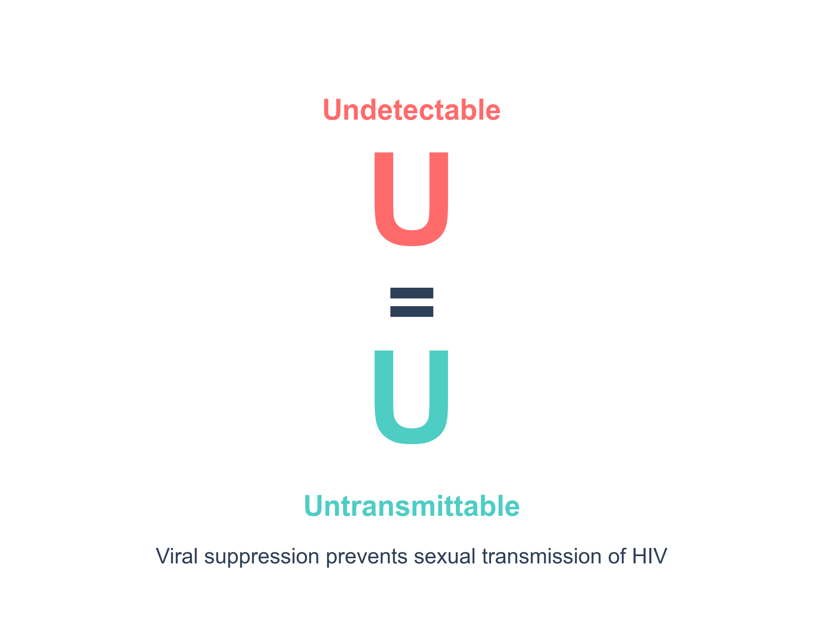
Prevention Strategies - Primary
HIV Prevention Approaches
Treatment as Prevention (TasP):
• U=U: Undetectable = Untransmittable
• Viral suppression prevents sexual transmission
• 96% reduction in transmission risk
Pre-Exposure Prophylaxis (PrEP):
• Daily TDF/FTC for high-risk individuals
• 99% effective when adherent
• Available through NACO since 2017
Post-Exposure Prophylaxis (PEP):
• 28-day ART regimen within 72 hours
• For occupational/non-occupational exposure
• Emergency prevention strategy
Biomedical Prevention:
• Male circumcision (60% risk reduction)
• Vaccines (in development)
• Microbicides (research stage)

Slide 15
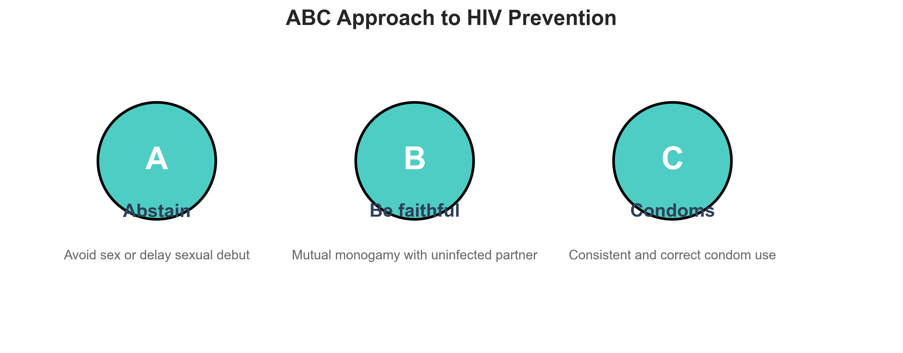
Prevention Strategies - Secondary
Prevention of Transmission
ABC Approach:
• Abstain from sex
• Be faithful to one uninfected partner
• Condoms consistently and correctly
NACO Prevention Programs:
• Targeted Interventions: For high-risk groups (MSM, FSWs, IDUs)
• Condom Promotion: 800 million condoms distributed annually
• Blood Safety: 100% voluntary blood donation
• ICTCs: 1,381 centers for testing and counseling
Prevention of Mother-to-Child Transmission (PMTCT):
• Antenatal HIV testing (95% coverage)
• ART for pregnant women
• Safe delivery practices
• Infant prophylaxis and testing

Slide 16
Prevention Strategies - Tertiary
Comprehensive Care and Support
ART Centers and Link ART Centers:
• Decentralized ART delivery
• 1,200+ centers across India
• Free lifelong treatment
Community Care Centers (CCCs):
• Nutritional support
• Psychosocial counseling
• Adherence support
Support Networks:
• Positive People Networks
• PLHIV groups
• Peer educators
• Mental health services
Surveillance and Monitoring:
• HIV Sentinel Surveillance
• Case reporting
• Program evaluation

Slide 17
Challenges in India
Barriers to HIV Control
Social and Cultural:
• Stigma and discrimination
• Gender inequalities
• Marginalized communities (MSM, transgender)
• Limited sexuality education
Healthcare System:
• Rural-urban disparities
• Human resource shortages
• Drug stockouts
• Weak referral systems
Behavioral Factors:
• Migration and mobility
• Concurrent sexual partnerships
• Alcohol and drug use
• Non-adherence to treatment
Biological Factors:
• Co-infections (TB, viral hepatitis)
• Drug resistance emergence
• Late presentation for care

Slide 18
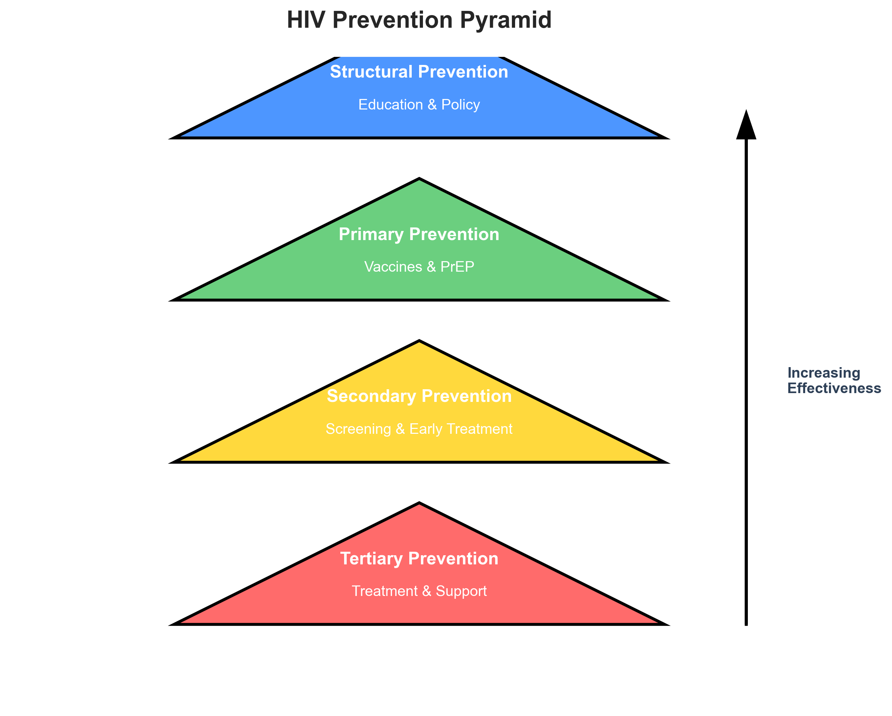
Success Story and Future
India's HIV Response
Achievements (2007-2023):
• 66% reduction in new infections
• 80% ART coverage
• 90% viral suppression rates
• 15,000 AIDS deaths annually (down from 100,000+)
NACP Phases:
• Phase I-IV: Building infrastructure
• Phase V (2017-2021): Test and treat
• Phase VI (2021-2026): Ending AIDS by 2030
Future Directions:
• 95-95-95 targets by 2030
• Integration with general healthcare
• Digital solutions for follow-up
• Research in vaccines and cure
Global Goals:
• End AIDS epidemic by 2030
• <200,000 new infections annually
• Zero discrimination

Slide 19
Key Takeaways
Summary
1. HIV is a manageable chronic condition with ART
2. Early diagnosis and treatment prevent complications
3. U=U: Undetectable viral load prevents transmission
4. Prevention through TasP, PrEP, PEP, and condoms
5. India's response shows what commitment can achieve
6. Stigma reduction and community engagement essential

Slide 20
Q&A Session
Questions and Discussion
Thank you for your attention!
References:
• NACO ART Guidelines 2023
• WHO HIV Guidelines 2021
• UNAIDS Global AIDS Update 2023

