Slide 1
Sexually Transmitted Diseases: Comprehensive Overview
MBBS 3rd Year Class
Duration: 60 minutes
Author: Dr Siddalingaiah H S, Professor, Community Medicine, SIMSRH, Tumkur
Email: hssling@yahoo.com | Phone: 8941087719
Date: [Date]

Slide 2
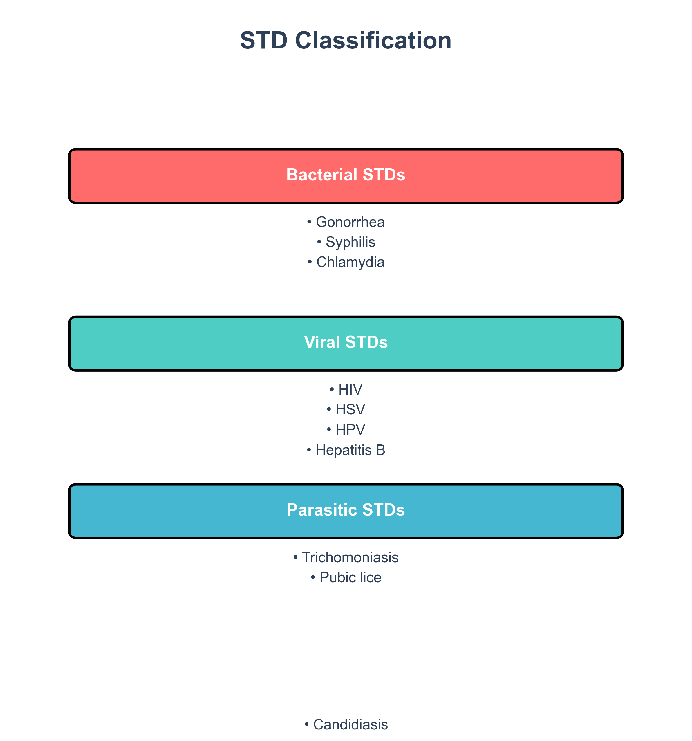
What are STDs?
Definition and Classification
Definition: Infections transmitted through sexual contact, including vaginal, anal, and oral sex
Classification by Causative Organism:

Slide 3
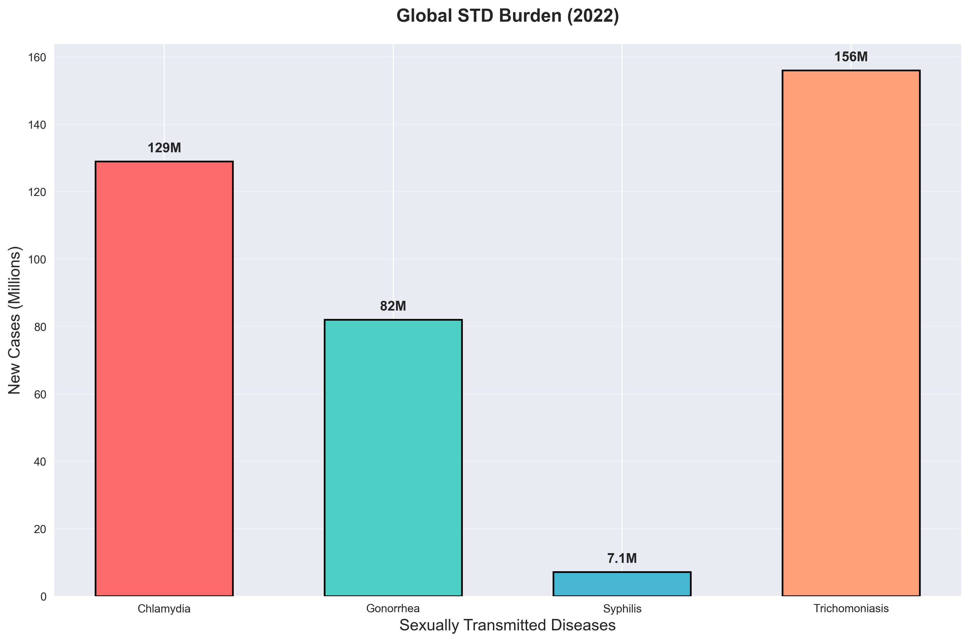
Epidemiology - Global Burden
WHO Statistics (2022): 1 million new STD cases daily

Slide 4
Epidemiology - Indian Context
NACO Estimates (2023):
• 30-40 million STD cases annually
• HIV prevalence: 0.22% (23.1 lakh PLHIV)
• Syphilis: Rising trend, especially congenital
• Gonorrhea/Chlamydia: High among youth and high-risk groups
Regional Distribution:
• Highest prevalence: Northeast (Nagaland, Manipur)
• Southern states: Karnataka, Andhra Pradesh, Telangana
• Urban vs Rural: Higher in urban areas

Slide 5
Transmission Routes
How STDs Spread
Sexual Transmission:
• Vaginal intercourse
• Anal intercourse
• Oral-genital contact
• Manual-genital contact
Non-Sexual Transmission:
• Mother-to-child (congenital syphilis, HIV)
• Blood transfusion (HIV, Hepatitis B)
• Sharing needles (HIV, Hepatitis B)
• Organ transplantation

Slide 6
Bacterial STDs - Gonorrhea
Gonorrhea: Clinical Features
Causative Agent: Neisseria gonorrhoeae (Gram-negative diplococcus)
Clinical Presentation:
Males: Acute urethritis
• Purulent discharge (yellow/green)
• Dysuria, frequency, urgency
• Incubation: 2-7 days
Females: Often asymptomatic (50%)
• May cause cervicitis, PID
• Abdominal pain, fever

Slide 7
Bacterial STDs - Syphilis
Syphilis: The Great Imitator
Causative Agent: Treponema pallidum
Stages:
1. Primary (2-12 weeks):
• Painless chancre at inoculation site
• Clean base, raised borders
• Regional lymphadenopathy
2. Secondary (6-24 weeks):
• Generalized rash (palms/soles)
• Condylomata lata, alopecia
• Fever, malaise, lymphadenopathy
3. Tertiary (>2 years):
• Cardiovascular syphilis
• Neurosyphilis, gummas
• Tabes dorsalis

Slide 8
Bacterial STDs - Chlamydia
Chlamydia: Silent Infection
Causative Agent: Chlamydia trachomatis
Clinical Features:
• Often asymptomatic (70-80%)
• Females: Cervicitis, PID, infertility
• Males: Urethritis, epididymitis
• Both: Proctitis, conjunctivitis
Complications:
• Pelvic inflammatory disease
• Ectopic pregnancy
• Chronic pelvic pain
• Infertility in both genders
Key Fact: Most common bacterial STD worldwide

Slide 9
Viral STDs Overview
Viral STDs: Chronic Infections
HIV/AIDS:
• Retrovirus attacking CD4+ T cells
• Progressive immunosuppression
• Lifelong infection, manageable with ART
HSV (Herpes Simplex):
• HSV-1: Oral herpes
• HSV-2: Genital herpes
• Recurrent painful ulcers
• Lifelong latency
HPV (Human Papillomavirus):
• 100+ subtypes
• Low-risk: Genital warts
• High-risk: Cervical cancer
• Vaccination available
Hepatitis B:
• Chronic liver disease
• Vaccine-preventable
• High prevalence in India

Slide 10
Diagnosis - Clinical Approach
Diagnostic Strategy
1. Sexual History (5 Ps):
• Partners (number, type)
• Practices (vaginal, anal, oral)
• Protection (condom use)
• Past STDs
• Pregnancy intentions
2. Physical Examination:
• Genital inspection
• Lymph node palpation
• Systemic signs
3. Laboratory Tests:
• Microscopy (Gram stain, wet mount)
• Culture and sensitivity
• PCR (gold standard for chlamydia)
• Serology (syphilis, HIV)

Slide 11
Diagnosis - Laboratory Tests
Specific Diagnostic Tests
Gonorrhea:
• Gram stain: Intracellular diplococci
• Culture: Thayer-Martin medium
• PCR: Most sensitive
Syphilis:
• VDRL/TPHA: Screening
• FTA-ABS: Confirmatory
• Dark field microscopy
Chlamydia:
• PCR: Endocervical swab
• Culture: McCoy cells
• EIA: Less sensitive
HSV:
• PCR: Vesicular fluid
• Viral culture
• Tzanck smear

Slide 12
Treatment - General Principles
Treatment Guidelines
NACO STI Management Guidelines (2020):
• Syndromic management approach
• Dual therapy for gonorrhea
• Partner treatment essential
• Test of cure recommended
Key Principles:
• Treat empirically based on symptoms
• Culture sensitivity for resistance
• Follow-up testing
• Prevention of reinfection

Slide 13
Treatment - Specific Regimens
Treatment Protocols
Syphilis:
• Primary/Secondary: Benzathine penicillin 2.4 MU IM single dose
• Latent: Benzathine penicillin 2.4 MU IM weekly × 3
• Tertiary/Neurosyphilis: Aqueous penicillin G 3-4 MU IV q4h × 14 days
• Alternative: Doxycycline 100mg PO twice daily × 14 days
Gonorrhea:
• Ceftriaxone 500mg IM single dose
• PLUS Azithromycin 1g PO single dose
• Test of cure in 7-14 days
Chlamydia:
• Azithromycin 1g PO single dose
• OR Doxycycline 100mg PO twice daily × 7 days
• Test of cure recommended
HSV:
• Acyclovir 400mg PO three times daily × 5-10 days
• Valacyclovir 1g PO twice daily × 5-10 days
• Suppressive therapy for recurrences

Slide 14
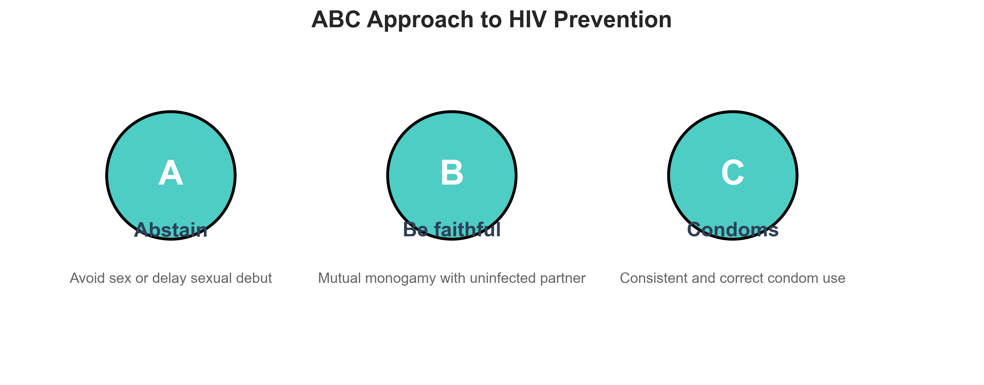
Prevention and Control - Primary
Primary Prevention
ABC Approach:
• Abstain from sex
• Be faithful to one partner
• Condoms consistently and correctly
Vaccines:
• HPV vaccine (9-26 years)
• Hepatitis B vaccine
• HIV vaccine (in development)
Other Strategies:
• Pre-exposure prophylaxis (PrEP) for HIV
• Post-exposure prophylaxis (PEP)
• Male circumcision

Slide 15
Prevention and Control - Secondary
Secondary Prevention
Screening Programs:
• Regular STI screening for high-risk groups
• Antenatal screening (syphilis, HIV)
• Targeted interventions (TI) for high-risk populations
NACO Programs:
• Integrated Counseling and Testing Centers (ICTCs)
• Prevention of Parent-to-Child Transmission (PPTCT)
• Link Worker Scheme for contact tracing
Key Achievements:
• 1,381 ICTCs across India
• 95% antenatal coverage for HIV testing
• 800 million condoms distributed annually

Slide 16
Prevention and Control - Tertiary
Tertiary Prevention
Management of Complications:
• ART centers for HIV care
• STD clinics for follow-up
• Community Care Centers (CCCs)
Support Services:
• Positive People Networks
• Counseling and psychosocial support
• Rehabilitation programs
Surveillance:
• HIV Sentinel Surveillance
• Integrated Disease Surveillance Program
• Regular reporting and monitoring

Slide 17
Challenges in India
Barriers to Effective Control
Social and Cultural:
• Stigma and discrimination
• Gender inequalities
• Religious and caste factors
• Limited sexuality education
Healthcare System:
• Rural-urban disparities
• Shortage of trained providers
• Drug stockouts
• Weak surveillance systems
Behavioral Factors:
• Low condom use
• Multiple concurrent partnerships
• Alcohol and drug use
• Migration and mobility

Slide 18
Future Directions
Way Forward
Strengthening Programs:
• Comprehensive sexuality education in schools
• Integration of STI services with primary healthcare
• Task shifting to nurses and community health workers
• Digital health solutions for follow-up
Research Priorities:
• Vaccine development
• Point-of-care diagnostics
• Drug resistance surveillance
• Behavioral interventions
Global Targets:
• 90% reduction in syphilis incidence by 2030
• Elimination of MTCT of HIV and syphilis
• Improved access to STI services

Slide 19
Key Takeaways
Summary
1. STDs are major public health problem with significant burden in India
2. Most are asymptomatic, requiring active screening
3. Syndromic management and partner treatment are key
4. Prevention through ABC approach, vaccines, and condoms
5. NACO programs provide framework for comprehensive control
6. Cultural sensitivity and community engagement essential

Slide 20
Q&A Session
Questions and Discussion
Thank you for your attention!
References:
• NACO STI Management Guidelines (2020)
• WHO Guidelines for STI Management (2016)
• CDC STD Treatment Guidelines (2021)

