Slide 1

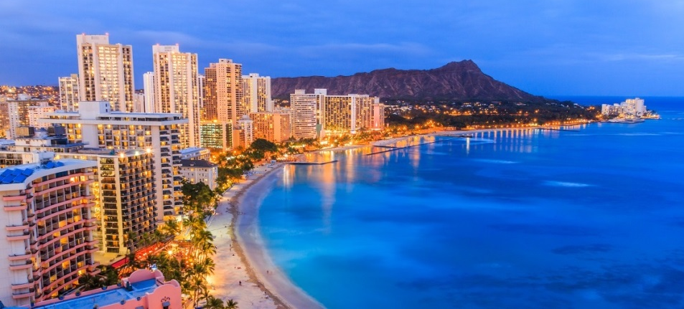

Extreme
Materials
Phenomena
Environments
IUCr HP 2018 Workshop
Honolulu, HI
July 29 – August 2, 2018

