Slide 1
CVX程式介紹
國立中央大學 通訊工程學系
古孟霖 教授

Slide 2
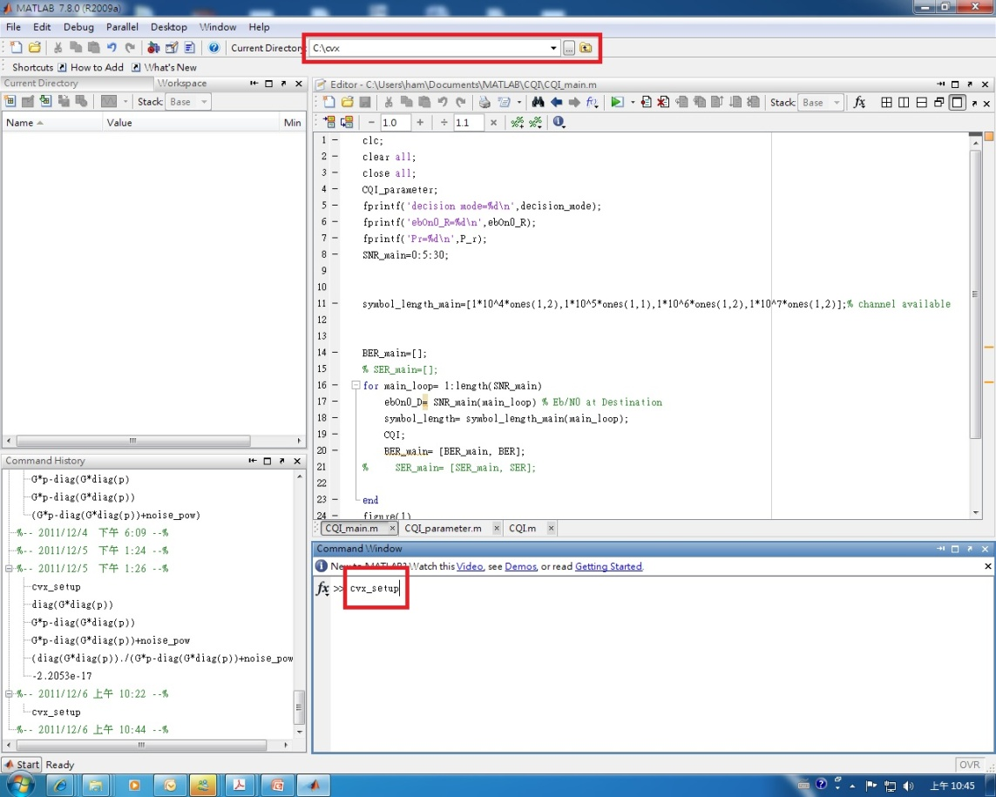
CVX Tool Setup
Search for CVX tool ( http://cvxr.com/cvx/ )
Dezip to your assigned directory
Key cvx_setup in the matlab command window
No errors! cvx has been successfully installed.

Slide 3
CVX Programming
Between cvx_begin & cvx_end
cvx_begin
variables w(x,y) (complex, symmetric,…..)(refer 3.2)
minimize (convex function) or maximize (concave function) (refer 3.3)
subject to
…… constraints(refer to 3.4)
cvx_end
Some special variables
Cvx_optval
Cvx_status (refer to Appendix C)
Cvx_slvtol
Cvx_slvitr

Slide 4
CVX Functions
Quadprog
Linprog
Norm
norm(*,Inf)
norm(*,1)
norm_largest
Quad_over_lin ➔
Refer to 3.5 and appendix B

Slide 5
Constraint Discipline
Equality constraints
The left-hand and right-hand sides of an equality constraint requires to be affine
Inequality constraints
f must be convex, but g must be concave.
Refer to 2.4,3.4

Slide 6
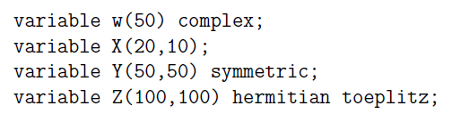
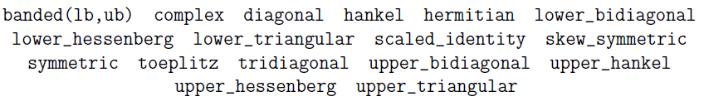
Data Types for Variables
Real, complex, scalar, vector, matrix:
Currently supported structure keyword:
Refer to 3.2

Slide 7

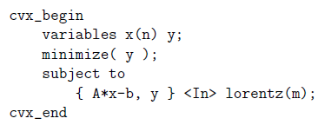

Others
Set (refer to 3.6 and appendix B.3)
➔
Dual variables (refer to 4.7)
Expression holders (refer to 4.8)
DCP ruleset (refer to 5)
Semidefinite programming using cvx (refer to 6)
Geometric programming using cvx(refer to 7)

Slide 8
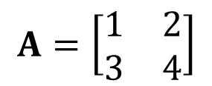
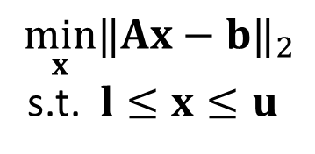
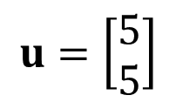
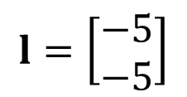
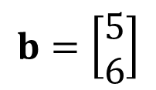
Q1: Bound-constrained Least-Square Problem
$$\min_{x}{‖Ax−b‖}_{2}$$
s.t. $l≤x≤u$
$$A=\left[\begin{matrix}1 & 2 \\ 3 & 4\end{matrix}\right]$$
$$b=\left[\begin{aligned}5 \\ 6\end{aligned}\right]$$
$$l=\left[\begin{aligned}−5 \\ −5\end{aligned}\right]$$
$$u=\left[\begin{aligned}5 \\ 5\end{aligned}\right]$$

Slide 9

Q2: Chebyshev Center
Consider a polyhedron composed of the half-spaces, $2x_{1}+x_{2}≤2$, $2x_{1}−x_{2}≤0$ , $x_{1}−{2x}_{2}≥−6$ and $x_{1}+2x_{2}≥−2$. Please plot the maximum norm ball inside the polyhedron and show the center and the radius of it.

Slide 10
Project: Support Vector Machine Design

Slide 11
Project: Filter Design
Problem: Find the filter coefficients that satisfy a certain specifications
It is a worst-case design criterion to minimize the absolute error between the desired and the actual channel frequency response.

