Slide 1
Polyglot
A compiler for mixed syntax
Compiler Design Project
Source code, typed IR, optimization and a custom virtual machine
Notes:
Opening: Polyglot accepts a restricted language with syntax inspired by six familiar languages. Its central design is to normalize those spellings into one AST and one execution model. Explain that the project compiles to its own bytecode and runs on its own VM. The slides describe the current local implementation, including local updates that have not been pushed.
Implementation sources (local snapshot 60f60ed, 26 October 2026):
https://github.com/hst257/PolyGlot [local file: README.md]
https://github.com/hst257/PolyGlot [local file: src/polyglot/compiler.py]

Slide 2
The basic idea
Different syntax forms share one language model
Many familiar spellings
One compiler
print(value)
System.out.println(value);
std::cout << value << std::endl;
console.log(value);
PRINT value
The parser normalizes syntax. Shared type rules, IR and bytecode determine the result.
Selected syntax from Python, C, C++, Java, JavaScript and BASIC.
02
Notes:
Motivation: a compiler course often studies individual phases separately. This project connects them in a working system and tests whether different front-end spellings can share the same back end. The output examples normalize to common output behavior. Restricted printf is a special formatting form that lowers through FORMAT and OUTPUT. This is not six complete language compilers, and it does not call the language runtimes.
Implementation sources (local snapshot 60f60ed, 26 October 2026):
https://github.com/hst257/PolyGlot [local file: src/polyglot/parser/dispatch.py]
https://github.com/hst257/PolyGlot [local file: src/polyglot/parser/shared.py]
https://github.com/hst257/PolyGlot [local file: src/polyglot/ir.py]

Slide 3
Supported language subset
A deliberately bounded grammar with real compilation and execution
Area | Implemented support
Values | int, float, bool, string and one-dimensional arrays
Functions | Typed parameters and returns, forward calls and recursion
Control flow | if / else, while, range, C-style for, break and continue
Declarations | Inferred or explicit types, let / const and BASIC LET
Blocks and output | Mixed indentation / braces and syntax-specific output forms
Every syntax uses the same binding, type and runtime rules.
03
Notes:
Make the scope explicit early. A Python-like assignment infers a fixed type rather than full Python dynamic semantics. Java-style output does not imply Java classes. JavaScript-style functions require Polyglot type annotations. Arrays have fixed-length objects and invariant primitive element types. The implemented grammar is in docs/grammar.ebnf and the detailed restrictions are in docs/language.md.
Implementation sources (local snapshot 60f60ed, 26 October 2026):
https://github.com/hst257/PolyGlot [local file: docs/language.md]
https://github.com/hst257/PolyGlot [local file: docs/grammar.ebnf]
https://github.com/hst257/PolyGlot [local file: README.md]

Slide 4
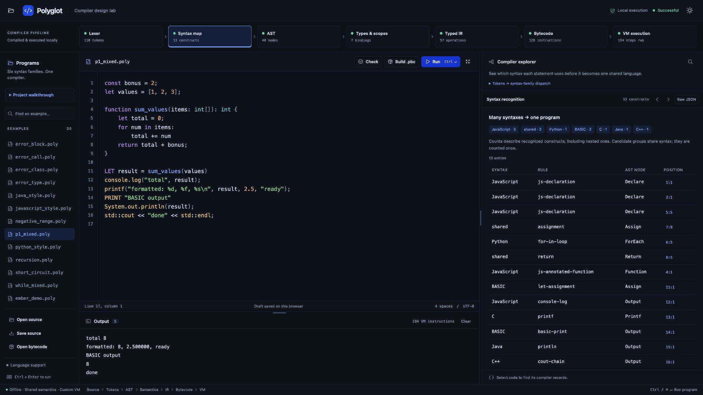
The working compiler workspace
04
Notes:
This is a real screenshot captured from the current local app. The editor contains p1_mixed.poly. The syntax map records JavaScript, Python, BASIC, C, Java and C++ constructs. The program emits five output lines and executes 194 VM instructions. The ribbon contains actual stage sizes, not simulated progress. Source links in the inspector select the corresponding text in the editor.
Implementation sources (local snapshot 60f60ed, 26 October 2026):
https://github.com/hst257/PolyGlot [local file: examples/p1_mixed.poly]
https://github.com/hst257/PolyGlot [local file: src/polyglot/web/static/app.js]

Slide 5
Compilation pipeline
Each phase consumes the representation produced by the previous phase
Phase | Output
Lexical analysis | Tokens with text and source spans
Parsing and normalization | Shared abstract syntax tree
Semantic analysis | Resolved symbols and checked types
IR generation | Typed three-address instructions
Optimization | Simplified IR with a pass report
Code generation | Validated .pbc stack bytecode
Execution | Program output or a mapped runtime diagnostic
05
Notes:
Walk through the dependency between stages. Parser recognition and AST construction happen in the same parsing pass. The analyzer annotates AST nodes with resolved binding/type information. Lowering creates per-function IR. Optimization runs before code generation by default. Check and Build stop before VM execution. Run includes execution. Both CLI and web call compile_source, so their compiler behavior is shared.
Implementation sources (local snapshot 60f60ed, 26 October 2026):
https://github.com/hst257/PolyGlot [local file: src/polyglot/compiler.py]
https://github.com/hst257/PolyGlot [local file: src/polyglot/web/worker.py]
https://github.com/hst257/PolyGlot [local file: src/polyglot/cli.py]

Slide 6
Mixed syntax in one program
A function written with one syntax can serve another syntax
int add(int a, int b) {
return a + b;
}
def twice(value: int) -> int:
return add(value, value)
int result = twice(6);
std::cout << result << std::endl;
print("done")
Output
12
done
Both calls resolve through the same symbol table and VM.
06
Notes:
This shortened worked example uses the same supported constructs as mixed_demo.poly. add has a C-style declaration and twice has a Python-style declaration. twice calls add, and top-level C-style code calls twice. All arguments and return types follow Polyglot rules. No source-to-C or source-to-Python translation occurs. The original mixed_demo also includes a range loop and Java-style output.
Implementation sources (local snapshot 60f60ed, 26 October 2026):
https://github.com/hst257/PolyGlot [local file: examples/mixed_demo.poly]
https://github.com/hst257/PolyGlot [local file: src/polyglot/semantics.py]
https://github.com/hst257/PolyGlot [local file: src/polyglot/vm.py]

Slide 7
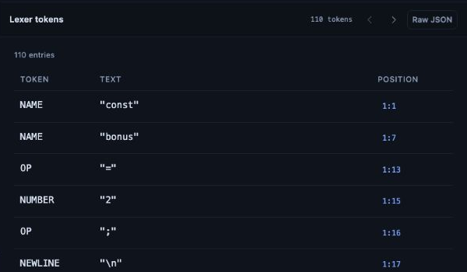
Lexical analysis
Characters become tokens that retain their source positions
Token categories
Names, literals, operators and layout markers.
Source spans
Locations support diagnostics and editor links.
07
Notes:
The scanner is handwritten. The actual UI shows const and bonus as NAME tokens: keyword interpretation happens during parsing, so do not claim a separate KEYWORD token class. The lexer recognizes operators and literals and preserves spans. The parser controls a layout context because indentation and braces can mix. This implementation does not generate a DFA or use Lex/Flex.
Implementation sources (local snapshot 60f60ed, 26 October 2026):
https://github.com/hst257/PolyGlot [local file: src/polyglot/lexer.py]
https://github.com/hst257/PolyGlot [local file: src/polyglot/source.py]
https://github.com/hst257/PolyGlot [local file: src/polyglot/layout.py]

Slide 8
Parsing and operator precedence
Recursive descent handles statements, while Pratt parsing handles expressions
Decision | Implementation
Statement family | Leading tokens and bounded lookahead
Expression structure | Binding powers encode operator precedence
Mixed blocks | Context-aware suite reader handles indentation and braces
Normalization | Family-specific spelling creates shared AST nodes
2 + 3 * 4
The multiplication groups before the addition.
08
Notes:
Dispatch examines distinctive prefixes such as def, function, console.log and PRINT. Shared declarations can have several candidate syntax families. There is one common Pratt expression parser. A higher binding power keeps multiplication inside the right operand of addition. Parentheses override the default precedence. This project uses a selected top-down strategy rather than maintaining LL(1), SLR, CLR and LALR parser tables simultaneously.
Implementation sources (local snapshot 60f60ed, 26 October 2026):
https://github.com/hst257/PolyGlot [local file: src/polyglot/parser/dispatch.py]
https://github.com/hst257/PolyGlot [local file: src/polyglot/parser/shared.py]
https://github.com/hst257/PolyGlot [local file: docs/grammar.ebnf]

Slide 9
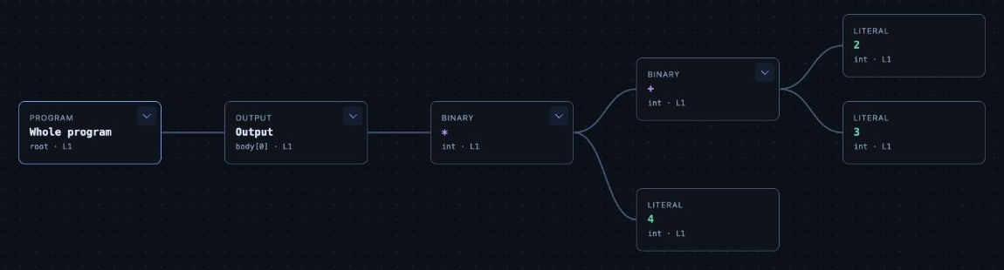
The AST is a real tree
print((2 + 3) * 4)
Semantic structure
Source connection
Operations and operands replace punctuation.
Types and source links stay attached to each node.
09
Notes:
The screenshot comes from the actual compiler result for print((2 + 3) * 4), expanded in the app. Program contains Output, whose value is a multiplication. The left child of multiplication is addition and the right child is 4. The addition contains 2 and 3. It is an abstract syntax tree rather than a concrete parse tree, so it omits parentheses and separators. The compiler retains this original checked AST even when optimization changes the IR.
Implementation sources (local snapshot 60f60ed, 26 October 2026):
https://github.com/hst257/PolyGlot [local file: src/polyglot/ast.py]
https://github.com/hst257/PolyGlot [local file: src/polyglot/parser/shared.py]
https://github.com/hst257/PolyGlot [local file: src/polyglot/web/static/app.js]

Slide 10
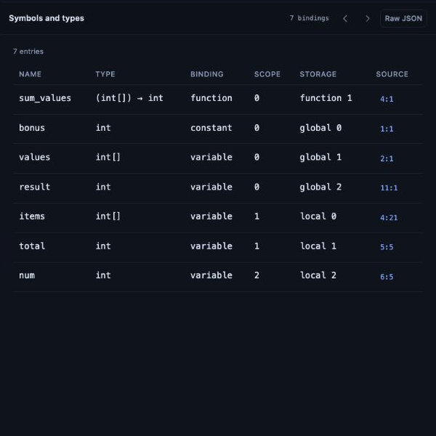
Semantic analysis
A well-formed tree must also obey binding and type rules
Name resolution
Nested scopes distinguish globals, parameters and local variables.
Type checking
Assignments, calls, returns and array operations must use compatible types.
10
Notes:
The symbol table screenshot is from p1_mixed.poly. bonus is an int constant in global slot 0, values is int[] in global slot 1, and sum_values has the signature (int[]) to int. Parameters and locals use frame-local slots. The analyzer collects top-level signatures before checking function bodies, enabling forward calls and recursion. Shared const checking prevents reassignment even if another syntax performs the assignment.
Implementation sources (local snapshot 60f60ed, 26 October 2026):
https://github.com/hst257/PolyGlot [local file: src/polyglot/semantics.py]
https://github.com/hst257/PolyGlot [local file: src/polyglot/types.py]
https://github.com/hst257/PolyGlot [local file: examples/p1_mixed.poly]

Slide 11
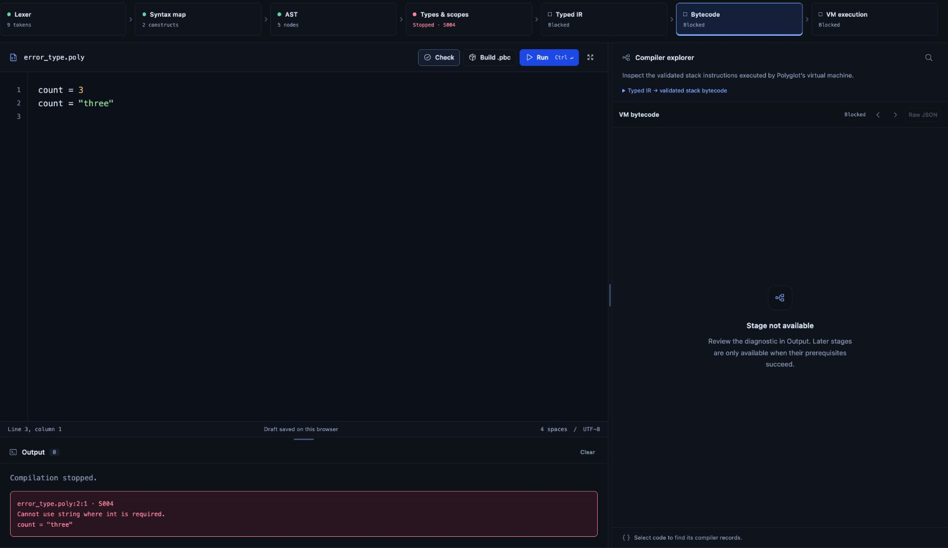
Semantic errors stop code generation
The source parses successfully, but assigning a string to an int fails
S004 at line 2: Cannot use string where int is required.
11
Notes:
The two-line error_type.poly program sets count to 3 and then tries to assign the string three. The lexer and parser complete, but semantic analysis stops with S004. No artifact is generated and the VM does not run invalid code. Available earlier representations remain inspectable. The current compiler reports the first error rather than attempting multi-error recovery.
Implementation sources (local snapshot 60f60ed, 26 October 2026):
https://github.com/hst257/PolyGlot [local file: examples/error_type.poly]
https://github.com/hst257/PolyGlot [local file: src/polyglot/compiler.py]
https://github.com/hst257/PolyGlot [local file: src/polyglot/semantics.py]

Slide 12
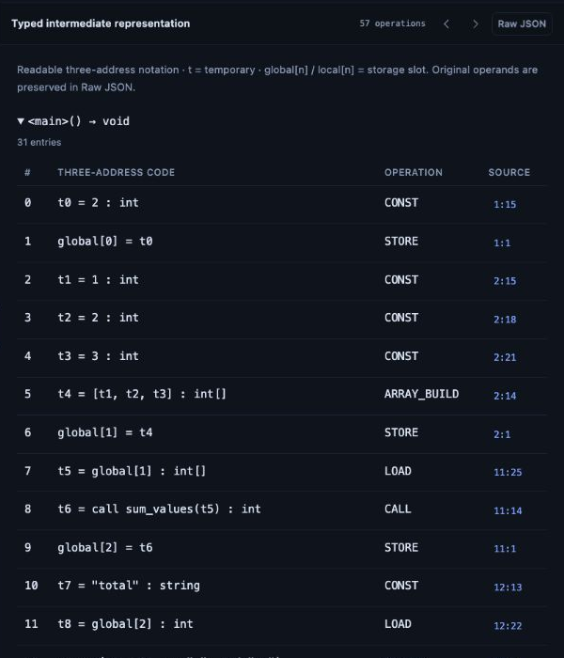
Typed three-address IR
The compiler expresses computation using explicit temporaries and operations
t0 = 2 : int
t1 = 3 : int
t2 = t0 + t1 : int
t3 = 4 : int
t4 = t2 * t3 : int
output(t4)
return
Readable notation for the expression.
The inspector shows original IR.
12
Notes:
The left side is a simplified readable rendering of the actual original IR for the worked expression. The right side shows the real app inspector for the mixed demo. Lowering makes evaluation order explicit with temporaries, typed operations, labels and branches. IR is a suitable place for language-independent optimization because front-end spelling has already disappeared. The existing browser IR tab shows original lowering. The CLI/API separately exposes optimized_ir and the optimization report.
Implementation sources (local snapshot 60f60ed, 26 October 2026):
https://github.com/hst257/PolyGlot [local file: src/polyglot/ir.py]
https://github.com/hst257/PolyGlot [local file: src/polyglot/compiler.py]
https://github.com/hst257/PolyGlot [local file: src/polyglot/web/static/app.js]

Slide 13
Control flow and data-flow analysis
These analyses support actual optimization decisions
Analysis | How the compiler uses it
Basic blocks | Split at entry, labels and instructions after terminators
Control-flow graph | Resolve branch, jump and fall-through successors
Reachability | Remove blocks with no path from function entry
Liveness and next use | Remove only safe unused constant definitions
OUT[B] = union of IN[S] for each successor S
IN[B] = USE[B] union (OUT[B] - DEF[B])
13
Notes:
analysis.py constructs the real CFG over IR instructions. A backwards worklist solves liveness until no IN sets change. Reverse scanning inside a block computes next use and distinguishes successive definitions of a temporary. Live-out values remain needed across block boundaries. These are temporary liveness facts, not a full memory alias or interprocedural data-flow analysis. The optimizer consumes this information to discard safe dead constants.
Implementation sources (local snapshot 60f60ed, 26 October 2026):
https://github.com/hst257/PolyGlot [local file: src/polyglot/analysis.py]
https://github.com/hst257/PolyGlot [local file: src/polyglot/optimizer.py]

Slide 14
Implemented optimization passes
Optimization runs on typed IR before bytecode generation
Pass | Actual transformation
Local constant folding | Replace a known successful operation with a typed constant
Constant branch simplification | Replace a proven Boolean branch with a direct jump
Unreachable code removal | Rebuild the graph and discard unreachable blocks
Safe dead-constant removal | Use liveness and next use to remove unused CONST definitions
Reachable calls, output, mutable loads and runtime checks remain.
14
Notes:
Facts track only bounded primitive constants inside one basic block. They do not propagate through mutable storage or control-flow joins. Division by zero, nonfinite numeric results and failed conversions stay as runtime operations with source diagnostics. The compiler retains reachable side effects and potentially trapping operations. This is conservative optimization, not general algebraic simplification, loop optimization or common-subexpression elimination.
Implementation sources (local snapshot 60f60ed, 26 October 2026):
https://github.com/hst257/PolyGlot [local file: src/polyglot/optimizer.py]
https://github.com/hst257/PolyGlot [local file: tests/test_optimization.py]

Slide 15
17 instructions become 5
Same source. Same output. Fewer executed VM instructions.
print((2 + 3) * 4)
20
output in both runs
70.6% fewer instructions in this example. This is an instruction count, not a timing benchmark.
15
Notes:
Measured again against the current local compiler for this presentation. optimize=False produced 17 static bytecode instructions and 17 executed VM steps. The default optimized path produced 5 of each. Both outputs were 20 followed by a newline. The original expression contains two binary operations. The optimizer reports two folds and four dead constants removed. Percentage reduction is (17 - 5) / 17 = 70.588%, rounded to 70.6%. Do not generalize this small example into a universal speedup.
Implementation sources (local snapshot 60f60ed, 26 October 2026):
https://github.com/hst257/PolyGlot [local file: src/polyglot/compiler.py]
https://github.com/hst257/PolyGlot [local file: src/polyglot/optimizer.py]
https://github.com/hst257/PolyGlot [local file: tests/test_optimization.py]

Slide 16
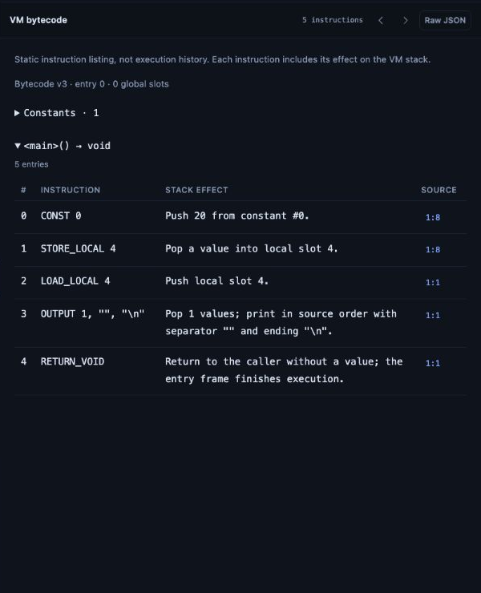
Generated stack bytecode
The executable representation contains one computed constant
CONST 0
STORE_LOCAL 4
LOAD_LOCAL 4
OUTPUT 1, "", "\n"
RETURN_VOID
Constant pool entry 0 contains 20.
16
Notes:
The screenshot and listing are the actual optimized artifact for the worked example. Code generation turns IR temporaries into frame-local slots and expands each operation into stack instructions. Slot 4 remains because optimization preserves temporary numbering rather than compacting storage. Codegen records label positions and patches pending jump operands after instruction emission. Artifact format version 3 supports FORMAT and remains compatible with earlier supported versions.
Implementation sources (local snapshot 60f60ed, 26 October 2026):
https://github.com/hst257/PolyGlot [local file: src/polyglot/codegen.py]
https://github.com/hst257/PolyGlot [local file: src/polyglot/artifact.py]
https://github.com/hst257/PolyGlot [local file: docs/bytecode.md]

Slide 17
Virtual machine and activation records
Each function call receives its own execution frame
Frame field | Purpose
function | Selected bytecode and function metadata
locals | Parameters, local variables and IR temporary slots
ip | Next instruction to execute
stack | Operand values for this call
callsite | Source location used in runtime diagnostics
factorial(6)
6 * factorial(5)
5 * factorial(4)
...
return 720
Fresh frames keep recursive calls separate.
17
Notes:
Frame is a dataclass in vm.py. Calls evaluate arguments left to right and create new local storage and operand stacks. Returns pop a frame and deliver the result to the caller. Globals remain shared. This implements the runtime idea of activation records in an interpreted stack machine. It does not allocate physical CPU registers. recursion.poly demonstrates a forward call to factorial and prints 720. The runtime builds diagnostic call stacks from stored callsites.
Implementation sources (local snapshot 60f60ed, 26 October 2026):
https://github.com/hst257/PolyGlot [local file: src/polyglot/vm.py]
https://github.com/hst257/PolyGlot [local file: examples/recursion.poly]
https://github.com/hst257/PolyGlot [local file: src/polyglot/codegen.py]

Slide 18
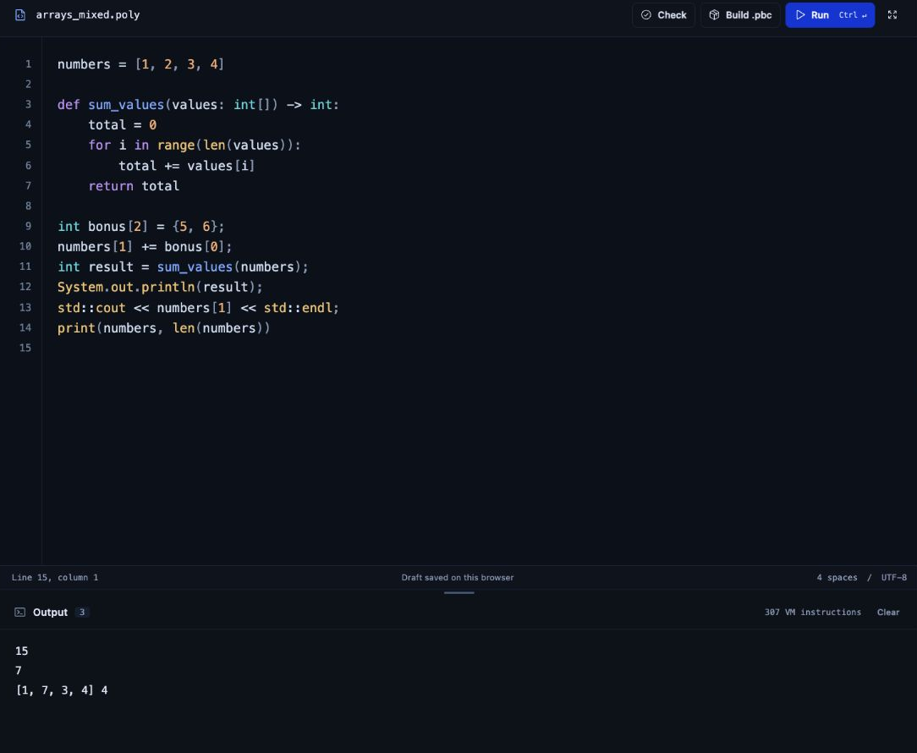
Arrays across syntax families
Shared references and checked indexing use dedicated IR and VM operations
Fixed element type
An int[] stays an int[] across declarations, assignment and function calls.
Runtime checks
The VM checks index types, bounds, element types and allocation limits.
18
Notes:
arrays_mixed.poly mixes array declarations and shared functions. Arrays carry primitive element types and reference identity. Assignment or parameter passing shares the array object, so updates can be visible through aliases. Sized allocations initialize values by type. ARRAY_BUILD, ARRAY_NEW, ARRAY_GET, ARRAY_SET and related operations implement the runtime behavior. Python-style array iteration captures the array once and lowers to an index loop. The screenshot shows actual output for the bundled example.
Implementation sources (local snapshot 60f60ed, 26 October 2026):
https://github.com/hst257/PolyGlot [local file: examples/arrays_mixed.poly]
https://github.com/hst257/PolyGlot [local file: src/polyglot/ir.py]
https://github.com/hst257/PolyGlot [local file: src/polyglot/vm.py]
https://github.com/hst257/PolyGlot [local file: src/polyglot/types.py]

Slide 19
A reusable .pbc artifact
Compilation and execution can happen separately
python run_polyglot.py build examples/mixed_demo.poly -o build/demo.pbc
python run_polyglot.py exec build/demo.pbc
Artifact contents
Independent execution
Constants, function code, storage metadata and source mappings.
The VM validates and executes the artifact without reading the source file.
19
Notes:
Building does not run the program. The .pbc file is structured JSON with format and version fields. Loading validates instruction operands, control flow and resource-related structure before execution. Stored source locations and excerpts allow runtime diagnostics without the original .poly file. Source-independent artifact execution has regression coverage.
Implementation sources (local snapshot 60f60ed, 26 October 2026):
https://github.com/hst257/PolyGlot [local file: src/polyglot/artifact.py]
https://github.com/hst257/PolyGlot [local file: src/polyglot/cli.py]
https://github.com/hst257/PolyGlot [local file: docs/bytecode.md]

Slide 20
Local application architecture
The CLI and browser share the compiler library
Component | Responsibility
Browser UI | Plain HTML, CSS and JavaScript with bundled offline assets
Loopback server | Routes requests and checks Host / Origin
Spawned worker | Compiles or runs with a parent wall-clock deadline
Compiler library | One implementation for CLI and web operations
Bounded VM | Validates bytecode and enforces execution limits
Runtime requirement: Python 3.11 or newer. No third-party runtime dependencies.
20
Notes:
The server binds to 127.0.0.1 and serves an explicit static allowlist. Each job uses a spawned worker rather than running user source in the web server process. The parent deadline can terminate runaway work. The VM defaults are 1,000,000 steps, recursion 64, output 65,536 bytes and a 5-second timeout. These are bounded educational execution safeguards, not a claim that the app is ready for untrusted public multi-user hosting. User programs never run via eval, exec or external language runtimes.
Implementation sources (local snapshot 60f60ed, 26 October 2026):
https://github.com/hst257/PolyGlot [local file: src/polyglot/web/server.py]
https://github.com/hst257/PolyGlot [local file: src/polyglot/web/worker.py]
https://github.com/hst257/PolyGlot [local file: src/polyglot/vm.py]
https://github.com/hst257/PolyGlot [local file: pyproject.toml]

Slide 21
Verification
Local verification snapshot from 26 October 2026
296
54
Python tests passed
Frontend tests passed
Compiler behavior, HTTP workers, artifact execution and editor interactions
Optimization tests compare outputs, errors, evaluation order and all valid bundled examples.
21
Notes:
These are the actual recorded full-suite results in docs/verification.md for the current optimization update, not coverage percentages. Python: 296 passed in 7.54 seconds. Frontend: 54 passed. The optimization suite contains 36 cases and includes seeded differential expressions, negative remainder behavior, floating overflow, calls/output order, short circuiting, arrays, cross-block liveness and oversized-function fallback. Real HTTP checks verify the default optimizer and optimize:false option. The presentation also re-executed the 17-versus-5 example. Test counts show regression evidence, not proof of the absence of defects.
Implementation sources (local snapshot 60f60ed, 26 October 2026):
https://github.com/hst257/PolyGlot [local file: docs/verification.md]
https://github.com/hst257/PolyGlot [local file: tests/test_optimization.py]
https://github.com/hst257/PolyGlot [local file: tests/test_http.py]
https://github.com/hst257/PolyGlot [local file: tests/web/]

Slide 22
Compiler-design concepts used
The concepts appear in the compiler implementation itself
Concept | Concrete implementation
Lexical and syntax analysis | Scanner, recursive descent, Pratt precedence and shared AST
Semantic analysis | Scoped symbols, fixed types, call / return validation
Intermediate code | Typed three-address operations and symbolic control flow
Optimization and data flow | Basic blocks, CFG, liveness, next use and constant folding
Code generation | Stack instructions and deferred jump-target patching
Runtime organization | Global slots, local slots, call frames and operand stacks
22
Notes:
This slide maps implemented mechanisms to the compiler course without presenting coursework modules in the app. The project selects one workable parser strategy and one target machine. It does not implement every alternative algorithm in a compiler syllabus. Syntax-directed translation happens procedurally when AST structure drives semantic checking and IR lowering. It is not a formal attribute-grammar engine. Deferred label patching implements jump target resolution, not a claim of a complete truelist/falselist SDT or switch-case implementation.
Implementation sources (local snapshot 60f60ed, 26 October 2026):
https://github.com/hst257/PolyGlot [local file: src/polyglot/lexer.py]
https://github.com/hst257/PolyGlot [local file: src/polyglot/parser/]
https://github.com/hst257/PolyGlot [local file: src/polyglot/semantics.py]
https://github.com/hst257/PolyGlot [local file: src/polyglot/ir.py]
https://github.com/hst257/PolyGlot [local file: src/polyglot/analysis.py]
https://github.com/hst257/PolyGlot [local file: src/polyglot/codegen.py]
https://github.com/hst257/PolyGlot [local file: src/polyglot/vm.py]

Slide 23
Demonstration sequence
A short walkthrough with observable results
Demo | What it demonstrates | Expected result
p1_mixed.poly | Six syntax families in one source | Five output lines
mixed_nesting.poly | Braces and indentation in nested blocks | 22
error_type.poly | A semantic failure blocks later phases | S004 at line 2
print((2 + 3) * 4) | Original and optimized compilation | 20 with 17 vs 5 steps
Finish by building a .pbc file and executing it independently.
23
Notes:
Suggested speaking path: run p1_mixed and briefly inspect recognition. Open the tree for mixed_nesting and point to the mixed block structure. Show error_type to distinguish syntax validity from semantic validity. Use the CLI no-optimize option for the measured expression comparison, because the current browser IR view retains original IR. Finally build mixed_demo and exec the artifact. p1_mixed output is total 8, formatted: 8, 2.500000, ready, BASIC output, 8, done across five lines. The known instruction count is specific to the current compiler snapshot.
Implementation sources (local snapshot 60f60ed, 26 October 2026):
https://github.com/hst257/PolyGlot [local file: docs/demo.md]
https://github.com/hst257/PolyGlot [local file: examples/p1_mixed.poly]
https://github.com/hst257/PolyGlot [local file: examples/mixed_nesting.poly]
https://github.com/hst257/PolyGlot [local file: examples/error_type.poly]
https://github.com/hst257/PolyGlot [local file: src/polyglot/cli.py]

Slide 24
Current limits and next steps
The implementation has a clear, testable boundary
Language boundary
Compiler boundary
Selected constructs only. Classes, imports and general object operations remain unsupported.
One handwritten parser strategy and a custom stack VM. No LLVM or LR parser-table backend.
Next compiler work
Next engineering work
Multiple-error recovery, broader data-flow analysis and further safe optimizations.
Larger benchmark programs and more diagnostics for grammar extensions.
24
Notes:
Do not claim full Python/C/C++/Java/JavaScript/BASIC compliance. No direct regular-expression-to-DFA generator, Lex/Yacc integration, CLR/LALR parser, physical-register allocator or LLVM target is present. Current initialization and return checking are conservative. Optimization deliberately limits analysis: 12 functions, 1,500 IR instructions per function, 3,000 total and 120 blocks per analyzed function. Oversized functions retain their original IR and report the skip. Future features listed here are proposals, not implemented results.
Implementation sources (local snapshot 60f60ed, 26 October 2026):
https://github.com/hst257/PolyGlot [local file: README.md]
https://github.com/hst257/PolyGlot [local file: docs/architecture.md]
https://github.com/hst257/PolyGlot [local file: src/polyglot/optimizer.py]

Slide 25
What Polyglot demonstrates
A complete compiler pipeline for a defined mixed-syntax language
One shared semantic model
Actual IR optimization
Independent bytecode execution
Working evidence is available in the editor, compiler stages, tests and artifacts.
25
Notes:
Close the main presentation here. The core contribution is connecting source recognition, semantic rules, IR transformations and a target runtime in a working local tool. Be ready to explain the original repository foundation and the current local additions separately. No grade or universal performance claim follows from the implementation alone. The appendix contains code navigation, likely viva questions and source credits.
Implementation sources (local snapshot 60f60ed, 26 October 2026):
https://github.com/hst257/PolyGlot [local file: src/polyglot/compiler.py]
https://github.com/hst257/PolyGlot [local file: docs/architecture.md]
https://github.com/hst257/PolyGlot [local file: docs/verification.md]

Slide 26
Appendix: implementation map
Files to open during a code walkthrough
Area | Source location
Compiler orchestration | src/polyglot/compiler.py
Scanner and parsing | lexer.py and parser/
Semantic rules and lowering | semantics.py and ir.py
Data flow and optimization | analysis.py and optimizer.py
Target and execution | codegen.py, artifact.py and vm.py
Web application | web/server.py, web/worker.py and web/static/
26
Notes:
All shortened paths in this table are relative to src/polyglot unless they already show the root. For an end-to-end walkthrough, start in compile_source and follow the imports. For the new optimizer, show basic block construction and the liveness worklist in analysis.py, then the transformation sequence in optimizer.py. Local snapshot: main at 60f60ed, with local commits ahead of origin at the time of presentation preparation. No GitHub push has been performed.
Implementation sources (local snapshot 60f60ed, 26 October 2026):
https://github.com/hst257/PolyGlot [local file: src/polyglot/compiler.py]
https://github.com/hst257/PolyGlot [local file: src/polyglot/analysis.py]
https://github.com/hst257/PolyGlot [local file: src/polyglot/optimizer.py]

Slide 27
Appendix: viva questions
Short answers grounded in the implementation
Compiler or interpreter?
Why a shared AST?
The front end compiles to .pbc. A custom VM interprets that bytecode.
It removes syntax differences before common semantic checking and code generation.
Why optimize the IR?
How is correctness checked?
Typed operations expose constants and control flow before stack lowering.
Differential tests compare output and errors with optimization enabled and disabled.
27
Notes:
Additional likely questions: Why no physical registers? The target is a stack VM and uses frame-local slots. Why preserve a division-by-zero operation? Replacing it incorrectly could hide a reachable diagnostic. Is the AST a parse tree? No, it records semantic structure and omits syntax punctuation. Can the artifact run without source? Yes, code and source mappings are in the artifact. Does source inspection show exactly executed IR? The browser original IR tab does not, but optimized_ir is available via CLI/API and bytecode is the actual executable. What does six languages mean? Six inspired syntax families within a restricted language.
Implementation sources (local snapshot 60f60ed, 26 October 2026):
https://github.com/hst257/PolyGlot [local file: src/polyglot/compiler.py]
https://github.com/hst257/PolyGlot [local file: src/polyglot/optimizer.py]
https://github.com/hst257/PolyGlot [local file: src/polyglot/vm.py]
https://github.com/hst257/PolyGlot [local file: tests/test_optimization.py]

Slide 28
Appendix: sources and attribution
Project foundation
hst257/PolyGlot on GitHub
MIT License, © 2026 Harshit and Polyglot contributors
Implementation evidence
Current local source, architecture notes and verification report
Live application screenshots captured on 26 October 2026
The local workspace includes editor improvements and a conservative IR optimizer. Local changes remain unpushed.
28
Notes:
Original project: https://github.com/hst257/PolyGlot
Original license: LICENSE in the repository, copyright 2026 Harshit and Polyglot contributors.
Local source snapshot: 60f60ed, 26 October 2026. Local updates are not necessarily available at the public remote.
Internal references: README.md, docs/architecture.md, docs/language.md, docs/grammar.ebnf, docs/bytecode.md, docs/verification.md.
All app screenshots in this deck are actual captures of the local application. The expression IR on slide 12 uses simplified notation for readability.
UI reference research documented in docs/ui-design.md: Compiler Explorer https://github.com/compiler-explorer/compiler-explorer/blob/main/docs/WhatIsCompilerExplorer.md and AST Explorer https://github.com/fkling/astexplorer. These inform interface design, not the claimed compiler algorithms.
Keep the original MIT attribution when distributing the project.
Implementation sources (local snapshot 60f60ed, 26 October 2026):

