Slide 1


Predicting airline Ticket prices IN THE US
Harshit Arora, Patrick He, Halle Steinberg, Sean Yu
April 13th, 2020

Slide 2




Meet the team
Harshit Arora
Patrick He
Halle Steinberg
Sean Yu
Favorite Destination:
London, UK
Favorite Destination:
Key West, Florida
Favorite Destination:
Corfu, Greece
Favorite Destination:
Oahu, Hawaii

Slide 3
Agenda
Data Mining Process Overview
Business Understanding
Data Understanding
Data Preparation and Cleaning
Model Building
Evaluation
Deployment Strategy and Future Considerations

Slide 4







Agenda/Data mining CRISP outline
Data Mining Process
What is the target variable and its distribution?
How many instances do I have?
Which features are important?
What attributes affect the price of an airline ticket?
How does airline carrier, time of the year, distance, etc. affect how much a ticket will cost?
How can we provide our customers with optimal ticket prices while allowing for flexibility?
Data Understanding
Identify target variable
Identify missing values
Identify numerical variables
Identify categorical variables
Select useful attributes
Business Understanding
Data Preparation
Linear Regression
Implement the best model using ensemble approaches to capture best performance
Implement strategy by offering online tool that allows customers to actively customize options and see best flight prices that fit their needs
DATA
Regression Tree
Deployment
Modeling
Random Forest
Evaluation
XGBoost
RMSE, MAE, MAPE

Slide 5
Business understanding
Business understanding
As an elite, world-wide travel agency, how can we provide honest and reliable airline ticket pricing options to our customers, based on their travel preferences?
The Airline Industry Crisis
Our Solution
COVID-19
The world has been painfully stricken by COVID-19, tearing apart the airline industry and causing economic downturn across the world
Flight demand is decreasing by the day, down nearly 90% from this time in 2019
Airlines will shrink in size and value over the next few months and customer loyalty will be a concern
As employees at one of the world’s top travel agencies, our responsibility of securing the best travel options for our customers in the future remains
Ticket Price Certainty
With such tentativeness in flying right now, we need to ensure confidence in our prices once flying does resume as normal
Why worry now when the industry is still struggling?
The crisis will hopefully slow down as the summer months approach, when people will be looking for vacation deals
Need to prepare now for the demand that will hopefully come soon

Slide 6



Data understanding
9.5 Million Booking Instances
252 Origins and Destinations Across US
13 Attributes (2 IDs, 5 Categorical, 6 Numerical)
Location
Origin and Destination airport
Airport to State and State to Region mapping
Ticket Price
Price Per Ticket in a booking (Target Variable)
Number of tickets booked also available
Other Factors Affecting Price
Miles between source and destination
Flight time in the year (Q1- Q4)
Airline company
Number of coupons in market for that flight
Goal: Based on customer travel preferences, predict the price of a booking depending on features that customers may or may not be flexible on.
Source: Bureau of Transportation Statistics

Slide 7
Data preparation and cleaning
Removing identifier columns
Feature selection and engineering
Step 1:
Remove Unnecessary Features
Step 3: Reducing Dimensionality
Our data includes features such as Itinerary ID and Booking ID, which can be common for flights booked in one transaction (e.g. Return Journeys). For the purpose of modeling, we treat each row as a unique booking.
As factors, Origin and Destination would have 250 levels each. We would map this to their respective States or Regions as we expect prices to not vary much within, giving a better generalized performance.
Step 2: Converting Categorical to Dummy Variables
Step 4: Variable Transformations
Dummy variables for non-binary categories
Monotonic transformations
Our categorical variables are nominal. We changed these columns (Quarter, Airline Code, Origin, and Destination) to n-1 dummy binary variables.
We tried our models with and without transformation of the dependent variable. Price had a skewed distribution, and was transformed using the log transformation.
Due to heavy computations involved, we used a random sample of 5M rows to train and test the models we built.

Slide 8
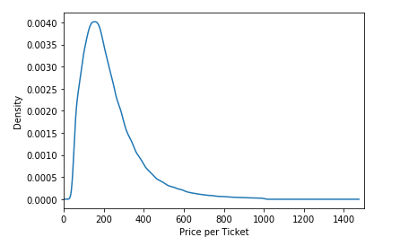
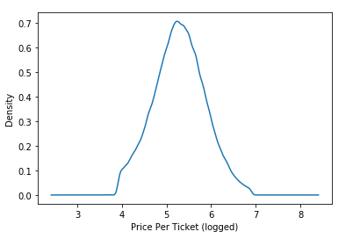
Transforming the target variable
Log Transformation
Right Skewness Observed
Symmetrical Distribution

Slide 9
Model building
Model building and tuning
Skewed Target Variable
Take Log of PricePerTicket
Untransformed Target Variable
Transformed Target Variable
Regression Tree
Random Forest
XGBoost
Linear Regression
Regression Tree
Random Forest
XGBoost
Max_depth = 20
Min_samples_leaf = 5
Number of estimators = 40
Max_features = auto
Min_samples_ split = 4
Learning rate = 0.05
Max_depth =15
Number of estimators = 500
Regularization: L1 Lasso
Max_depth = 20
Min_samples_leaf = 5
Number of estimators = 30
Max_features = auto
Min_samples_split = 8
Learning rate = 0.07
Max_depth =10
Number of estimators = 500
We used 70% of the 5M instances to train and optimize the model parameters, and 30% test data to verify “model goodness”

Slide 10




Model evaluation
Criterion
Linear Regression - Lasso
Regression Tree
Random Forest
XGBoost
Transformed
Transformed
Untransformed
Transformed
Untransformed
Transformed
Untransformed
RMSE
212.33
120.93
121.62
122.13
122.82
120.56
121.03
MAE
196.03
82.81
85.67
83.01
85.77
81.30
81.46
MAPE
61.32
38.81
43.92
39.93
44.20
37.81
38.44
Computational Efficiency
High
Medium
Low
Medium
Interpretability
High
High
Medium
Medium

Slide 11

Final model – Ensemble method results
Regression Tree
XGBoost
Ensemble Model – Using average of DT and XGBoost’s individual predictions
Stress-tested on multiple test sets sampled from unused data of ~4.5M rows
Better generalized performance than individual predictors
Performance on Original Test Data
RMSE - 120.11
MAE - 81.30
MAPE - 37.77%

Slide 12
Model Deployment
Interactive Online Tool
Business Travelers & Vacation Seekers
Maintain Customer Loyalty
Provide our customers with an enhanced, easy-to-use online tool that allows them to receive real-time pricing options
Promote flight flexibility and customizability – customers will be able to compare different flight options and choose which ones best fits their needs
Enhance customer experience by providing flexibility and accessibility
People will be very tentative to travel once pandemic dies down
Business travelers will be the first to start traveling
Once the summer months hit, travelers will start to plan vacations
Target these customers as first users of the tool by offering promotional incentives for flights
Flyers will be looking for trustworthy and honest prices after the current state of uncertainty
By providing our customers with an accurate pricing tool, we can maintain loyalty among our existing customers
Gain new customers through word-of-mouth and online promotions

Slide 13




considerations and risk mitigation
Considerations and Risk Mitigation
Biggest risks lie in offering too high or too low of prices for our customers once the pandemic is over.
If we predict a price too high, when in reality, the flight is available cheaper, we risk losing the trust of our customers
After a time of such uncertainty, trust in the accuracy of our prices is key – without it we risk a decrease in satisfaction and possibly customers churning
People will start flying again, but it will be very different – these uncertainties are hard to model from historical data
By implementing a trustworthy model with minimized errors, we can bring honesty and trust to our customers and provide them with the best travel experience possible.

Slide 14



Future considerations
Additional Features
More Than Just 2018
Interactive Tool
Airline pricing is very dynamic and complex
Many additional factors affect pricing
E.g. day and time of booking, time between booking and departure
Better capture seasonality
Learn overall pricing trend across the years
Allows users to specify preferences
Allows for flexibility
What factors are flexible?
E.g. Day of week
Which ones are not?
E.g. Source city

Slide 15





Conclusion and recap
Conclusion and Recap
Business Understanding
Data Understanding & Preparation
Modeling & Evaluation
Deployment
What attributes affect the price of an airline ticket?
How can we provide our customers with optimal ticket prices while allowing for flexibility?
Data source
Data types
Transformation of dependent variable
Compare multiple regression models
Minimize RMSE and other prediction errors
Maximize performance using ensemble methods
Evaluate risks of deployment untrustworthy model results
Understand risks of model and costs of losing customers
We hope to see you flying again soon!*
*With Delta Air Lines, of course.

Slide 16
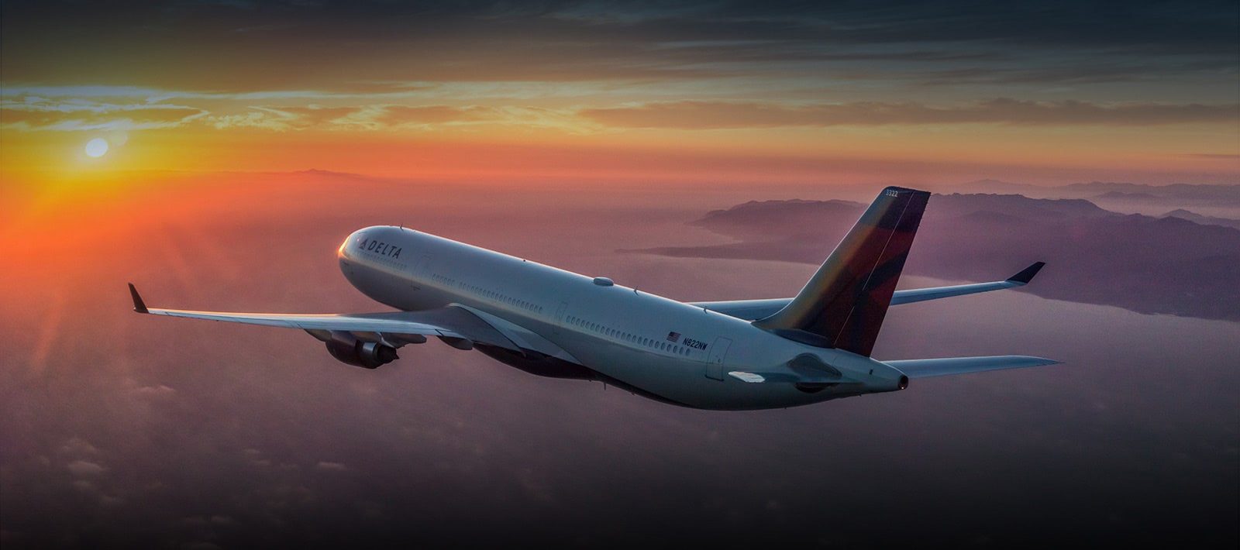
Thank you! Questions?

