Slide 1

Project set-up
Concepts
Hidden states
Position of coin (x_box)
Speed of first enemy (v_enemy)
Position of first pipe (x_pipe)
Reference experiment
Start game with randomly selected values for hidden states
Let Mario run (walk) at normal speed
Observations:
Some number of pictures of the game taken at equal time deltas
Questions
Given Mario's constant running speed (a random variable as question input), at what point in time does Mario need to jump in order to:
Kill the enemy?
Get the coin from the first question mark?
Overcome the pipe?
x_box
x_pipe
v_enemy

Slide 2
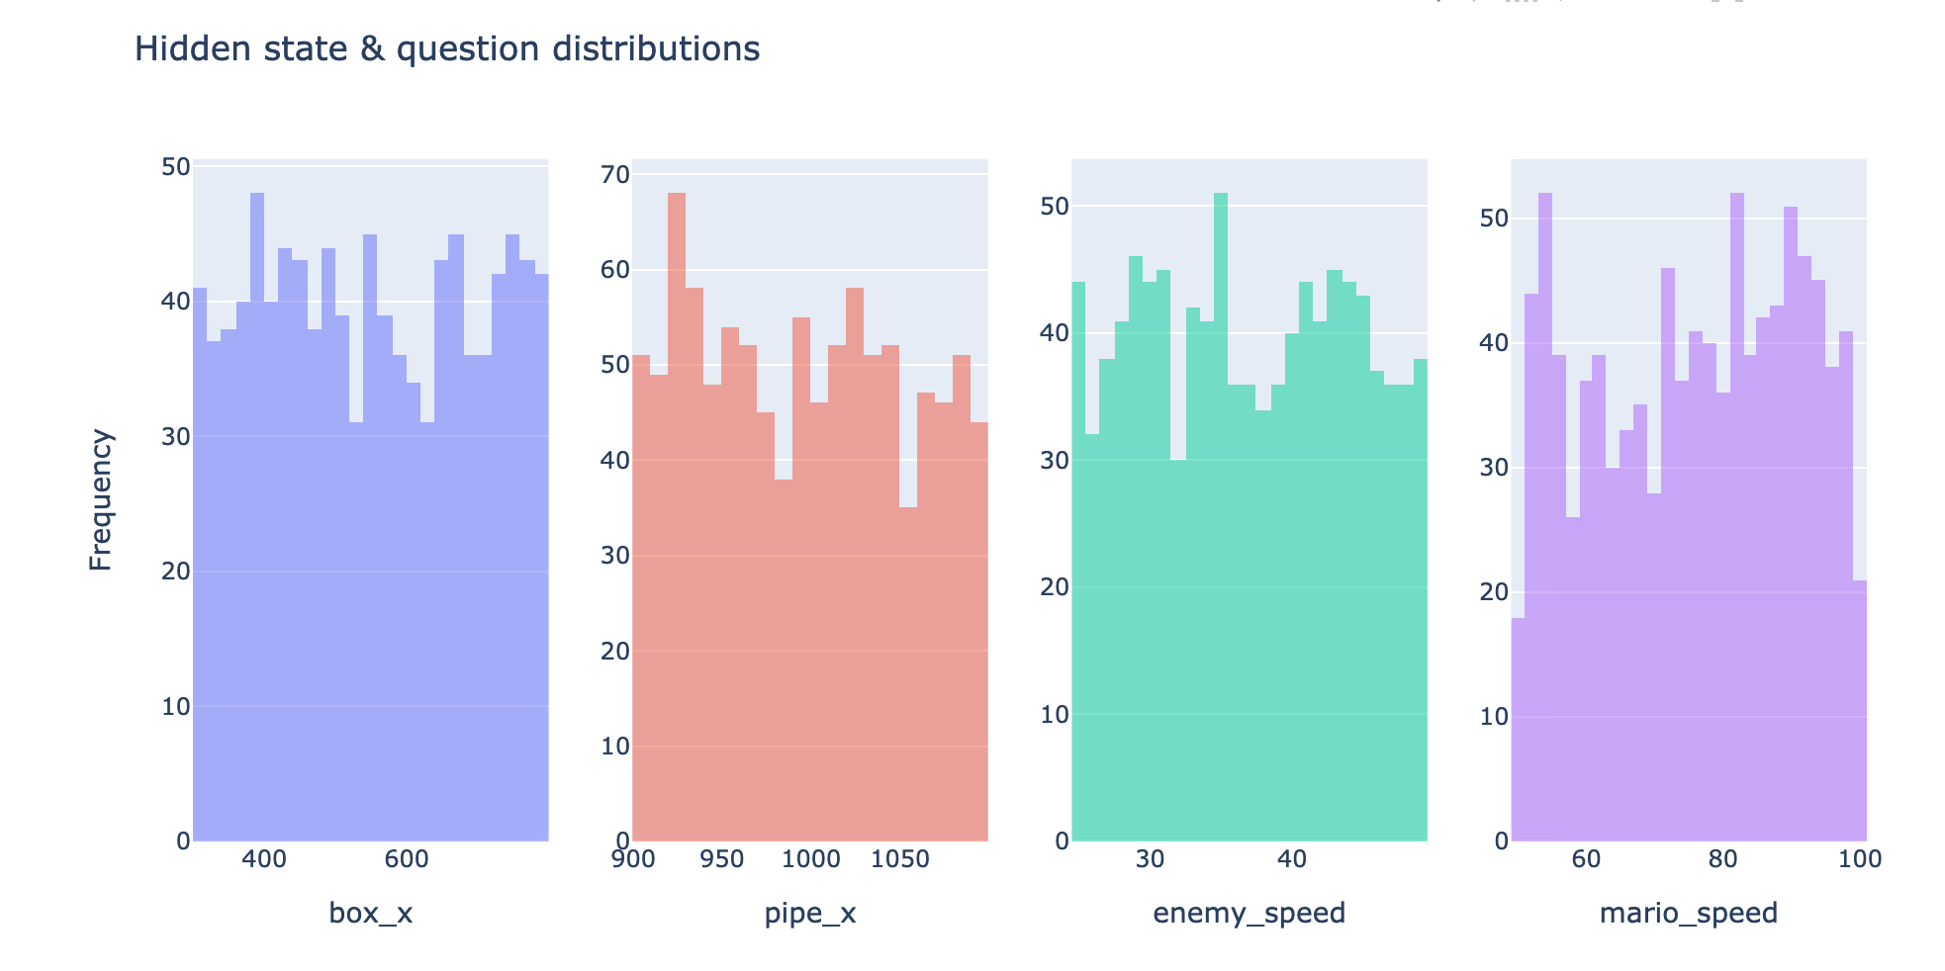
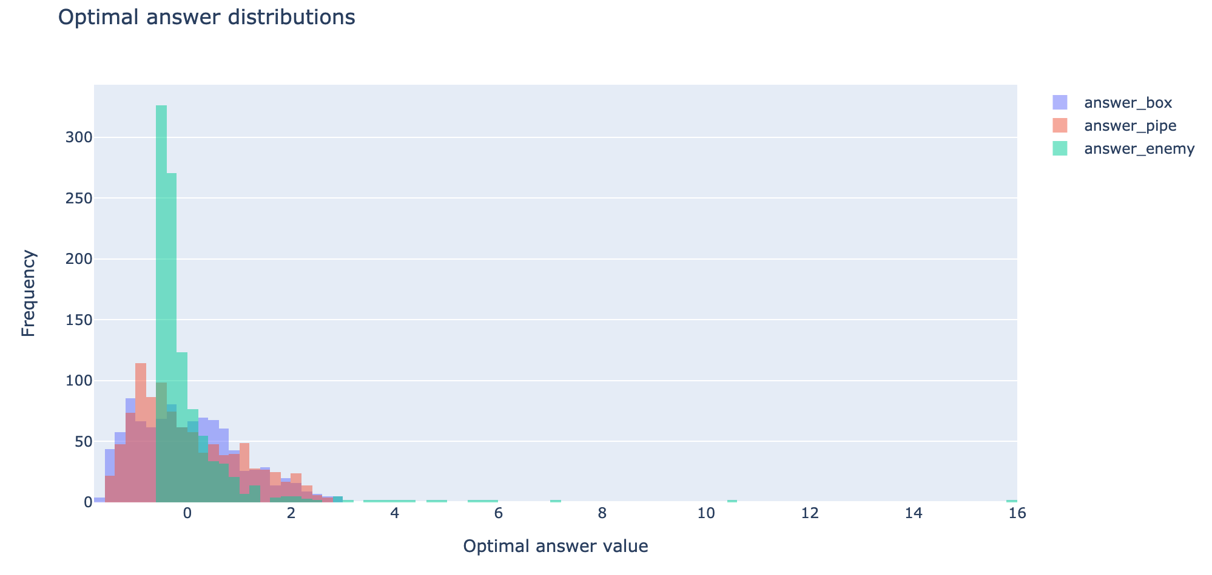
Reference experiments
Reference experiment sampling procedure
Sample random values for hidden states (uniformly distributed)
Collect observations by running the Mario game with hidden states sampled in step 1
Observe the game and store a video in form of ten images for each sample
Compute optimal answers
Note: This procedure only works in a theoretical setting. In practice, the hidden states are unknown, so that the necessary observation question answer tuples must be collected differently (e.g. by using reinforcement learning)

Slide 3





Model implementation – overview
t
Implementation details
 | Input | Output | Implementation
Encoder | Sequence of ten images (video) | 1x3 vector (number of hidden states) | Pretrained Resnet18 & two-layer LSTM
Filter | 1x3 vector (latent space) | 3x3 Matrix (filtered hidden space) | 9 bias nodes and reparameterization trick
Decoder (0-2) | 1x4 vector (one row of the filter output and question input) | Scalar (answer prediction) | Fully connected 10-layer dense neural network
Encoder
Latent space
Filter
Questions
Decoder 0
Decoder 1
Decoder 2
Answers

Slide 4
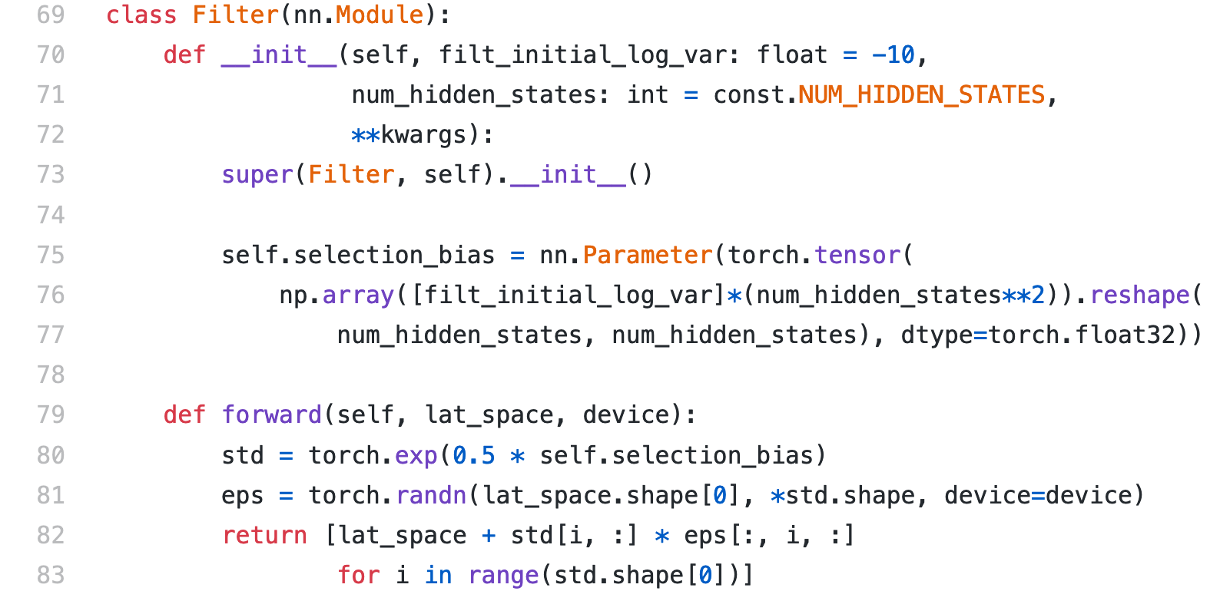
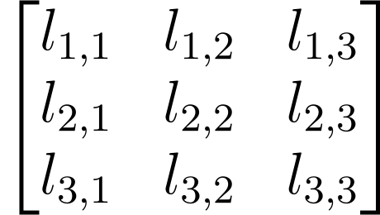
Filter implementation
t
Pytorch module filter
Encoder
Latent space
Filter
Questions
Decoder 0
Decoder 1
Decoder 2
Filter output
Input decoder 0
Answers
Filtered output latent neuron 1

Slide 5
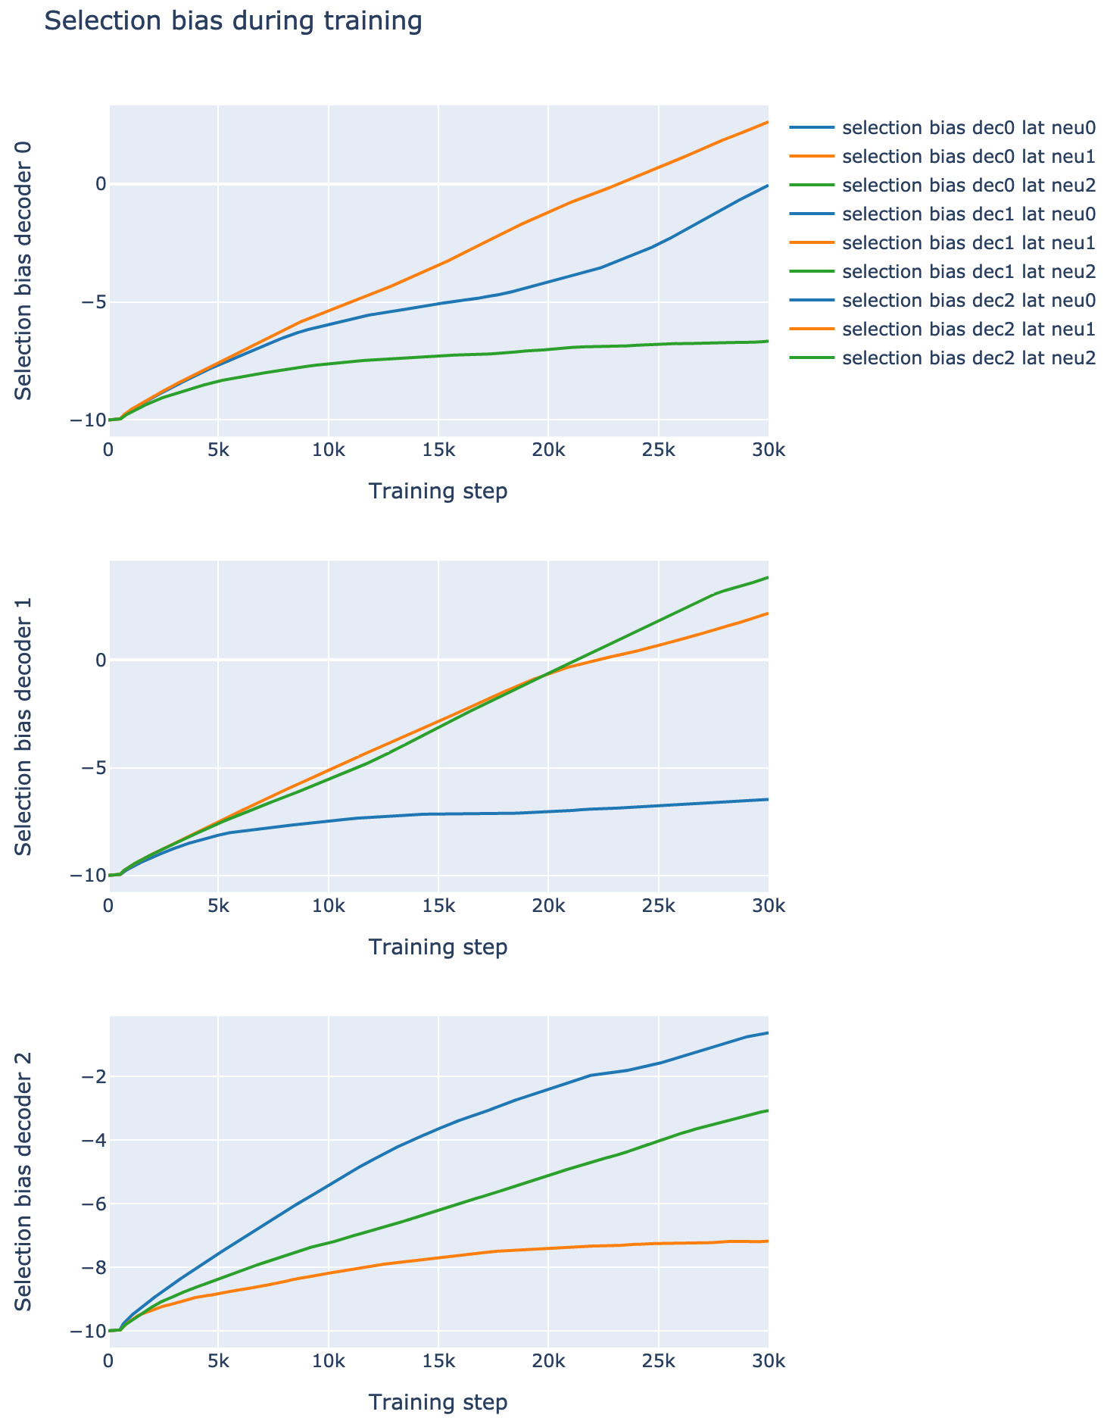
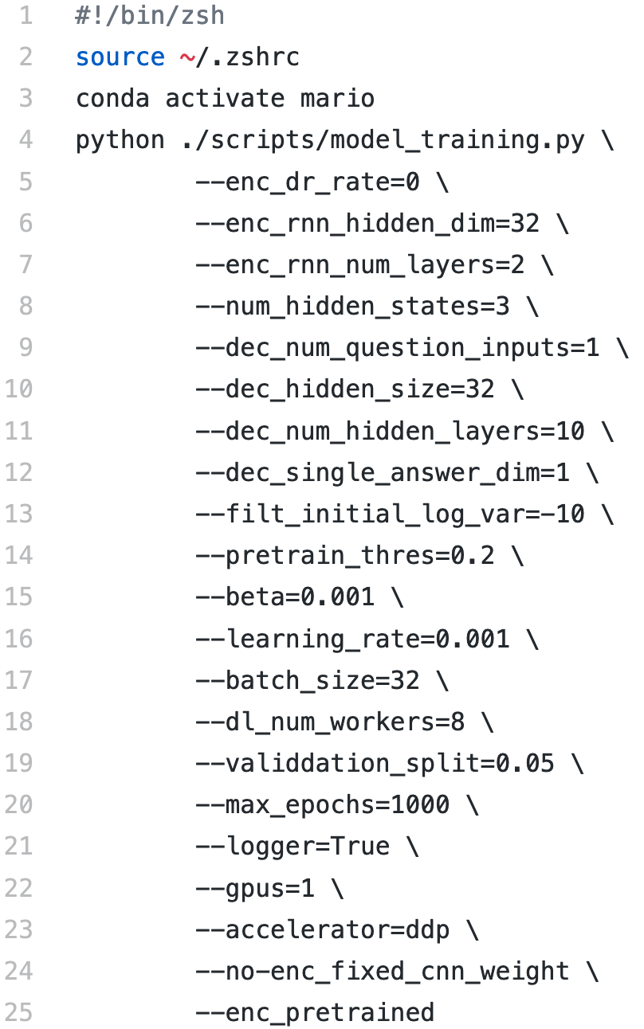
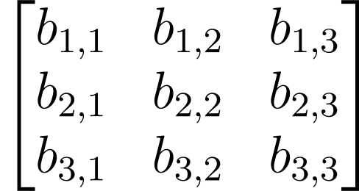
Model training
Model- and hyperparameters (selection)
Filter(**hparams).selection_bias

Slide 6
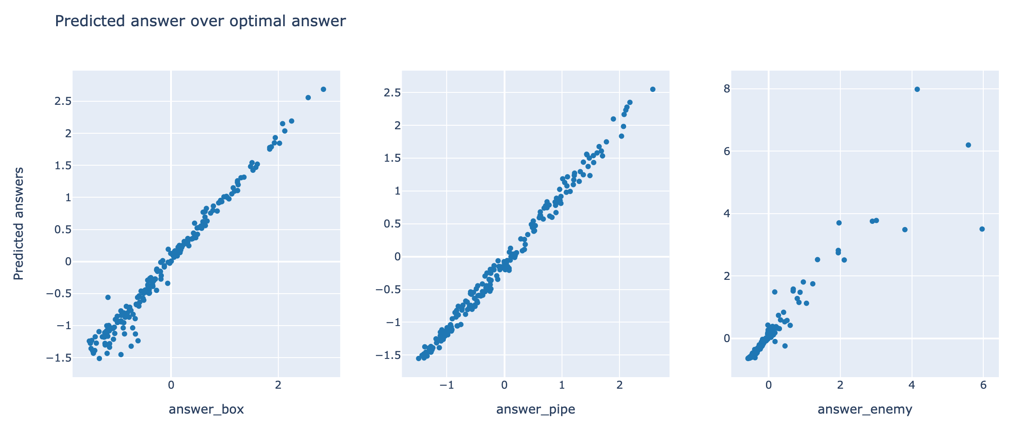
Results – answer predictions

Slide 7
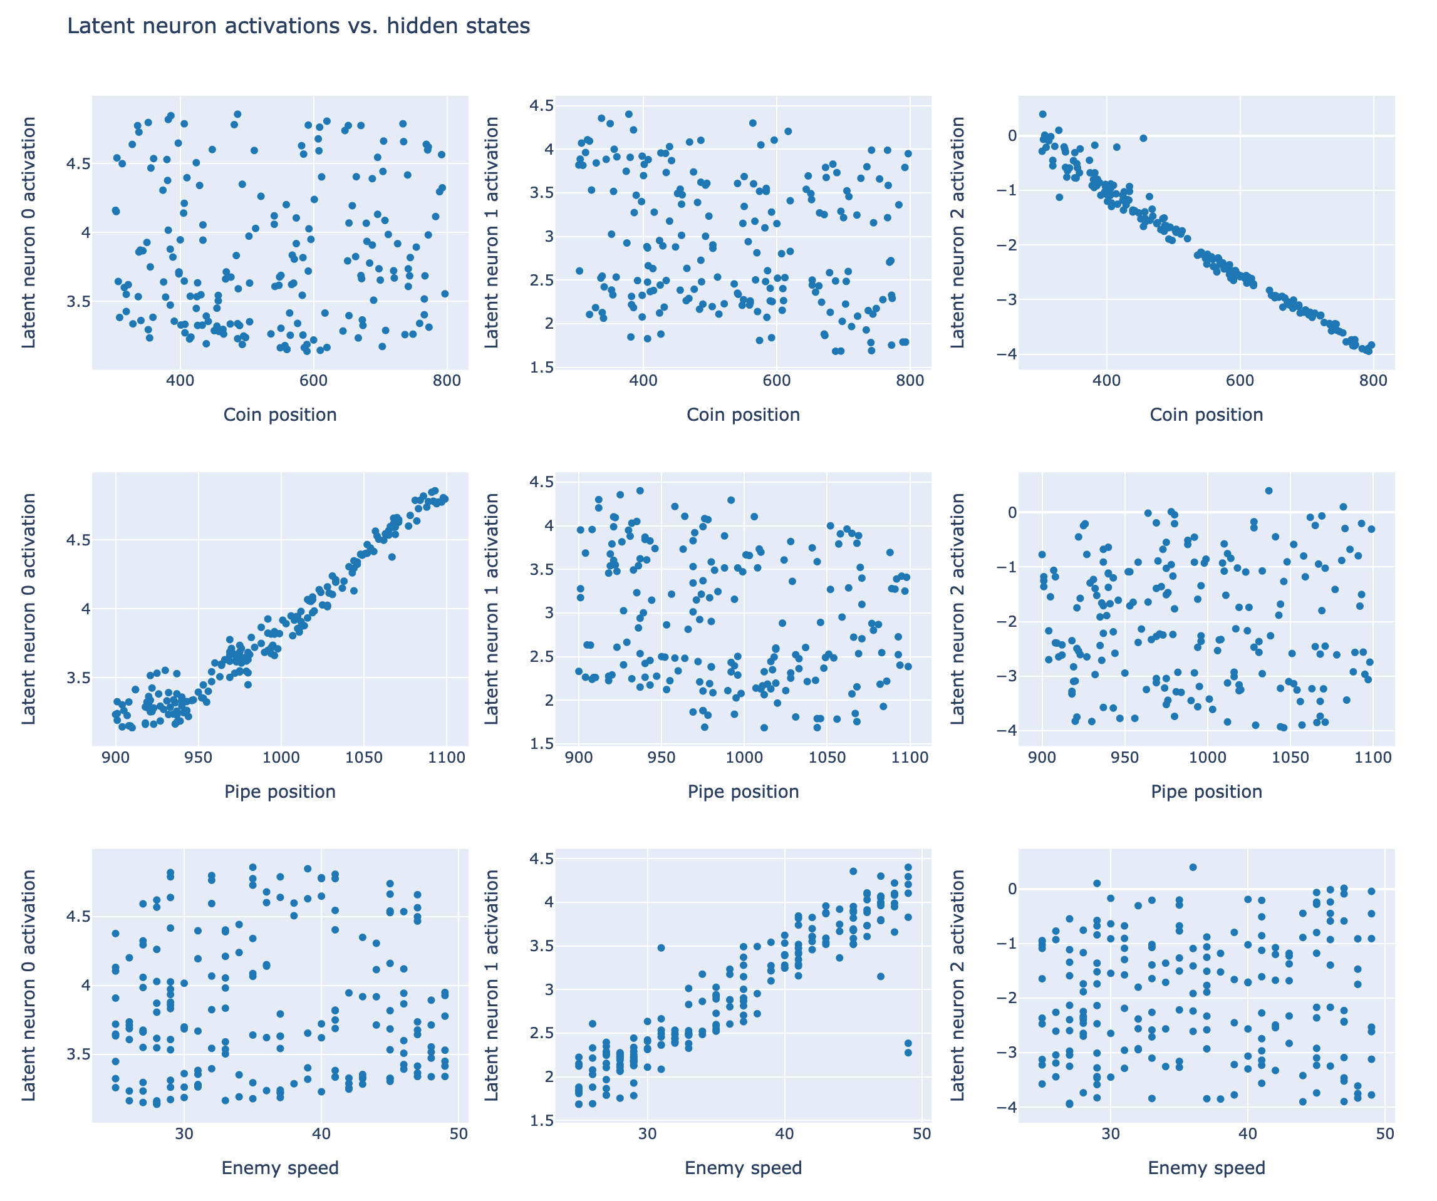
Results – hidden state predictions

