Slide 1
Final Project
電機乙 碩一 徐奕翔

Slide 2
Outline
Introduction
Dataset
Experiment
Result
Conclusion

Slide 3
Introduction
Emotion recognition is important in many way such as movie screening or game trial etc.
We want to create a emotion recognition system based on ECG.
Many datasets of emotion based on ECG are static, so we get a dataset that is dynamic.
ECG of watching a video
ECG of watching a video
One emotion label
emotion 1
emotion 2
……
emotion N
Static dataset: only one emotion in watching a video
Dynamic dataset: may have more then one emotion in watching a video

Slide 4
Dataset

Slide 5
Metric of emotion
There are two metric of emotion: valence and arousal.
Valence: measure the positive metric of emotion
Arousal: measure the excite metric of emotion
Valence
Positive
Relax
Happy
Arousal
Calm
Exciting
Sadness
Anger
Negative

Slide 6
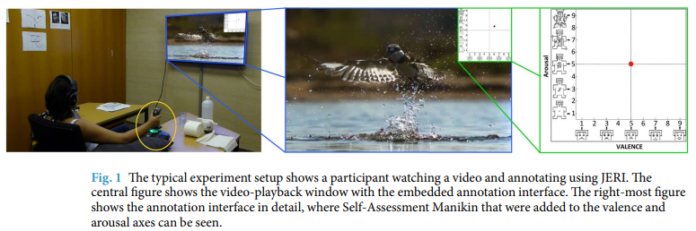
CASE (Continuously Annotated Signals of Emotion)
30 participants, each participants watch 12 videos

Slide 7
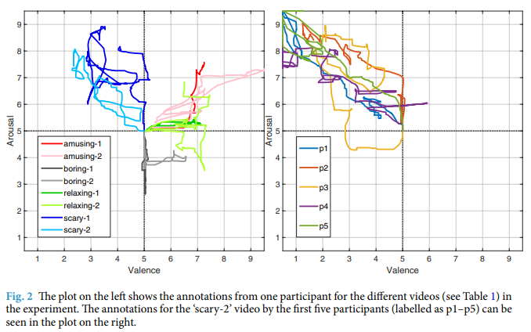
CASE (2)

Slide 8
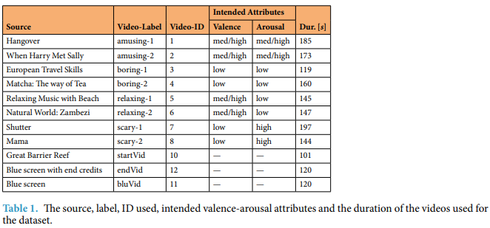
CASE (3)

Slide 9
Preprocess
Clip 2 seconds per clip, neighboring clips have 0.75% overlap
0.75 overlap
ECG data of a person watching a video (1000 Hz)
Correspond emotion label (20 Hz)
2s
2s
2s

Slide 10
Preprocess (2)
Average the valence and arousal value in each clip so that we get two value (valence and arousal) at each clip
Label each clip to a class based on the value(valence and arousal)
Every clip will have two label (correspond to valence and arousal)
[0, 3) | [3, 6) | [6, 9)
low | Medium | High
3 class classification

Slide 11
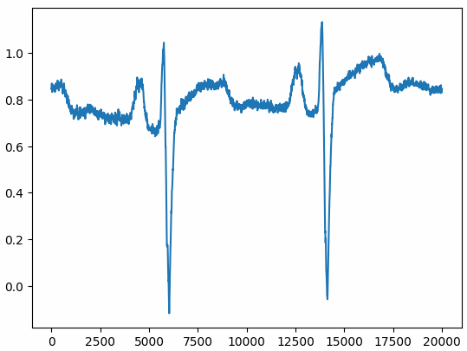
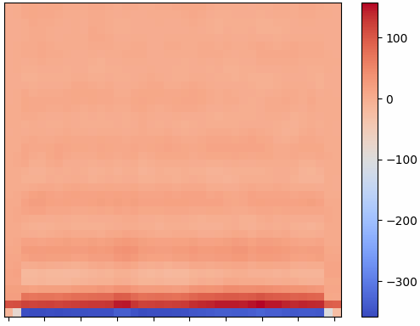
Preprocess (3)
Resample ECG from 2000 samples to 20000 samples per clip
And convert audio signal to MFCC, each shape is (40, 40)

Slide 12
Final data description
low | Medium | High
7473 | 114421 | 25106
Distribution of valence
Spilt to train and test set
low | Medium | High
3737 | 110685 | 21370
low | Medium | High
3736 | 3736 | 3736
Training set
Testing set

Slide 13
Experiment

Slide 14
Experiment flow
Origin data
Generative
Model
Generate
50000 MFCC for
Low class and high class
Add to train set
Classification
model
Training set and
Generative data
training

Slide 15
Generative model
Condition GAN
Diffusion Model

Slide 16
Condition GAN
Latent vector
Generator
Generative
data
Label
Discriminator

Slide 17
Diffusion model
Low class
data
Diffusion
model
for low class
Generative
low class data
High class
data
Diffusion
model
for high class
Generative
low class data
Epochs | 10
Diffusion step | 800

Slide 18
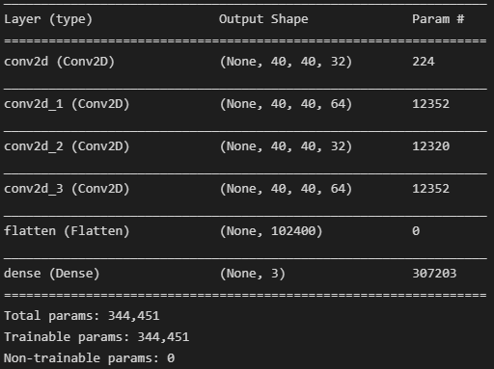
Classification model
A simple CNN
Epochs | 30
Batch size | 32

Slide 19
Result

Slide 20
Without generative data
Predict
 | Low | Medium | High
Low | 499 | 2726 | 521
Medium | 40 | 3362 | 334
High | 71 | 2804 | 861
Low accuracy: 0.13
Label
Medium accuracy: 0.89
High accuracy: 0.22
Confusion matrix
Accuracy: 0.42

Slide 21
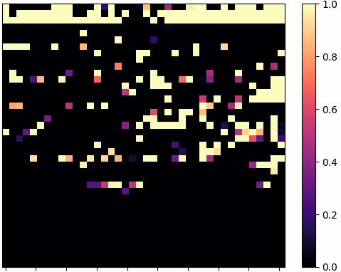
Condition GAN
Original data
Generative data
FID : 343.834(low class), 320.356(high class)

Slide 22
Condition GAN (2)
Predict
 | Low | Medium | High
Low | 404 | 2838 | 494
Medium | 17 | 3542 | 177
High | 40 | 3045 | 651
Low accuracy: 0.10
Label
Medium accuracy: 0.94
High accuracy: 0.17
Confusion matrix
Accuracy: 0.41

Slide 23
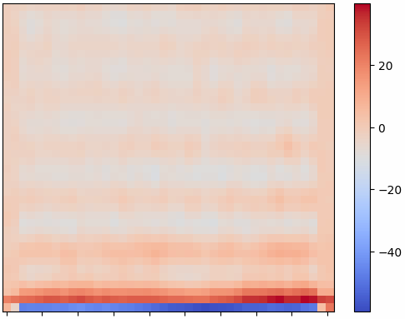
Diffusion model
Original data
Generative data
FID : 56.564(low class), 104.039(high class)

Slide 24
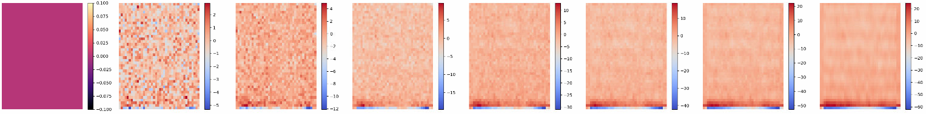
Diffusion model (2)

Slide 25
Diffusion model (3)
Predict
 | Low | Medium | High
Low | 545 | 2770 | 421
Medium | 43 | 3478 | 215
High | 70 | 2937 | 729
Low accuracy: 0.14
Label
Medium accuracy: 0.92
High accuracy: 0.19
Confusion matrix
Accuracy: 0.42

Slide 26
Comparison
 | Low accuracy | Medium accuracy | High accuracy | Total accuracy
Without generative model | 0.13 | 0.89 | 0.22 | 0.42
With Condition GAN | 0.10 | 0.94 | 0.17 | 0.41
With Diffusion model | 0.14 | 0.92 | 0.19 | 0.42

Slide 27
Conclusion
Generate audio signal rather than MFCC
May design a more robust generative model
Classification model is not robust enough
Generative data do not have high correlation to correspond class
Original data may have some problem

