Slide 1
HLS LabA Design Optimization
Matrix Multiplication
2022/03/30

Slide 2
Outline
Original code explanation
Optimized code explanation
Performance analysis
Tradeoff

Slide 3
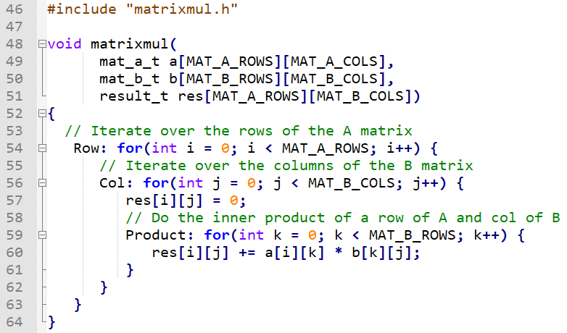
Original code explanation
a
x
b
=
res
Row
Col

Slide 4
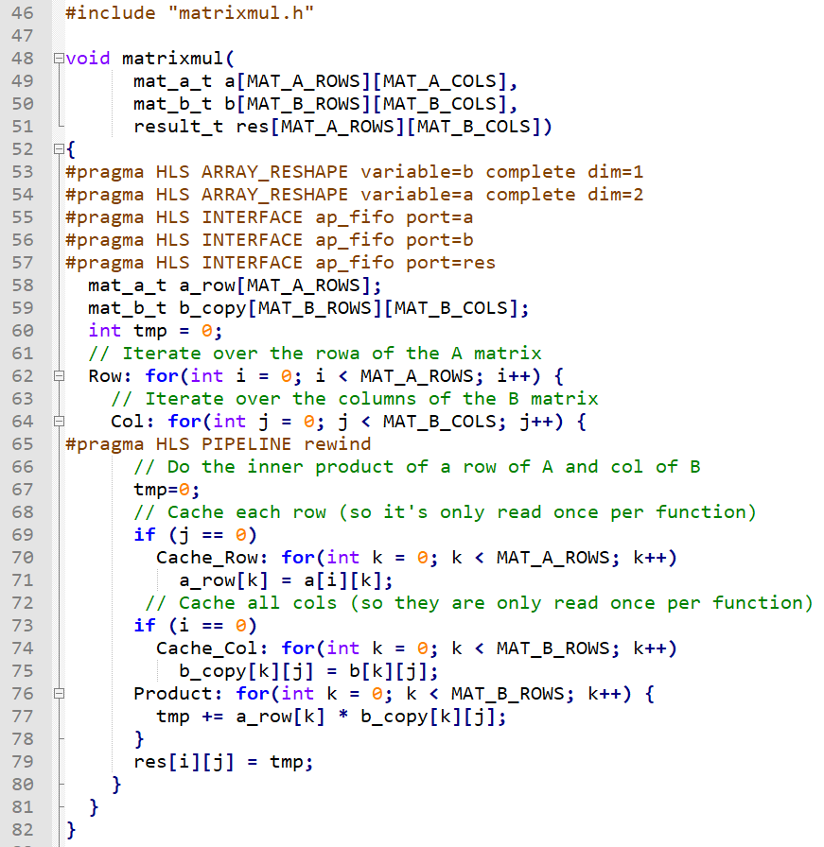
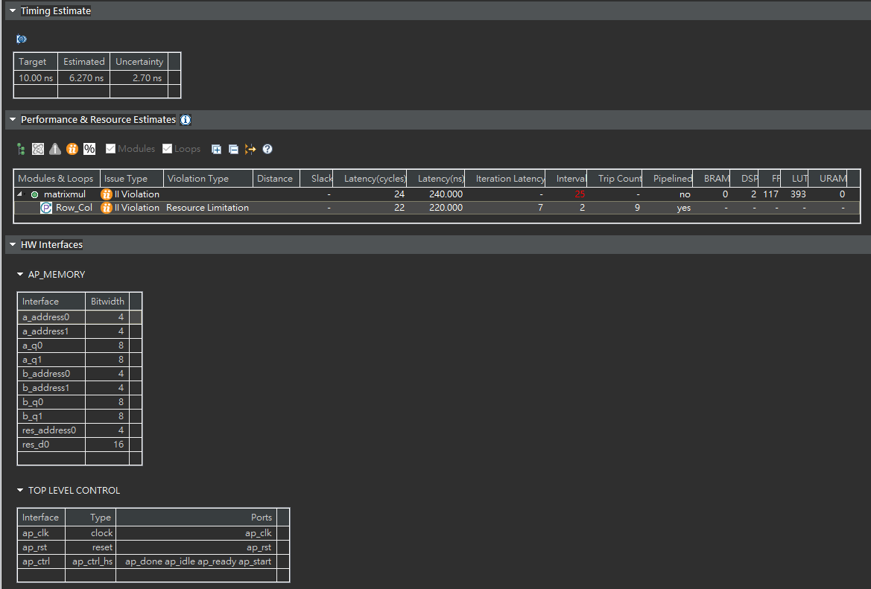
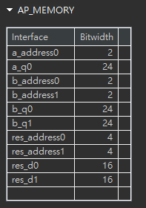
Optimized code explanation
ARRAY_RESHAPE
New array with fewer elements but with greater bit-width
a
Bit-width from 8-bit to 24-bit
b

Slide 5
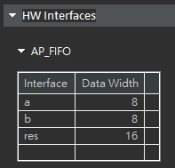
Optimized code explanation
INTERFACE ap_fifo
Enable steam data transfer

Slide 6
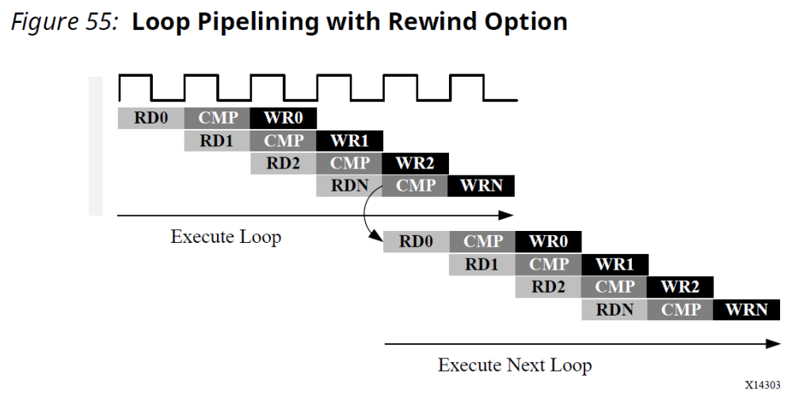
Optimized code explanation
PIPELINE rewind
No pause between loops

Slide 7
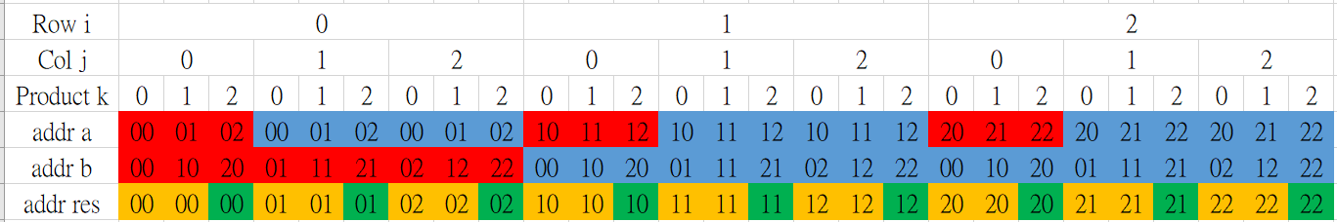
Optimized code explanation
Cache input data
Red: first read
Blue: data reuse

Slide 8
Optimized code explanation
Write once
Red: write to tmp
Blue: write to res

Slide 9
Performance analysis
 | Latency | Interval | DSP | FF | LUT
Lab1 | 24 | 25 | 2 | 117 | 393
Lab2 | 14 | 9 | 2 | 243 | 543
ARRAY_RESHAPE | 15 | 16 | 6 | 248 | 367
ap_fifo | 33 | 34 | 2 | 62 | 201
ARRAY_RESHAPE + ap_fifo | 23 | 24 | 6 | 172 | 289
rewind | 23 | 18 | 2 | 162 | 405
cache | 24 | 25 | 2 | 239 | 667
Loop_flatten | 18 | 19 | 6 | 441 | 472
Red is min, blue is max.

Slide 10
Tradeoff
For FPGA hardware, 3x3 matrix multiplication utilizes ~0%.
Use the fastest one: Optimized code from Lab2
ARRAY_RESHAPE
INTERFACE ap_fifo
PIPELINE rewind
Cache input data
Write once

Slide 11
Thank you!
hsu880105/HLS_LabA_Design_Optimization (github.com)

