Slide 1

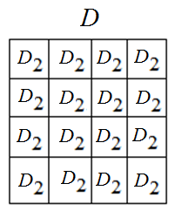
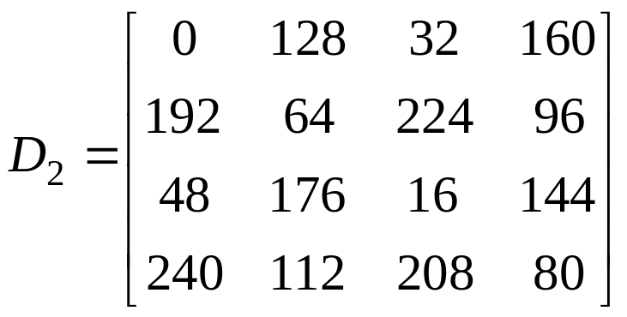
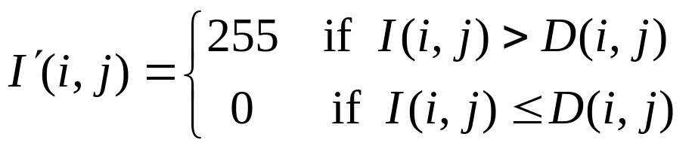

Homework 2 (Due:3/10 )
(A) Given a grayscale image I,
Step 1: Use the dithering matrix to generate an
array D of image size by repeating
Step 2: Threshold image I by
Step 3: Show images I and
3-<number>

Slide 2

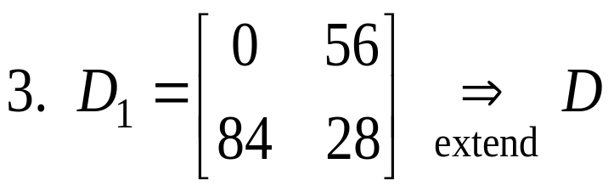
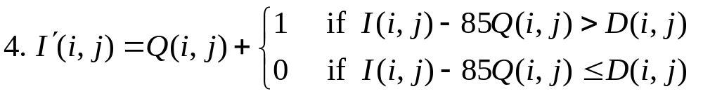

(B) Extend to n = 4 gray values
1. 255 / 3 = 85
5. Scale values of so that its values are in
[0, 255] for displaying
3-<number>

