Slide 1
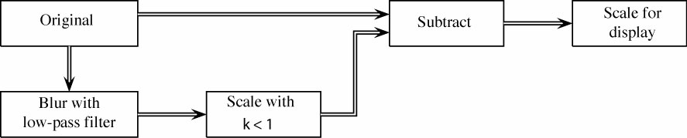
Homework 4 (Due: 3/24)
1. Select an experimental image
2. Apply a 3 by 3 (a) average filter and (b) median
filter to the image
3. Unsharp masking

