Slide 1
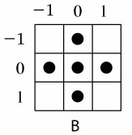



Homework 9 (Due:5/12 )
Implement the Lantuejoul’s skeletonization method
using the structuring element B:
Apply the method to the following input image
Input image
Experimental results

Slide 2
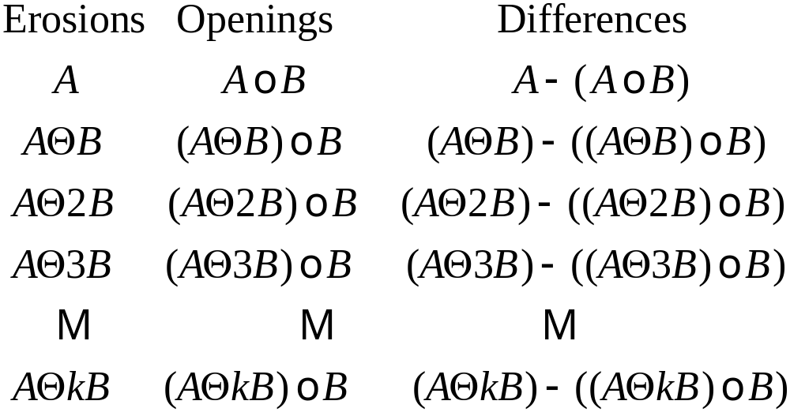

○ Lantuejoul’s method
10-<number>

