Slide 1
Image Processing (I)
Instructor : Prof. Sei-Wang Chen, PhD (陳世旺)
Office : Applied Science Building,
Room 101
Contact : Tel: 7749-6661
E-mail: schen@csie.ntnu.edu.tw
Class Room: 理圖 003
Class Hr. : Thur. 9:10AM – 10:30AM
10:50AM – 12:00NOON

Slide 2
Teaching assistant : 沈哲偉
Office : Applied Science Building,
Room 108
Telephone : 7749-6668
E-mail : karta07123@gmail.com
Office Hrs. :

Slide 3
Teaching Intention
Study on image processing, focusing
on practical techniques for 2D images.
This course covers a wide range
of application problems commonly encountered in image processing
and provides detailed algorithmic
and practical treatments for each.
Familiar with Opencv library and
Python language.

Slide 4
Textbook:
A Computational Introduction to
Digital Image Processing 2nd Ed.
Alasdair McAndrew, 2016
開發圖書公司
(02)82423988
魏錦鈴
0939852332

Slide 5
Contents
Ch.1: Introduction
Ch.2: Files and File Types
Ch.3: Image Display
Ch.4: Point Processing
Ch.5: Neighborhood Processing
Ch.6: Image Geometry
Ch.7: Fourier Transform
Ch.8: Image Restoration
Ch.9: Image Segmentation

Slide 6
Ch.10: Mathematical Morphology
Ch.11: Image Topology
Ch.12: Shapes and Boundaries
Ch.13: Color Processing
Ch.14: Image Coding and Compression
Ch.15: Wavelets
Ch.16: Special Effects
App. A: Introduction to MATLAB and Octave
App. B: Python and OpenCV
App. C: Fast Fourier Transform

Slide 7
Syllabus
Week Content
1 Chs0,1
2 AppB, Ch2
3 Chs3,4
4 Ch5
5 Chs5,6
6 Ch8
7 Chs 8,9
8 Ch9
9 Ch10
10 Ch10

Slide 8
Week Content
11 Exam.
12 Ch13
13 Chs13,15
14 Ch15
15 Project Report
16 Project Report

Slide 9
Finding the PPTs of chapters:
(1) Moodle
https://moodle.ntnu.edu.tw/
(2) 登入
(3) 點選: 1102影像處理 (Image Processing)
(4) 點選: 上課用PPT檔案區

Slide 10
Assignment Submission
(A) Prepare the assignment file
File Name: name.hw# , e.g., 陳世旺.hw1
Content:
(1) General assignment
i) Problem statement,
ii) Answer
Example:
Homework 1

Slide 11
(2) Program assignment
i) Problem statement
ii) Experimental results:
Input/Output images,
Source code,
Comments
Example:
Homework 2
(B) Submit assignment
Moodle → 作業繳交區
作業繳交時間在下一次上課前

Slide 12
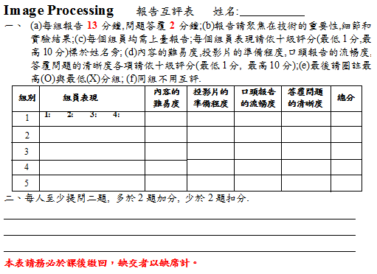

Slide 13
Evaluation
Homework 35%
Examination 20%
Quiz 15%
Presentation 30%
Late -0.5 Absence -2.0
Late: After 9:30AM
Absence: After 10:30AM
Late homework will not be accepted
Plagiarism is definitely not allowed

Slide 14
References:
Books
(1) Perception by R. Sekuler and R. Blake, 1985
(2) Digital Image Processing by K. R. Castleman,
1996
(3) Handbook of Computer Vision Algorithms in
Image Algebra by G. X. Ritter and J. N.
Wilson, 2001
(4) Digital Image Processing by W. K. Pratt, 2007
(5) Image Processing, Analysis, and Machine
Vision by M. Sonka, V. Hlavac, and R. Boyle,
2015
(6) Digital Image Processing by R. C. Gonzalez
and R. E. Woods, 2018

Slide 15
(B) Journals
(1) IEEE Trans. on Pattern Analysis and
Machine Intelligence
(2) IEEE Trans. on Image Processing
(3) International Journal of Computer
Vision
(4) Computer Vision and Image
Understanding
(5) Pattern Recognition

Slide 16
(C) Conferences
(1) International Conference on Computer
Vision (ICCV)
(2) International Conference on Pattern
Recognition (ICPR)
(3) International Conference on Image
Processing (ICIP)
(4) Computer Vision and Pattern Recognition
(CVPR)

