Slide 1
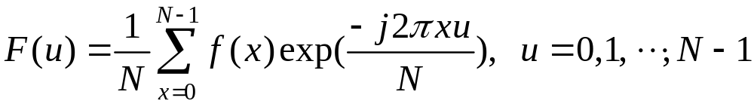



Chapter 15: Wavelets
(i) Fourier transform
requires that the entire input signal
be readily available for calculating every
(ii) Periodic waves considered are sinuous.
(iii) Fourier spectrum provides
all the frequencies present in a signal but does
not tell where they are present.
15-<number>

Slide 2
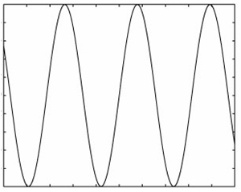
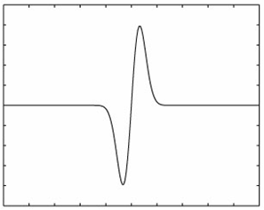
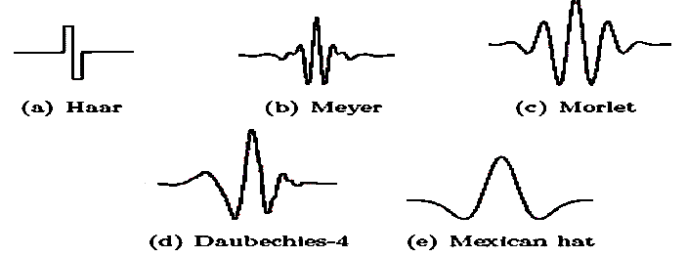
Windowed Fourier transform suffers from
Small range – poor frequency resolution
Large range – poor localization
Wavelet: wave that is only nonzero in a small region
Wave
Wavelet
Types of wavelets:
15-<number>

Slide 3
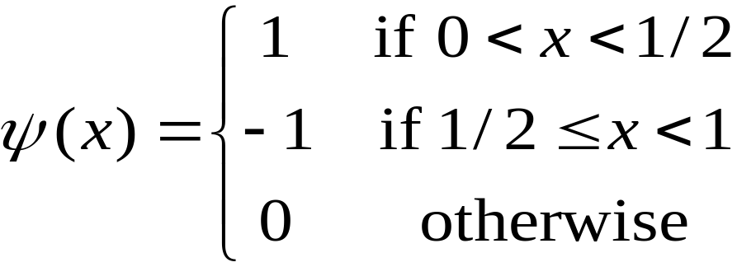

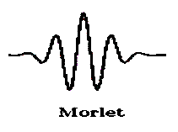
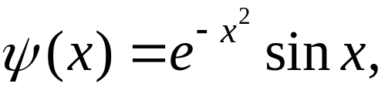
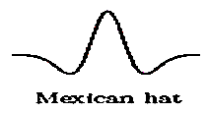
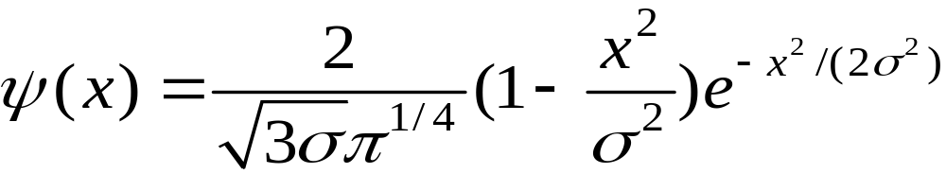
Haar:
Morlet:
Mexican hat:
DOG, LOG
LOG:
15-<number>

Slide 4








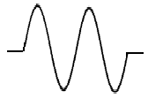



○ Operations on wavelet:
(a) Dilation:
i) Squashing ii) Expanding
(b) Translation:
i) Shift to the right ii) Shift to the left
(c) Magnitude change:
i) Amplification ii) Minification
15-<number>

Slide 5


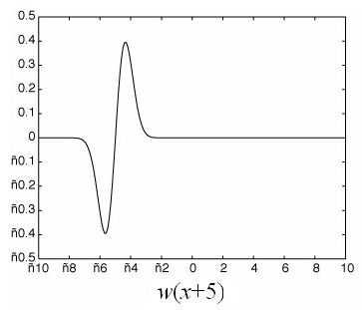
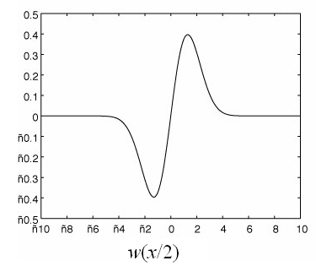
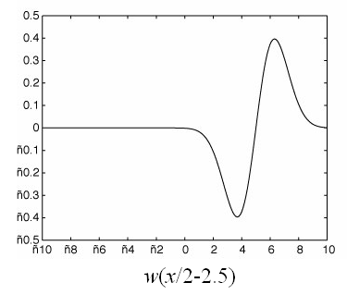
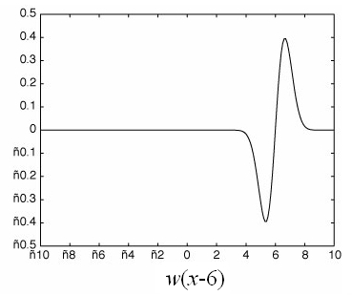
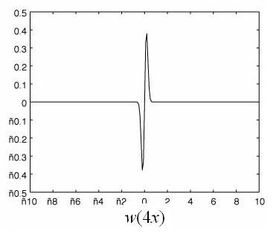
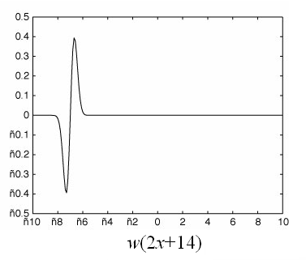
Any function can be expressed as a sum of wavelets
of the form , where govern the
amplitude, frequency and translation of wavelet i.
15-<number>

Slide 6
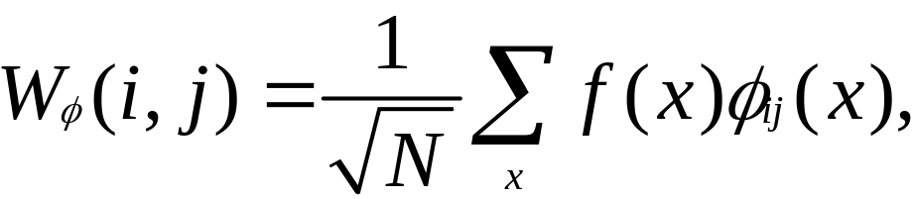
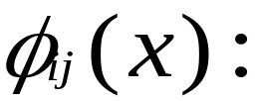
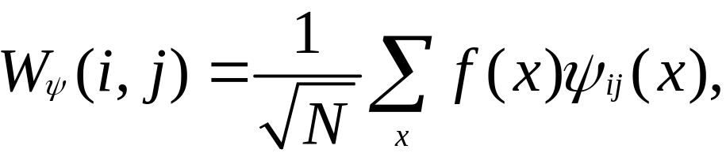

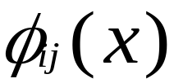
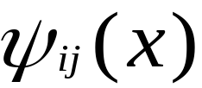
Discrete Wavelet Transform:
Approximation coefficients (cA)
scaling functions
Detail coefficients (cD)
wavelet functions
creates a series of approximations of f(x).
encodes differences between f(x) and its
approximations.
15-<number>

Slide 7

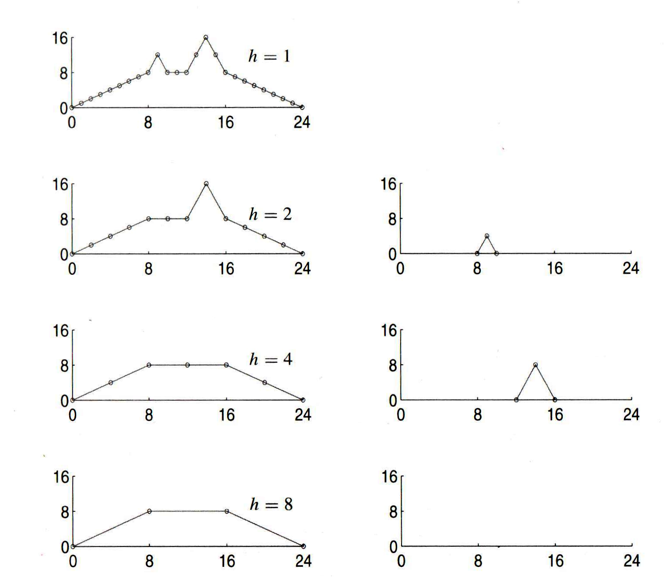

Average filtering
Difference filtering
Approximation
Detail
15-<number>

Slide 8

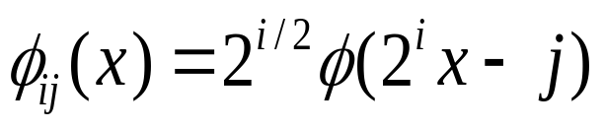
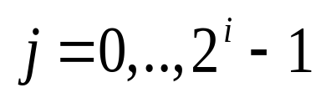
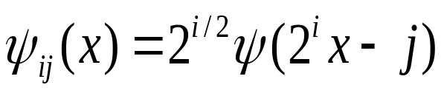
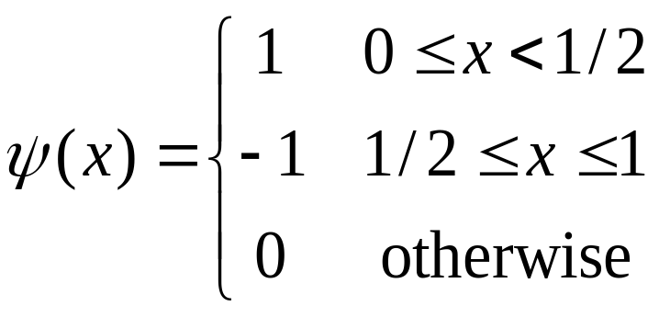
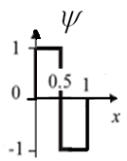
basis functions of wavelet transform
Dilations, translations, and magnitudes of the basis functions are all based on powers of 2, i.e.,
Scaling function
Wavelet function
Example:
Haar wavelet :
15-<number>

Slide 9
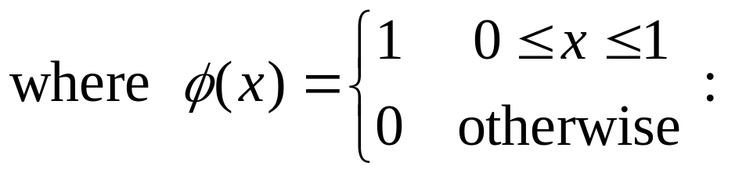
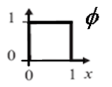
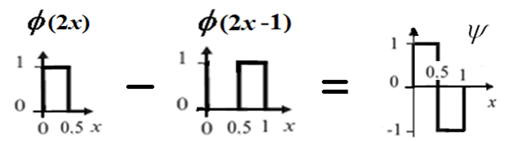


father wavelet
Dilations, translations, and magnitudes of functions
are based on powers of 2.
15-<number>

Slide 10
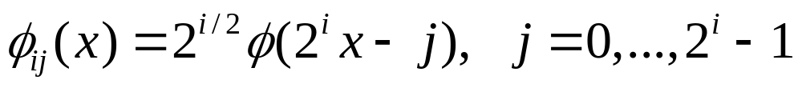

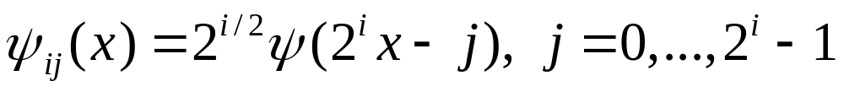
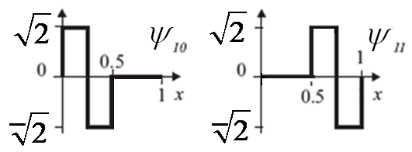
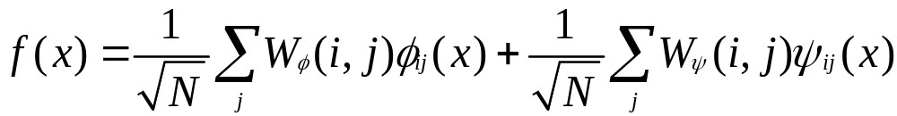
Inverse discrete wavelet transform:
15-<number>

Slide 11
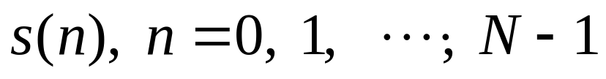
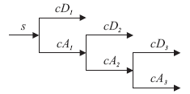
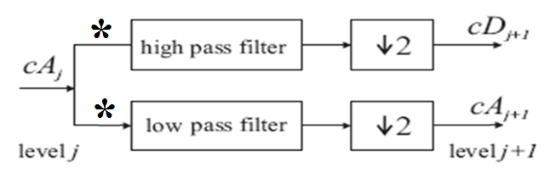

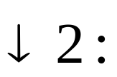
Fast Wavelet Transform
Discrete signal
to be transformed into wavelet coefficients
cA: approximate coef.
cD: detailed coef.
: convolution
downsampling by 2
15-<number>

Slide 12
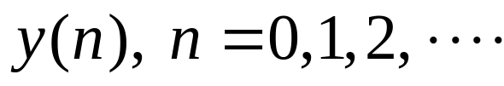
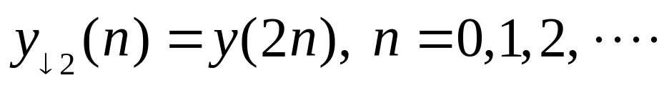
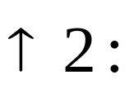
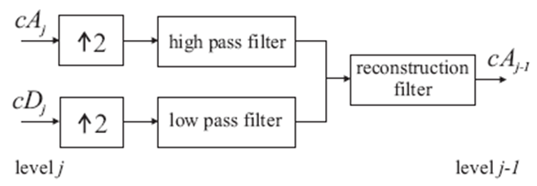
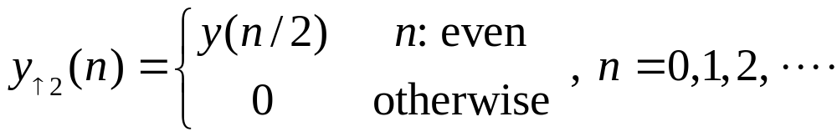
discard every other convolved value
e.g.,
Giving sequence
its downsampled sequence is
Inverse Wavelet Transform
upsampling by 2
15-<number>

Slide 13
○ Wavelet transforms work by taking low pass filtering
(LPF) and high pass filtering (HPF) of input data
e.g., Input data: a, b
LPF (+): s = a + b; HPF (–): d = a – b
Wavelet coefficients: (s, d).
○ Inverse wavelet transforms work by taking addition
and subtraction of wavelet coefficients
e.g., Input (s, d)
LPF(+/2) : (s+d)/2 = ((a+b)+(a–b))/2 = a,
HPF(–/2) : (s–d)/2 = ((a+b)– (a–b))/2 = b
Inverse wavelet coefficients: (a, b).
15-<number>

Slide 14
。 Example: Input data (14, 22)
Wavelet transform:
s =14＋22 = 36, d = 14 – 22= –8
Transform result (36, –8).
Inverse wavelet transform:
Input data (36 –8)
(s＋d)/2 = (36+(–8))/2 = 14,
(s－d)/2 = (36–(–8))/2 = 22
Inverse transform result (14, 22).
15-<number>

Slide 15
。 Example: Input data: [71 67 24 26 36 32 14 18]
Wavelet transform:
s1 = [(71+67) (24+26) (36+32) (14+18)]
= [138 50 68 32]
d1 = [(71–67) (24–26) (36–32) (14–18)]
= [4 –2 4 –4]
(cA)
(cD)
Transform result at 1 scale:
v1 = [s1 d1] = [138 50 68 32 4 –2 4 –4]
(cA)
(cD)
15-<number>

Slide 16
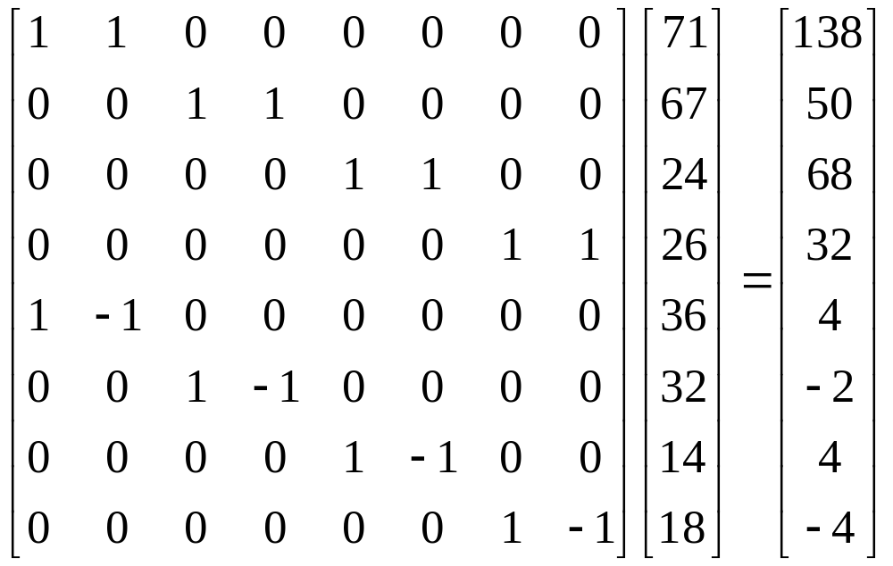
In matrix form:
15-<number>

Slide 17
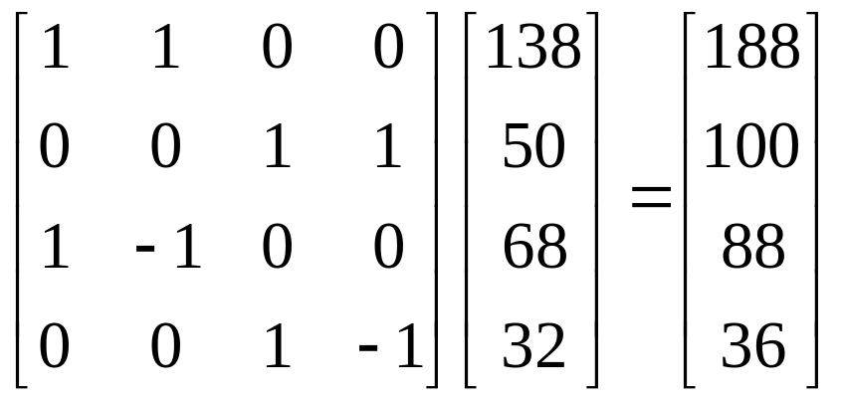
(cA): [138 50 68 32]
s2 = [(138+50) (68+32)] = [188 100]
d2 = [(138–50) (68–32)] = [88 36]
Transform result at 2 scale:
v2 = [s2 d2] = [188 100 88 36]
In matrix form:
15-<number>

Slide 18
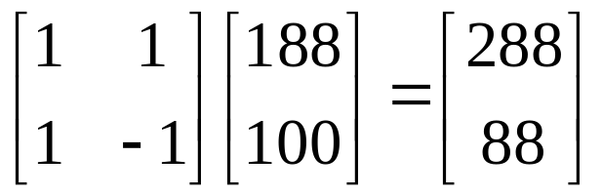
s3 = [(188+100)] = [288], d3 = [188–100] = [88]
Transform result at 3 scale:
v3 = [s3 d3] = [288 88]
In matrix form:
Inverse wavelet transform:
Input data: [s3 d3 d2 d1] =
[288 88 88 36 4 –2 4 –4]
15-<number>

Slide 19
[(288+88)/2 (288–88)/2 88 36 4 –2 4 –4]
= [188 100 88 36 4 –2 4 –4]
[([188 100]+[88 36])/2 ([188 100]–[88 36])/2
4 –2 4 –4] = [[138 68] [50 32] 4 –2 4 –4]
= [138 50 68 32 4 –2 4 –4 ]
[([138 50 68 32]+[4 –2 4 –4 ])/2
([138 50 68 32]–[4 –2 4 –4 ])/2]
= [[71 24 36 14] [67 26 32 18]]
= [71 67 24 26 36 32 14 18]
15-<number>

Slide 20
○ If [4 –2 4 –4] are small, this leads to compression
by letting the transform values [288 88 88 36 0 0
0 0]. Inverse transform results [69 69 25 25 34 34
16 16] close to [71 67 24 26 36 32 14 18].
Or remove negative values [4 0 4 0] leading to the
transform values [288 88 88 36 4 0 4 0]. Its
inverse transform results [71 67 25 25 36 32 16 16].
○ Different filters can be used, e.g.,
Average (s = (a + b) / 2) as the low pass filter,
Difference (d = a – s) as the high pass filter.
15-<number>

Slide 21
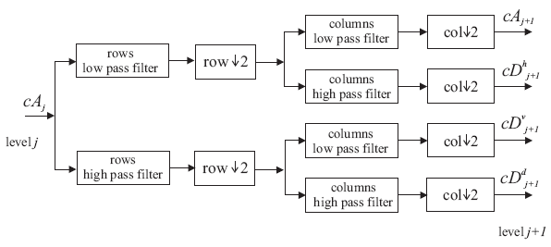
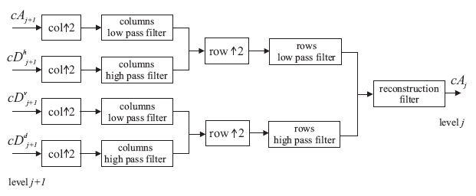
2-D:
15-<number>

Slide 22
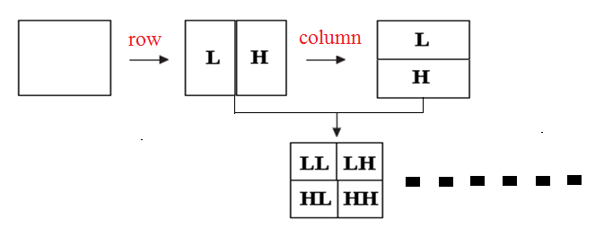
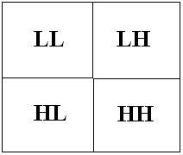


1-scale transform
2-scale transform
3-scale transform
15-<number>

Slide 23

15-<number>

Slide 24




Example: High pass filtering
Set all the values to 0
Input
image
2-scale decomposition
3-scale decomposition
15-<number>

Slide 25



Example: Denoising
Set DWT values that are smaller than d to 0.
Input noisy image
d = 0.1
d = 0.3
d = 0.5
15-<number>

