Slide 1
Pytorch
and
Trail-Following
2020/12

Slide 2
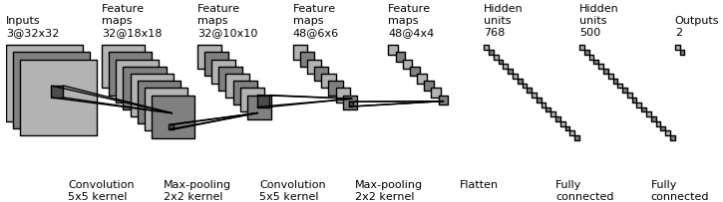
Convolution Neural Network
Architecture Overview
Convolution
3D volumes of neurons
Feature extraction
Weight sharing
Maxpooling
Subsampling
Fully connection
(1) CNN architecture
Notes:
扮演的角色
conv想像成3D神經元
後曾Conv

Slide 3
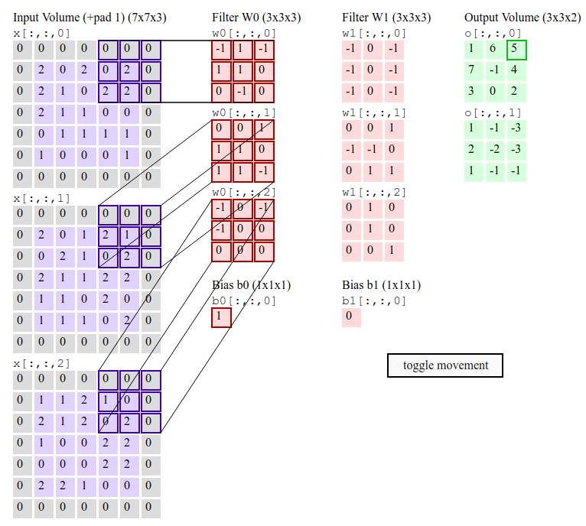
Convolution
convolution operation
source:stanford cs231n
multi-channel input

Slide 4
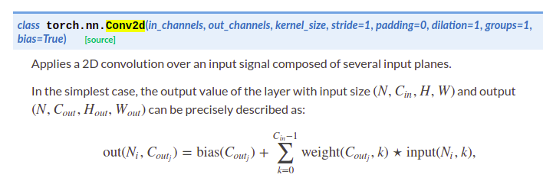
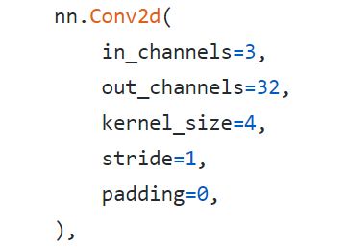
Convolution layer
p=0, s=1
torch.nn [link]
Use torch.nn module to declare convolution operation
p=1, s=1
p=1, s=2
source:stanford cs231n
Notes:
進行內積

Slide 5
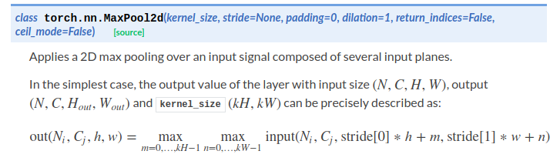
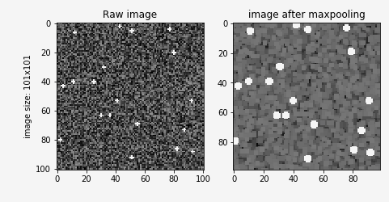
Maxpool
Downsampling without feature loss?
Code :

Slide 6
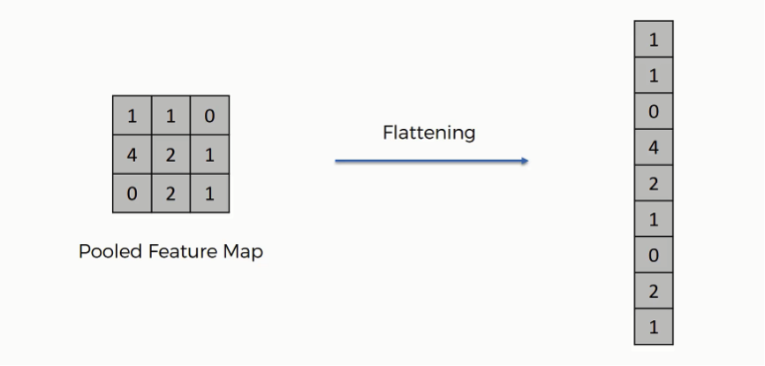
Flattern

Slide 7

Flattern
Code
flatten code 2

Slide 8
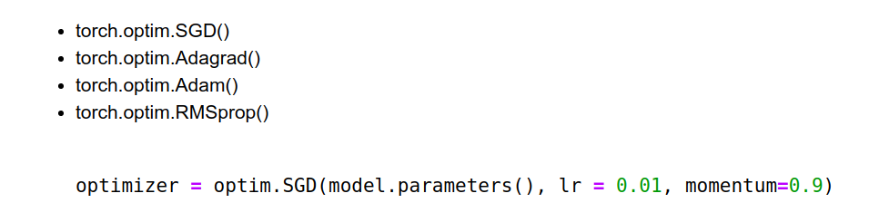
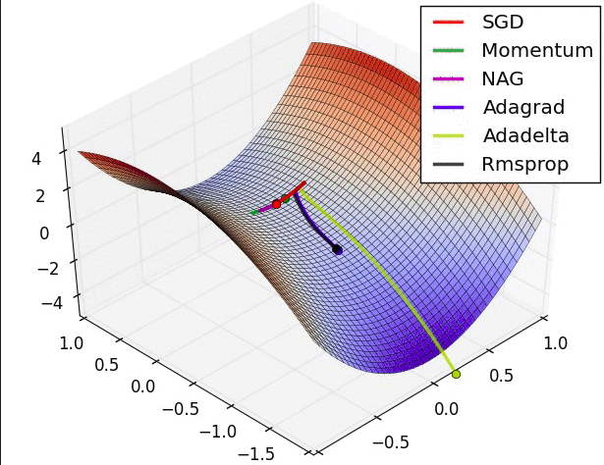
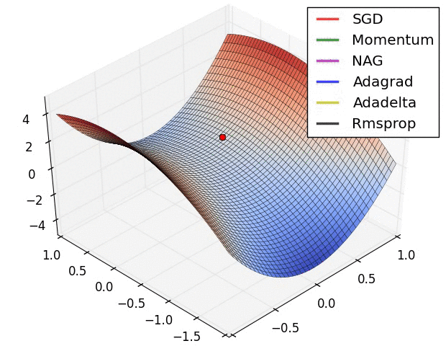
Optimizer
torch.optim
Hyperparameters(learning rate, momentum of gradient descent)
loss function with weight

Slide 9
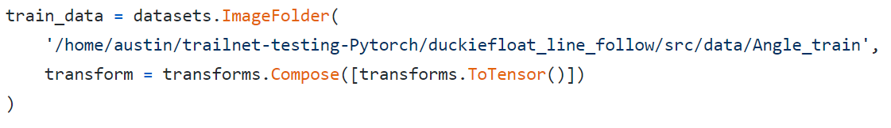
Load images as data
class torchvision.datasets.ImageFolder :
Load images from the folder and set the foldername as labels.
transforms.ToTensor() : transforms data type to tensor.
DataLoader : packaging your data for training.
YOUR PATH

Slide 10
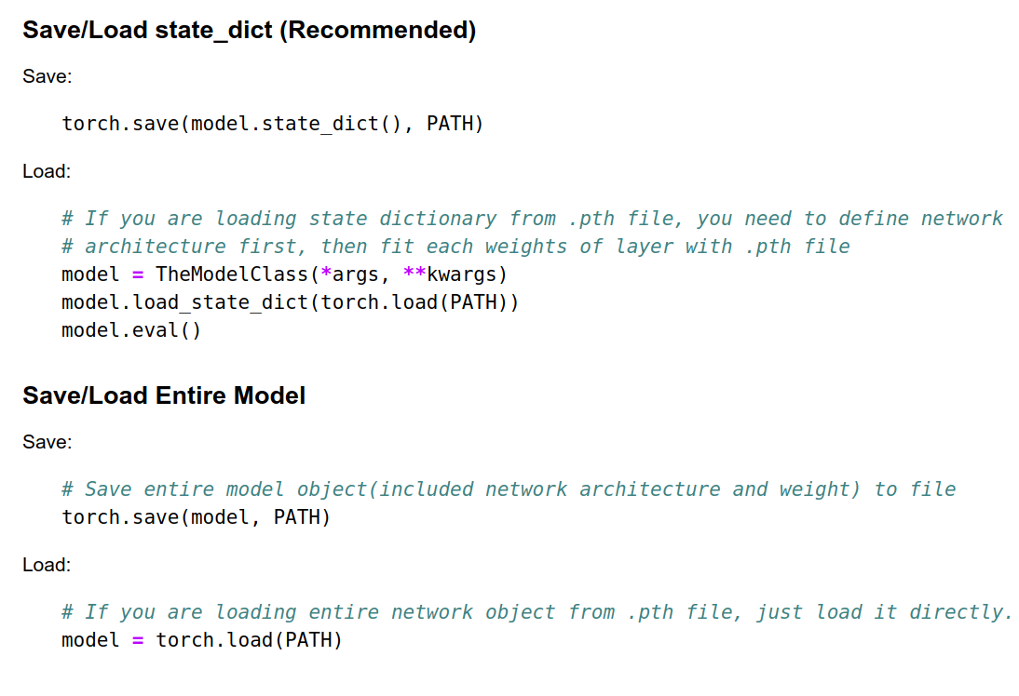
Save/ load pretrained model with Pytorch
*.pth file
Save/load state_dict
State dictionary
Save/load entire model
Entire network object

