Slide 1
MobileNets: Efficient Convolutional Neural Networks for Mobile Vision Applications MobileNetV2: Inverted Residuals and Linear Bottlenecks
Group 9: Sai Suvajit Acharjee, Muhammad Faisal, 許朝鈞

Slide 2
Outline

Slide 3
Introduction
Convolutional neural networks have become ubiquitous in computer vision .
General trend has been to make deeper and more complicated networks in order to achieve higher accuracy.
The recognition tasks need to be carried out in a timely fashion on a computationally limited platform, e.g. robotics, self-driving car and augmented reality.
V1: This paper provides an efficient network architecture and a set of two hyper-parameters.
V2: The main contribution is a novel layer module: the inverted residual with linear bottleneck.
V2: Significantly reduce the memory footprint needed during inference by never fully materializing large intermediate tensors

Slide 4
Related Work
Ways for building small and efficient neural networks
compressing pretrained networks: based on product quantization, hashing, pruning, vector quantization and Huffman coding
shrinking
factorizing
distillation: uses a larger network to teach a smaller network.
Flattened networks build a network out of fully factorized convolutions and showed the potential of extremely factorized networks.
Factorized networks introduces a similar factorized convolution as well as the use of topological connections.
Xception network demonstrated how to scale up depth-wise separable filters to out perform Inception V3 networks.
Squeezenet which uses a bottleneck approach to design a very small network.

Slide 5
Related Work
Progress in algorithmic architecture exploration
hyper- parameter optimization
network pruning
connectivity learning
changing the connectivity structure of the internal convolutional blocks
introducing sparsity
e.t.c.
AlexNet, VGGNet, GoogleNet, ResNet, ShuffleNet

Slide 6
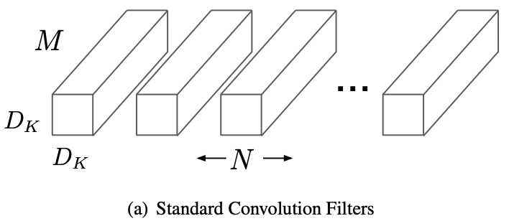
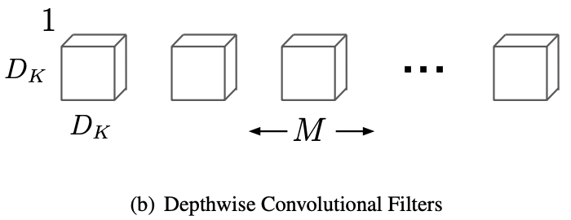



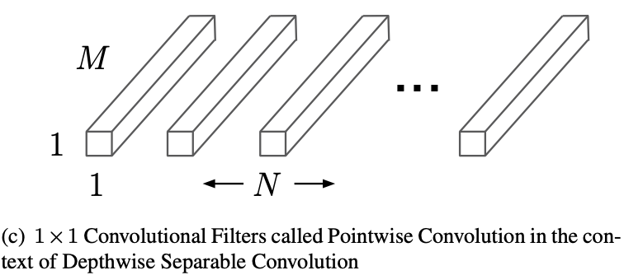


MobileNet Architecture – Depth-wise Separable Convolution
Core layers that MobileNet builds on.
A form of factorized convolutions.
Breaking the interaction between the number of output channels and the size of the kernel.
Reducing of the computation and model size.
Standard convolution computational cost:
: spatial width and height of a square input feature map
: number of input channels
: number of output channels
: spatial dimension of the kernel
Notes:
factorized convolutions: factorize a standard convolution into a depth-wise convolution and a 1x1 convolution called a pointwise convolution.

Slide 7

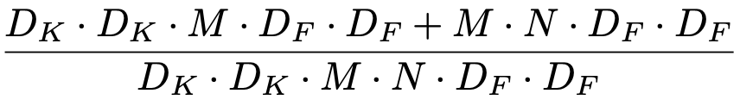
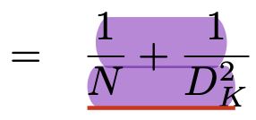
MobileNet Architecture – Depth-wise Separable Convolution
Depth-wise convolutions: apply a single filter per each input channel (input depth)
Point-wise convolution: create a linear combination of the output of the depth-wise layer
Depth-wise convolution computational cost:
Depth-wise separable convolutions cost:
Reduction in computation:
Notes:
MobileNet uses 3x3 depth-wise separable convolutions which uses between 8 to 9 times less computation than standard convolutions.

Slide 8
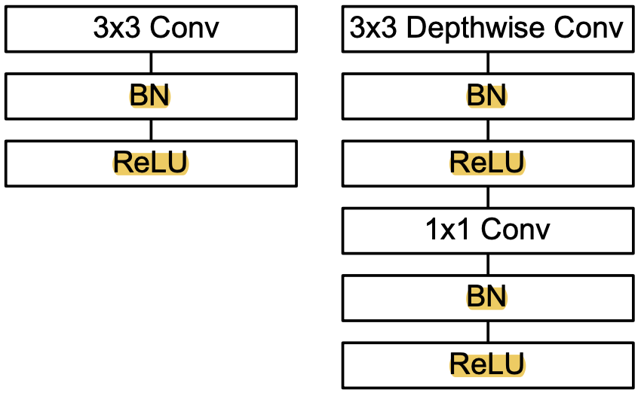
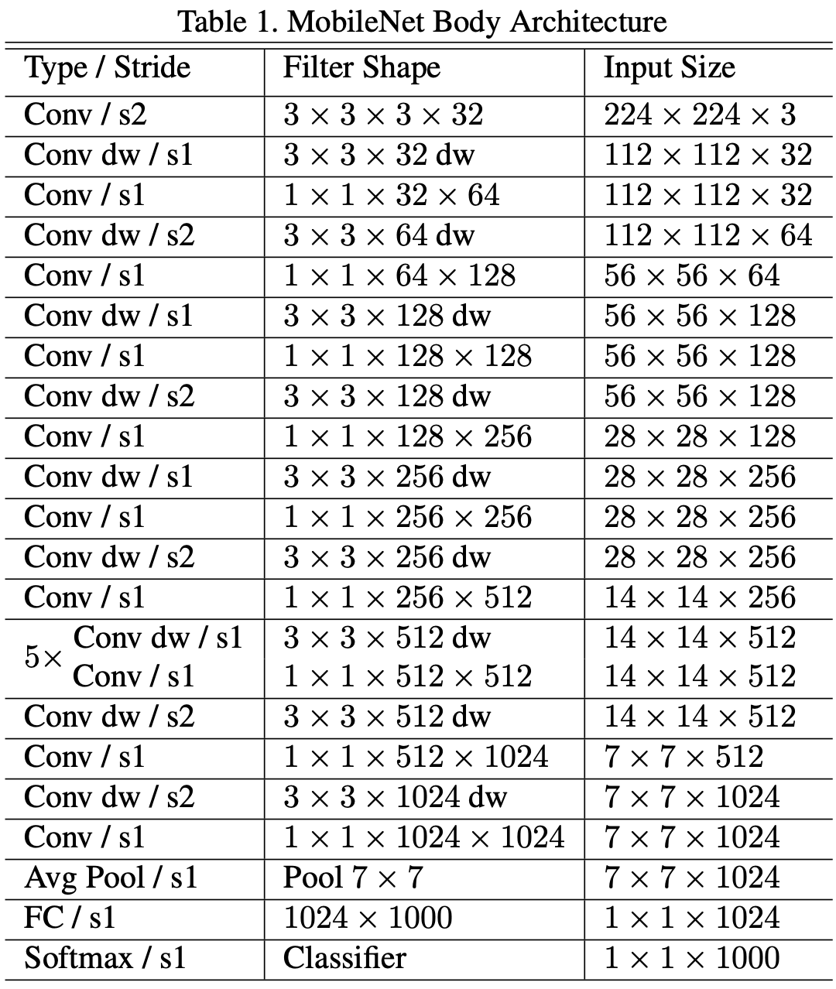
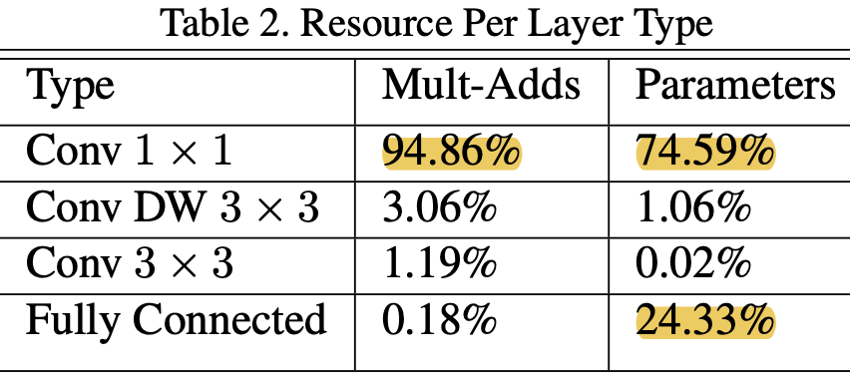
MobileNet Architecture – Network Structure and Training
Unstructured sparse matrix operations are not typically faster than dense matrix operations until a very high level of sparsity. -> highly optimized general matrix multiply (GEMM) functions.
Trained in Tensorflow using RMSprop with asynchronous gradient descent similar to Inception V3.
Using less regularization and data augmentation techniques (small models have less trouble with overfitting)
Didn’t use side heads or label smoothing and additionally reduce the amount image of distortions by limiting the size of small crops.
Put very little or no weight decay (l2 regularization) on the depth-wise filters (their are so few parameters in them)
Notes:
All layers are followed by a batchnorm and ReLU nonlinearity with the exception of the final fully connected layer which has no nonlinearity and feeds into a softmax layer for classification.
MobileNet has 28 layers.
MobileNet spends 95% of it’s computation time in 1x1 convolutions which also has 75% of the parameters as can be seen in Table 2. Nearly all of the additional parameters are in the fully connected layer.

Slide 9



MobileNet Architecture – Width Multiplier: Thinner Models
Make the model to be smaller and faster.
Thin a network uniformly at each layer.
Depth-wise separable convolutions cost:
Reducing computational cost and the number of parameters quadratically by roughly .
Notes:
Although the base MobileNet architecture is already small and low latency, many times a specific use case or application may require the model to be smaller and faster.

Slide 10



MobileNet Architecture – Resolution Multiplier: Reduced Representation
Reducing the computational cost of a neural network.
Apply this to the input image and the internal representation of every layer.
Depth-wise separable convolutions cost:
Reducing computational cost by .

Slide 11
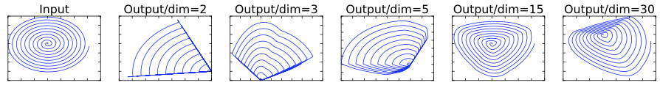
Preliminaries, discussion and intuition – Linear Bottlenecks
We say that the set of layer activations (any layer) forms a “manifold of interest”.
Manifolds of interest in neural networks could be embedded in low-dimensional subspaces.
Two properties that are indicative of the requirement that the manifold of interest should lie in a low-dimensional subspace of the higher-dimensional activation space
If the manifold of interest remains non-zero volume after ReLU transformation, it corresponds to a linear transformation
ReLU is capable of preserving complete information about the input manifold, but only if the input manifold lies in a low-dimensional subspace of the input space.
Examples of ReLU transformations of low-dimensional manifolds embedded in higher-dimensional spaces.
n = 2, 3 result in information loss where certain points of the manifold collapse into each other, while for n = 15 to 30 the transformation is highly non-convex.
Notes:
Following that intuition, the width multiplier approach allows one to reduce the dimensionality of the activation space until the manifold of interest spans this entire space. However, this intuition breaks down when we recall that deep convolutional neural networks actually have non-linear per coordinate transformations, such as ReLU. For example, ReLU applied to a line in 1D space produces a ’ray’, where as in Rn space, it generally results in a piece-wise linear curve with n-joints.
In general if a result of a layer transformation ReLU(Bx) has a non-zero volume S, the points mapped to interior S are obtained via a linear transformation B of the input, thus indicating that the part of the input space corresponding to the full dimensional output, is limited to a linear transformation. In other words, deep networks only have the power of a linear classifier on the non-zero volume part of the output domain.

Slide 12
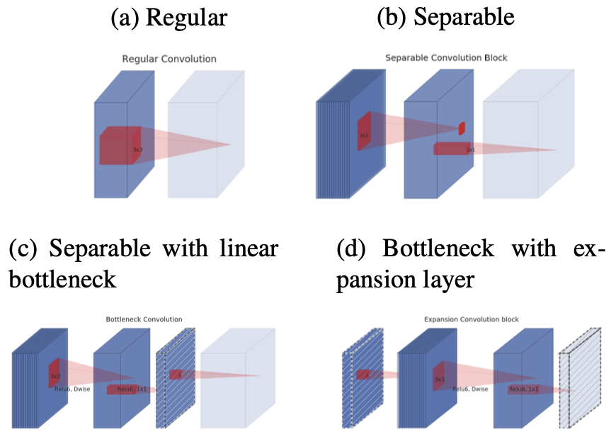
Preliminaries, discussion and intuition – Linear Bottlenecks
Made manifold of interest low-dimensional by inserting linear bottleneck layers into the convolutional blocks.
Using linear layers is crucial as it prevents non-linearities from destroying too much information.
Expansion ratio: ratio between the size of the input bottleneck and the inner size.
Evolution of separable convolution blocks. The diagonally hatched texture indicates layers that do not contain non-linearities.
Note: 2d and 2c are equivalent blocks when stacked. Best viewed in color.

Slide 13
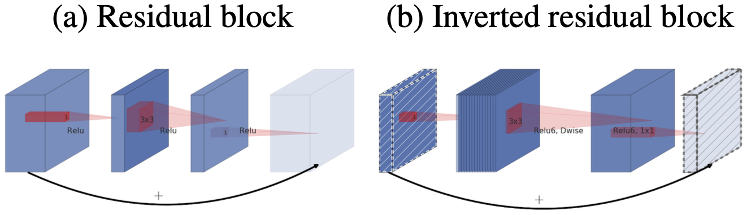
Preliminaries, discussion and intuition – Inverted residuals
How classical residuals connects the layers with high number of channels, whereas the inverted residuals connect the bottlenecks.
Bottlenecks actually contain all the necessary information → use shortcuts directly between the bottlenecks
considerably more memory efficient
works slightly better in our experiments.
Notes:
However, inspired by the intuition that the bottlenecks actually contain all the necessary information, while an expansion layer acts merely as an implementation detail that accompanies a non-linear transformation of the tensor, we use shortcuts directly between the bottlenecks.
The motivation for inserting shortcuts is similar to that of classical residual connections: we want to improve the ability of a gradient to propagate across multiplier layers. However, the inverted design is considerably more memory efficient (see Section 5 for details), as well as works slightly better in our experiments.

Slide 14
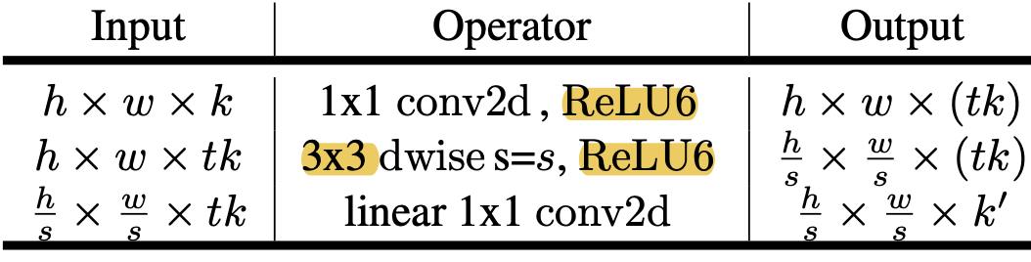

Preliminaries, discussion and intuition – Inverted residuals
Running time and parameter count for bottleneck convolution.
Bottleneck residual block transforming from k to k’ channels, with stride s, and expansion factor t.
Total number of multiply add required:
h x w: block of size
d’: input channel
d’’: output channel

Slide 15
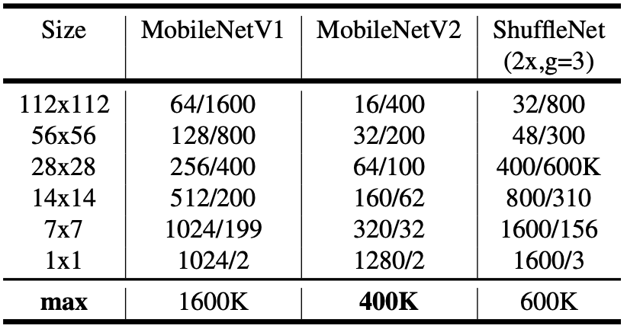
Preliminaries, discussion and intuition – Inverted residuals
The max number of channels/memory (in Kb) that needs to be materialized at each spatial resolution for different architectures.

Slide 16
Preliminaries, discussion and intuition – Information flow interpretation
The architecture provides a natural separation between the input/output domains of the building blocks (bottleneck layers), and the layer transformation – that is a non-linear function that converts input to the output
bottleneck layers: can be seen as the capacity of the network at each layer
layer transformation: can be seen as expressiveness.

Slide 17
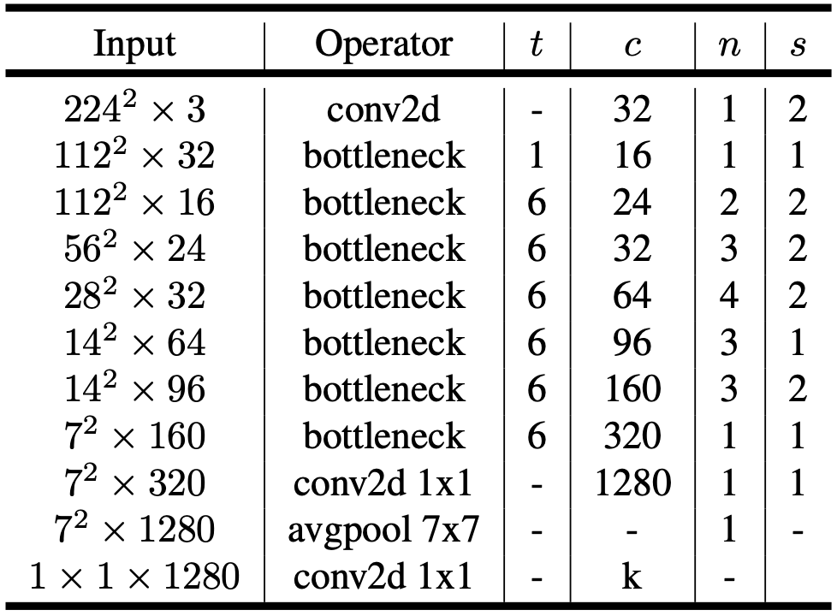
MobileNetV2 Architecture
Basic building block: bottleneck depth-separable convolution with residuals.
The architecture of MobileNetV2 contains the initial fully convolution layer with 32 filters, followed by 19 residual bottleneck layers.
Use ReLU6 as the non-linearity (robustness when used with low-precision computation)
kernel size: 3x3
Utilize dropout and batch normalization during training.
Notes:
With the exception of the first layer, we use constant expansion rate throughout the network. In our experiments we find that expansion rates between 5 and 10 result in nearly identical performance curves, with smaller networks being better off with slightly smaller expansion rates and larger networks having slightly better performance with larger expansion rates.
For all our main experiments we use expansion factor of 6 applied to the size of the input tensor. For example, for a bottleneck layer that takes 64-channel input tensor and produces a tensor with 128 channels, the intermediate expansion layer is then 64 · 6 = 384 channels.
Trade-off hyper parameters:
Our primary network (width multiplier 1, 224x224), has a computational cost of 300 million multiply-adds and uses 3.4 million parameters. We explore the performance trade offs, for input resolutions from 96 to 224, and width multipliers of 0.35 to 1.4. The network computational cost ranges from 7 multiply adds to 585M Adds, while the model size vary between 1.7M and 6.9M parameters. For multipliers less than one, we apply width multiplier to all layers except the very last convolutional layer. This improves performance for smaller models.

Slide 18
Implementation Notes - Memory efficient inference

Slide 19
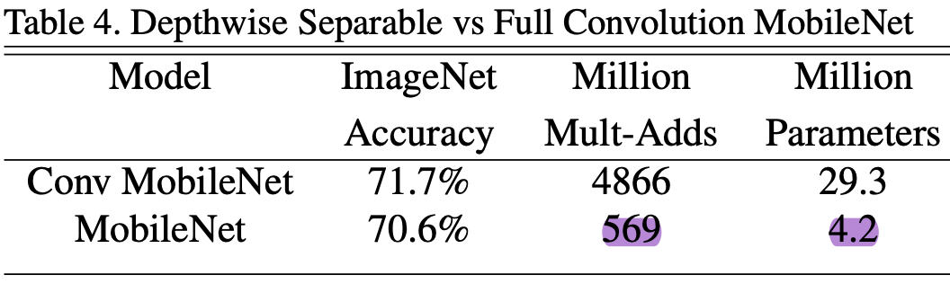
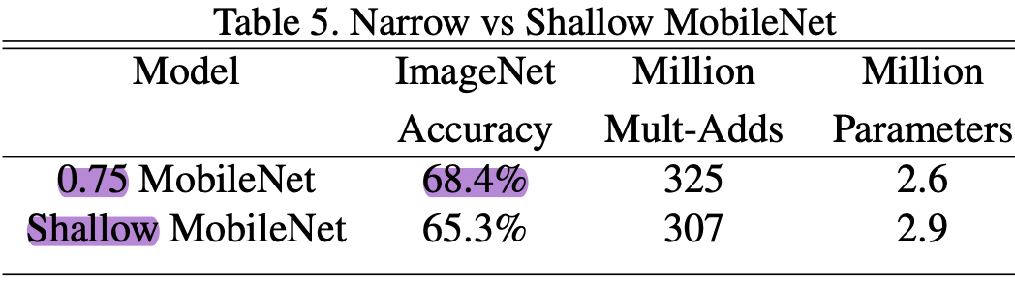
V1 Experiments - Model Choices
MobileNet with depth-wise separable convolutions compared to a model built with full convolutions.
0.75 MobileNet: width multiplier(⍺) = 0.75
Shallow MobileNet: 5 layers of separable filters with feature size 14x14x512 in Table-1 are removed.

Slide 20
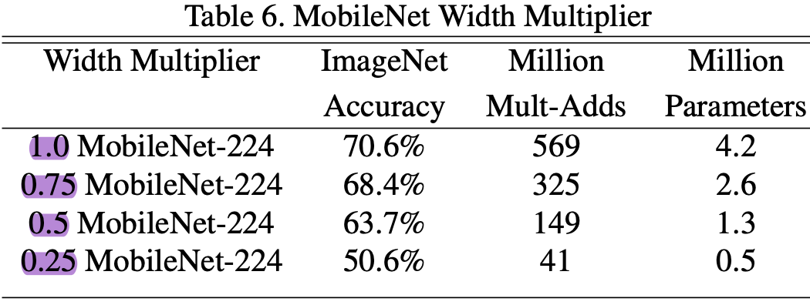
V1 Experiments – Model Shrinking Hyperparameters
Accuracy, computation and size trade offs of shrinking the MobileNet architecture with the width multiplier.
Accuracy drops off smoothly until the architecture is made too small at ⍺ = 0.25.

Slide 21
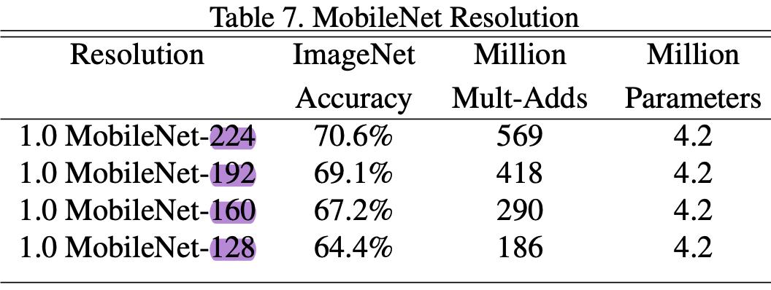
V1 Experiments – Model Shrinking Hyperparameters
Accuracy, computation and size trade offs for different resolution multipliers by training MobileNets with reduced input resolutions.
Accuracy drops off smoothly across resolution.

Slide 22
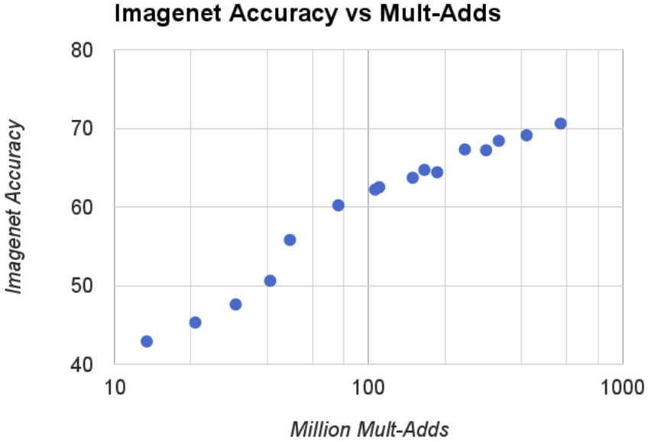
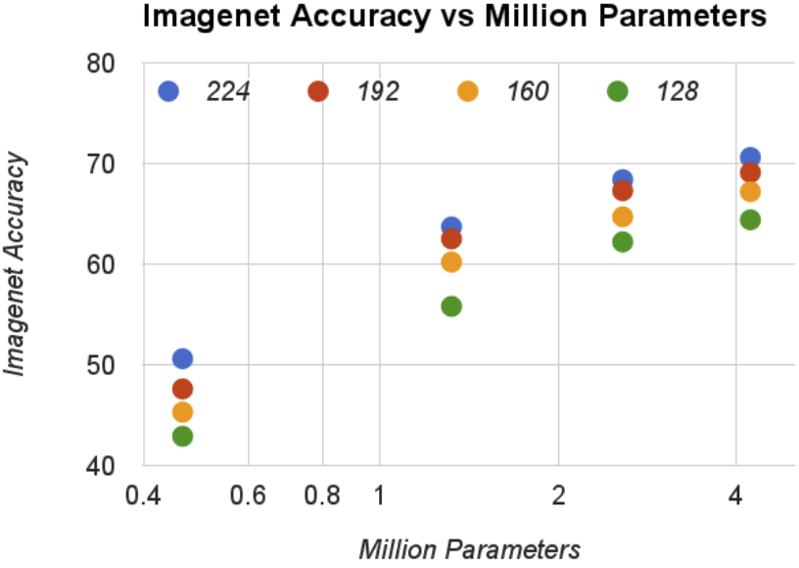
V1 Experiments – Model Shrinking Hyperparameters
Trade off between ImageNet accuracy and computation(left)/number of parameters(right) for the 16 models made from the cross product of width multiplier ⍺ ∈ {1, 0.75, 0.5, 0.25} and resolutions {224, 192, 160, 128}.
Results are log linear with a jump when models get very small at ⍺ = 0.25.

Slide 23
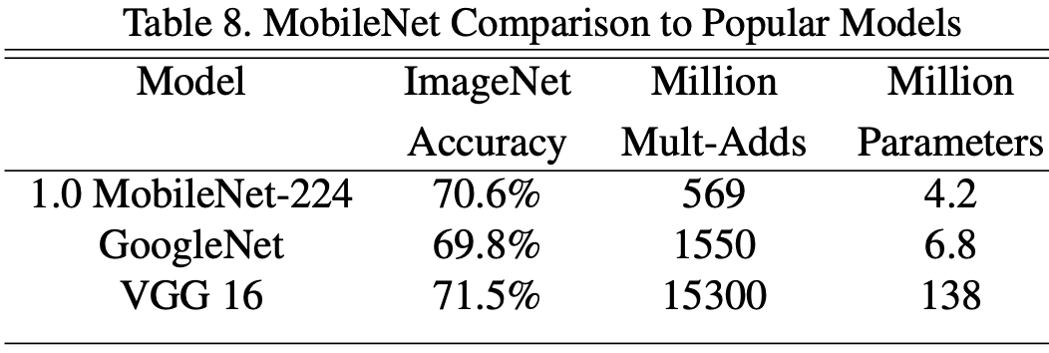
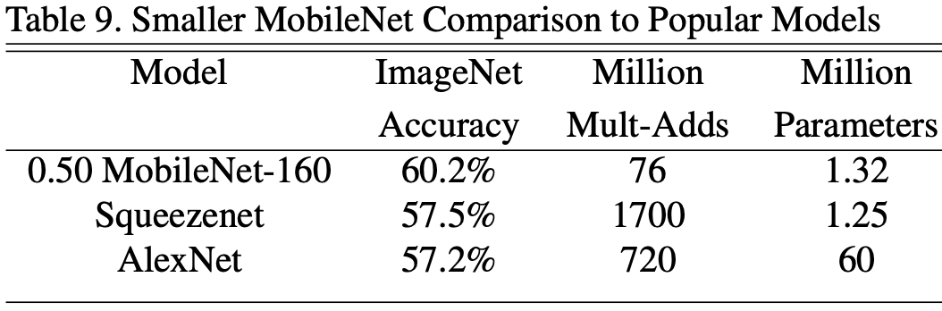
V1 Experiments – Model Shrinking Hyperparameters
Nearly as accurate as VGG16 (32x smaller, 27x less compute intensive).
More accurate than GoogleNet (smaller, more than 2.5x less computation).
Reduced MobileNet with width multiplier ⍺ = 0.5 and reduced resolution 160x160.
4% better than AlexNet (45 times smaller, 9.4x less compute)
4% better than Squeezenet (about the same size, 22x less computation.

Slide 24
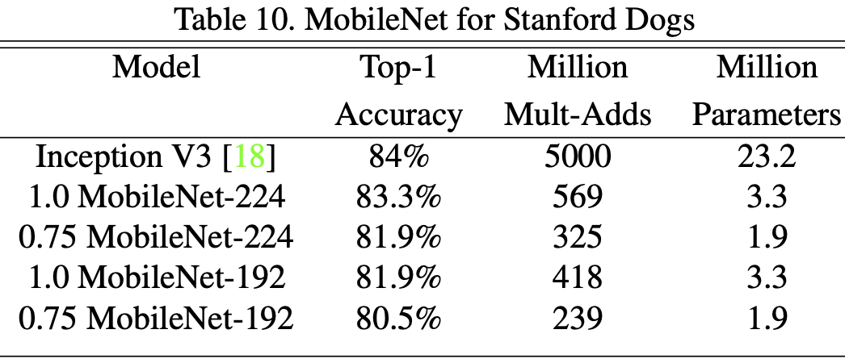
V1 Experiments – Fine Grained Recognition
Trained on Stanford Dogs dataset.
Use the noisy web data to pretrain a fine grained dog recognition model and then fine tune the model on the Stanford Dogs training set.
MobileNet can almost achieve the state of the art results(Inception V3) from at greatly reduced computation and size.

Slide 25
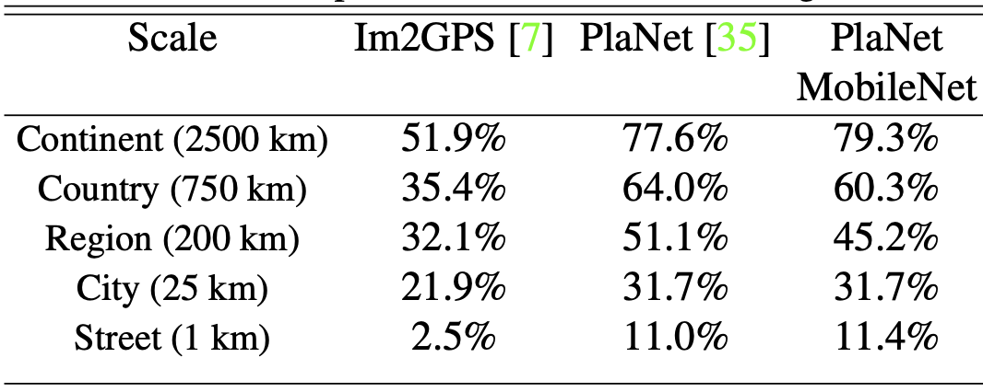
V1 Experiments – Large Scale Geolocalizaton
PlaNet casts the task of determining where on earth a photo was taken as a classification problem.
Re-train PlaNet using the MobileNet architecture on the same data.
Inception V3 architecture has 52 million parameters and 5.74 billion mult-adds.
MobileNet model has only 13 million parameters with the usual 3 million for the body and 10 million for the final layer and 0.58 Million mult-adds.
MobileNet version delivers only slightly decreased performance compared to PlaNet despite being much more compact.
Outperforms Im2GPS by a large margin.
Notes:
PlaNet casts the task of determining where on earth a photo was taken as a classification problem. The approach divides the earth into a grid of geographic cells that serve as the target classes and trains a convolutional neural network on millions of geo-tagged photos.

Slide 26
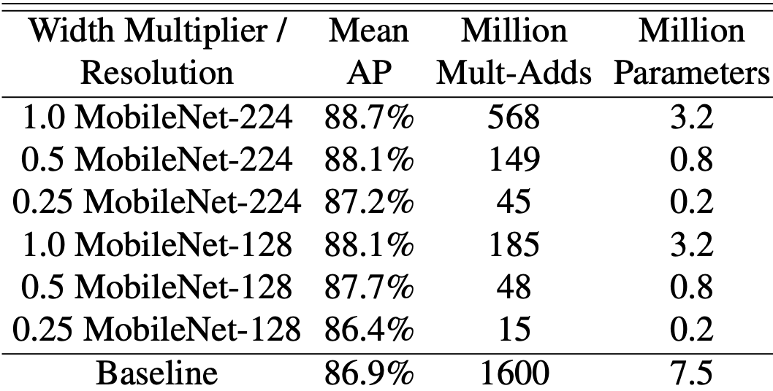
V1 Experiments – Face Attributes
Compressing large systems with unknown or esoteric training procedures.
Synergistic relationship between MobileNet and distillation (a knowledge transfer technique for deep networks).
Distill a face attribute classifier using the MobileNet architecture (training the classifier to emulate the outputs of a larger model instead of the ground-truth labels).
End system not only requires no regularization (e.g. weight-decay and early-stopping).
MobileNet-based classifier is resilient to aggressive model shrinking (achieves a similar mean average precision across attributes (mean AP) as the in-house while consuming only 1% the Multi-Adds ).

Slide 27
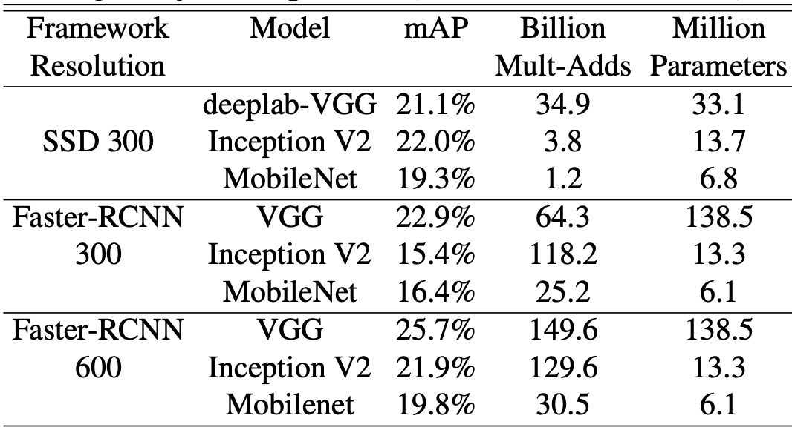
V1 Experiments – Object Detection
MobileNet trained for object detection on COCO data based on the recent work that won the 2016 COCO challenge
SSD 300: SSD evaluated with 300 input resolution.
Faster- RCNN 300, Faster-RCNN 600: Faster-RCNN compared with both 300 and 600 input resolution.
MobileNet achieves comparable results to other networks with only a fraction of computational complexity and model size.

Slide 28
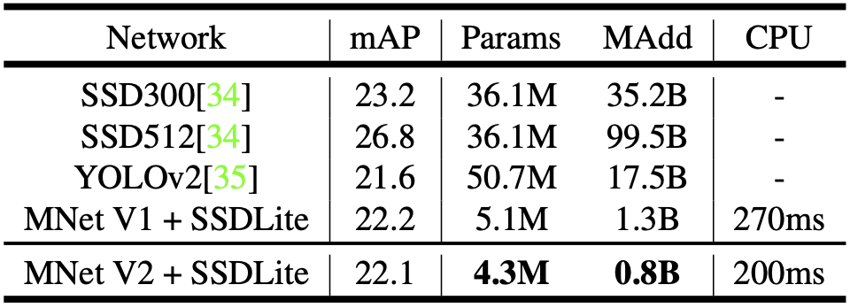
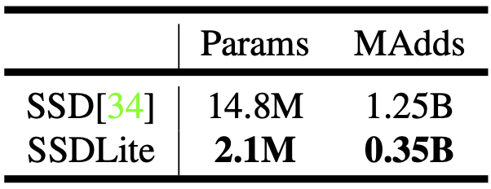
V2 Experiments – Object Detection
SSDLite: replace all the regular convolutions with separable convolutions (depth-wise followed by 1x1 projection) in SSD prediction layers.
Performance comparison of MobileNetV2 + SSDLite and other real-time detectors on the COCO dataset object detection task.
MobileNetV2 + SSDLite achieves competitive accuracy with significantly fewer parameters and smaller computational complexity.
MobileNetV2 SSDLite is 20x more efficient and 10x smaller while still outperforms YOLOv2 on COCO dataset.
Comparison of the size and the computational cost between SSD and SSDLite configured with MobileNetV2 and making predictions for 80 classes.

Slide 29
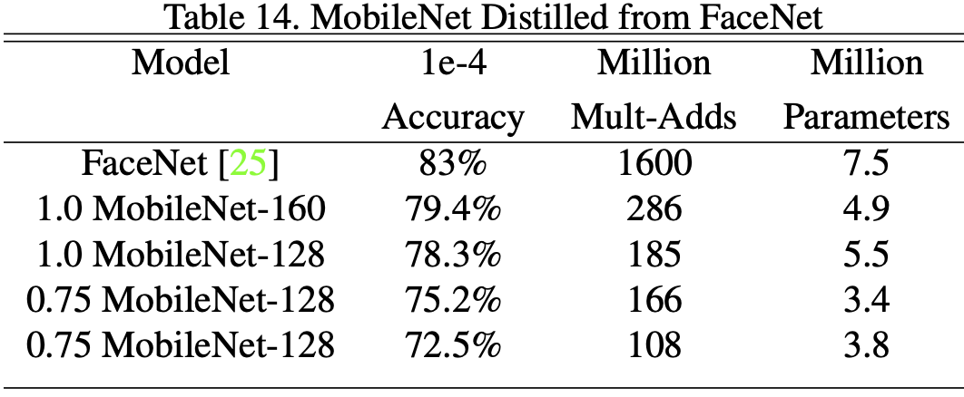
V1 Experiments – Face Embeddings
Using distillation to train by minimizing the squared differences of the output of FaceNet and MobileNet on the training data.
FaceNet model: the state of the art face recognition model (builds face embeddings based on the triplet loss).

Slide 30
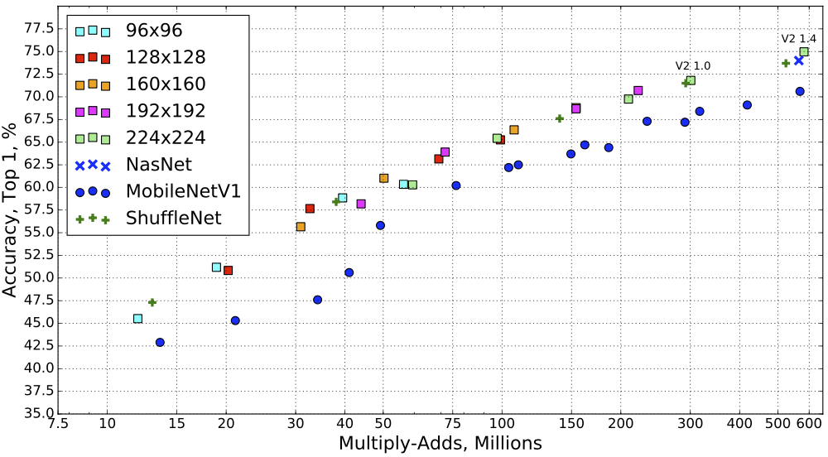
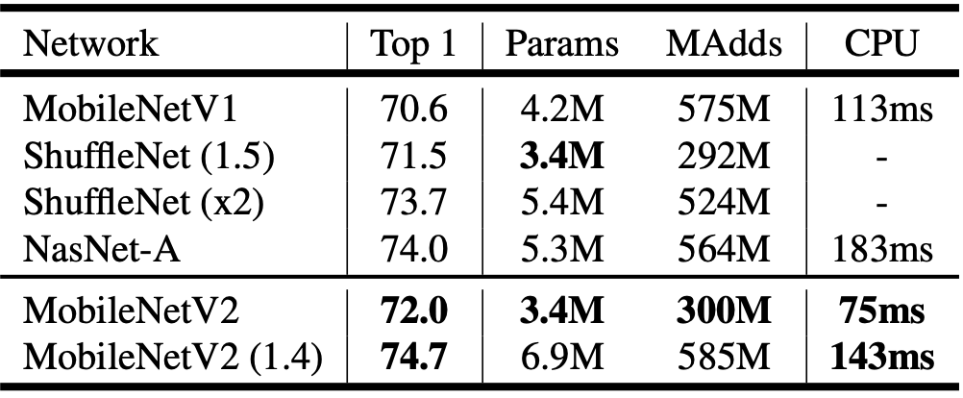
V2 Experiments – ImageNet Classification
Training setup
RMSProp Optimizer with both decay and momentum set to 0.9
use batch normalization after every layer.
Performance curve of MobileNetV2 vs MobileNetV1, ShuffleNet, NAS.
MobileNetV2 using multipliers 0.35, 0.5, 0.75, 1.0 for all resolutions, and additional 1.4 for for 224.
Performance on ImageNet, comparison for different networks.
Notes:
We use the standard RMSProp Optimizer with both decay and momentum set to 0.9. We use batch normalization after every layer, and the standard weight decay is set to 0.00004. Following MobileNetV1 setup we use initial learning rate of 0.045, and learning rate decay rate of 0.98 per epoch. We use 16 GPU asynchronous workers, and a batch size of 96.

Slide 31
V2 Experiments – Semantic Segmentation
Compare MobileNetV1 and MobileNetV2 models used as feature extractors with DeepLabv3 for the task of mobile semantic segmentation.
Three design variations:
different feature extractors
simplifying the DeepLabv3 heads for faster computation
different inference strategies for boosting the performance
Notes:
DeepLabv3 adopts atrous convolution [40, 41, 42], a powerful tool to explicitly control the resolution of computed feature maps, and builds five parallel heads including (a) Atrous Spatial Pyramid Pooling module (ASPP) containing three 3x3 convolutions with different atrous rates, (b) 1x1 convolution head, and (c) Image-level features. We denote by output stride the ratio of input image spatial resolution to final output resolution, which is controlled by applying the atrous convolution properly. For semantic segmentation, we usually employ output stride = 16 or 8 for denser feature maps. We conduct the experiments on the PASCAL VOC 2012 dataset, with extra annotated images from and evaluation metric mIOU.

Slide 32
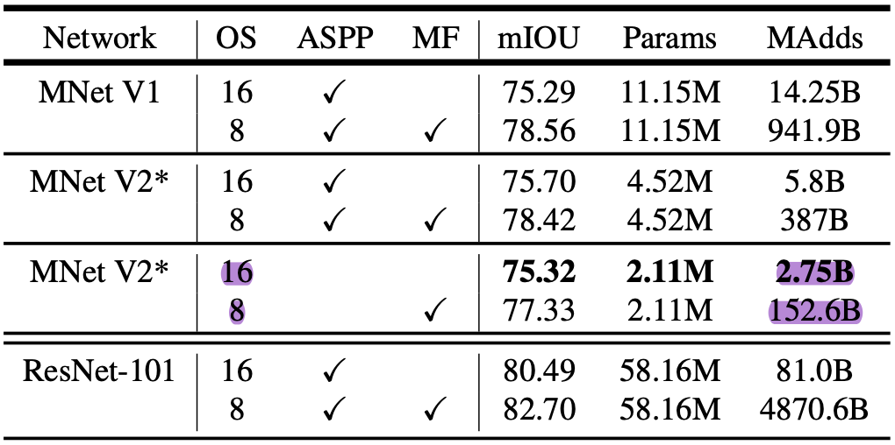
V2 Experiments – Semantic Segmentation
MobileNet + DeepLabv3 inference strategy on the PASCAL VOC 2012 validation set.
MNet V2*: Second last feature map is used for DeepLabv3 heads, which includes
Atrous Spatial Pyramid Pooling (ASPP) module
1x1 convolution as well as image-pooling feature.
OS: output stride that controls the output resolution of the segmentation map.
MF: Multi-scale and left-right flipped inputs during test.

Slide 33
V2 Experiments – Semantic Segmentation
The inference strategies, including multi-scale inputs and adding left-right flipped images, significantly increase the MAdds and thus are not suitable for on-device applications.
Using output stride = 16 is more efficient than output stride = 8.
MobileNetV1 is already a powerful feature extractor and only requires about 4.9 5.7 times fewer MAdds than ResNet-101.
It is more efficient to build DeepLabv3 heads on top of the second last feature map of MobileNetV2 than on the original last-layer feature map, since the second to last feature map contains 320 channels instead of 1280, and by doing so, we attain similar performance, but require about 2.5 times fewer operations than the MobileNetV1 counterparts.
DeepLabv3 heads are computationally expensive and removing the ASPP module significantly reduces the MAdds with only a slight performance degradation.

Slide 34
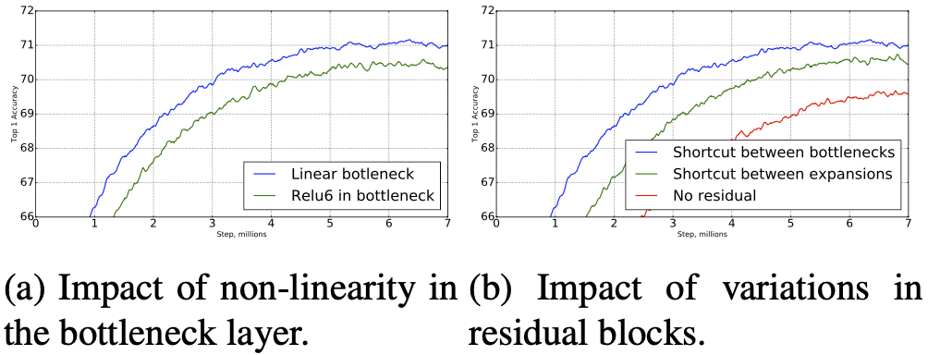
V2 Experiments – Ablation study
Inverted residual connections → the shortcut connecting bottleneck perform better than shortcuts connecting the expanded layers. (Fig. (b))
Importance of linear bottlenecks → linear bottlenecks improve performance, providing support that non-linearity destroys information in low-dimensional space. (Fig. (a))
Notes:
Importance of linear bottlenecks: The linear bottleneck models are strictly less powerful than models with non-linearities, because the activations can always operate in linear regime with appropriate changes to biases and scaling. However our experiments shown in Figure 6a indicate that linear bottlenecks improve performance, providing support that non-linearity destroys information in low-dimensional space.

Slide 35
Conclusion & Future Work
Proposed a new model architecture called MobileNets based on depth-wise separable convolutions.
Demonstrated how to build smaller and faster MobileNets using width multiplier and resolution multiplier by trading off a reasonable amount of accuracy to reduce size and latency.

Slide 36
Comparison
MobileNetV2 retains MobileNet’s simplicity and does not require any special operators while significantly improves its accuracy, achieving state of the art on multiple image classification and detection tasks for mobile applications.

