Slide 1
Network Programming (Chapter 5: TCP client/server example)
Po-Ching Lin@CS.CCU
相關程式
tcpcliserv/tcpserv01.c tcpcliserv/sigchldwaitpid.c
lib/str_echo.c tcpcliserv/tcpserv04.c
tcpcliserv/tcpcli01.c tcpcliserv/str_cli11.c
lib/str_cli.c tcpcliserv/str_echo08.c
lib/signal.c tcpcliserv/strcli09.c
tcpcliserv/sigchldwait.c
tcpcliserv/tcpcli04.c

Slide 2
Simple echo client and server
stdin
fgets
writen
read
TCP
server
TCP
client
stdout
fputs
readline
writen
See tcpcliserv/tcpcliserv01.c
lib/str_echo.c
tcpcliserv/tcpcli01.c
lib/str_cli.c
Watch out for boundary conditions:
Server terminates prematurely, server crashes, etc.

Slide 3
Signal handling
Signal
A notification to a process that an event has occurred.
A software interrupt occurs asynchronously.
Signals can be from
One process to another (or to itself)
The kernel to a process
Prototype
typedef void (*sighandler_t)(int);
sighandler_t signal(int signum, sighandler_t handler);
signal() sets the disposition of the signal signum to handler, which is either SIG_IGN (ignore), SIG_DFL (default), or the address of a programmer-defined function (a "signal handler").

Slide 4
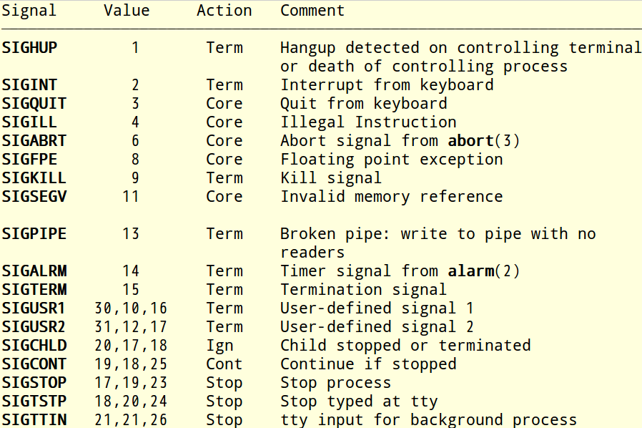
Signals that usually appear

Slide 5
The semantics when a signal handler is invoked? (System V)
In the original UNIX systems, when a handler that was established using signal() was invoked by the delivery of a signal, the disposition of the signal would be reset to SIG_DFL, and the system did not block delivery of further instances of the signal.
the signal might be delivered again before the handler had a chance to reestablish itself.
Furthermore, rapid deliveries of the same signal could result in recursive invocations of the handler.

Slide 6
The semantics when a signal handler is invoked? (BSD and Linux)
On BSD, when a signal handler is invoked, the signal disposition is not reset, and further instances of the signal are blocked from being delivered while the handler is executing.
On Linux
The kernel's signal() system call provides System V semantics.
By default, in glibc 2 and later, the signal() wrapper function does not invoke the kernel system call. Instead, it calls sigaction(2) using flags that supply BSD semantics. This default behavior is provided as long as the _BSD_SOURCE feature test macro is defined. By default, _BSD_SOURCE is defined; it is also implicitly defined if one defines _GNU_SOURCE, and can of course be explicitly defined.

Slide 7
wait and waitpid Functions
#include <sys/wait.h>
pid_t wait (int *statloc);
pid_t waitpid (pid_t pid, int *statloc, int options);
returns: process ID if OK, o, or -1 on error
The wait() system call suspends execution of the calling process until one of its children terminates.
The waitpid() system call suspends execution of the calling process until a child specified by pid argument has changed state.
State change of child process
Terminated
Stopped by a signal
Resumed by a signal
A SIGCHLD signal is sent to the parent when the child terminates.
Child will be in the zombie state if the parent does not wait the SIGCHLD signal.
If a child has already changed state, then the wait calls return immediately.
Otherwise they block until either a child changes state or a signal handler interrupts the call.

Slide 8
Difference between wait and waitpid
wait(&status) == waitpid(-1, &status, 0)
Consider a client that establishes five
connections with server.
Signals are not queued (System V semantics)
Client and server run on the same host
The signal handler is executed once.
Not on the same host
Depending on the timing of FINs arriving at the server host
The signal handler is executed twice or more.
Result: four or fewer zombies left
Solution: call waitpid (non-blocking) within a loop

Slide 9
Client Terminates All Five Connections
catching all SIGCHLD signals in server parent
SIGCHLD
SIGCHLD
SIGCHLD
SIGCHLD
SIGCHLD
client server server server server server server
4 3 2 1 0 parent child 1 child 2 child 3 child 4 child 5
FIN
FIN
FIN
FIN
FIN

Slide 10
Boundary conditions
Connection abort before accept returns
client
server
connect
SYN
SYN, ACK
SYN_RCVD
connect returns
ACK
ESTABLISHED
RST
accept called

Slide 11
Boundary conditions (cont.)
Termination of server process
SIGPIPE signal (See tcpcliserv/strcli11.c)
Crashing of server host
Crashing and rebooting server host
Shutdown of server host

Slide 12
Data format
Passing text strings between client and server
tcpcliserv/str_echo08.c
Passing binary structures between client and server
tcpcliserv/sum.h
tcpcliserv/str_cli09.c
tcpcliserv/str_echo09.c

