Slide 1
Course AI-102: Designing and Implementing a Microsoft Azure AI Solution

Slide 2
About This Course
Learn how to develop AI solutions on Azure
Build on your existing software development skills:
C# or Python
REST and JSON
Create AI applications with Azure services:
Azure Cognitive Services
Azure Bot Service
Azure Cognitive Search

Slide 3
Course Agenda
Module 1: Introduction to AI on Azure
Module 2: Developing AI Apps with Cognitive Services
Module 3: Getting Started with Natural Language Processing
Module 4: Building Speech-Enabled Applications
Module 5: Creating Language Understanding Solutions
Module 6: Building a Question Answering Solution
Module 7: Conversational AI and the Azure Bot Service
Module 8: Getting Started with Computer Vision
Module 9: Developing Custom Vision Solutions
Module 10: Detecting, Analyzing, and Recognizing Faces
Module 11: Reading Text in Images and Documents
Module 12: Creating a Knowledge Mining Solution

Slide 4
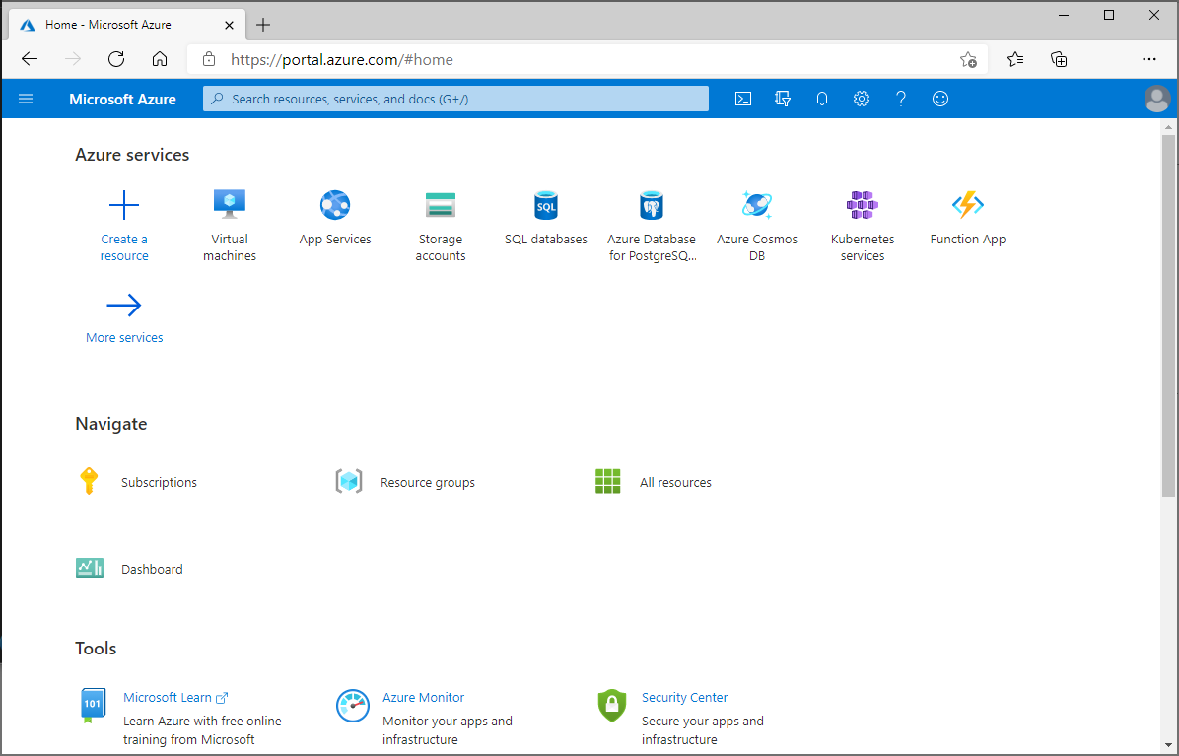
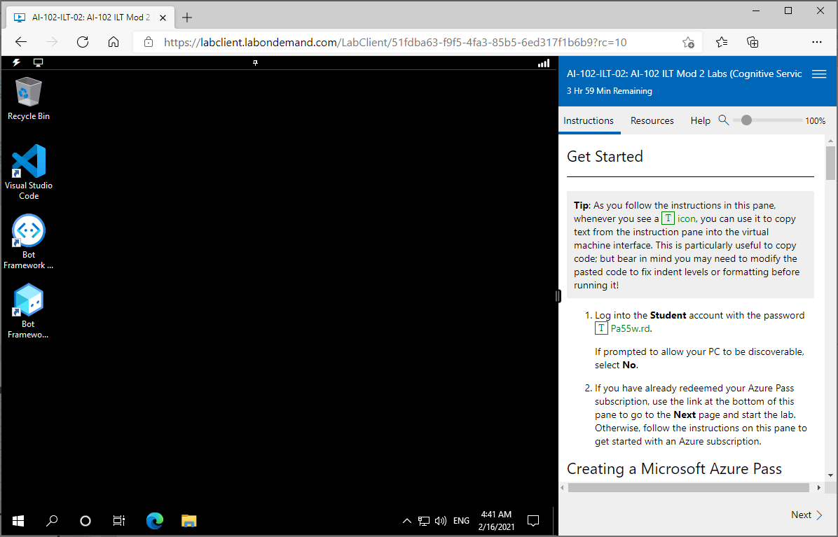
Lab Environment
Hosted Virtual Machine
Windows 10
Visual Studio Code
C#
Python
Bot Framework Emulator
Bot Framework Composer
Azure Subscription
Free Azure Pass – requires a Microsoft Account
Or bring your own environment:
https://microsoftlearning.github.io/AI-102-AIEngineer/

Slide 5

Microsoft Certified Azure AI Engineer Associate
https://docs.microsoft.com/learn/certifications/azure-ai-engineer/
This course helps prepare for exam AI-102: Designing and Implementing a Microsoft Azure AI Solution
Complete this instructor-led course
Review online modules on Microsoft Learn
Refer to the service documentation and build experience with the technologies
Notes:
Encourage students to visit the certification landing page, which includes links to self-paced modules on Microsoft Learn that supplement the content in this course.

Slide 6
Closing slide

