Slide 1
Module 2: Developing AI Apps with Cognitive Services

Slide 2
Module Agenda
Getting Started with Cognitive Services
Using Cognitive Services for Enterprise Applications

Slide 3
Lesson 1: Getting Started with Cognitive Services

Slide 4
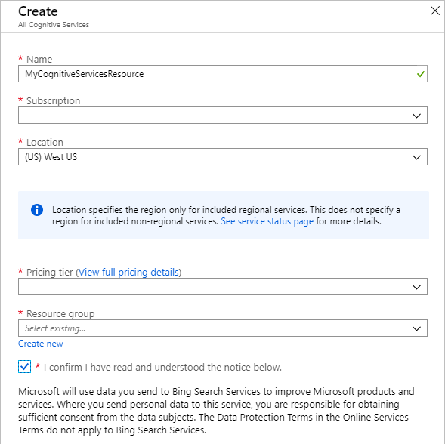
Provisioning Cognitive Services Resources
Create a resource in your Azure subscription
You will create either a single-service resource or a multi-service resource:
Multi-service resource (Cognitive Services):
Access multiple Azure Cognitive Services with a single key and endpoint.
Consolidates billing from the services you use.
Single-service resource (for example, Language):
Access a single Azure Cognitive Service with a unique key and endpoint for each service created.
Use the free tier to try out the service.
Training and Prediction Resources
Some services require separate resources for model training and predictions

Slide 5
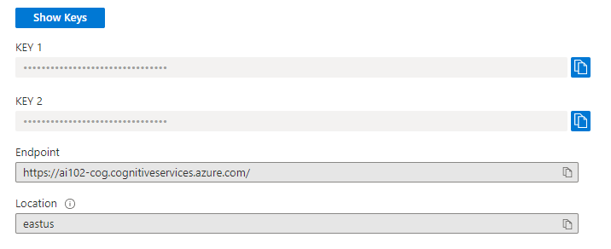
Endpoints, Keys, and Locations
Information required to connect
Endpoint:
URL at which service can be consumed
Required by most SDK clients
Keys:
Use either key to authenticate
Location:
Azure data center in which resource is provisioned
Required by some SDK clients

Slide 6


Cognitive Services REST APIs
Clients submit HTTP requests to the resource endpoint
Key specified in request header
Input data in JSON format
Specific schema varies by service and method
Service returns JSON response
HTTP
Request
{
{
json: [..]
}
}
Response
{
{
json: [..]
}
}

Slide 7
Cognitive Services SDKs
Runtime library abstracts REST interface
Multiple SDKs for each service:
.NET
Python
Node.js
Java
Others…
HTTP
Request
{
{
json: [..]
}
}
Response
{
{
json: [..]
}
}
.NET
Python
Node.js
…

Slide 8
Lab – Get Started with Cognitive Services
Provision a Cognitive Services Resource
Use a REST Interface
Use an SDK

Slide 9
Lesson 2: Using Cognitive Services for Enterprise Applications

Slide 10






Considerations for Cognitive Services Security
Regenerate keys regularly to protect access
To avoid service interruption, switch apps to use key 2 before regenerating key 1; and vice-versa.
Consider protecting keys by storing them in Azure Key Vault
Apps can use a Service Principal as a managed identity to retrieve keys from Key Vault
App retrieves key from key vault
App uses key to access Cognitive Services resource
App uses Service Principal ID to access key vault

Slide 11
Lab – Manage Cognitive Services Security
Manage Authorization Keys
Secure Key Access with Azure KeyVault

Slide 12
Monitoring Cognitive Services Activity
Alerts
Alerts will ensure that the correct team knows when a problem arises.
Every alert or notification available in Azure Monitor is the product of a rule
Metrics
Metrics are numerical values
The metrics are collected at regular intervals and are useful for alerting.
Metrics are stored in a time-series database.
Diagnostic Settings
Configure diagnostic settings is to provide detailed information for diagnostics and auditing.
Diagnostic Destinations:
Log Analytics Workspace
Event Hubs
Azure Storage
Logs
Logs contain time-stamped information about changes made to resources.
The log data is organized into record
The logs can include numeric values, but most include text data
The most common type of log entry records an event

Slide 13
Lab – Monitor Cognitive Services
Configure an Alert
Visualize a Metric

Slide 14



Cognitive Services and Containers
Container images are available for commonly used cognitive services APIs
Deploy containers to:
Local Docker hosts
Azure Container Instances
Azure Kubernetes Services clusters
others…
Enables more control over data sent to public cognitive service endpoint
A Cognitive Services resource is still required, and the container must communicate with it to send billing data
mcr.microsoft.com/azure-cognitive-services
Usage metrics required for billing are sent to Cognitive Services resource in Azure
Container image deployed to host
Client app sends data to container instance and receives response
Container host

Slide 15
Lab – Use a Cognitive Services Container
Deploy and Run a Container
Use a Container

Slide 16

Module Review
How are client applications typically granted access to a cognitive services endpoint?
The application must specify a valid subscription key for the Azure resource.
The user of the application must enter a user name and password associated with the Azure subscription.
Access to cognitive services is granted to anonymous users by default.
You want to keep track of how often the subscription keys for your cognitive services resource are retrieved. What should you do?
Regenerate the keys for your cognitive services resource.
Create an alert for your cognitive services resource.
Store the keys in Azure Key Vault.
You plan to use a cognitive services container in a local Docker host.
Which of the following is true?
Client applications must pass a subscription key to the Azure resource endpoint before using the container.
All data passed from the client application to the container is forwarded to the Azure resource endpoint.
The container must be able to connect to the Azure resource endpoint to send usage data for billing.
Notes:
Use the slide animation to reveal the correct answers.

Slide 17
Closing slide

