Slide 1
Module 3: Getting Started with Natural Language Processing Understanding Generation

Slide 2
Module Agenda
Analyzing Text
Translating Text

Slide 3
Lesson 1: Analyzing Text

Slide 4


The Language Service
Key Phrases:
"the news",
"New York"
Entities:
Manhattan
(https://en.wikipedia.org/wiki/Manhattan)
Natural Language Processing (NLP) features for text analysis:
Language detection
Key phrase extraction
Sentiment analysis
Named entity recognition
Entity linking
Can be used as:
Standalone Language resource
Multi-service Cognitive Services resource
Language=English
Sentiment=Positive

Slide 5
Language Detection
Determine the language in which text is written
Often useful as a pre-cursor to further analysis that requires a known language
{
"documents": [
{
"id": "1",
"detectedLanguage": {
"name": "English",
"iso6391Name": "en",
"confidenceScore": 1
},
"warnings": []
},
{
"id": "2",
"detectedLanguage": {
"name": "French",
"iso6391Name": "fr",
"confidenceScore": 1
},
"warnings": []
}
],
"errors": [],
"modelVersion": "2020-04-01"
}
Language name
(in English)
2-character language code
Collection of one or more text documents
Prediction confidence (0 to 1)
{
"documents": [
{
"countryHint": "US",
"id": "1",
"text": "Hello world"
},
{
"id": "2",
"text": "Bonjour tout le monde"
}
]
}
Optional country hint
String to be analyzed

Slide 6
Key Phrase Extraction
Identify the main "talking points" of the text
Works best with larger documents
(up to 5,120 characters)
{
"documents": [
{
"id": "1",
"keyPhrases": [
"change",
"world"
],
"warnings": []
},
{
"id": "2",
"keyPhrases": [
"miles",
"single step",
"journey"
],
"warnings": []
}
],
"errors": [],
"modelVersion": "2020-04-01"
}
List of key phrases in document 1
{
"documents": [
{
"id": "1",
"language": "en",
"text": "You must be the change you wish
to see in the world."
},
{
"id": "2",
"language": "en",
"text": "The journey of a thousand miles
begins with a single step."
}
]
}
List of key phrases in document 2
Language (defaults to English if not present)

Slide 7
Sentiment Analysis
{
"documents": [
{
"id": "1",
"sentiment": "positive",
"confidenceScores": {
"positive": 0.99,
"neutral": 0.01,
"negative": 0.00
},
"sentences": [
{
"text": "Smile!",
"sentiment": "positive",
"confidenceScores": {
"positive": 0.97,
"neutral": 0.02,
"negative": 0.01
},
"offset": 0,
"length": 6
},
{
"text": "Life is good!",
...
}
],
"warnings": []
}
],
"errors": [],
"modelVersion": "2020-04-01"
}
Overall sentiment
Scores overall document sentiment and individual sentence sentiment
Sentence sentiment is based on confidence scores for positive, negative, and neutral
Overall document sentiment is based on sentences:
All sentences are neutral = neutral
Sentences include positive and neutral = positive
Sentences include negative and neutral = negative
Sentences include positive and negative = mixed
Overall confidence
Breakdown by sentence
Sentence sentiment
Sentence confidence
{
"documents": [
{
"language": "en",
"id": "1",
"text": "Smile! Life is good!"
}
]
}
Sentence location
Next sentence
Notes:
V 3.1 (currently in preview) also includes opinion mining – for example "The food was great!" would be evaluated as a positive opinion about the food.

Slide 8
Named Entity Recognition
{
"documents":[
{
"id":"1",
"entities":[
{
"text":"Joe",
"category":"Person",
"offset":0,
"length":3,
"confidenceScore":0.62
},
{
"text":"London",
"category":"Location",
"subcategory":"GPE",
"offset":12,
"length":6,
"confidenceScore":0.88
},
{
"text":"Saturday",
"category":"DateTime",
"subcategory":"Date",
"offset":22,
"length":8,
"confidenceScore":0.8
}
],
"warnings":[]
}
],
"errors":[],
"modelVersion":"2021-01-15"
}
Identifies entities that are mentioned in the text
Entities are grouped into categories and subcategories, for example:
Person
Location
DateTime
Organization
Address
Email
URL
Others…
Person entity
Location entity
{
"documents": [
{
"language": "en",
"id": "1",
"text": "Joe went to London on Saturday"
}
]
}
DateTime entity

Slide 9
Entity Linking
Used to disambiguate entities of the same name
For example, is "Venus" a planet or a goddess?
Wikipedia provides the knowledge base
Specific article links are determined based on entity context within the text
"I saw Venus shining in the sky":
https://en.wikipedia.org/wiki/Venus
"Venus, the goddess of beauty":
https://en.wikipedia.org/wiki/Venus_(mythology)
{
"documents":
[
{
"id":"1",
"entities":[
{
"name":"Venus",
"matches":[
{
"text":"Venus",
"offset":6,
"length":5,
"confidenceScore":0.01
}
],
"language":"en",
"id":"Venus",
"url":"https://en.wikipedia.org/wiki/Venus",
"dataSource":"Wikipedia"
}
],
"warnings":[]
}
],
"errors":[],
"modelVersion":"2020-02-01"
}
Named entity
Wikipedia unique article ID
{
"documents": [
{
"language": "en",
"id": "1",
"text": "I saw Venus shining in the sky"
}
]
}
Article link

Slide 10
Lab – Analyze Text
Detect Language
Evaluate Sentiment
Identify Key Phrases
Extract Entities
Extract Linked Entities

Slide 11
Lesson 2: Translating Text

Slide 12
The Translator Service
Translation:
en: "Hello"
fr: "Bonjour"
Multilingual text translation REST API
Language detection
One-to-many translation
Script transliteration
Can be used as:
Standalone Translator resource
Multi-service Cognitive Services resource
Detect:
Language: ja
Transliteration:
"Kon'nichiwa"
こんにちは
Notes:
Note that there are no SDKs at this time – to use Translator, you must use its REST API.

Slide 13
Detection, Translation, and Transliteration
Detection
[
{
"isTranslationSupported": true,
"isTransliterationSupported": true,
"language": "ja",
"score": 1.0
}
]
https://api.cognitive.microsofttranslator.com/detect?api-version=3.0
Body: [
{ 'Text' : 'こんにちは' }
]
ISO Language code
Translation
[
{'translations':
[
{'text': 'Hello', 'to': 'en'},
{'text': 'Bonjour', 'to': 'fr'}
]
}
]
https://api.cognitive.microsofttranslator.com/translate?api-version=3.0
&from=ja&to=en&to=fr
Body: [
{ 'Text' : 'こんにちは' }
]
Add to parameters for each target language
Transliteration
[
{
"script": "Latn",
"text": "Kon'nichiwa"
}
]
https://api.cognitive.microsofttranslator.com/transliterate?api-version=3.0
&language=ja&fromScript=Jpan&toScript=Latn
Body: [
{ 'Text' : 'こんにちは' }
]
Source text language code
Source text script
Target text script
Headers omitted for brevity
Notes:
You can find the full set of supported languages at https://api.cognitive.microsofttranslator.com/languages?api-version=3.0

Slide 14
Translation Options
Word Alignment
[
{'translations':
[
{'text': '认知服务', 'to': 'zh-Hans',
'alignment': {'proj': '0:8-0:1 10:17-2:3'}
}
]
}
]
https://api.cognitive.microsofttranslator.com/translate?api-version=3.0
&from=en&to=zh& includeAlignment=true
Body: [
{ 'Text' : 'Cognitive Services' }
]
Chars 0-8 in the source are chars 0-1 in the translation
Chars 10-17 in the source are chars 2-3 in the translation
Sentence Length
[
{'translations':
[
{'text': 'Salut tout le monde!', 'to': 'fr',
'sentLen':{'srcSentLen':[12], 'transSentLen':[20]}
}
]
}
]
https://api.cognitive.microsofttranslator.com/translate?api-version=3.0
&from=en&to=fr&includeSentenceLength=true
Body: [
{ 'Text' : 'Hello world!' }
]
Source is 12 characters
Translation is 20 characters
Profanity filtering
https://api.cognitive.microsofttranslator.com/translate?api-version=3.0
&from=en&to=fr&profanityAction=Marked
Body: [
{ 'Text' : 'JSON is &%!$% great!' }
]
[
{'translations':
[
{'text': 'JSON est *** génial!', 'to': 'fr'}
]
}
]
Default marker for obscenity is asterisk
Notes:
https://docs.microsoft.com/azure/cognitive-services/translator/reference/v3-0-translate#request-parameters
https://docs.microsoft.com/azure/cognitive-services/translator/word-alignment
https://docs.microsoft.com/azure/cognitive-services/translator/profanity-filtering

Slide 15
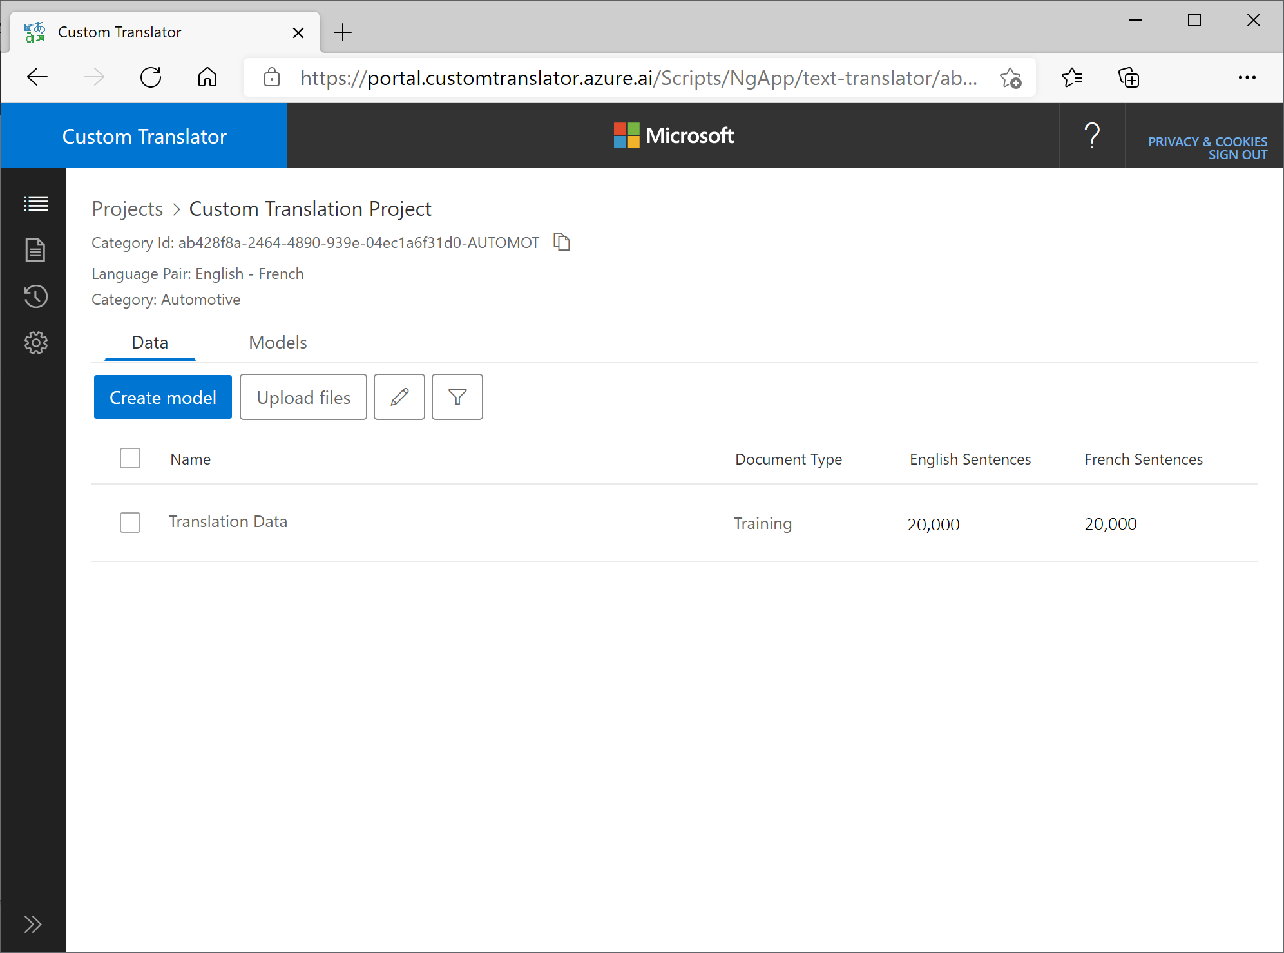
Custom Translation
Create a custom translation model
Use the Custom Translator portal
Link a workspace to your Translator resource
Create a project
Upload training data files
Train a model
Call your model through the Translator API
Specify a category parameter with the project category Id
Project category Id
Notes:
A custom translation model is useful when you need to define translations for organization or industry-specific terms that aren't defined in the default Translator model.
For more details, see the Quickstart at https://docs.microsoft.com/azure/cognitive-services/translator/custom-translator/quickstart-build-deploy-custom-model

Slide 16
Lab – Translate Text
Detect Language
Translate Text

Slide 17

Module Review
How should you create an application that monitors the comments on your company's web site and flags any indication that customers are unhappy?
Use the Translator service to detect profanities in comments
Use the Language service to perform sentiment analysis of the comments.
Use the Language service to extract named entities from the comments.
You have analyzed text that contains the word "Paris". How might you determine of this word refers to the French city or the character in Homer's The Iliad?
Use the Language service to extract key phrases.
Use the Language service to analyze sentiment.
Use the Language service to extract linked entities.
What function of the Translator service should you use to convert the Russian word "спасибо" in Cyrillic characters to "spasibo" in Latin characters?
detect
translate
transliterate
Notes:
Use the slide animation to reveal the correct answers.

Slide 18
Closing slide

