Slide 1
Medical Insurance Claim Fraud Detection
Approach 1: Explainable Traditional Machine Learning Baseline
AI-Driven Claim Verification & Responsible Fraud Screening
IIIT Dharwad — Department of Data Science and AI
Faculty Adviser: Ramesh Athe
B Varshith (23BDS011) | M Jagadeshwar (23BDS033) | J Ganesh (23BDS024)
Academic mini-project | 7 August 2026
IIIT Dharwad | Medical Insurance Claim Fraud Detection | Approach 1
1

Slide 2
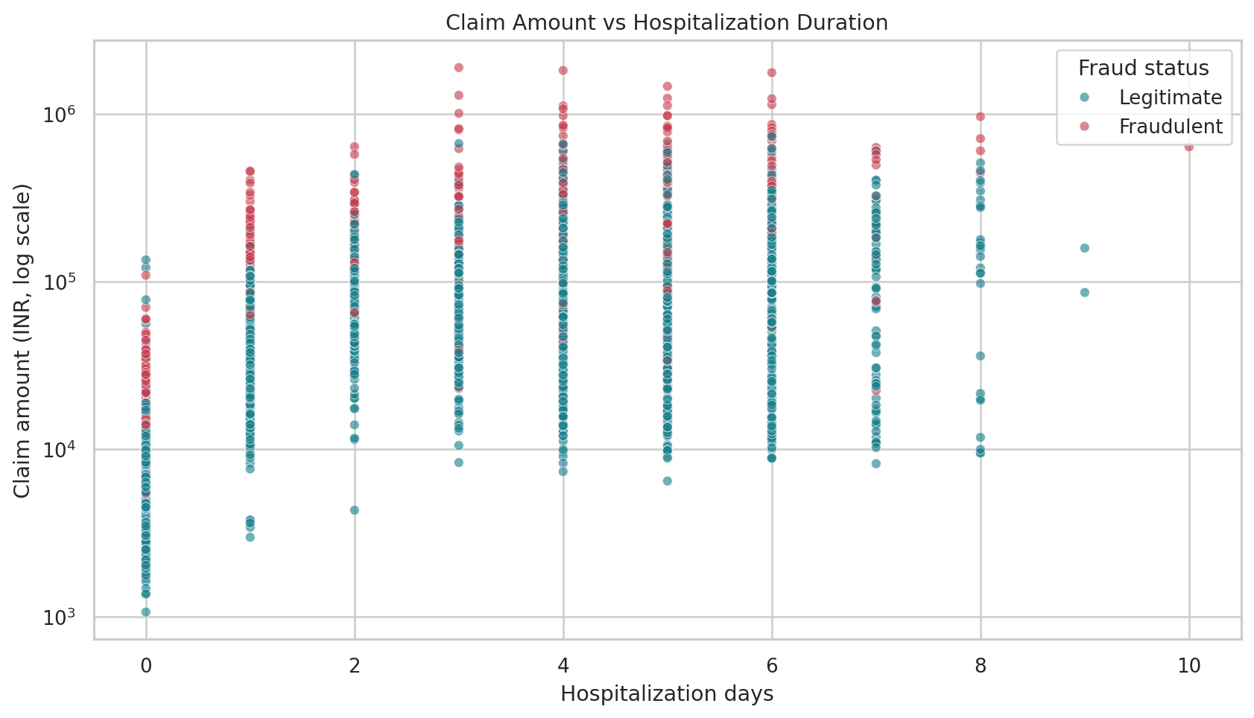
Problem Statement
Fraud screening must protect genuine policyholders without automated adverse decisions
Medical claims can involve inflated bills, duplicate episodes, timing manipulation and inconsistent documents.
Indian context matters: family floater/group covers, Ayushman Bharat/ECHS, allopathic and Ayurvedic care, GST and regional cost variation.
Goal: classify historic tabular claims as high-risk or legitimate, then route high-risk cases to human evidence review.
A score is not a denial: policy eligibility and due process remain human responsibilities.
IIIT Dharwad | Medical Insurance Claim Fraud Detection | Approach 1
2

Slide 3
Objectives and Scope
What this baseline does—and does not—claim
Benchmark diverse classical models with recall-weighted F2 selection.
Build leakage-aware preprocessing and interpretable feature evidence.
Audit subgroup error rates, calibration, INR-oriented screening costs and computational cost.
Use a transparent synthetic fallback because the bundled file is not adequate Indian claim data.
Not a production settlement engine or estimate of real insurer fraud performance.
IIIT Dharwad | Medical Insurance Claim Fraud Detection | Approach 1
3

Slide 4
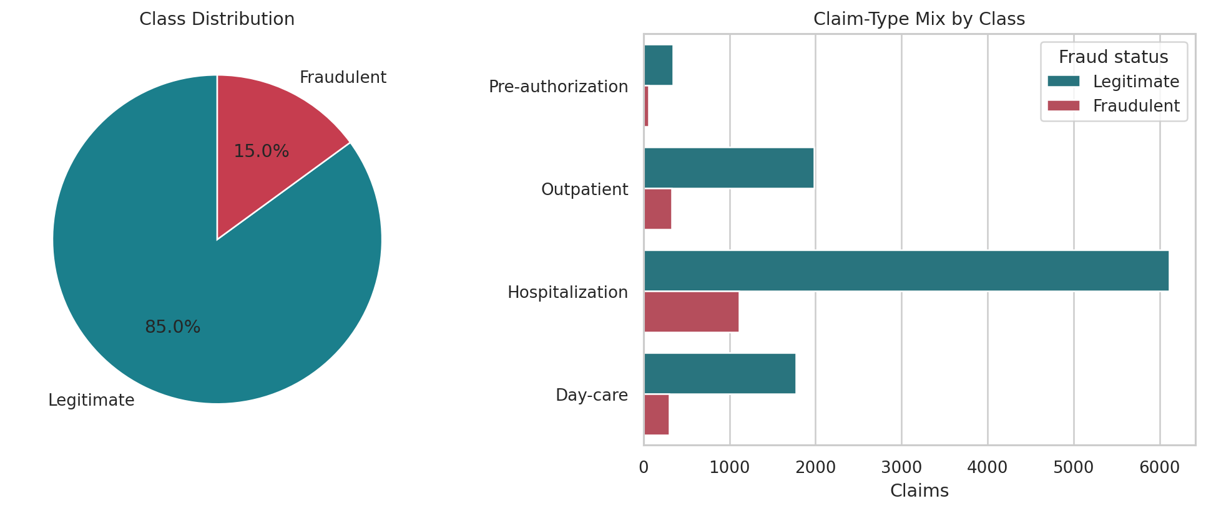
Dataset Decision
Preserve the supplied workbook; do not misrepresent it
Supplied workbook: 4,500 records (below the ≥10,000 adequacy threshold).
Adequacy review: generic locations and missing Indian policy/history fields.
Fallback: deterministic Indian-context synthetic claims in INR, labelled for educational benchmarking.
Raw reference remains untouched with checksum and metadata.
IIIT Dharwad | Medical Insurance Claim Fraud Detection | Approach 1
4

Slide 5
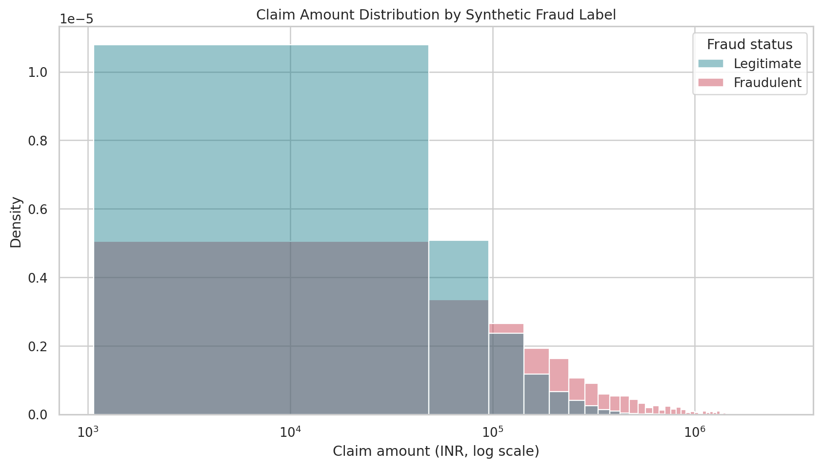
Synthetic Population and Split
Same frozen split supports fair later ML-vs-DL comparison
After exact duplicate removal: 12,000 claims.
Stratified train/validation/test: 8,400 / 1,800 / 1,800.
Features: demographic context, policy terms, claim/provider details, temporal history and regional treatment baseline.
Fraud rate is synthetic; values cannot be generalized to an insurer.
IIIT Dharwad | Medical Insurance Claim Fraud Detection | Approach 1
5

Slide 6
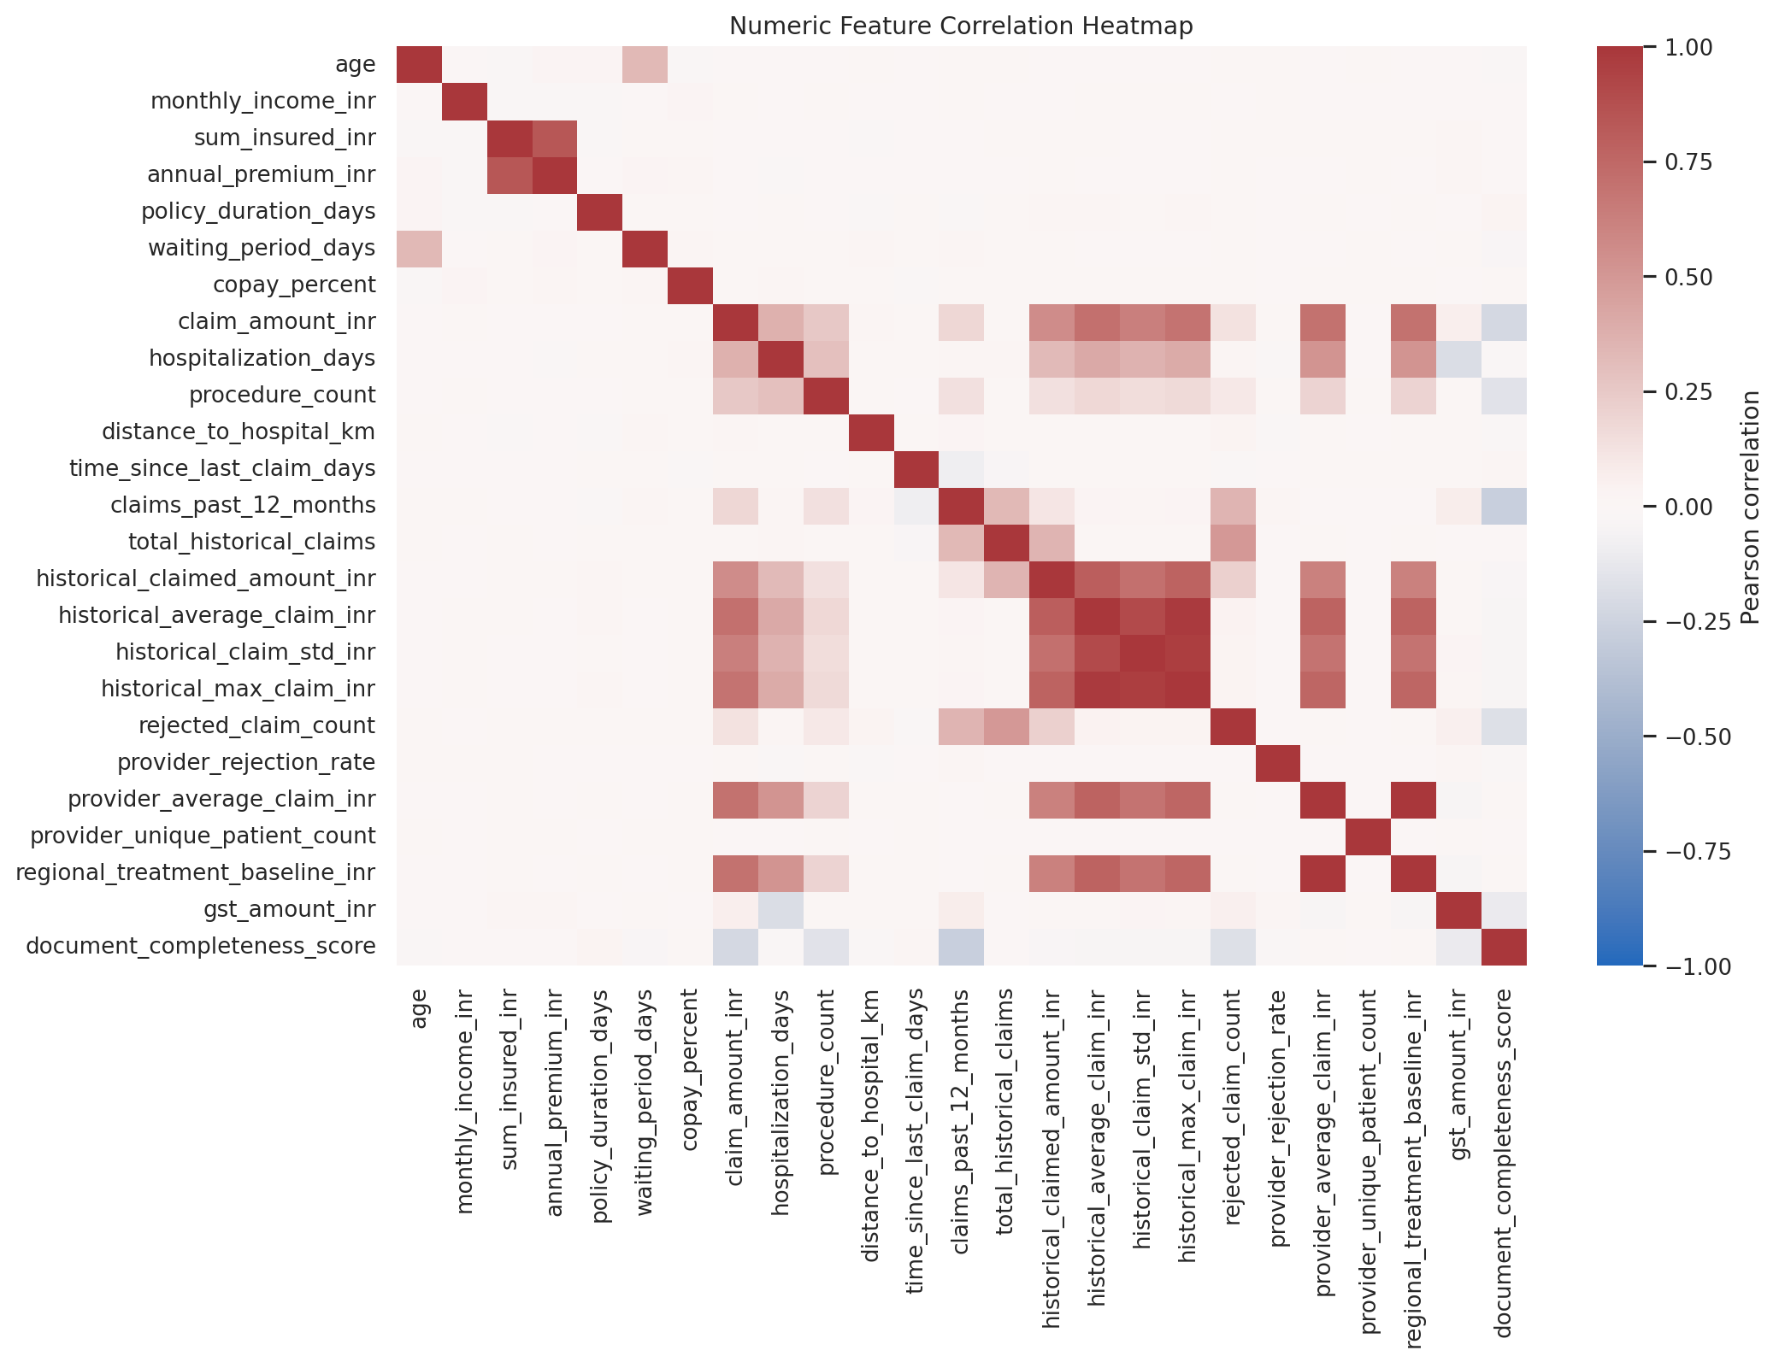
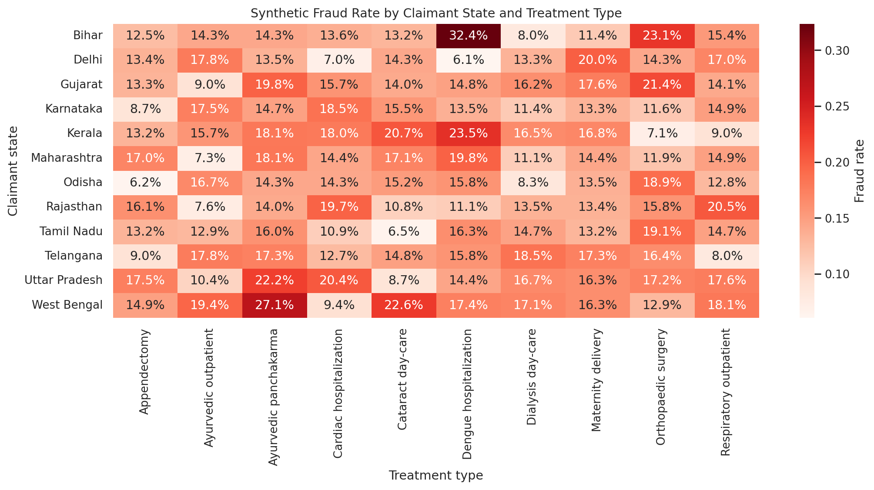
Exploratory Data Analysis
Right-skewed INR costs and regional/treatment heterogeneity
IIIT Dharwad | Medical Insurance Claim Fraud Detection | Approach 1
6

Slide 7
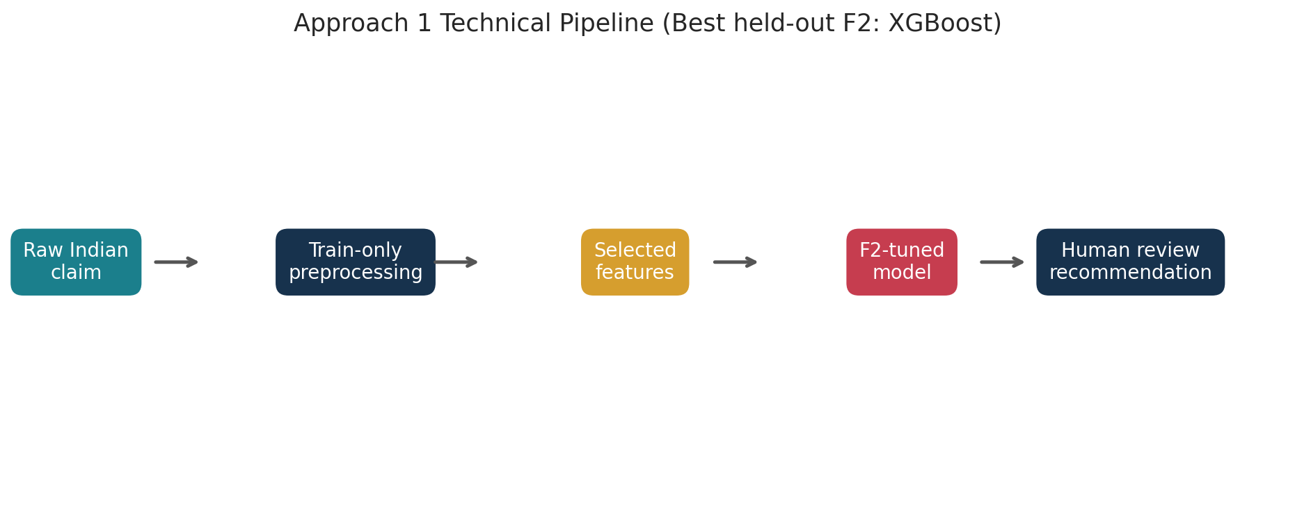
Leakage-Aware Preprocessing
All learned transforms fit on training data only
Exact duplicate removal; missingness audit; plausible outliers retained as potential signal.
Median/mode imputation, robust scaling, one-hot low-cardinality encoding and smoothed target encoding for high-cardinality features.
Mutual-information selection: 162 transformed inputs → 60 selected inputs.
Validation chooses threshold; held-out test is evaluated once.
IIIT Dharwad | Medical Insurance Claim Fraud Detection | Approach 1
7

Slide 8
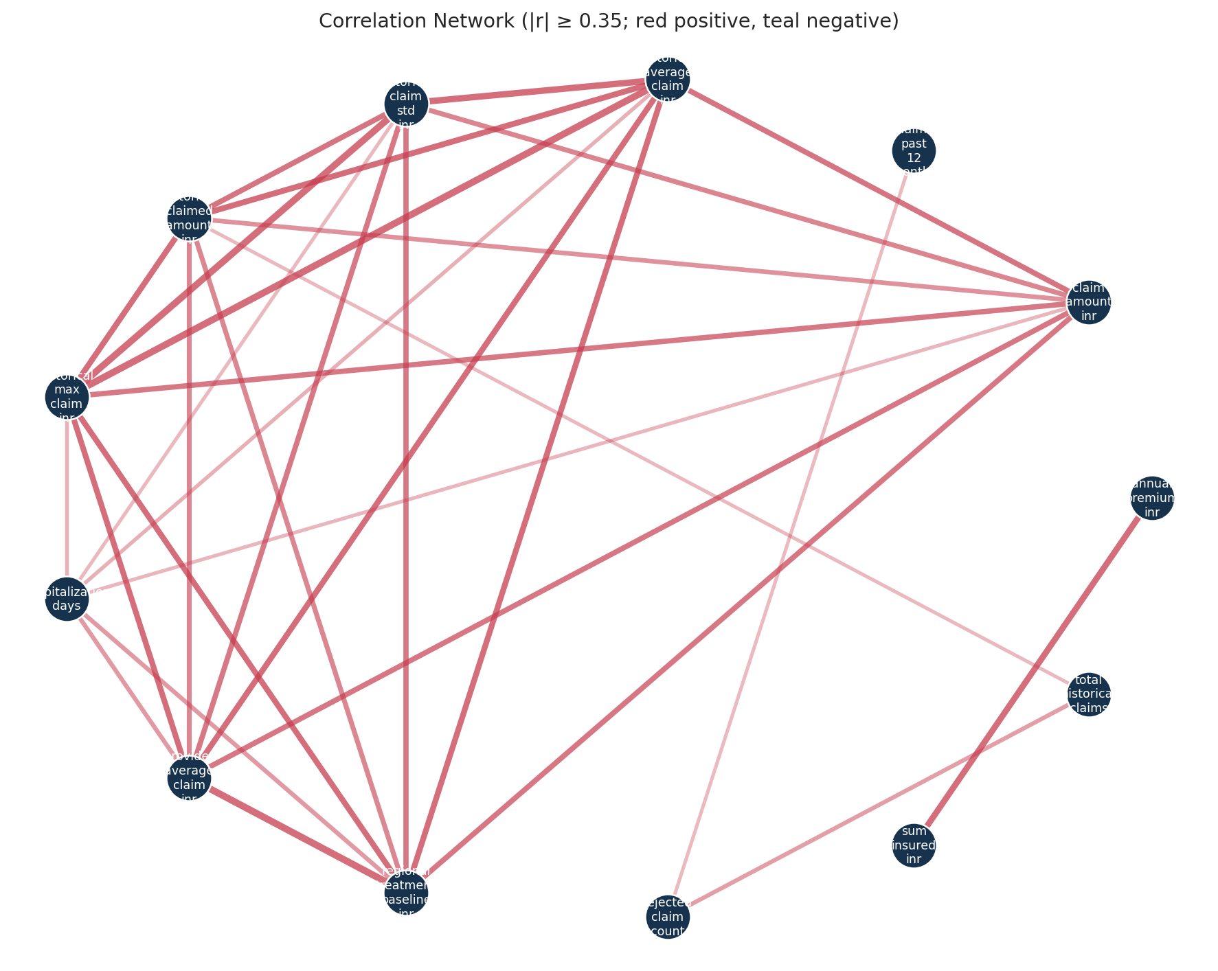
Feature Engineering
Domain knowledge expressed as auditable features
Claim-to-premium and claim-to-sum-insured ratios
Regional treatment-cost deviation and amount per hospital day
Days relative to waiting-period end and claim-frequency intensity
Current-to-history amount ratio; provider-risk × distance interaction
Limited squared amount/stay terms—no uncontrolled feature explosion
IIIT Dharwad | Medical Insurance Claim Fraud Detection | Approach 1
8

Slide 9
Model Suite
Thirteen+ classical classifiers under one F2-first protocol
Linear: L1/L2 Logistic Regression; QDA; Gaussian and Multinomial Naive Bayes
Trees/ensembles: Decision Tree, Random Forest, Histogram GB, AdaBoost, XGBoost, LightGBM
Geometry: Linear/RBF SVM and KNN
Bridge model: shallow neural network with Adam/early stopping
5-fold stratified CV; grid search for small spaces and random search for broader tree/NN spaces
IIIT Dharwad | Medical Insurance Claim Fraud Detection | Approach 1
9

Slide 10
Class-Imbalance Strategy
Recall is important, but must be balanced against false flags
Compared: class-weighted learning, random undersampling, Tomek links, SMOTE and SMOTEENN.
Sampling is fit only on train data. Validation determines F2 threshold.
The full benchmark uses consistent class-aware settings; results disclose precision, recall, PR-AUC, MCC and INR proxy cost.
random_under: validation F2=0.970, recall=0.974
tomek: validation F2=0.970, recall=0.970
class_weight: validation F2=0.964, recall=0.963
smote: validation F2=0.962, recall=0.970
smoteenn: validation F2=0.962, recall=0.970
IIIT Dharwad | Medical Insurance Claim Fraud Detection | Approach 1
10

Slide 11
Evaluation Design
Why F2, PR-AUC, costs and paired tests are all necessary
F2 is primary: false negatives receive greater weight because missed suspicious claims can be costly.
PR-AUC complements ROC-AUC when fraud is minority class; MCC remains informative under imbalance.
Threshold scans run on validation only—not default 0.50.
McNemar exact test compares same-test predictions; Wilcoxon compares CV folds.
Costs are illustrative: missed synthetic fraud amount + ₹3,500 review/friction per false flag.
IIIT Dharwad | Medical Insurance Claim Fraud Detection | Approach 1
11

Slide 12
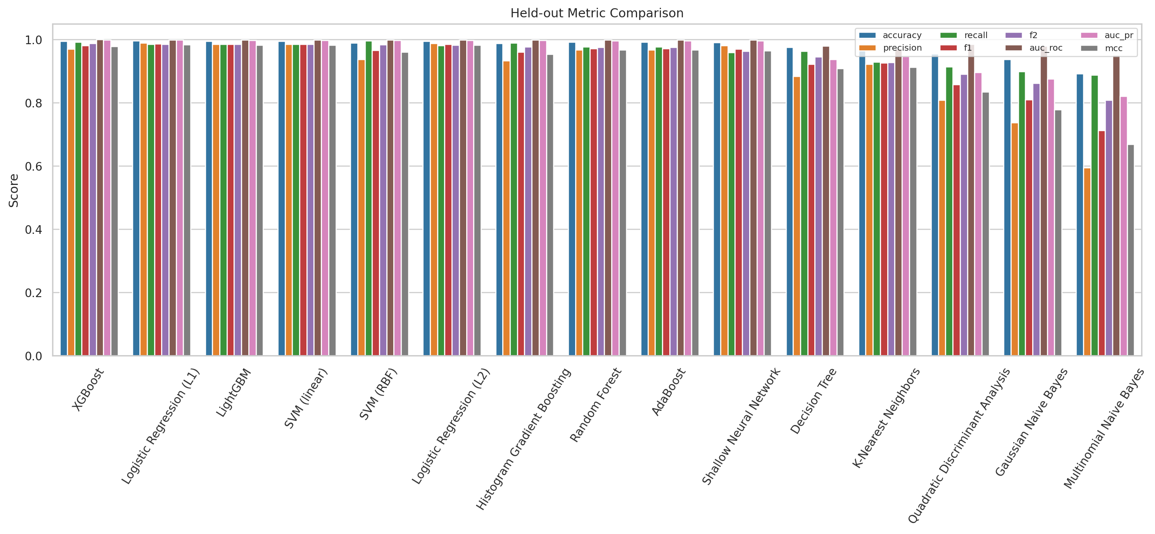
Held-out Benchmark
Ranked by F2, then ROC-AUC; test set untouched until final evaluation
IIIT Dharwad | Medical Insurance Claim Fraud Detection | Approach 1
12

Slide 13
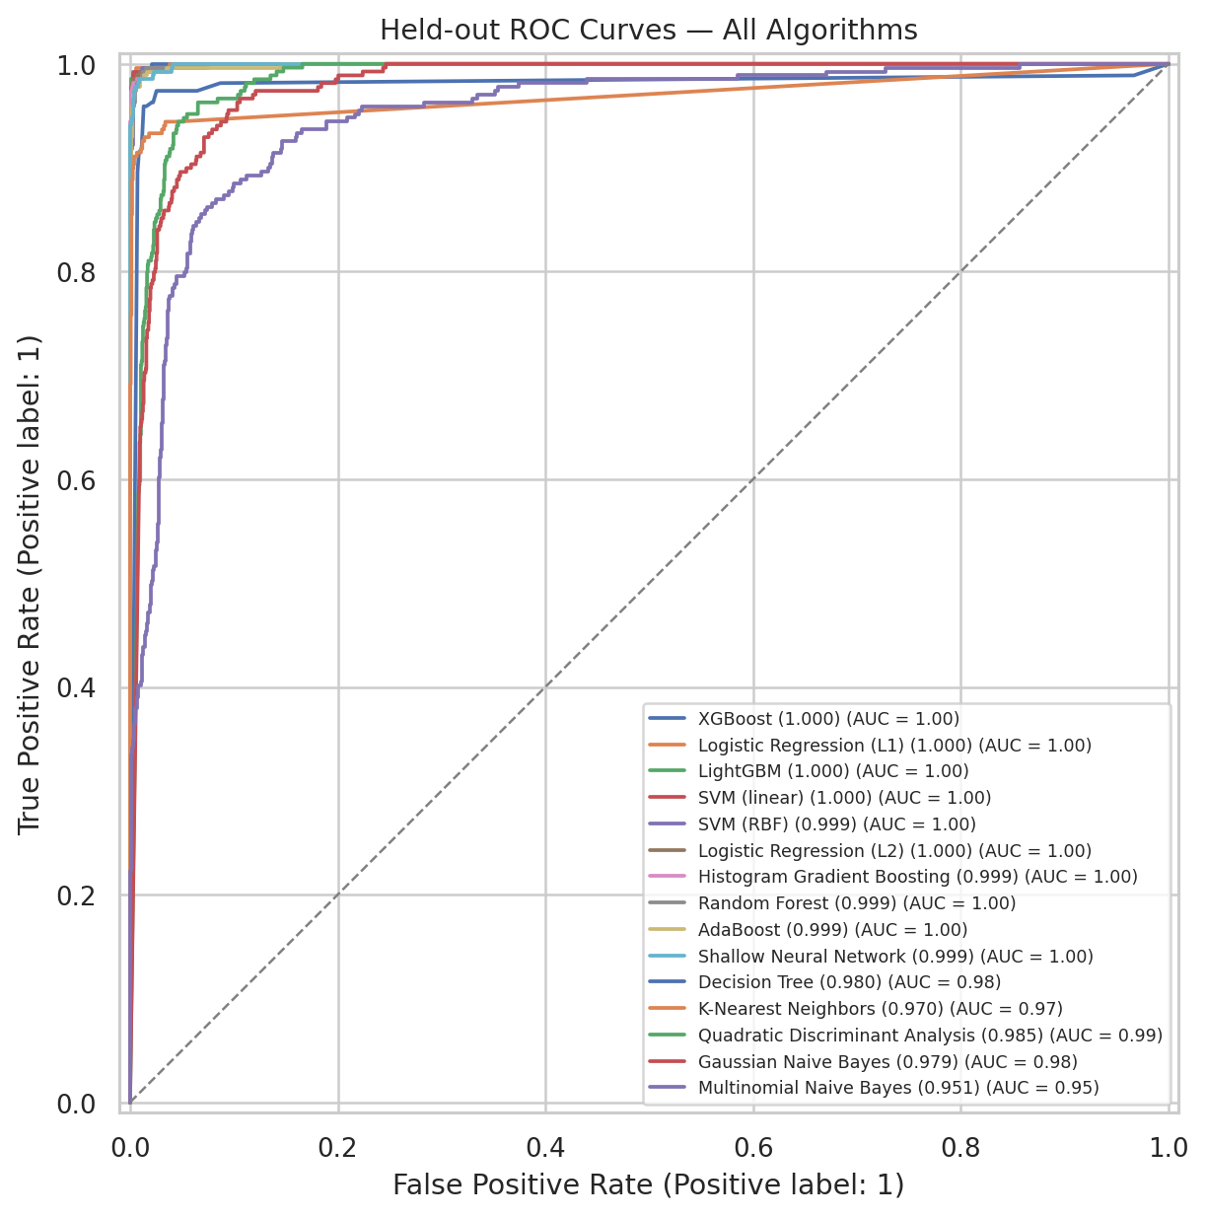
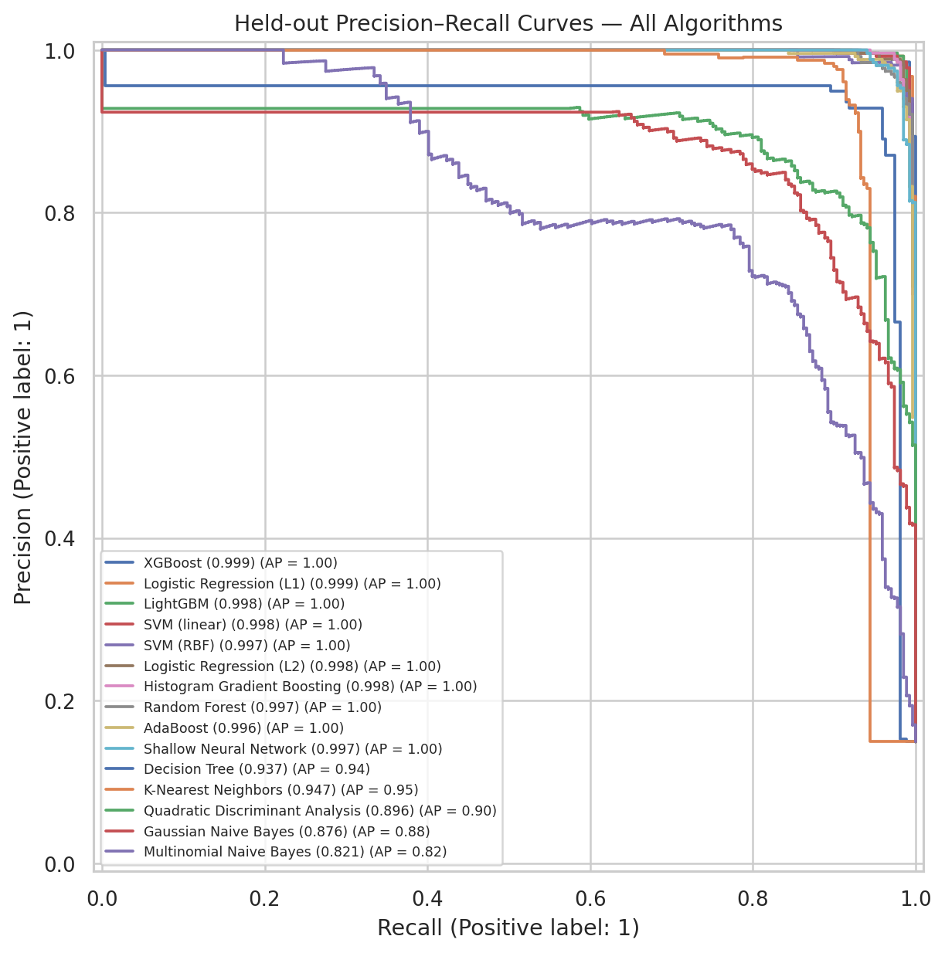
ROC and PR Curves
PR curves reveal positive-class performance under imbalance
IIIT Dharwad | Medical Insurance Claim Fraud Detection | Approach 1
13

Slide 14
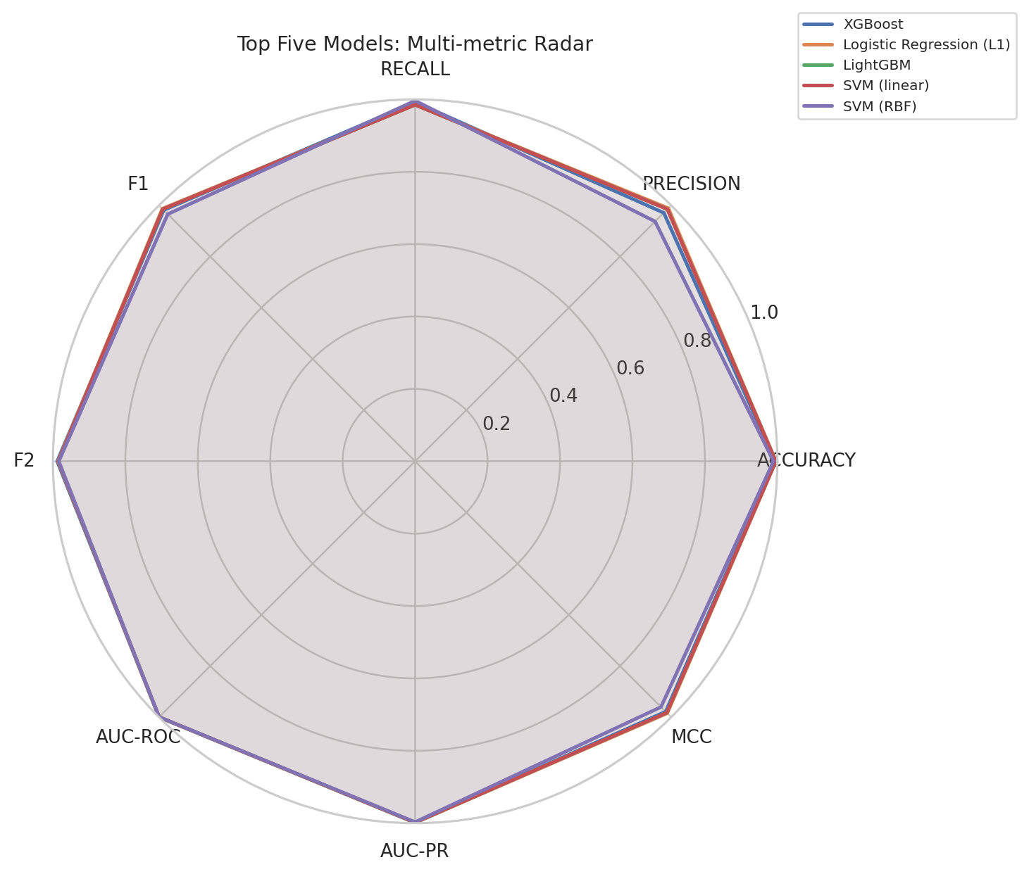
Best-Performer Summary
Held-out leader: XGBoost
F2 = 0.988; Recall = 0.993; Precision = 0.971
ROC-AUC = 1.000; PR-AUC = 0.999; MCC = 0.978
Validation-selected threshold = 0.295
Training/tuning = 4.79s; latency = 0.0025 ms/claim
This result describes the synthetic test set only.
IIIT Dharwad | Medical Insurance Claim Fraud Detection | Approach 1
14

Slide 15
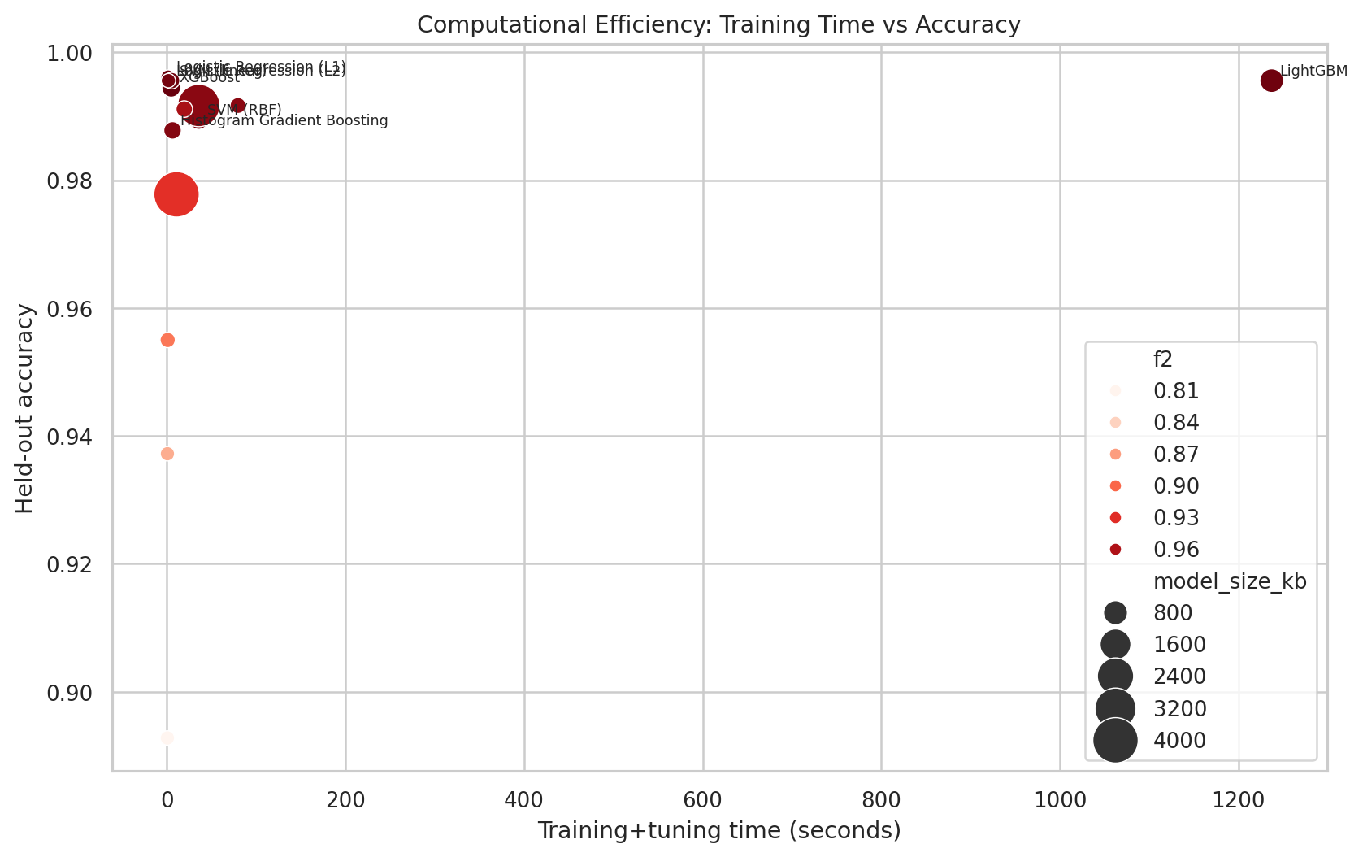
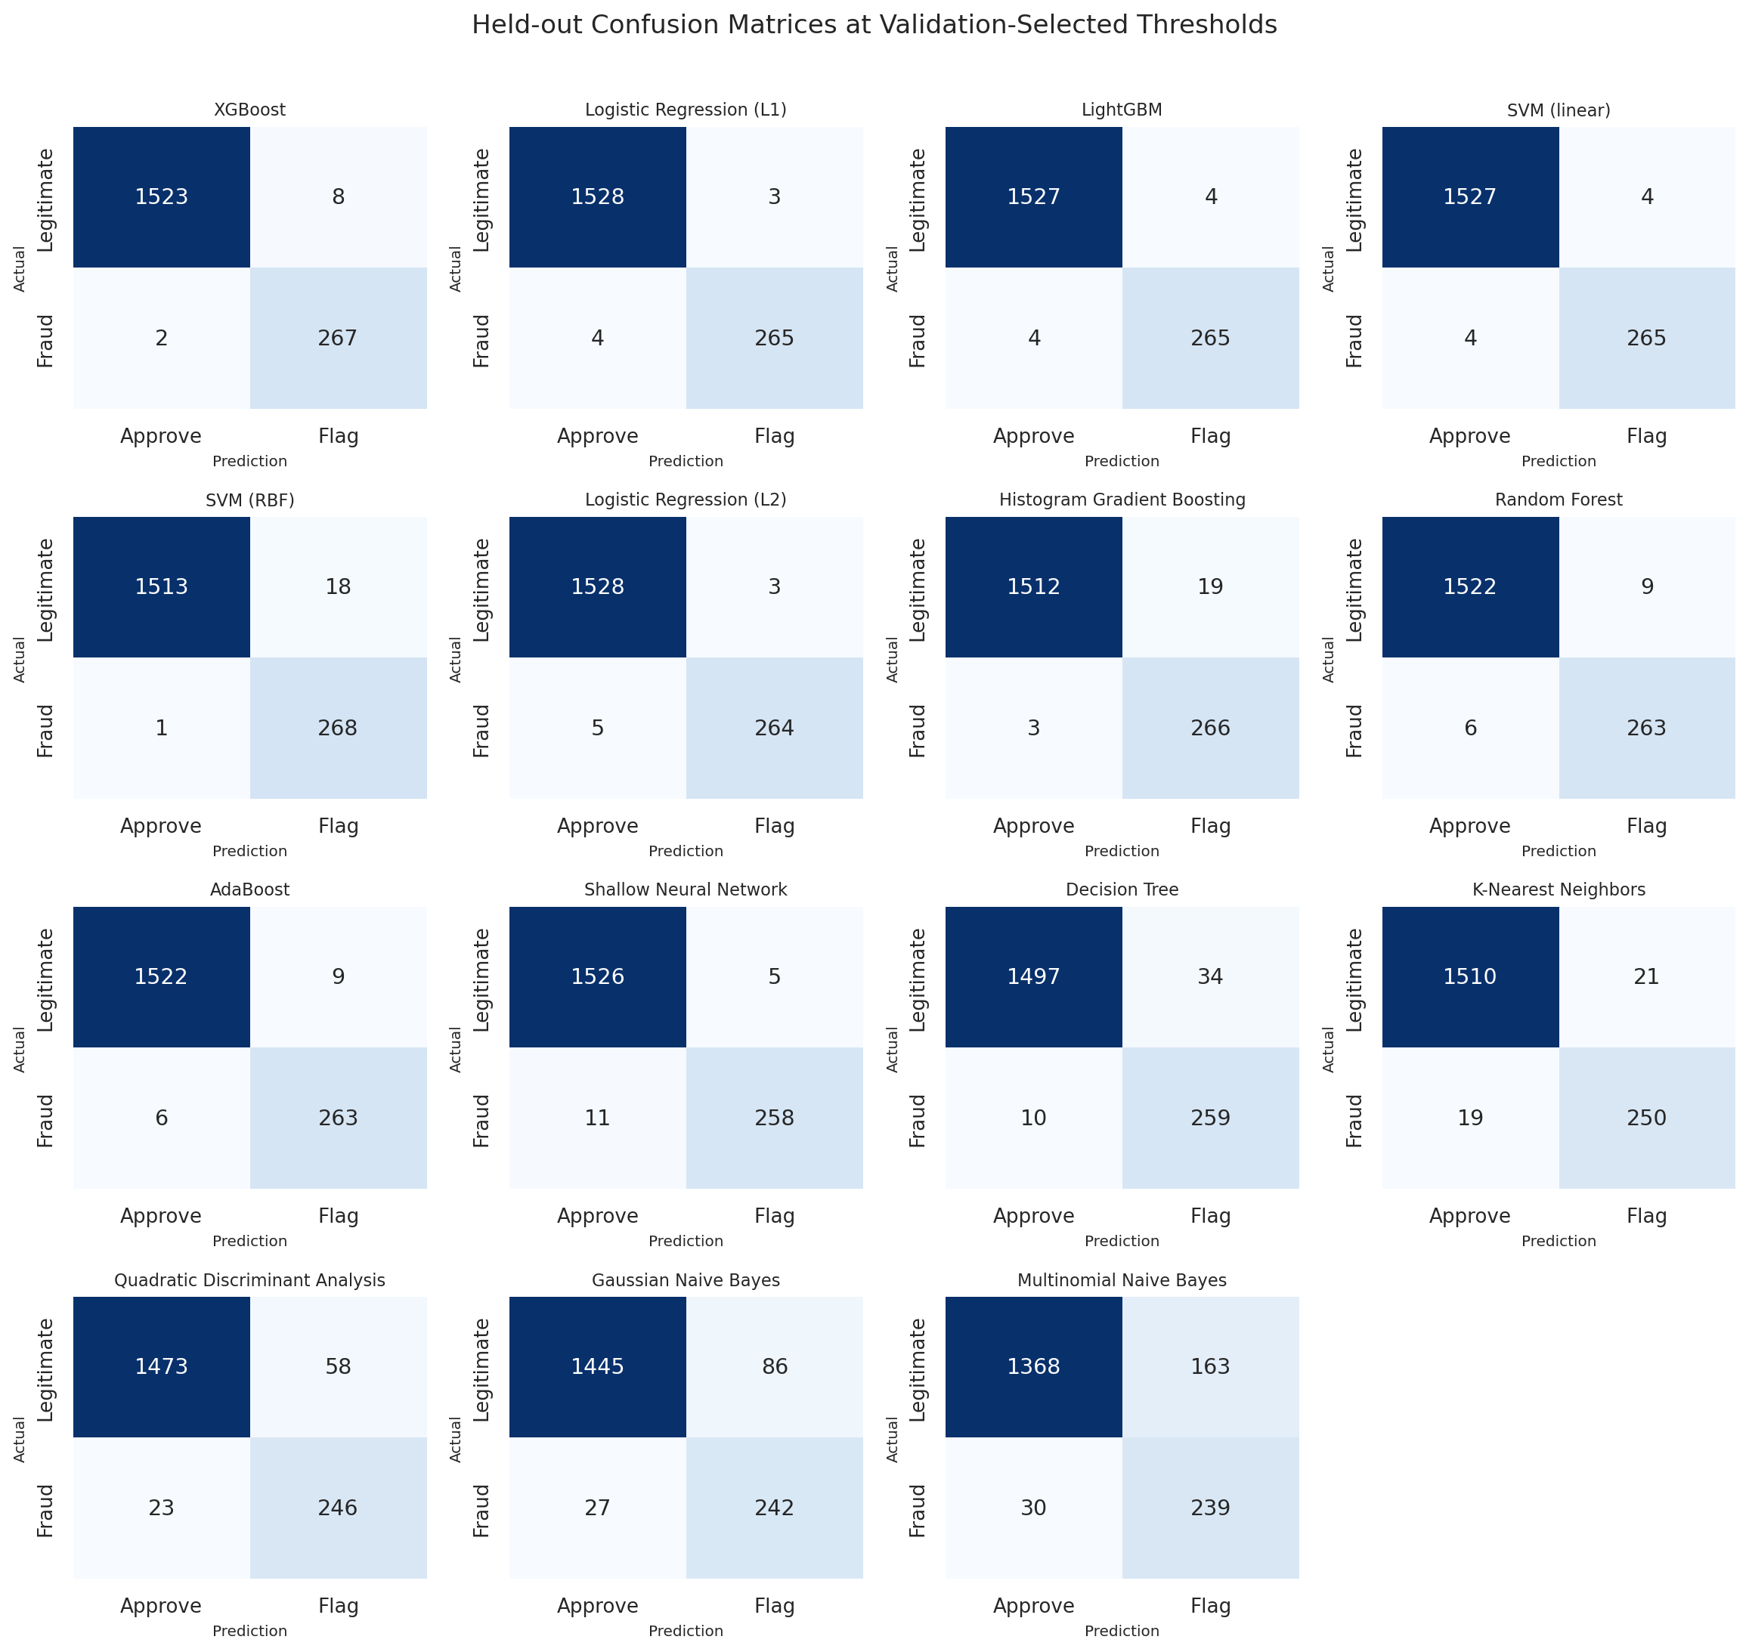
Computational Efficiency
Operational choice needs more than a single score
IIIT Dharwad | Medical Insurance Claim Fraud Detection | Approach 1
15

Slide 16
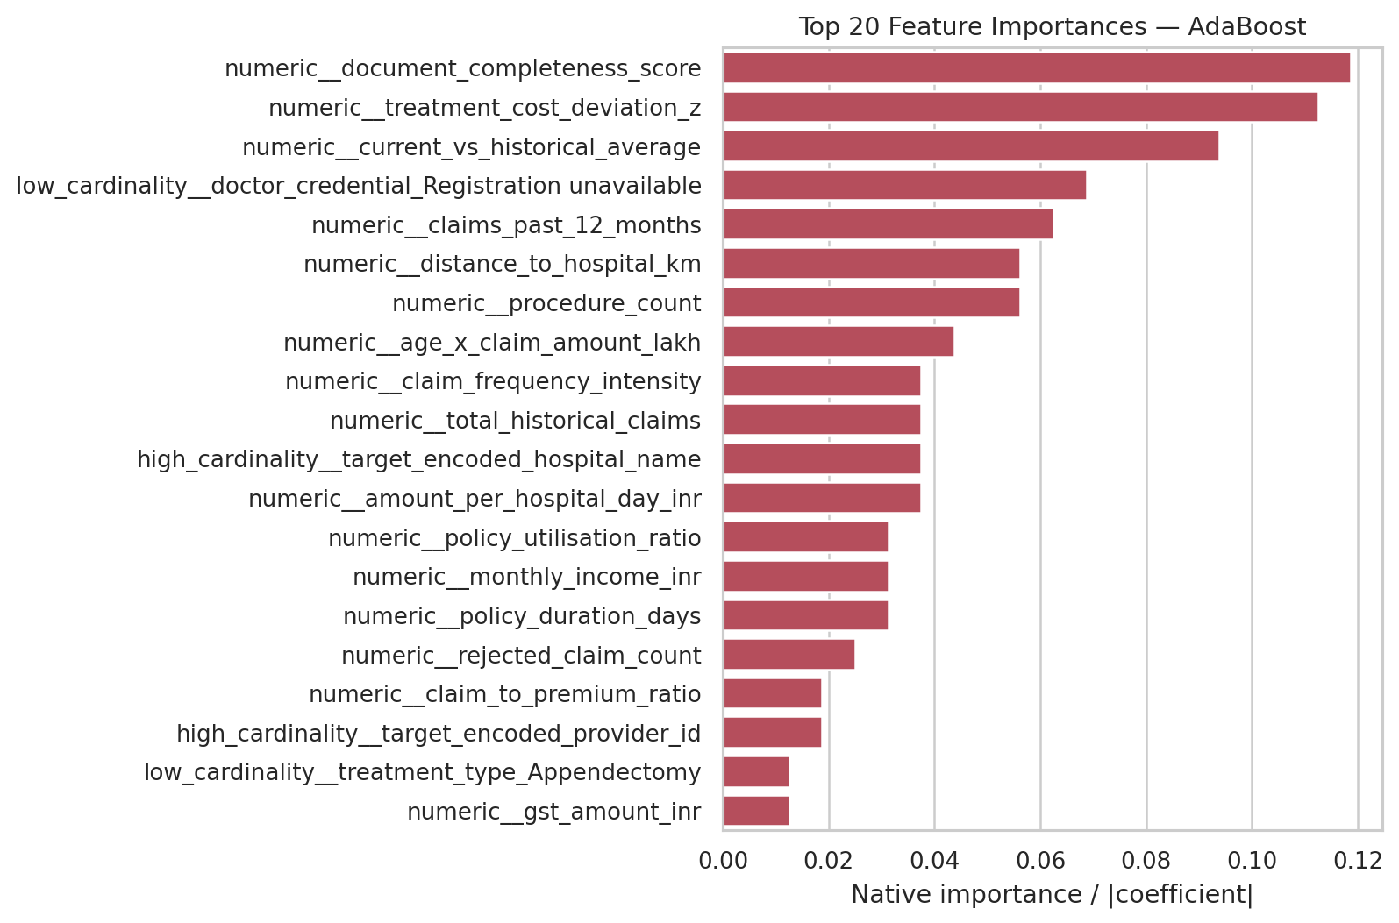
Model Interpretability
Associations guide review; they do not prove fraud
Coefficients/rules/tree importances identify inputs associated with synthetic risk.
A claimant-facing explanation must cite verifiable documents/policy clauses, not merely a model feature.
High-risk recommendation → human investigator verifies billing, coverage and clinical evidence.
No demographic attribute should be an adverse-decision reason.
IIIT Dharwad | Medical Insurance Claim Fraud Detection | Approach 1
16

Slide 17
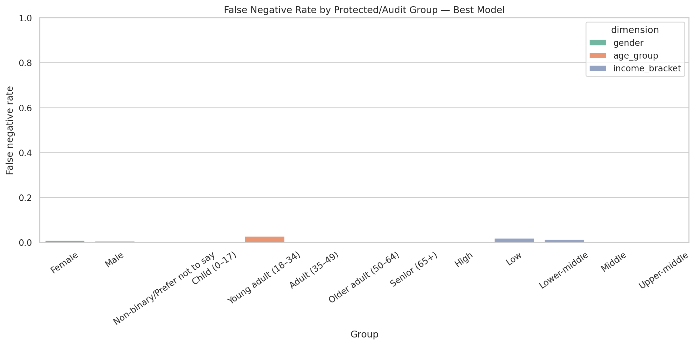
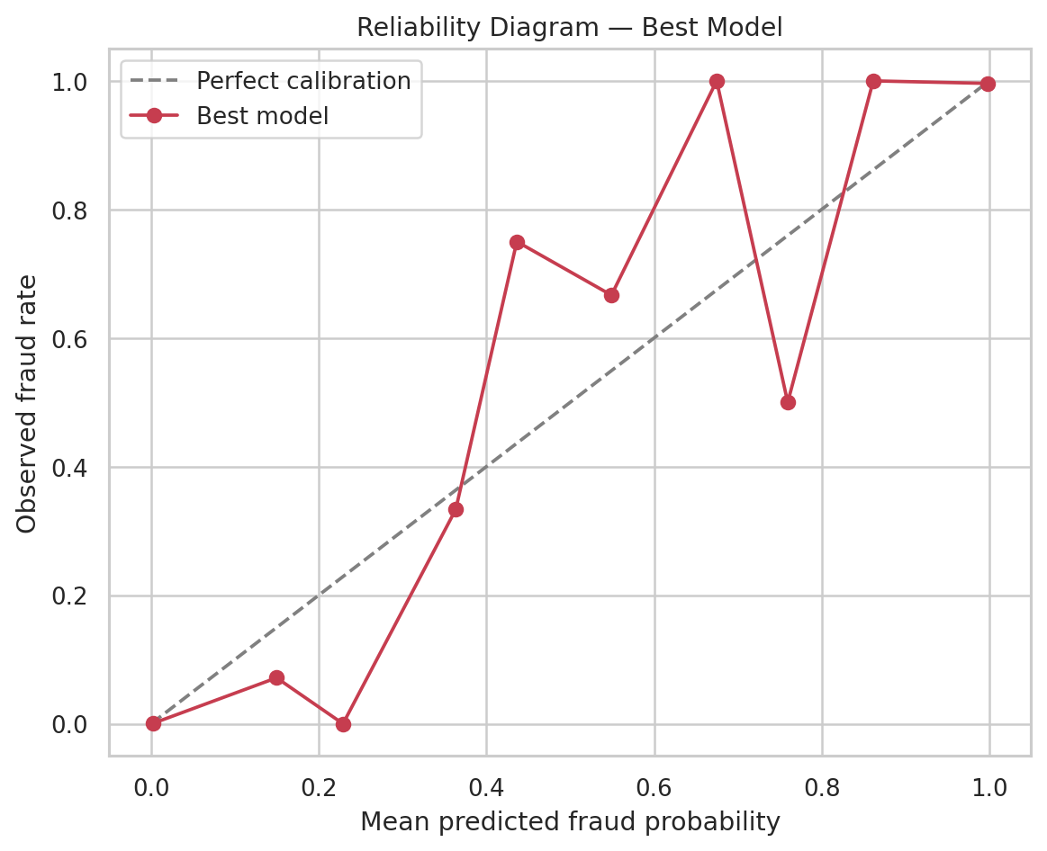
Fairness and Calibration
Audit outcomes across groups; investigate disparities
IIIT Dharwad | Medical Insurance Claim Fraud Detection | Approach 1
17

Slide 18
Strengths, Limitations and Approach Comparison
Responsible interpretation of an academic baseline
Strengths: reproducibility, Indian-context assumptions, broad model suite, threshold/cost/fairness evidence and explainability assets.
Limits: labels and mechanisms are synthetic; random claim split can retain correlated entities; provider history is a proxy.
Approach 2 will test learned embeddings/temporal neural representations on this frozen split; Approach 3 will add document/RAG evidence and human checkpoints.
No model output may automatically reject a person’s claim; production needs governed data, validation, privacy/security, monitoring, appeal and human accountability.
IIIT Dharwad | Medical Insurance Claim Fraud Detection | Approach 1
18

Slide 19
Conclusion, Future Work and References
Key takeaways and reproducibility direction
15 models were evaluated under a consistent, F2-led synthetic protocol; the leader is XGBoost (F2 0.988).
Validation-selected thresholds and INR proxy cost expose operational trade-offs; fairness/calibration/interpretability are required alongside discrimination metrics.
Next: entity-disjoint and temporal validation, insurer-approved labels, policy-specific coverage rules, Approach-2 neural tests and Approach-3 evidence-grounded review.
References include Phua et al. (2010), Joudaki et al. (2015), Chawla et al. (2002), Chen & Guestrin (2016), Ke et al. (2017), Lundberg & Lee (2017), Hardt et al. (2016) and IRDAI (2024). Full list in documentation.
IIIT Dharwad | Medical Insurance Claim Fraud Detection | Approach 1
19

Slide 20
Thank You
Questions and discussion
Medical Insurance Claim Fraud Detection
IIIT Dharwad — Department of Data Science and AI
Faculty Adviser: Ramesh Athe
Team: B Varshith | M Jagadeshwar | J Ganesh
Contact: project team via IIIT Dharwad academic channel
IIIT Dharwad | Medical Insurance Claim Fraud Detection | Approach 1
20

