Slide 1
Medical Insurance Claim Fraud Detection
Approach 3 — Agent AI Multi-Agent System
IIIT Dharwad — Department of Data Science and AI
Faculty Adviser: Ramesh Athe
Team: B Varshith, M Jagadeshwar, J Ganesh
2026

Slide 2
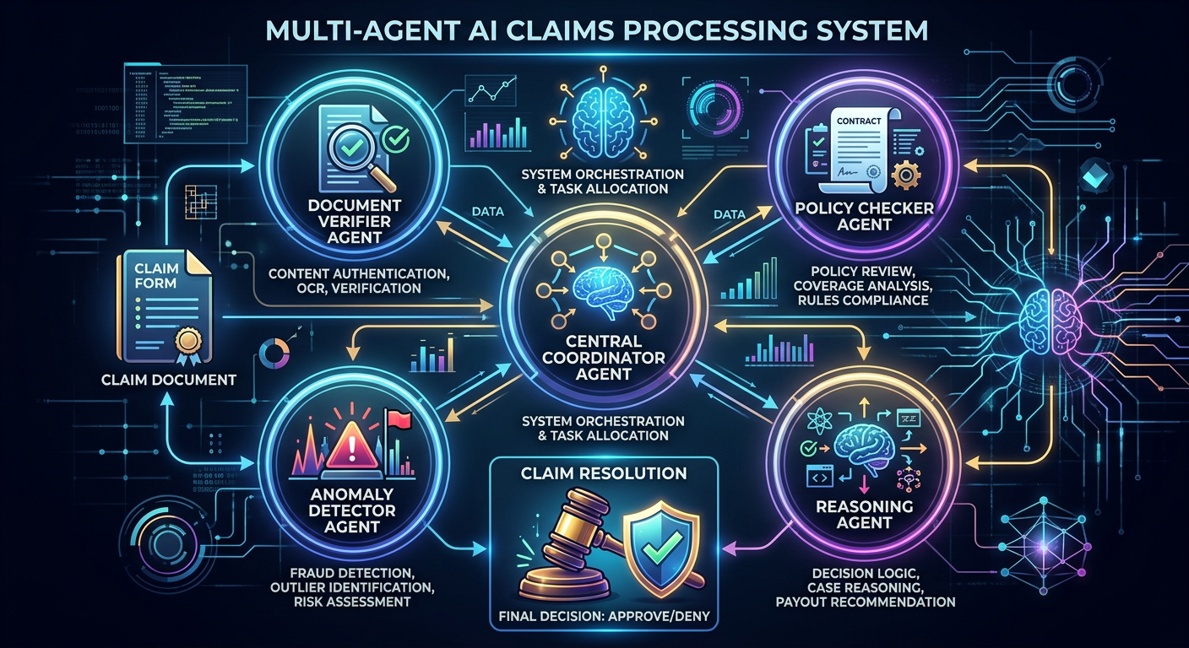
Overview
• Coordinator orchestrates 5 specialised agents.
• Each agent verifies a different aspect of the claim.
• Reasoning agent synthesises findings into an explainable verdict.
• Verdicts: Approved / Flagged / Rejected with natural-language explanation.

Slide 3
Agents
• Eligibility/Document agent — completeness & plausibility of claim fields.
• Policy agent — coverage, waiting-period and cost baselines.
• Anomaly agent — cost/age/temporal deviations from norms.
• Historical agent — provider-level and percentile risk signals.
• Reasoning agent — risk aggregation and decision with evidence.

Slide 4
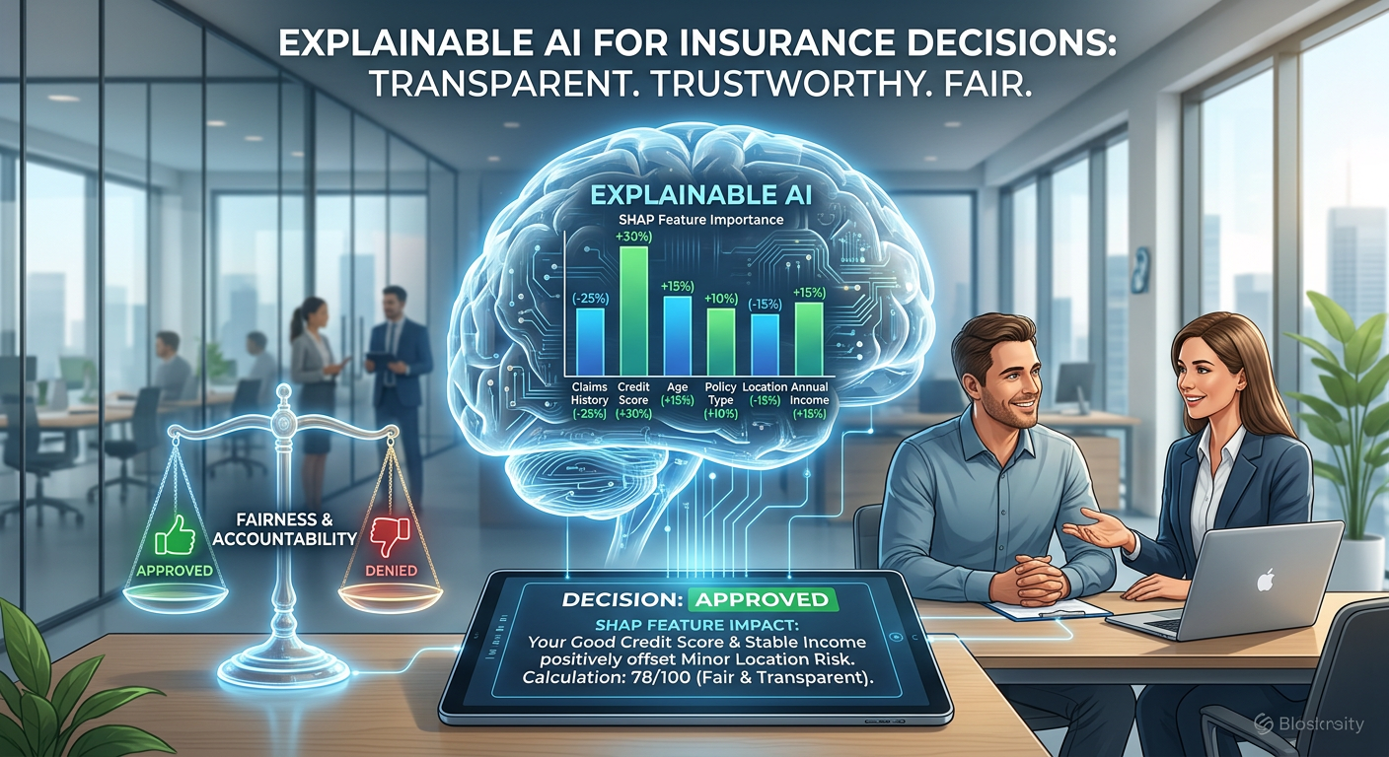
Explainability
• Every decision cites specific, reproducible evidence.
• Layer detail: summary -> detailed findings -> technical appendix.
• Designed for regulator-friendly, policyholder-understandable decisions.

Slide 5

Results & Deployment
• Aggregate accuracy/precision/recall/F2 on held-out claims.
• Sample decision report shows full agent trail.
• Path to LLM-backed agents (Gemini) + LangGraph orchestration + Next.js UI.

Slide 6
Conclusions
• Agent AI delivers the most explainable, auditable decisions.
• Complements ML and DL approaches with human-readable reasoning.

Slide 7
Thank You
• IIIT Dharwad — Dept. of Data Science and AI

