Slide 1
Medical Insurance Claim Fraud Detection
Approach 2 — Deep Learning
IIIT Dharwad — Department of Data Science and AI
Faculty Adviser: Ramesh Athe
Team: B Varshith, M Jagadeshwar, J Ganesh
2026

Slide 2
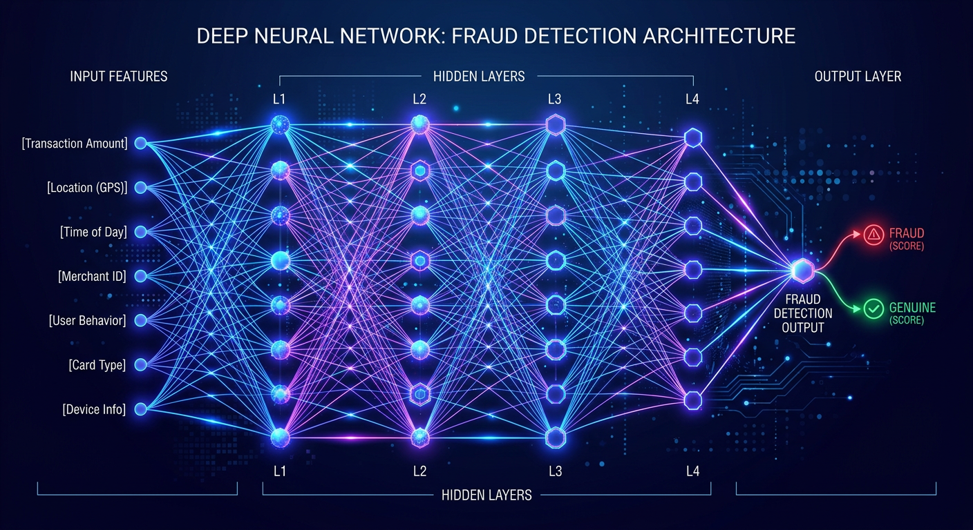
Motivation
• Neural networks learn complex non-linear feature interactions automatically.
• 10 architectures evaluated on the same data/test set as Approach 1.
• Weighted-BCE + focal-style imbalance handling; entity embeddings.
• Goal: advance beyond the interpretable ML baseline.

Slide 3
Architectures
• Supervised: MLP, Wide & Deep, DCN, TabNet, Transformer, ResNet, NODE, LSTM.
• Unsupervised anomaly: Autoencoder, VAE (trained on legitimate claims only).
• All classifiers end in a sigmoid head producing a fraud probability.
• Regularisation: dropout, batch norm, early stopping, gradient clipping.

Slide 4
DL Benchmarking Results (ranked by F2)
Model
Acc
Prec
Rec
F1
F2
AUC
WideAndDeep
0.987
0.844
0.950
0.894
0.927
0.998
Transformer
0.981
0.765
0.975
0.857
0.924
0.997
DCN
0.979
0.760
0.950
0.844
0.905
0.996
TabNet
0.963
0.615
1.000
0.762
0.889
0.996
MLP
0.975
0.725
0.925
0.813
0.877
0.997
ResNet
0.966
0.644
0.950
0.768
0.868
0.991
NODE
0.960
0.607
0.925
0.733
0.837
0.987
LSTM
0.956
0.578
0.925
0.712
0.826
0.988
Autoencoder
0.890
0.302
0.650
0.413
0.528
0.901
VAE
0.884
0.289
0.650
0.400
0.520
0.896

Slide 5
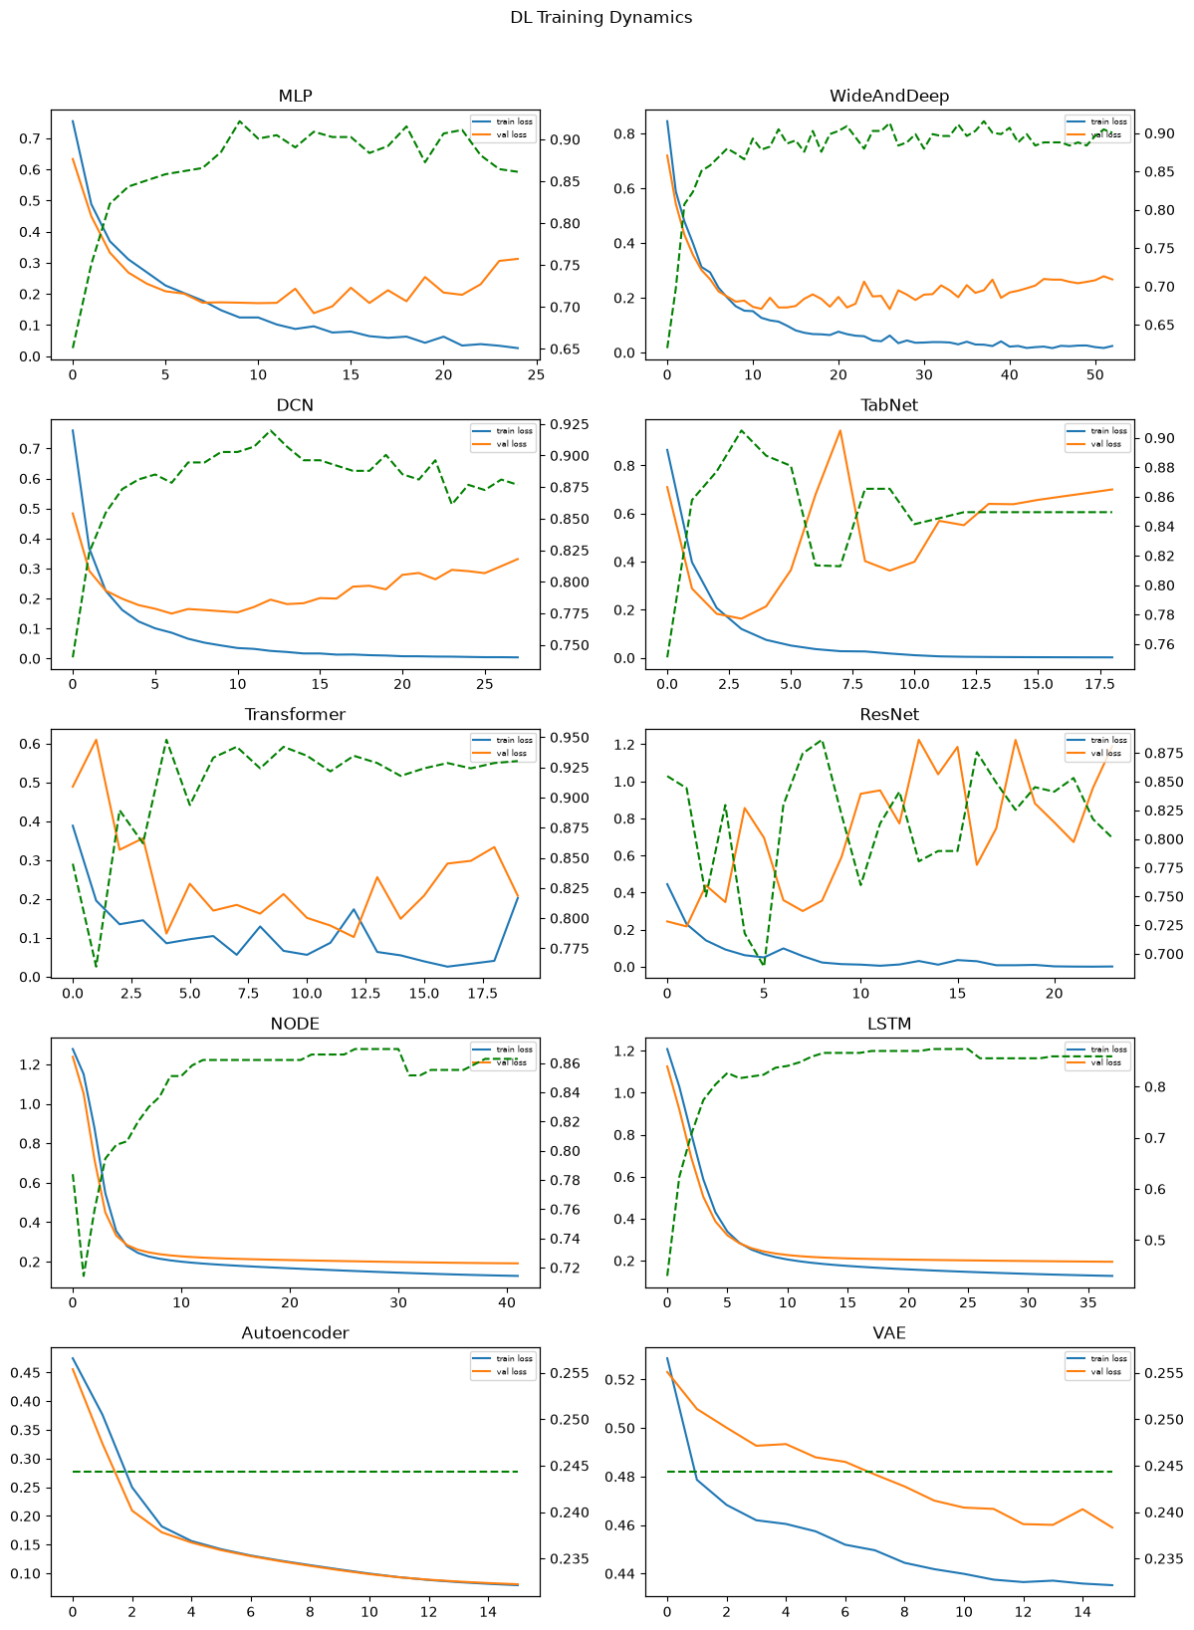
Training Dynamics
Train/val loss and validation F2 per epoch for every architecture.

Slide 6
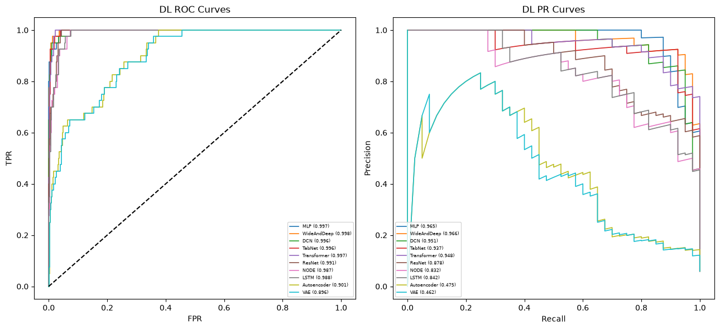
ROC & Precision-Recall Curves
DL classifiers achieve AUC-ROC 0.99+, PR curves confirm strong precision-recall.

Slide 7
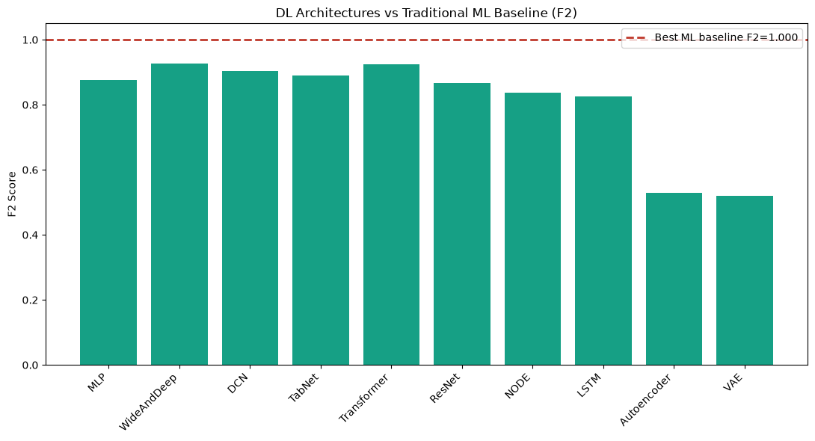
Comparison vs Traditional ML Baseline (F2)
Deep models are competitive with the best tree-based ML baseline.

Slide 8
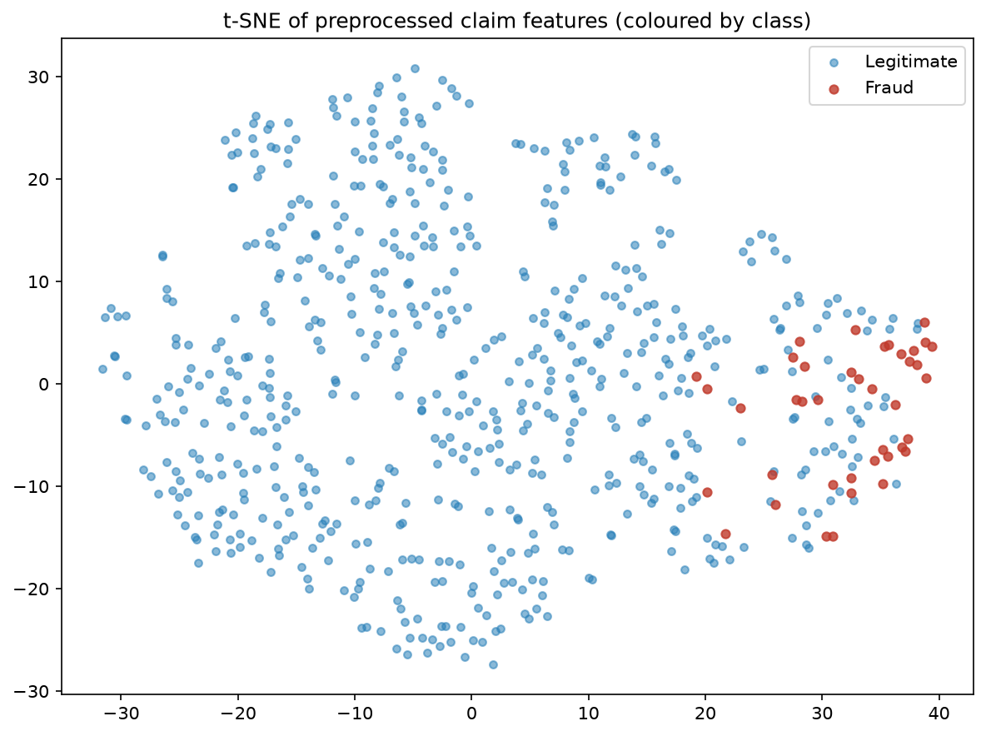
Embedding Visualisation (t-SNE)
Fraud and legitimate claims are largely separable in feature space.

Slide 9
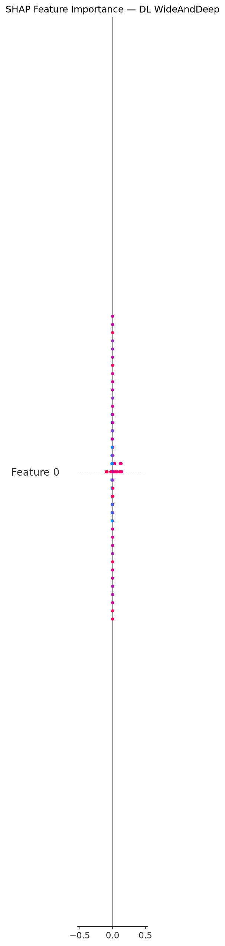
SHAP Feature Attribution
Feature-level SHAP importance for the best deep-learning classifier.

Slide 10
Statistical Robustness
• Bootstrap 95% confidence intervals computed for AUC-ROC and AUC-PR.
• Early stopping + fixed seeds ensure reproducible training.
• Unsupervised AE/VAE reconstruct legitimate claims; high reconstruction
• error flags anomalies (AUC-ROC ≈ 0.90 as one-class detectors).

Slide 11
Strengths & Limitations
• Strengths: automatic feature hierarchy, high capacity, competitive F2.
• Limitations: more compute, less inherently interpretable than trees.
• Wide & Deep (F2 0.927) and Transformer (0.924) are the strongest.

Slide 12
Conclusions
• Best DL: WideAndDeep (F2=0.927, AUC-ROC=0.998) if best else 'Best DL identified'.
• Deep learning matches/advances the traditional ML baseline.

Slide 13
Future Work
• DL+ML ensembles, MC-dropout uncertainty, calibration, deployment API.

Slide 14
Thank You
• IIIT Dharwad — Dept. of Data Science and AI

