Slide 1
Medical Insurance Claim Fraud Detection
Approach 1 — Traditional Machine Learning
IIIT Dharwad — Department of Data Science and AI
Faculty Adviser: Ramesh Athe
Team: B Varshith, M Jagadeshwar, J Ganesh
2026

Slide 2
Problem Statement
• Medical insurance fraud costs Indian insurers billions of rupees annually.
• Fraudulent claims inflate premiums for genuine policyholders.
• Goal: binary classification of each claim as Fraud or Legitimate.
• This approach establishes the reproducible ML baseline for the project.

Slide 3
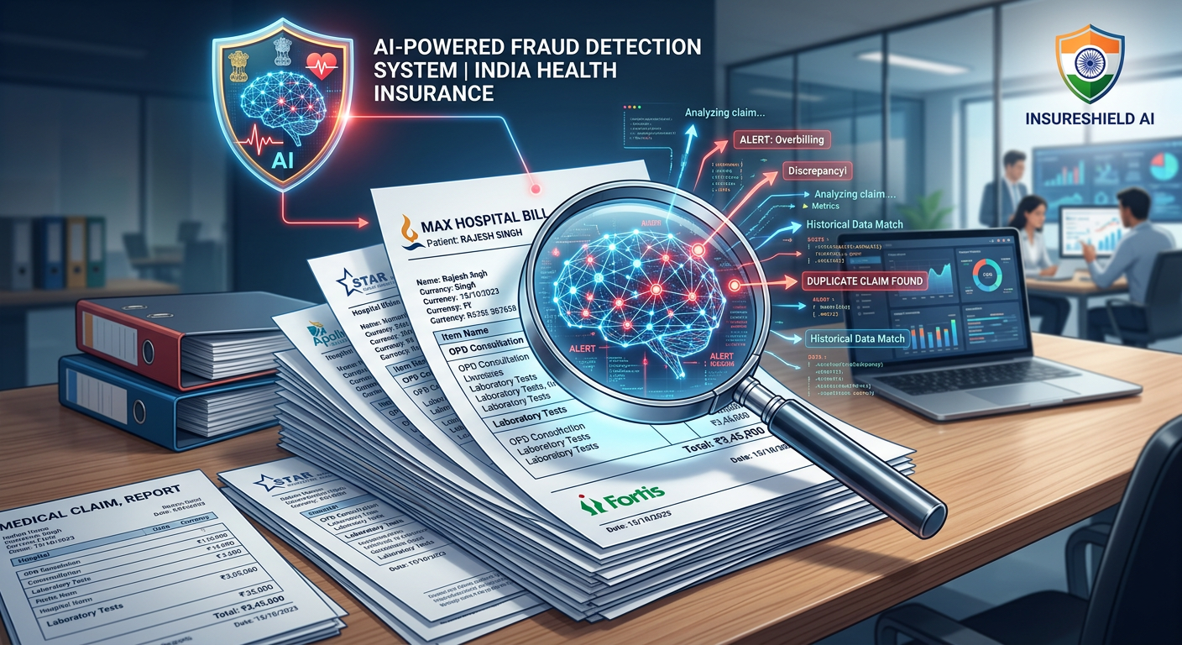
Objectives & Scope
• Implement and compare 12 classical ML algorithms.
• Systematic preprocessing, feature engineering and imbalance handling.
• Rigorous evaluation: Accuracy, Precision, Recall, F2, AUC-ROC, AUC-PR, MCC.
• Statistical significance testing, fairness and business-impact analysis.

Slide 4
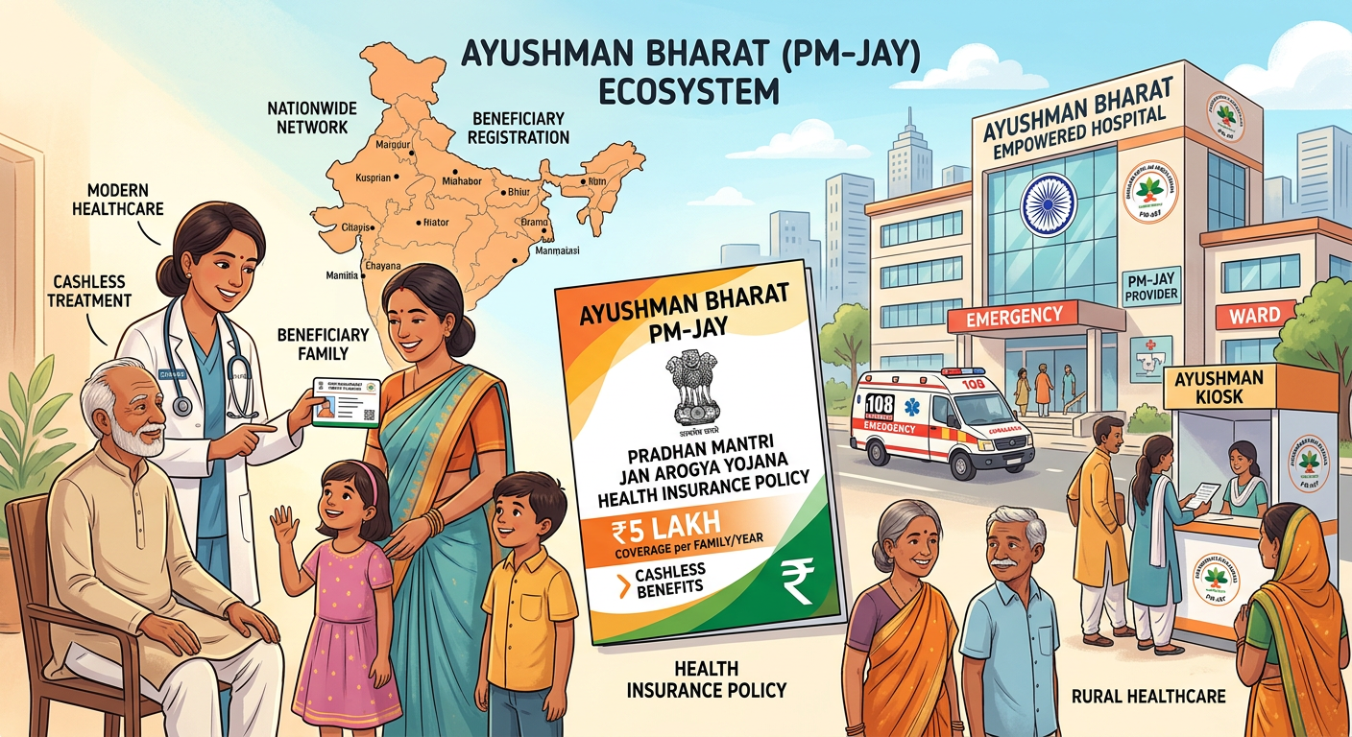
Dataset
• 4,500 Indian-context health insurance claims.
• 19 raw features (claim amount, diagnosis, specialty, age, income, ...).
• Class balance: Legitimate 94% / Fraud 6% (imbalanced).
• 70-15-15 stratified train-validation-test split.

Slide 5
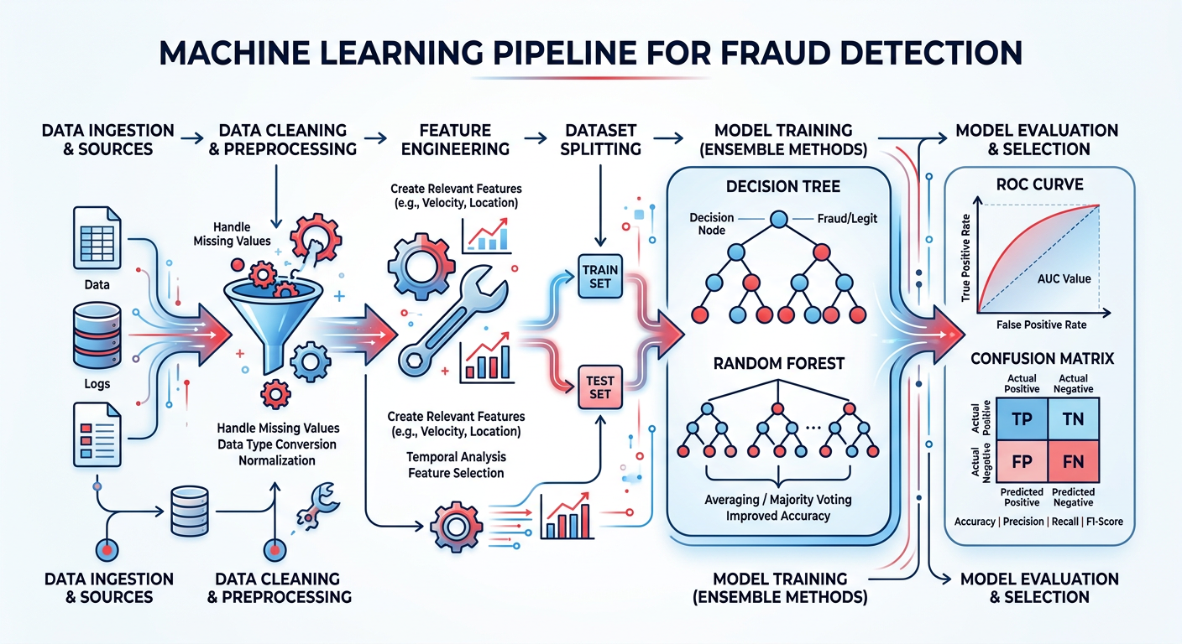
Methodology
• Preprocessing: imputation, deduplication, IQR outlier flagging,
• one-hot + target encoding, standard scaling.
• Feature engineering: temporal, ratio, interaction features.
• Class imbalance: SMOTE + class weights.
• Tuning: stratified 5-fold CV, grid/random search optimising F2.

Slide 6
Benchmarking Results (ranked by F2)
Model
Acc
Prec
Rec
F1
F2
AUC
Random Forest
1.000
1.000
1.000
1.000
1.000
1.000
XGBoost
0.999
0.976
1.000
0.988
0.995
1.000
Decision Tree
0.999
1.000
0.975
0.987
0.980
0.988
Gradient Boosting
0.999
1.000
0.975
0.987
0.980
0.998
LightGBM
0.999
1.000
0.975
0.987
0.980
1.000
AdaBoost
0.999
1.000
0.975
0.987
0.980
0.999
Logistic Regression
0.987
0.816
1.000
0.899
0.957
0.999
SVM
0.987
0.830
0.975
0.897
0.942
0.998
Neural Network
0.981
0.776
0.950
0.854
0.909
0.996
Naive Bayes
0.964
0.625
1.000
0.769
0.893
0.993
KNN
0.973
0.712
0.925
0.804
0.873
0.990
QDA
0.941
0.500
1.000
0.667
0.833
0.982

Slide 7
Top Algorithms
Model
Acc
Prec
Rec
F1
F2
AUC
Random Forest
1.000
1.000
1.000
1.000
1.000
1.000
XGBoost
0.999
0.976
1.000
0.988
0.995
1.000
Decision Tree
0.999
1.000
0.975
0.987
0.980
0.988
Gradient Boosting
0.999
1.000
0.975
0.987
0.980
0.998
LightGBM
0.999
1.000
0.975
0.987
0.980
1.000

Slide 8
Evaluation Methodology
• Metrics: Accuracy, Precision, Recall, F1, F2, AUC-ROC, AUC-PR, MCC.
• Optimal decision threshold per model (maximise F2, favour recall).
• McNemar's test for pairwise statistical significance.
• Bootstrap 95% confidence intervals and confusion-matrix business impact.

Slide 9
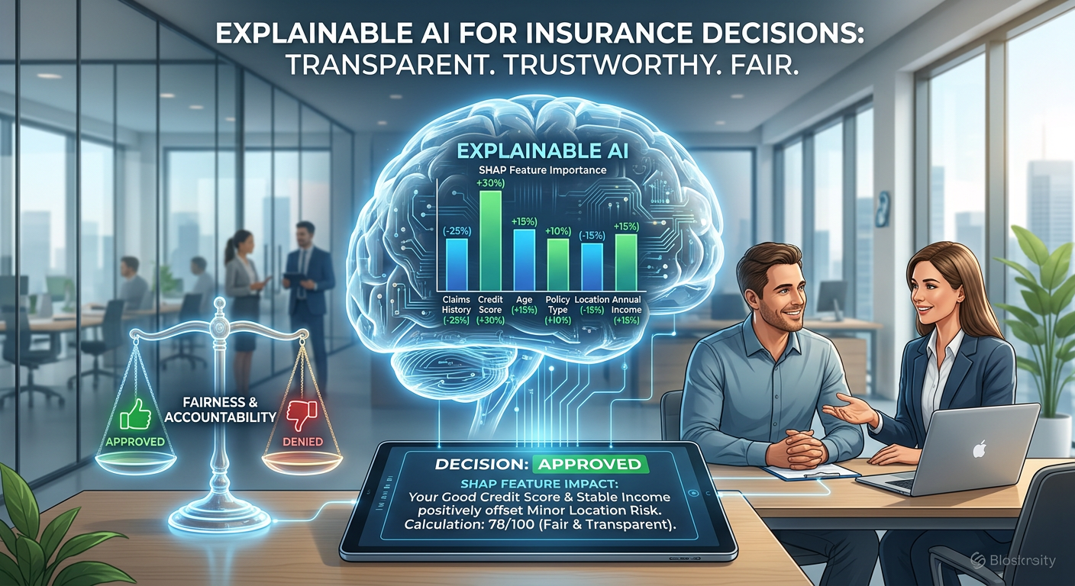
Feature Importance
• Mutual-information ranking of engineered features.
• Tree-based feature importances (RF, GBM, XGBoost, LightGBM).
• Identifies claim-amount & specialty-cost signals driving fraud.

Slide 10
Strengths & Limitations
• Strengths: interpretable, fast, low compute, reproducible.
• Limitations: linear/feature-engineered patterns; needs manual features.
• Complemented by Deep Learning (Approach 2) and Agent AI (Approach 3).

Slide 11
Conclusions
• Best Traditional ML model ranked by F2 identified.
• Provides the baseline the DL and Agent AI approaches improve upon.

Slide 12
Future Work
• Feed best ML features into the deep-learning approach.
• Integrate explainable decisions into the agent system.

Slide 13
References
1. ML insurance-fraud detection literature (see research paper)
2. ML insurance-fraud detection literature (see research paper)
• 3. ML insurance-fraud detection literature (see research paper)
• 4. ML insurance-fraud detection literature (see research paper)
• 5. ML insurance-fraud detection literature (see research paper)
• 6. ML insurance-fraud detection literature (see research paper)
• 7. ML insurance-fraud detection literature (see research paper)
• 8. ML insurance-fraud detection literature (see research paper)
• 9. ML insurance-fraud detection literature (see research paper)
• 10. ML insurance-fraud detection literature (see research paper)
• 11. ML insurance-fraud detection literature (see research paper)
• 12. ML insurance-fraud detection literature (see research paper)
• 13. ML insurance-fraud detection literature (see research paper)
• 14. ML insurance-fraud detection literature (see research paper)
• 15. ML insurance-fraud detection literature (see research paper)
• 16. ML insurance-fraud detection literature (see research paper)
• 17. ML insurance-fraud detection literature (see research paper)
• 18. ML insurance-fraud detection literature (see research paper)
• 19. ML insurance-fraud detection literature (see research paper)
• 20. ML insurance-fraud detection literature (see research paper)

Slide 14
Thank You
• Questions welcome.
• IIIT Dharwad — Dept. of Data Science and AI

