Slide 1
Medical Insurance Claim Fraud Detection
Approach 2 • Deep Learning with Explainable AI
B Varshith • M Jagadeshwar • J Ganesh IIIT Dharwad • Department of Data Science and AI
Faculty Adviser: Prof. Ramesh Athe

Slide 2
Three-approach project arc
A common evidence spine makes comparisons defensible
• Approach 1: classical tabular baseline with interpretable benchmarking
• Approach 2: learned tabular representations plus XAI
• Approach 3: document-grounded multi-agent reasoning
• Approach 2 reuses the frozen Approach 1 split fingerprint
• No approach may move the test set or redefine Fraud=1
IIIT Dharwad • Approach 2 • Prof. Ramesh Athe • run_20260807_155540

Slide 3
Why deep learning for tabular claims?
Hypotheses registered before training
• H1: nonlinear interactions may be learned beyond manual ratios
• H2: attention can expose instance-wise feature usage
• H3: reconstruction error can add an anomaly signal
• H4: token interactions may complement tree baselines
• Risks: overfitting, tuning hunger, instability, and opaque explanations
IIIT Dharwad • Approach 2 • Prof. Ramesh Athe • run_20260807_155540

Slide 4
Comparability spine
Same data and metrics, new model families
• Rows: same supplied workbook and 70/15/15 membership
• Features: same train-fitted imputer, encoder, and scaler
• Labels: Fraud=1 and Legitimate=0
• Metrics: F2, PR-AUC, ROC-AUC, MCC, calibration and fairness
• Test evaluation follows validation selection and XAI asset checks
IIIT Dharwad • Approach 2 • Prof. Ramesh Athe • run_20260807_155540

Slide 5
Five deep architectures
Dense, attention, convolution, anomaly, transformer
• MLP: batch-normalized feed-forward reference
• TabNet-style: sequential soft feature masks
• 1D CNN: local patterns over frozen feature order
• Autoencoder hybrid: reconstruction error plus supervised head
• Feature-token transformer: self-attention across feature tokens
IIIT Dharwad • Approach 2 • Prof. Ramesh Athe • run_20260807_155540

Slide 6
Input contract and tensor journey
The frozen matrix is the first-class interface
XLSX
Train-only transformer
Float32 B × F
Architecture forward
Sigmoid probability
XAI + triage
The model sees transformed features, not raw identifiers. Zero represents the training mean in the scaled view and supports uniform occlusion explanations.
IIIT Dharwad • Approach 2 • Prof. Ramesh Athe • run_20260807_155540

Slide 7
MLP and TabNet-style models
Learned depth versus learned feature selection
• MLP uses ReLU, BatchNorm, dropout, AdamW, cosine schedule, and BCE-with-logits
• TabNet-style masks are stored as auxiliary artifacts, not granted an XAI score bonus
• Both models receive class-weighted loss and early stopping
• Three seeds quantify variance rather than cherry-picking one run
IIIT Dharwad • Approach 2 • Prof. Ramesh Athe • run_20260807_155540

Slide 8
CNN1D and feature ordering
A deliberate probe, with an explicit caveat
• 1D convolution sees the frozen feature order as a sequence
• Kernel neighborhoods can capture local numeric/category patterns
• Feature order is not naturally translational like an image
• A future ordering-sensitivity ablation should compare semantic, importance, and random orders
• Any gain is interpreted cautiously
IIIT Dharwad • Approach 2 • Prof. Ramesh Athe • run_20260807_155540

Slide 9
Autoencoder anomaly hybrid
Unusualness is not guilt
• Encoder compresses the transformed row and decoder reconstructs it
• Mean reconstruction error becomes an auxiliary anomaly signal
• A supervised logistic head maps error to a fraud logit
• The run stores reconstruction-related artifacts for interpretation
• The explanation language says unusualness, never claimant intent
IIIT Dharwad • Approach 2 • Prof. Ramesh Athe • run_20260807_155540

Slide 10
Feature-token transformer
Attention across feature tokens
• Each scalar feature is projected to a token embedding
• Pre-norm TransformerEncoder layers model feature interactions
• Mean pooling produces the fraud logit
• Token representations are stored for future attention analysis
• Attention weights are auxiliary evidence; they are not treated as explanations by themselves
IIIT Dharwad • Approach 2 • Prof. Ramesh Athe • run_20260807_155540

Slide 11
Training governance
Three seeds, checkpoints, and health telemetry
• Seeds: 42, 43, and 44
• AdamW, cosine learning-rate decay, gradient clipping at norm 1.0
• BCE-with-logits with inverse-frequency fraud weighting
• Best checkpoint restored by validation PR-AUC
• Epoch CSVs record losses, PR-AUC, learning rate, gradient norms, and duration
• NaN loss aborts with a diagnostic
IIIT Dharwad • Approach 2 • Prof. Ramesh Athe • run_20260807_155540

Slide 12
Validation leaderboard
Mean over three seeds
Rank | Model | Val PR-AUC | Val F2 | Std PR-AUC | XAI
1 | Feature-token transformer | 0.9800 | 0.9709 | 0.0058 | available
2 | TabNet-style attentive ne | 0.9782 | 0.9709 | 0.0038 | available
3 | 1D convolutional tabular | 0.9763 | 0.9570 | 0.0033 | available
4 | MLP | 0.9748 | 0.9662 | 0.0047 | available
5 | Autoencoder anomaly hybri | 0.9528 | 0.9362 | 0.0210 | available
IIIT Dharwad • Approach 2 • Prof. Ramesh Athe • run_20260807_155540

Slide 13
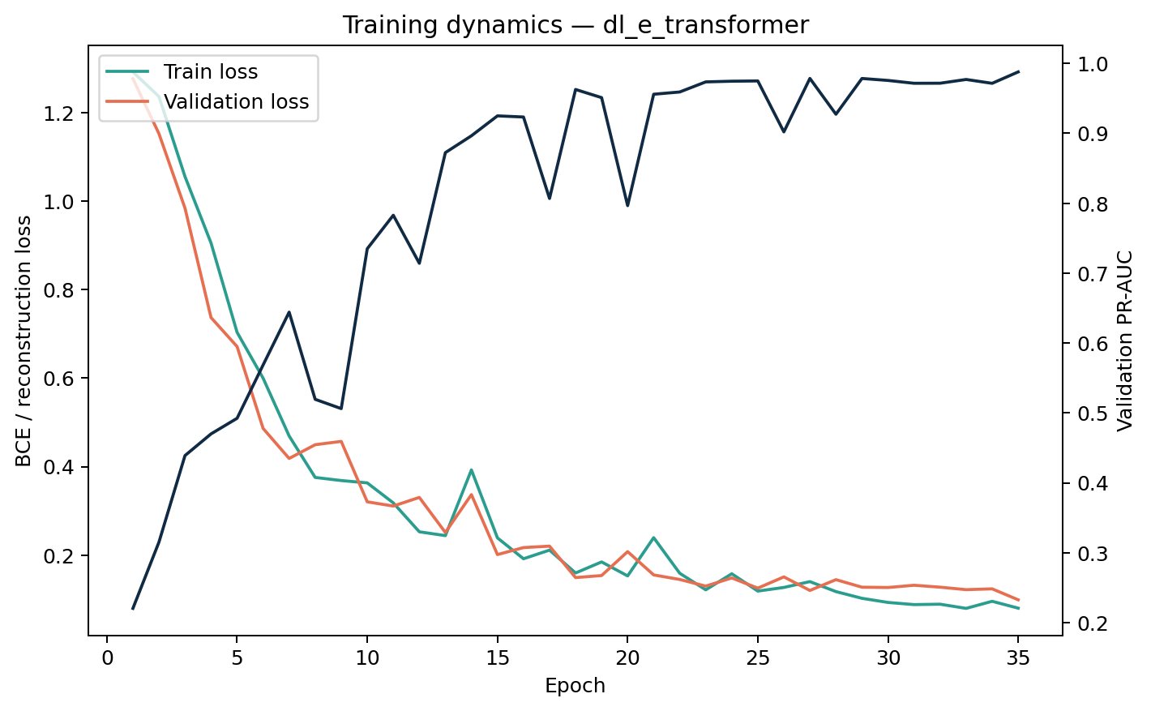
Training dynamics
Loss and PR-AUC are evidence of convergence
IIIT Dharwad • Approach 2 • Prof. Ramesh Athe • run_20260807_155540

Slide 14
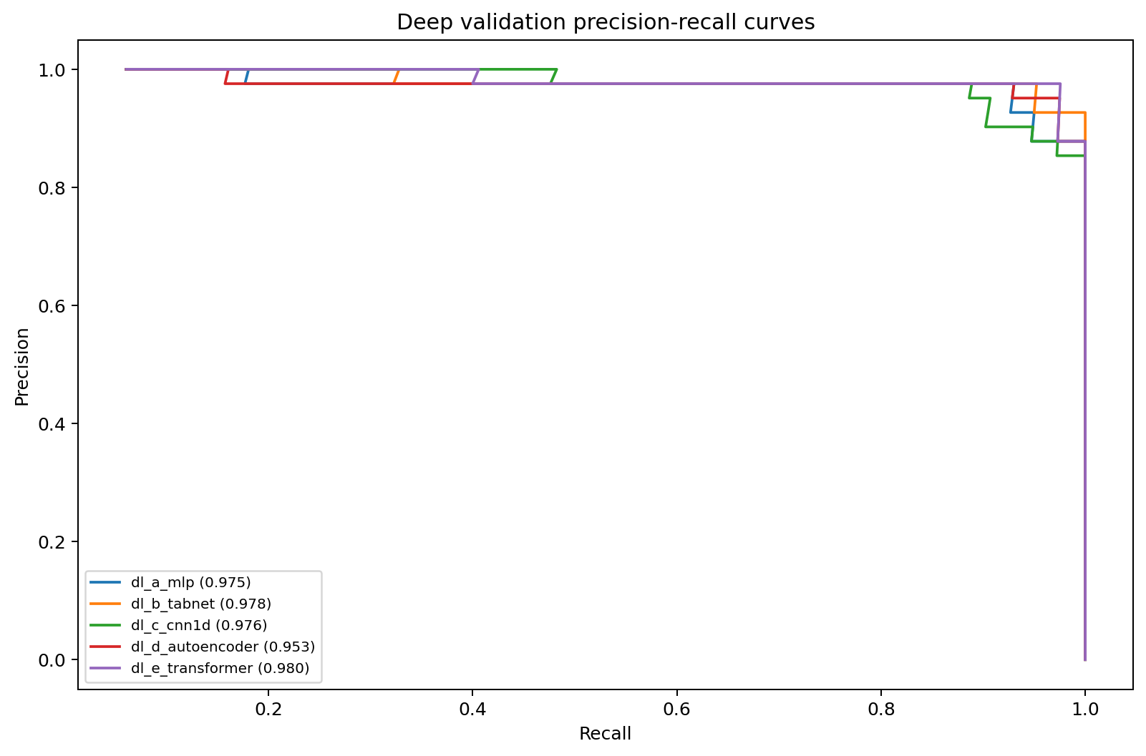
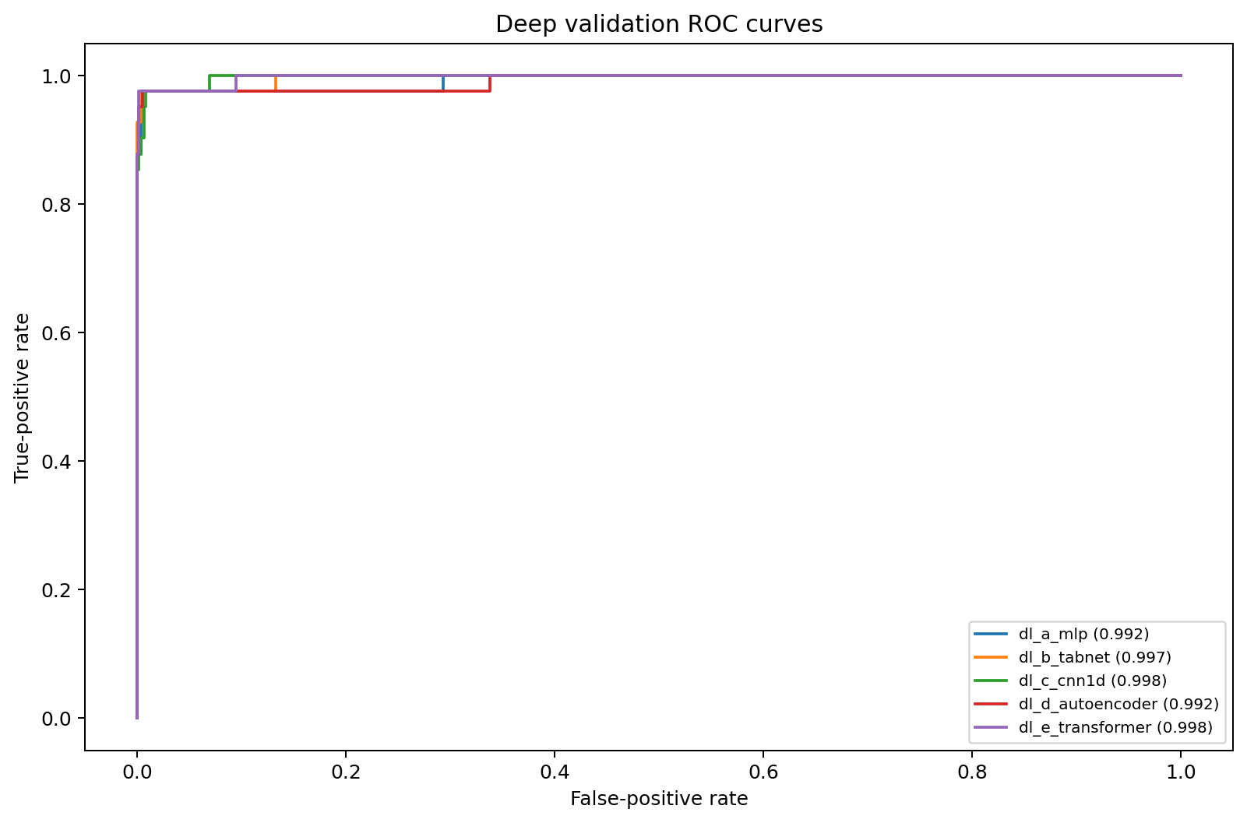
Deep ROC and PR curves
Minority-class ranking remains central
IIIT Dharwad • Approach 2 • Prof. Ramesh Athe • run_20260807_155540

Slide 15
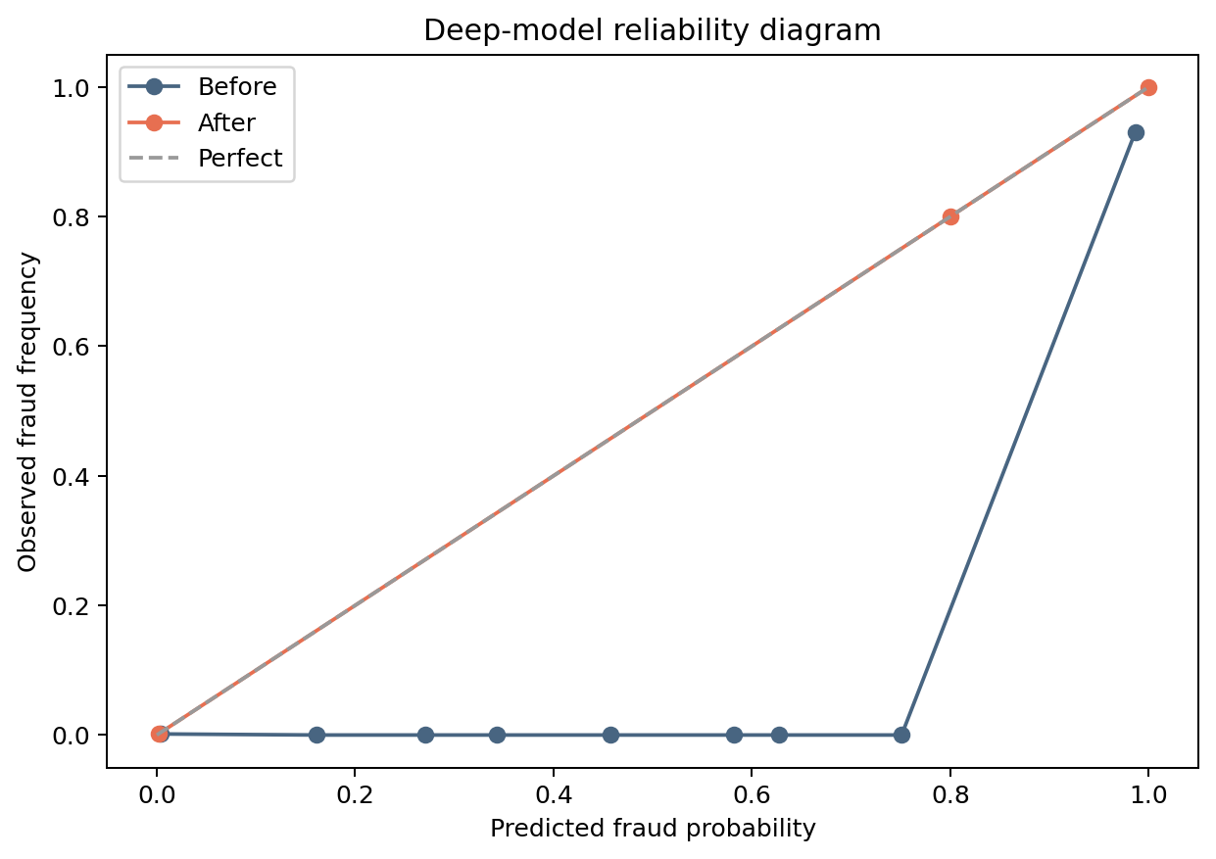
Calibration and threshold
Probability quality before action bands
• Selected model: Feature-token transformer
• Operating threshold: 0.9800
• Calibration is fitted on validation probabilities
• Below 0.30: routine candidate; middle band: review; above threshold: priority review
• No automatic denial is permitted
IIIT Dharwad • Approach 2 • Prof. Ramesh Athe • run_20260807_155540

Slide 16
XAI framework
One scored method, architecture-specific auxiliary views
• Occlusion importance: mean probability change when a transformed feature is zeroed
• Faithfulness: top-feature deletion versus random deletion
• Stability: top-10 Jaccard overlap under small jitter
• Native masks, reconstruction contributions, and tokens enrich the narrative
• SHAP/LIME are optional extensions, not silently claimed as executed
IIIT Dharwad • Approach 2 • Prof. Ramesh Athe • run_20260807_155540

Slide 17
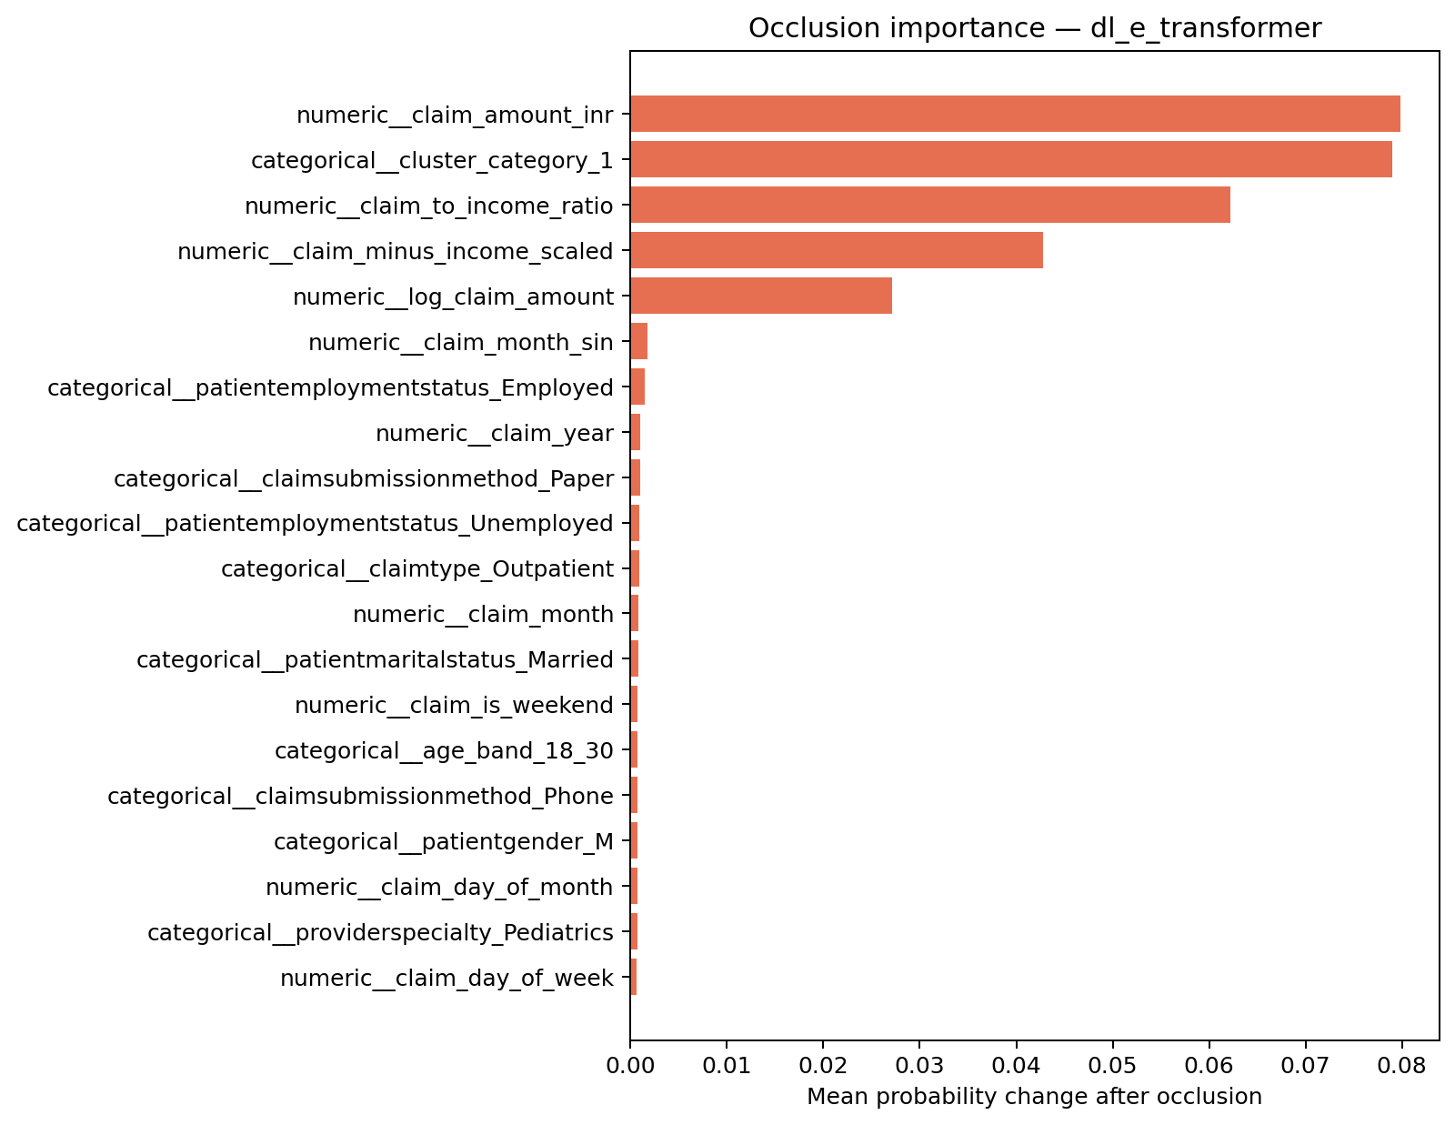
XAI result: selected deep model
Global importance and a local dossier
• Faithfulness at k=5: 0.0778
• Stability Jaccard: 0.2500
• Local dossier contains top five neutral drivers
• Interpretation is association, not causation
• Review evidence and documents before action
IIIT Dharwad • Approach 2 • Prof. Ramesh Athe • run_20260807_155540

Slide 18
Fairness and explanation equity
Audited across the same slices as Approach 1
• Gender, age band, claim type, and employment slices
• Recall/TPR, FPR, precision, accuracy, and predicted fraud rate
• Small cells remain visible and are marked unstable
• Sensitive attributes are used for audit, never as direct denial features
• Synthetic-data limitations are foregrounded
IIIT Dharwad • Approach 2 • Prof. Ramesh Athe • run_20260807_155540

Slide 19
Class imbalance and augmentation
Weighted loss is the reference policy
• Reference: inverse-frequency fraud weight in BCE-with-logits
• Balanced sampler and focal loss are configurable follow-on probes
• No validation or test oversampling
• Gaussian noise, masking, and mixup require ablation before adoption
• A deep model should not win by seeing a different evaluation distribution
IIIT Dharwad • Approach 2 • Prof. Ramesh Athe • run_20260807_155540

Slide 20
Classical versus deep comparison
Parity is a valid result
• Classical trees often excel on small structured datasets
• Deep models can learn interactions and representation geometry
• Deep training adds compute, tuning, and stability costs
• XAI quality and calibration matter alongside PR-AUC
• The combined champion is decided only after all approaches share a locked test
IIIT Dharwad • Approach 2 • Prof. Ramesh Athe • run_20260807_155540

Slide 21
Limitations and reproducibility
What this run can and cannot support
• 4,500-row supplied workbook; no policy/document fields
• Same one-row transformed matrix, not a full entity-embedding ingestion
• Three-seed reference training, not a 50-trial Bayesian sweep
• GPU determinism may differ from CPU; device is logged
• Future: temporal, graph, external validation, and document evidence
IIIT Dharwad • Approach 2 • Prof. Ramesh Athe • run_20260807_155540

Slide 22
Handoff to Approach 3
Document intelligence is the next layer
• Use the deep/classical probability as one statistical evidence channel
• Add document quality and OCR/VLM extraction
• Retrieve policy clauses and fraud rules with citations
• Route disagreement between models and agents to human review
• Preserve audit trails and claimant-facing explanations
IIIT Dharwad • Approach 2 • Prof. Ramesh Athe • run_20260807_155540

Slide 23
Thank you
Questions and discussion
B Varshith • M Jagadeshwar • J Ganesh Faculty Adviser: Prof. Ramesh Athe IIIT Dharwad
References: documentation2/references.md • XAI artifacts: evaluation2/xai/

