Slide 1
Medical Insurance Claim Fraud Detection
Approach 1 • Traditional machine learning with leakage-aware benchmarking
B Varshith • M Jagadeshwar • J Ganesh IIIT Dharwad • Department of Data Science and AI
Faculty Adviser: Prof. Ramesh Athe
Run run_20260807_151423 • 07-08-2026 15:14:23 UTC

Slide 2
The problem in one decision
A binary classifier with an asymmetric operational cost
Input: structured claim fields available at screening time
Output: fraud probability plus yes/no fraud label
False negative: fraudulent payment may create financial loss
False positive: legitimate policyholder may face delay
Responsible use: approve, flag, or reject only after policy and human review
IIIT Dharwad • Traditional ML baseline • Prof. Ramesh Athe

Slide 3
Objectives and success criteria
Pre-registered before model fitting
Use the supplied workbook: 4,500 claims and 6.0% fraud prevalence
Create a reproducible 70/15/15 stratified split
Fit all transformations on training data only
Benchmark 20 classical baselines and ensembles under one protocol
Select one model by validation F2, then PR-AUC tie-breaker
Generate explainability, fairness, PPT, project PDF, and IEEE paper artifacts
IIIT Dharwad • Traditional ML baseline • Prof. Ramesh Athe

Slide 4
Dataset snapshot
Repository-provided Excel workbook • provenance limitation recorded
4,500 claims
6.0% fraud prevalence
Mixed numeric and categorical claim fields • no verified policy, hospital-tier, or Indian geography fields • no real patient identifiers observed
IIIT Dharwad • Traditional ML baseline • Prof. Ramesh Athe

Slide 5
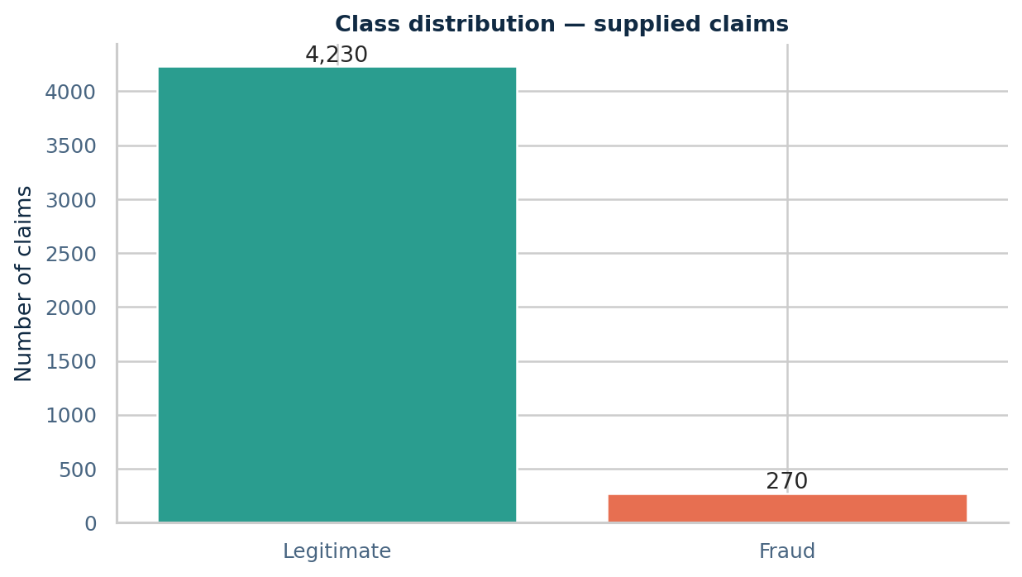
Class imbalance changes the evaluation
Fraud is the positive class
Accuracy can look strong when a model predicts legitimate for everyone
F2 weights recall more heavily than F1
PR-AUC is the headline ranking companion
Threshold selection is separated from test evaluation
IIIT Dharwad • Traditional ML baseline • Prof. Ramesh Athe

Slide 6
Data-quality and leakage gates
The pipeline fails loudly rather than hiding problems
Schema and target labels validated before EDA
ClaimID uniqueness and missingness are profiled
IDs and near-unique code/location fields excluded
ClaimStatus excluded because it can be post-decision
Imputation, one-hot encoding, and scaling fit on train only
Validation and test use frozen transformation state
IIIT Dharwad • Traditional ML baseline • Prof. Ramesh Athe

Slide 7
Feature engineering for screening-time signals
Transformations are documented and reproducible
Financial: log claim amount, log income, claim-to-income ratio
Temporal: year, month, weekday, weekend, cyclic month terms
Interactions: amount per age and income per age
Categorical: specialty, claim type, submission method, demographics
Shortcut audit: supplied Cluster retained but reviewed for concentration
IIIT Dharwad • Traditional ML baseline • Prof. Ramesh Athe

Slide 8
Reproducible pipeline architecture
Raw workbook → feature matrix → evidence pack
Load validate
→
Engineer features
→
Split 70/15/15
→
Fit transformer
→
Train model zoo
→
Select threshold
→
Lock test
→
Build reports
Every stage leaves a machine-readable artifact and a human-readable explanation. The final PPT and PDFs are generated from the run artifacts, not hand-edited tables.
IIIT Dharwad • Traditional ML baseline • Prof. Ramesh Athe

Slide 9
Model zoo
Diverse families, equal data and metric protocol
Linear: logistic L1/L2, ridge, passive-aggressive
Trees and ensembles: decision tree, random forest, extra trees
Boosting: gradient, histogram gradient, AdaBoost
Probabilistic and geometric: NB, LDA/QDA, KNN, RBF-SVM
Neural and ensemble references: MLP, voting, stacking
Optional external boosters remain documented as future adapters
IIIT Dharwad • Traditional ML baseline • Prof. Ramesh Athe

Slide 10
Hyperparameter search discipline
Small, explicit, laptop-friendly budgets
Search scoring: stratified three-fold average precision on training rows
Grid or randomized search is declared per model
All stochastic estimators receive seed 42
Failed fits remain visible with status and error reason
Best validation threshold maximizes F2 with precision floor
Test labels do not steer search or threshold
IIIT Dharwad • Traditional ML baseline • Prof. Ramesh Athe

Slide 11
Validation leaderboard
Top models under the frozen selection policy
Rank | Model | Val F2 | Val PR-AUC | Train s
1 | Random forest | 1.0000 | 1.0000 | 3.22
2 | Gradient boosting | 1.0000 | 1.0000 | 6.83
3 | Histogram gradient boost | 1.0000 | 1.0000 | 1.13
4 | AdaBoost | 1.0000 | 1.0000 | 4.52
5 | Soft voting ensemble | 1.0000 | 1.0000 | 0.46
6 | Stacking ensemble | 1.0000 | 1.0000 | 1.26
7 | Support vector machine ( | 0.9804 | 0.9820 | 1.29
IIIT Dharwad • Traditional ML baseline • Prof. Ramesh Athe

Slide 12
Winner spotlight
Soft voting ensemble • validation-selected
Soft voting ensemble
Validation F2: 1.0000
Validation PR-AUC: 1.0000
Validation ROC-AUC: 1.0000
Operating threshold: 0.4900
Final refit: train plus validation; test remains locked until this decision
IIIT Dharwad • Traditional ML baseline • Prof. Ramesh Athe

Slide 13
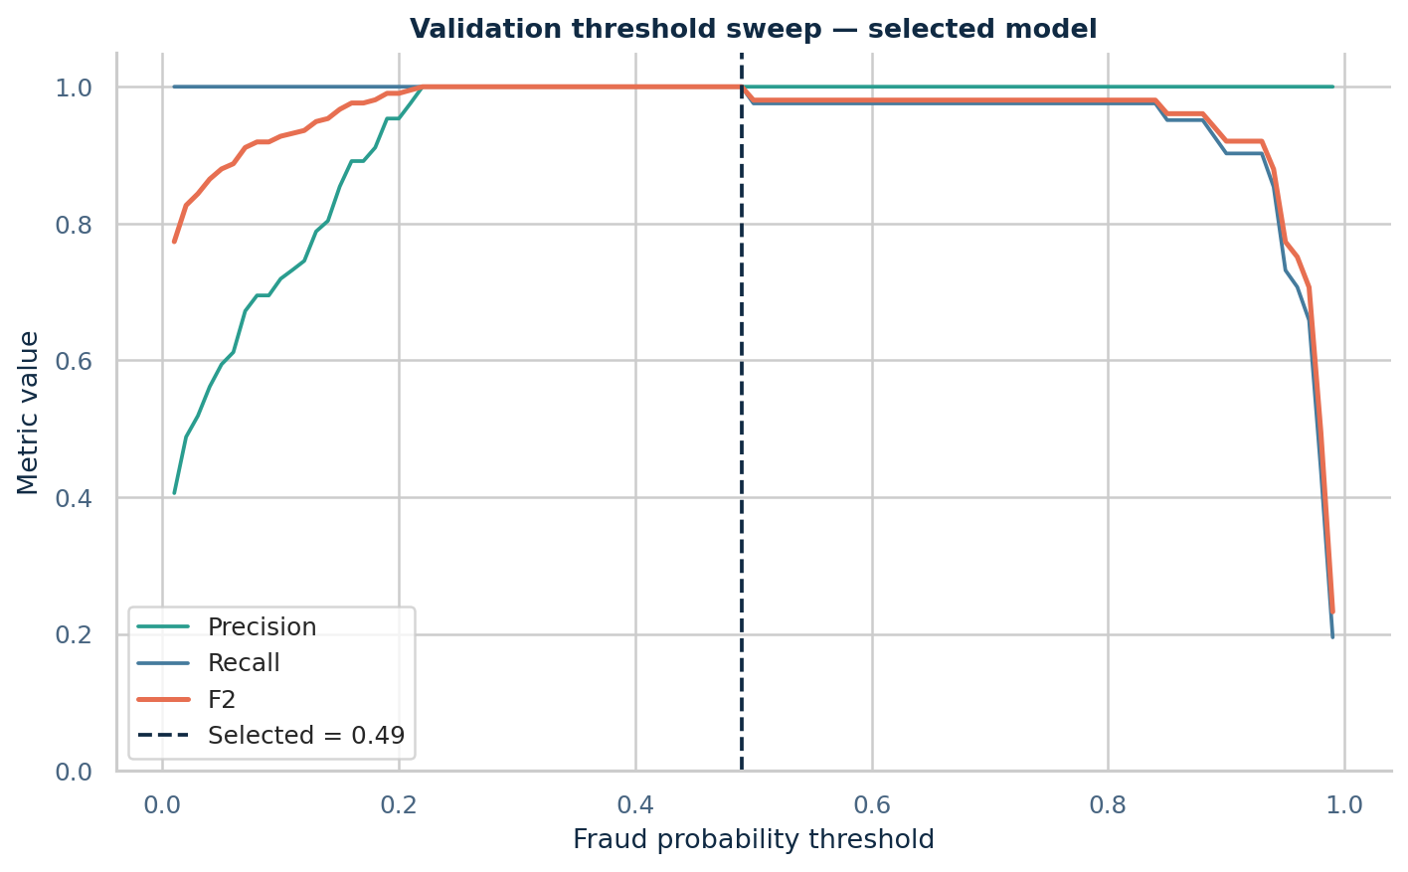
Operating threshold
Probability becomes a triage action, not an automatic verdict
Below 0.30: routine-processing candidate
0.30 to operating threshold: manual-review candidate
At/above threshold: priority investigation
Threshold chosen on validation data by F2
Business owners may recalibrate after capacity and cost analysis
IIIT Dharwad • Traditional ML baseline • Prof. Ramesh Athe

Slide 14
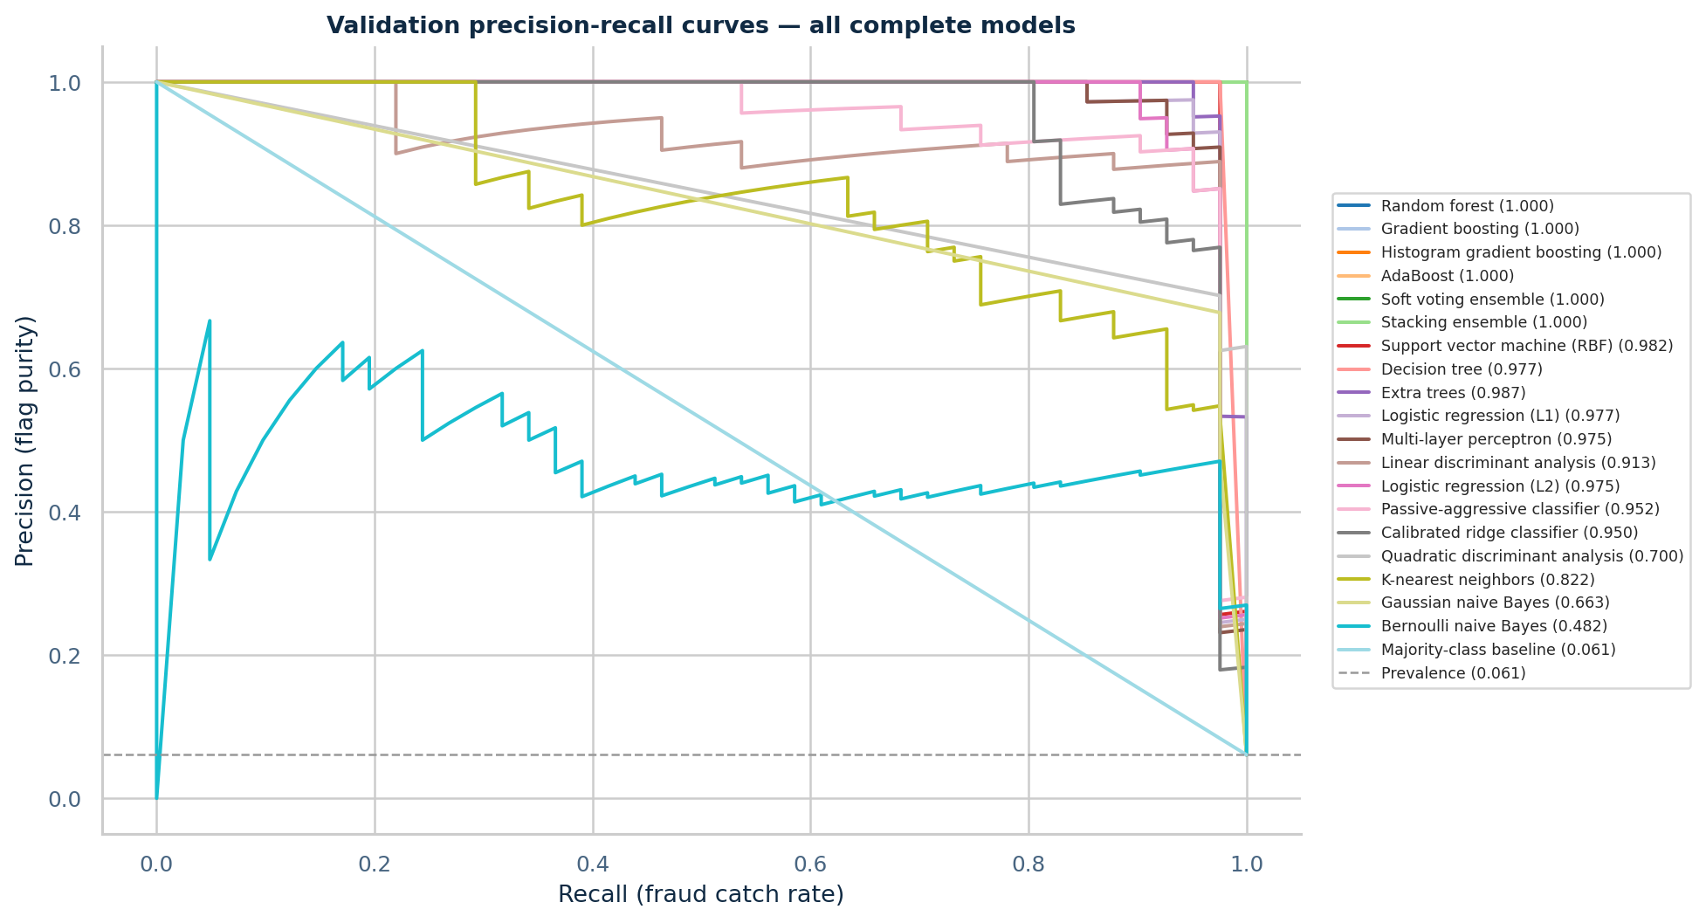
Model comparison at a glance
PR curves foreground the minority class
IIIT Dharwad • Traditional ML baseline • Prof. Ramesh Athe

Slide 15
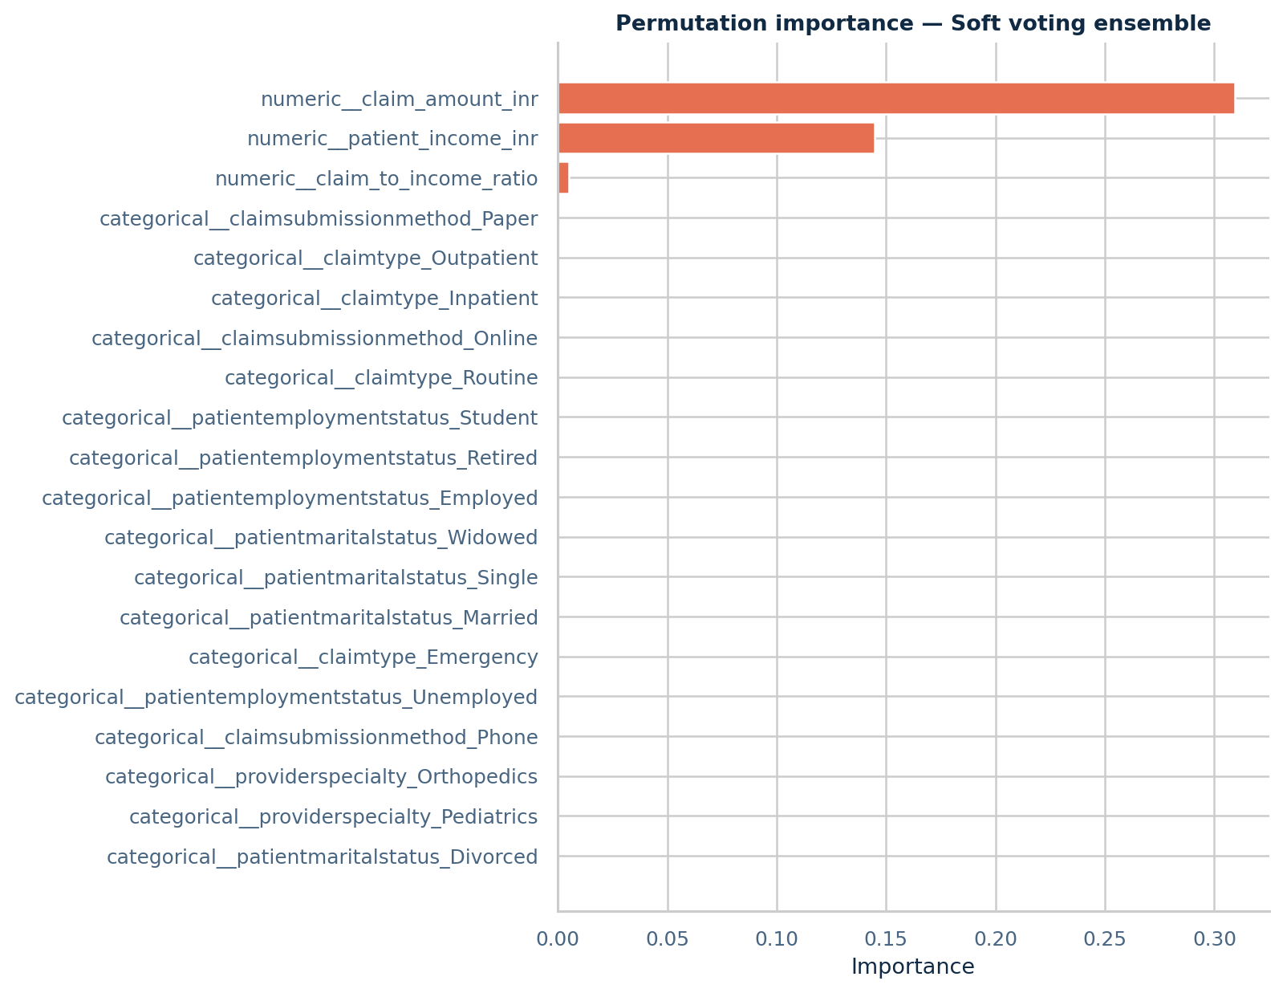
Explainability pack
Global importance plus neutral claim-level language
Permutation importance measures validation PR-AUC drop
Positive importance is association, not causation
Local reasons use evidence-led, non-accusatory wording
A claimant receives next steps, not an accusation
SHAP/counterfactuals are a planned extension
IIIT Dharwad • Traditional ML baseline • Prof. Ramesh Athe

Slide 16

Fairness audit
Sensitive fields are audited, not used as identifiers
Slices: gender, age band, claim type, employment
Metrics: recall/TPR, FPR, precision, accuracy
Small cells are marked unstable
A gap triggers investigation; it is not a causal finding
The supplied workbook is not population-representative
IIIT Dharwad • Traditional ML baseline • Prof. Ramesh Athe

Slide 17

Error costs and review workflow
The model is a triage assistant
False negatives: fraud can be approved and paid
False positives: genuine claims can be delayed
Review queue should show probability, reason codes, and evidence
Policy and medical documentation remain the source of truth
Appeal and grievance channels must stay visible to claimants
IIIT Dharwad • Traditional ML baseline • Prof. Ramesh Athe

Slide 18
Limitations and next research steps
A strong baseline is honest about what it cannot see
Only 4,500 supplied rows; no external validation split
No policy clauses, sum insured, hospital tier, or document images
Near-unique codes and cluster structure may be synthetic shortcuts
No current claim history aggregation because one row is unique per entity
Next: license-cleared Indian claims, temporal holdout, document/agent approach, deep tabular approach
IIIT Dharwad • Traditional ML baseline • Prof. Ramesh Athe

Slide 19
Submission-ready artifact map
Everything is generated from one run identifier
Code: `src/` and `scripts/run_pipeline.py`
Data: `data/raw/`, data card, dictionary, checksum manifest
Evaluation: leaderboard CSV, per-model JSON/curves, fairness, calibration
Images: EDA, curves, confusion matrices, concept illustrations
Documents: 20-slide PPTX, project report PDF, IEEE paper PDF
Reproduce: `python scripts/run_pipeline.py --config config/default.yaml`
IIIT Dharwad • Traditional ML baseline • Prof. Ramesh Athe

Slide 20
Thank you
Questions and discussion
B Varshith • M Jagadeshwar • J Ganesh Faculty Adviser: Prof. Ramesh Athe IIIT Dharwad • Department of Data Science and AI
References: documentation/references.md • Evidence run: run_20260807_151423

