Slide 1
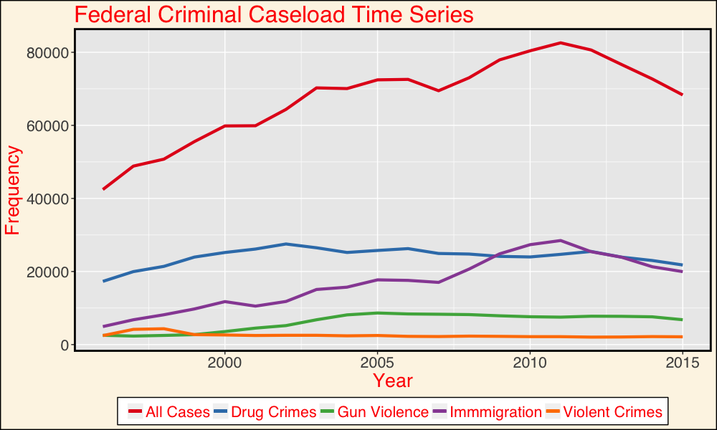
Taking the Baton in Maintaining Incarceration in Federal Courts Johnathan Hsu
Federal
References
United States Sentencing Commission. Monitoring of Federal Criminal Sentences Series, 1987-2015. ICPSR36571. Ann Arbor, MI: Inter-university Consortium for Political and Social Research [distributor].

