Slide 1
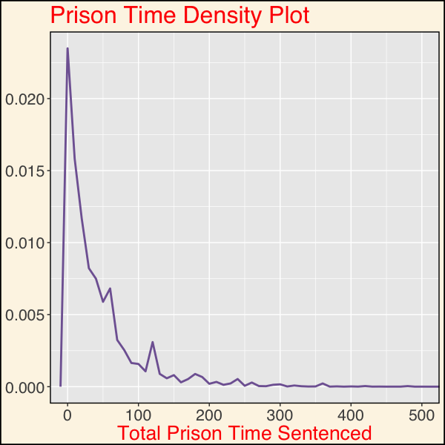
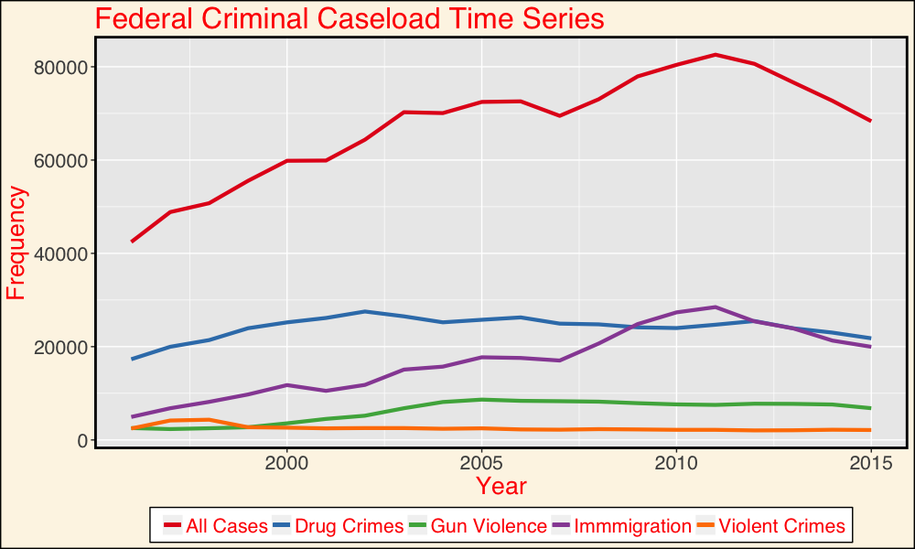
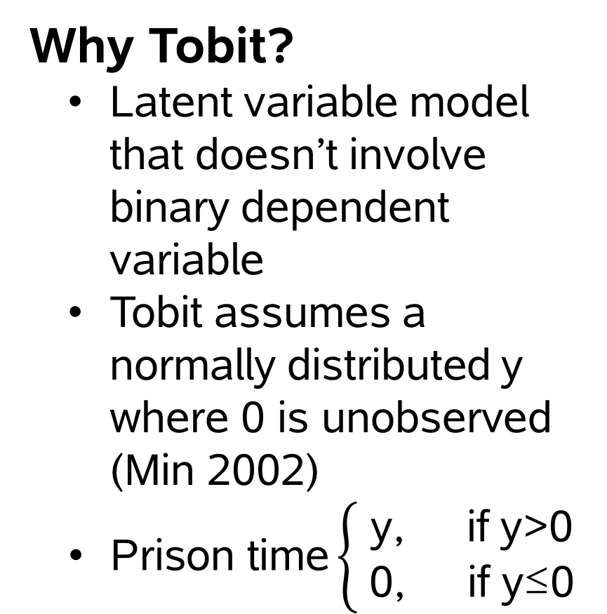
Are the Main Drivers of Federal Caseload Also the Most Punitive? Identifying Determinants of Federal Sentencing with the Tobit Model Johnathan Hsu
Research Question
Do drug cases receive more punitive sentences than violent crimes in the federal criminal justice system?
Why Drug and Violent Crimes?
Drug case production is the single most important driver of federal criminal caseload until the recent years (immigration).
Federal Criminal Justice holds symbolic value of criminal legislation (Wright).
Drug and violent crimes have been politically contested in the past years
Mandatory minimums for drug crimes have been criticized for being applied disproportionately against black defendants
Methods
Data Preparation
Convert data
Categorical lumping
Select data
Merge data
Filter data
Findings
Drug cases receive less punishment than violent, firearm, and immigration cases independent of severity of crime
Race, age, and education is correlated with the time sentenced independent of severity of crime and criminal history
Black, young, and less educated defendants receive harsher sentences
The results from linear and controlled Tobit are mostly consistent with exception of immigration cases
Discussion
This research shows the penalties that specific types of cases receive at sentencing while accounting for other extralegal factors. Although drug cases do not receive harsher sentences when compared with violent crimes, the interaction of drug and blacks are not identified in the analysis.
Future Research
Although this research identifies correlation between case and defendant characteristics, it does not include death penalty and life without parole cases, other extralegal characteristics such as citizenship. Additionally, the Tobit does not account for the random effects across different districts and years. This project suggests further research on the interaction between race and type of crime. Lastly, further research should include the effects of cross-district and time on the outcome of sentences.
References
United States Sentencing Commission. Monitoring of Federal Criminal Sentences Series, 1987-2015. ICPSR36571. Ann Arbor, MI: Inter-university Consortium for Political and Social Research [distributor].
Min, Agresti A. 2002. Modeling Nonnegative Data with Clumping at Zero. Journal of the Iranian Statistical Society. 1(1):7–33
Wright, Ronald F. 2006. “Federal or State-Sorting as a Sentencing Choice.” Crim. Just. 21:16.
Variables
Dependent: Total prison time sentenced (months)
Independent: Criminal History, Final Offense Level
Controlled: Age, Race, Gender, Type of case, Disposition of case
Why Tobit?
Latent variable model that doesn’t involve binary dependent variable
Tobit assumes a normally distributed y where 0 is unobserved (Min 2002)
$\text{Prison} \text{time}\left\{\begin{aligned} \text{y}\text{, }\text{if} \text{y}\text{>0 } \\ \text{0, }\text{if} \text{y}\text{≤0}\end{aligned}\right.$
Analysis
Compare results from three methods:
Ordinary Linear Squares
Parsimonious Tobit
Controlled Tobit
Data
United States Sentencing Commission data from FY 1996-FY2015
This project uses demographic, sentencing, and guideline application information on cases sentenced under the guidelines in the federal court system.
Results
Demographics

