Slide 1
AdaBoost Regressor
AdaBoost, short for Adaptive Boosting, is a machine learning ensemble technique that combines the predictions of several base estimators to improve robustness over a single estimator.
It fits a regression model on the weighted training data and combines the predictions of multiple models to improve accuracy.

Slide 2
How AdaBoost Works
Sample Weight will be calculated
Weight will be in the range of 0 to 1
Sum of all the Weights equal to 1
Reassign weight to each instance
Transforming week learners to strong by assigning weight to them
Reduce Bias and Variance by assigning higher weights to incorrectly classified data
Each tree will be called as Stumps
It is used in both Classification and Regression

Slide 3
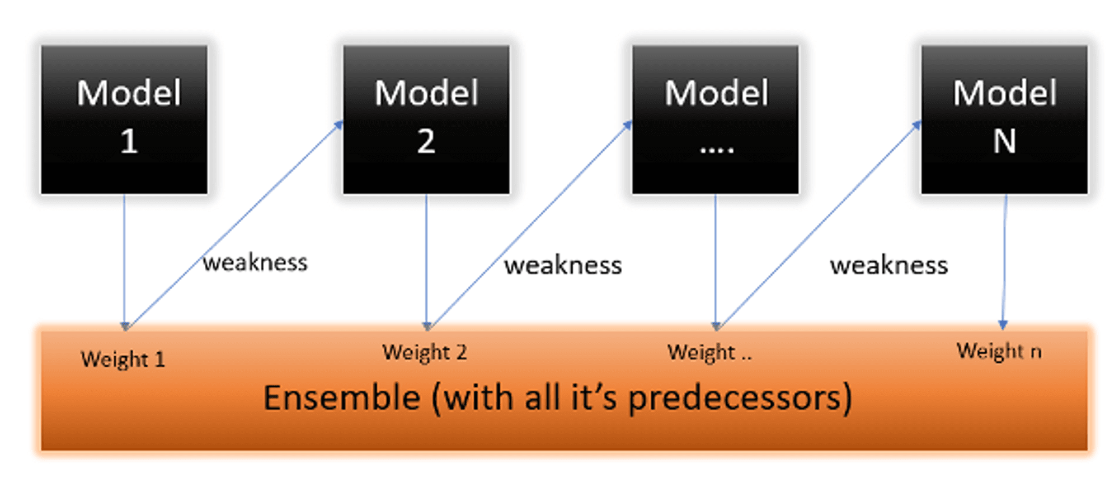

Slide 4
Advantages
1. Can achieve high accuracy with less overfitting.
2. Works well with various types of base learners.
3. Robust to noisy data and outliers.

Slide 5
Applications of AdaBoost Regressor
1. Regression tasks in finance, healthcare, and marketing.
2. Predicting continuous outcomes such as prices, sales, and demand.
3. Enhancing the performance of other regression models.

